Slide 1
Smart Assist
An AI powered chatbot for assisting NOC Engineers by handling customer queries
By Sanjiv. T

Slide 2
Pre-Preparation
Understanding Use case and requirements
Artificial Intelligence
Python, SQL

Slide 3
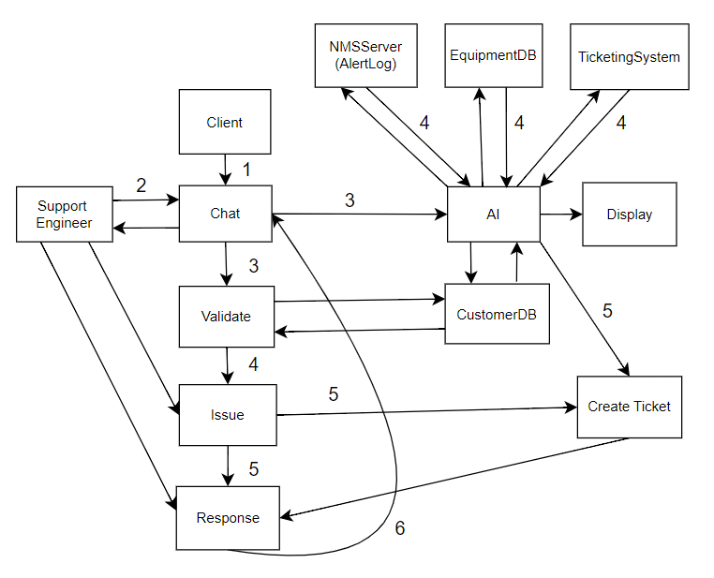


Instructions by my Guide
End-to-end project flow

Slide 4
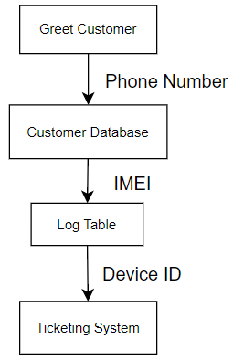
Instructions by my Guide
Project flow in detail
Greet Customer
Get Customer's Phone number and verify using OTP
Use Customer's Phone number to retrieve IMEI from Customer Database
Use IMEI to retrieve Device ID from Log Table
Use Device ID to check if a ticket is created in Ticketing System

Slide 5
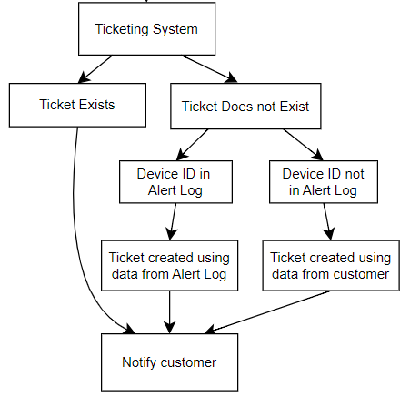
Instructions by my Guide
Project flow​ continued
If a ticket is already created for the issue, inform the customer
If a ticket hasn't yet been created for the issue, create a ticket and notify the customer

Slide 6
What I did
Key Technologies Used:
transformers: Hugging Face library for accessing NLP models
neulab/omnitab-large-finetuned-wtq: AI model used for table question answering
tkinter: Python library for GUI development
pandas: Python library for data manipulation
scikit-learn (sklearn): Python machine learning library
TfidfVectorizer: sklearn module to convert text data into a matrix of TF-IDF features to assess importance of words in the data
LogisticRegression: sklearn module used for data classification

Slide 7
What I did
Key Features/Steps:
Greeting: Enhance user engagement
Identity Verification: For secure interaction
Data Processing: Retrieve data from various databases
AI Integration: Use AI model for querying the data for specific information
Ticket Management: Automates creation of new tickets if necessary and updates status
User-Friendly GUI: Provides interface to interact with users
Dynamic Data Display: Show relevant data in a new window
Session Management: Maintain the state of conversation and reset for new sessions

Slide 8
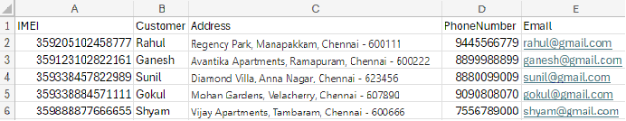
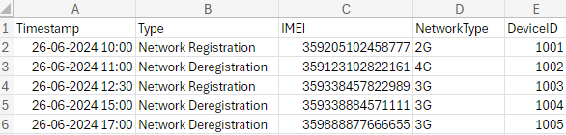
Database used
CustomerDB
LogDetails

Slide 9
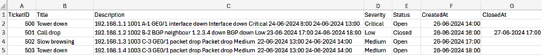
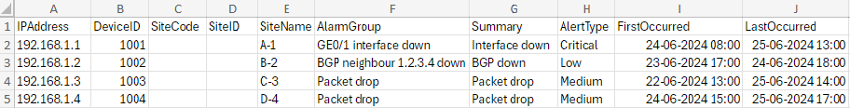
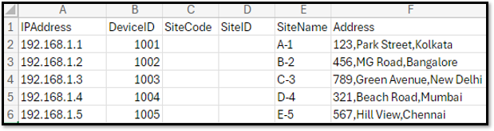
Database used
TicketingSystem
AlertLog
DeviceDB

Slide 10
NOC operation process
Level 1 Engineer: Interacts with customer, notes their issue and raises an instance ticket. The mode of interaction is either through chat, phone call or mail.
Level 2 Engineer (Technical Engineer): Gathers technical details once an instance ticket is created, debugs the issue and raises a problem ticket.
Level 3 Engineer (Field Engineer): Raises change management ticket once the instance ticket is created.

Slide 11
NOC operation process with Smart Assist
Level 1 Engineer: Smart Assist Interacts with customer through chat, verifies identity and notes the issue.
Benefit: Number of instance tickets reduces
Level 2 Engineer (Technical Engineer): Smart Assist displays the required technical data simultaneously, debugs the issue and creates a ticket.
Benefit: Number of problem tickets reduces
Level 3 Engineer (Field Engineer): Smart Assist decides which issues should be assigned to a Field Engineer.
Benefit: Number of change management tickets reduces

Slide 12
NOC operation with Smart Assist
Possible Scenarios for given customer issue:
Ticket exists and issue matches
Ticket exists but Issue doesn't match
Ticket doesn't exist but alert log present
Ticket doesn't exist and alert log not present
Benefits:
Reduces the number of instance tickets, which in turn reduces the number of problem tickets and change management tickets
If a ticket is not present, it automatically debugs and raises a ticket

Slide 13
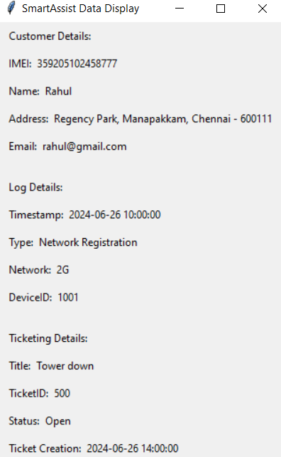
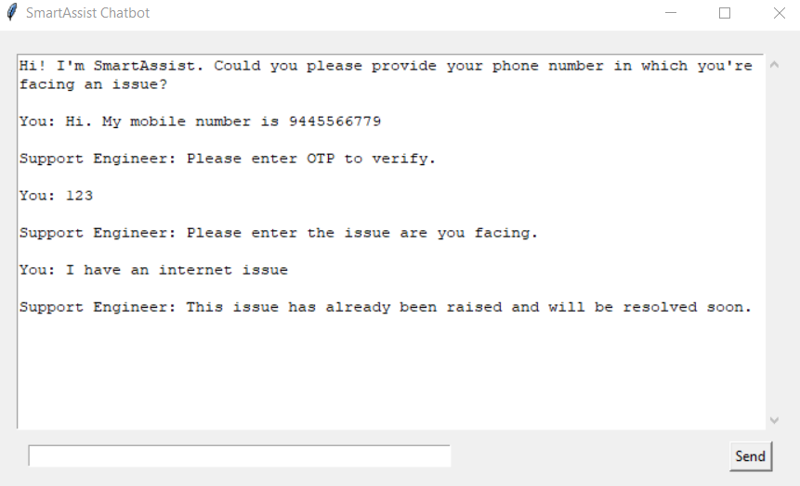
1.Ticket exists and issue matches
AI window
Chat interface

Slide 14
2.Ticket exists but issue doesn't match
AI window​
Chat interface​

Slide 15
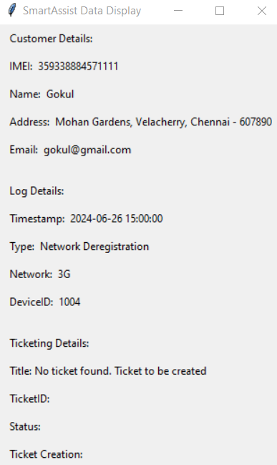
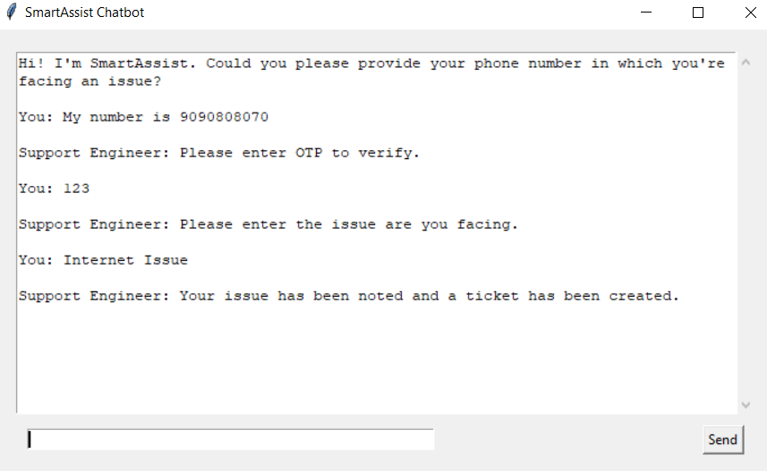
3.Ticket does not exist but alert log present
AI window
Chat interface​

Slide 16
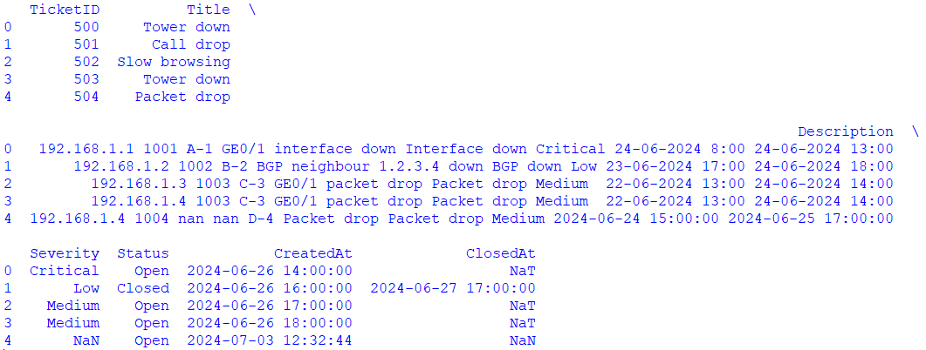




3.Ticket does not exist but alert log present -> Ticket Created

Slide 17
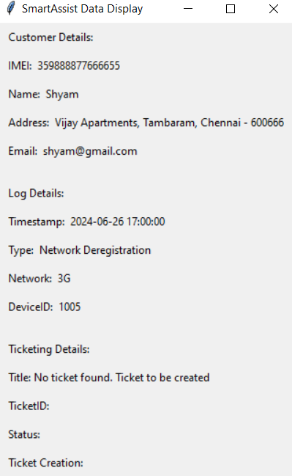
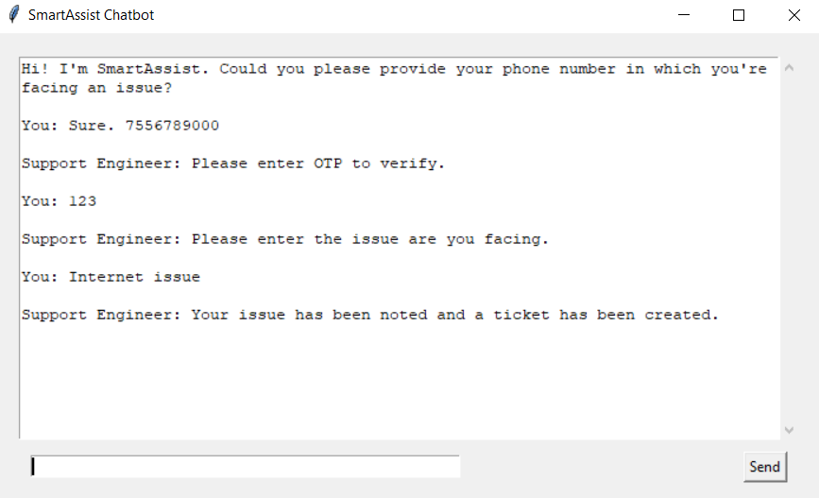
4.Ticket does not exist and alert log not present
AI window
Chat interface​​

Slide 18
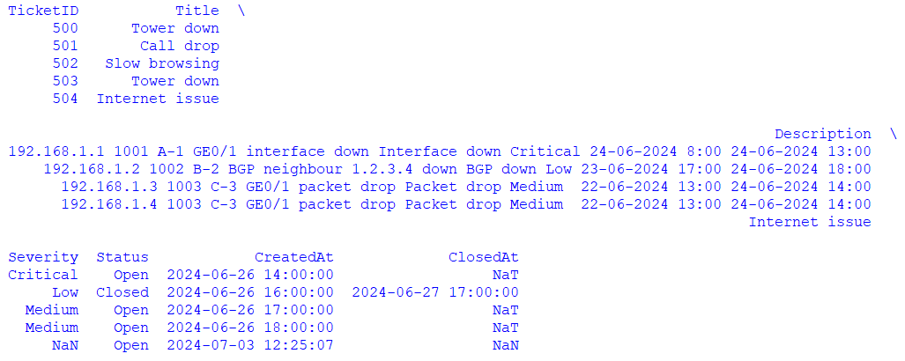



4.Ticket does not exist and alert log not present -> Ticket Created

Slide 19
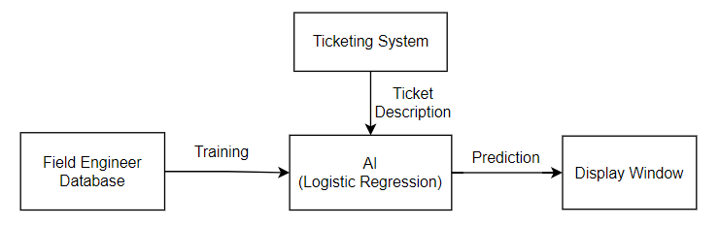









AI based checking if Field Engineer is needed
Project flow​
Train a Logistic Regression model using training data from FieldEngineerReq database to predict if a Field Engineer is required for a particular scenario
Obtain ticket description from the ticketing system
Predict if a Field Engineer is required or not for the ticket issue

Slide 20
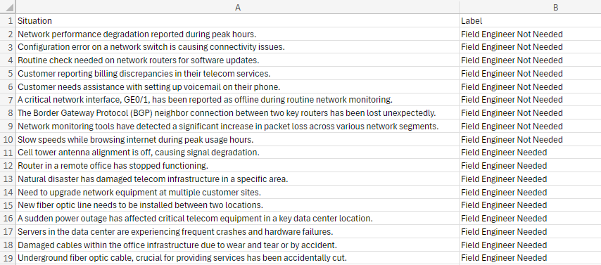
Database used
FieldEngineerReq

Slide 21
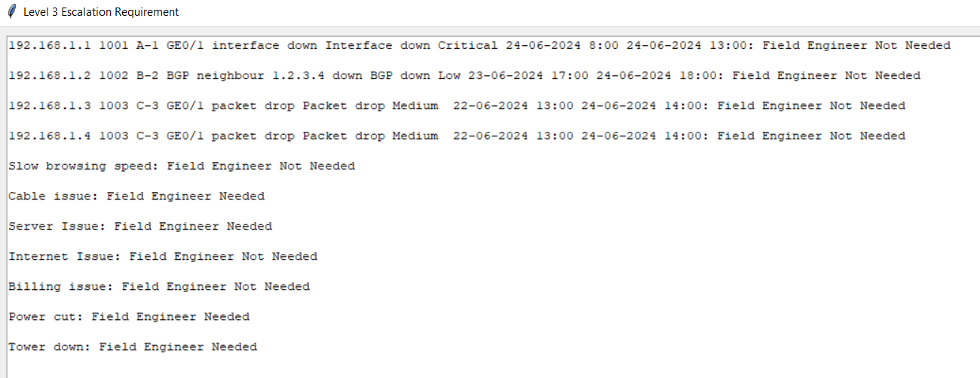
Predictions by Smart Assist

Slide 22
Thank You

