Slide 1
Bank Note Authentication using SVM
Submitted to : Dr. Aparna P.
By:
Shrikant Madhukar Patil (202SP024)
Tiwari Shubham Rajeshnath (202SP027)

Slide 2
Content
Introduction
Dataset
Algorithm
Results and Conclusion

Slide 3
Introduction
Need for Machine learning model for Bank Note Authentication.
Technique used for making this model
Logistic Regression
State Vector machine
Metrices used for comparing this models on performance measures.

Slide 4
Dataset
Dataset used is from UCI machine learning repository .
The dataset has five attributes
Wavelet Transform tool were used to extract features from images.
Attribute name | Description
Variance | It is a measure of the 'spread' of a distribution about its average value
Skewness | Skewness tells about the direction of variation of the lack of symmetry
Curtosis | Curtosis is a parameter that describes the peakedness of distribution
Entropy | Image entropy is the amount of information which must be coded for, by a compression algorithm
Class | Class contains two values namely 0 and 1 where 0 represents genuine banknotes and 1 represents fake banknotes

Slide 5
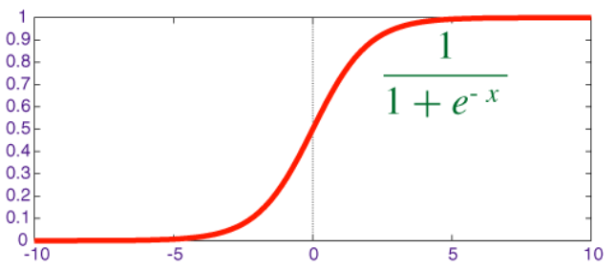
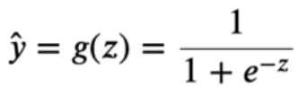
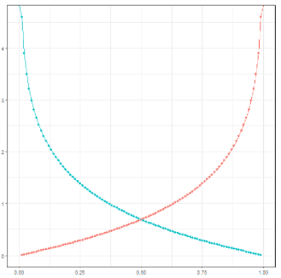




Logistic Regression
Sigmoid Function:
Binary Cross Entropy Loss:
Cost Function:
Gradient Of Cost Function:

Slide 6
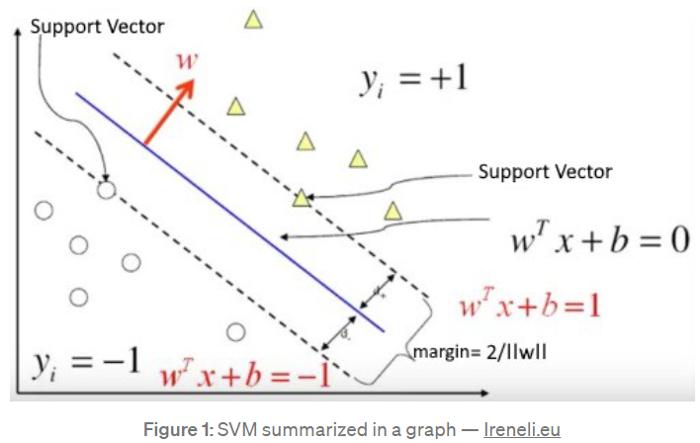


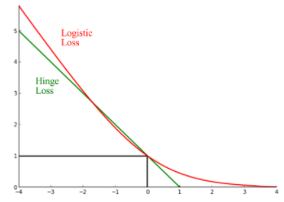


Support Vector Machine
What’s our objective in SVM?
Our objective is to find a hyperplane that separates +ve and -ve examples with the largest margin while keeping the misclassification as low as possible
Cost Function:
Hinge Loss:
Gradient Of Cost Function:
SVM Model with optimal hyperplane:

Slide 7
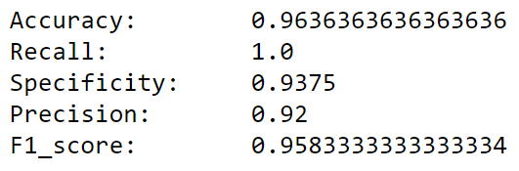
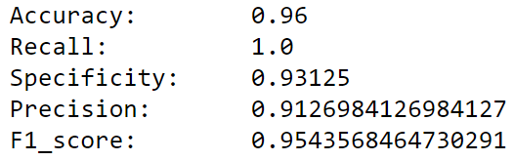
Results and Conclusion:
Logistic Regression
SVM
 | Predicted YES | Predicted NO
Actual YES | 115 | 0
Actual NO | 10 | 150
 | Predicted YES | Predicted NO
Actual YES | 115 | 0
Actual NO | 11 | 149
Computationally Efficient(Converges Faster)
Accuracy will be affected by the noisy data(Won’t Generalize Well)
Computationally Complex(Converges Slowly)
Accuracy will not be affected by the noisy data (Generalizes Well)

Slide 8
Thank You!

