Slide 1
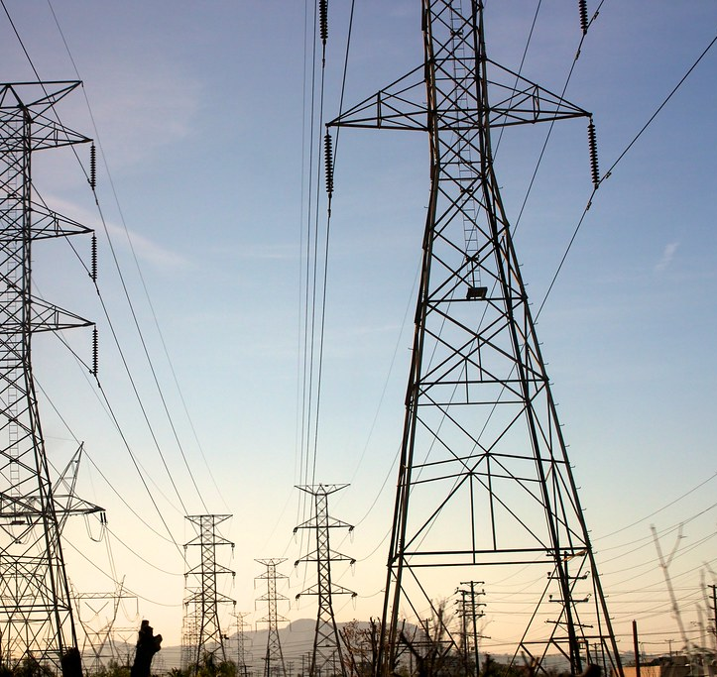
Electricity Demand and Supply Analysis in Ontario
Tania Tasmin
DataTalent - Cohort 18
Sept 10, 2025
This Photo by Unknown Author is licensed under CC BY-SA

Slide 2
Problem Statement
The goal of this analysis is to understand Ontario’s electricity demand and supply patterns.
Why: Demand forecasting, planning capacity, guiding economic & policy decisions, Managing imports and exports etc.

Slide 3
Content
Energy Demand Analysis in Ontario
Annual Average Electricity Demand trends from 2002 to 2025
Energy Supply Analysis by Fuel Type
Total Energy Supply by each Fuel
for years 2021 - 2025
Key Findings and AI-based future steps.

Slide 4
Data Collection
Source: IESO
Independent Electricity System Operation Ontario, Canada
https://www.ieso.ca/power-data/data-directory
Datasets:
Ontario & Market demand (hourly)
Generator output by fuel type (hourly)

Slide 5
Tools Used
IDE: VS Code with Jupyter Notebook
Data Cleaning:
Numpy and Pandas
Data Visualization
Bokeh
Matplotlib
Power BI

Slide 6
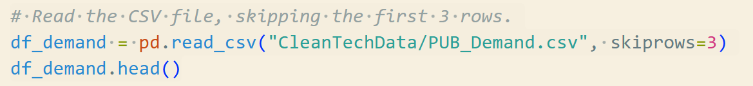
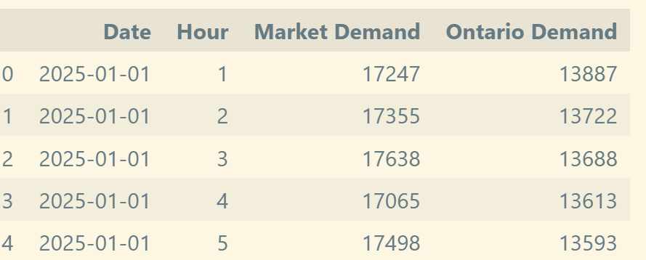
Energy Demand Analysis

Slide 7
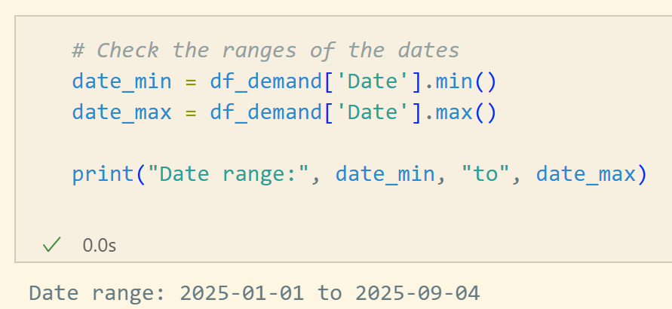
Energy Demand Analysis

Slide 8
Ontario Demand vs. Market Demand
Market Demand−Ontario Demand=
Transmission Losses+Net Exports
Understanding this difference helps in grid planning, efficiency analysis, and forecasting.

Slide 9
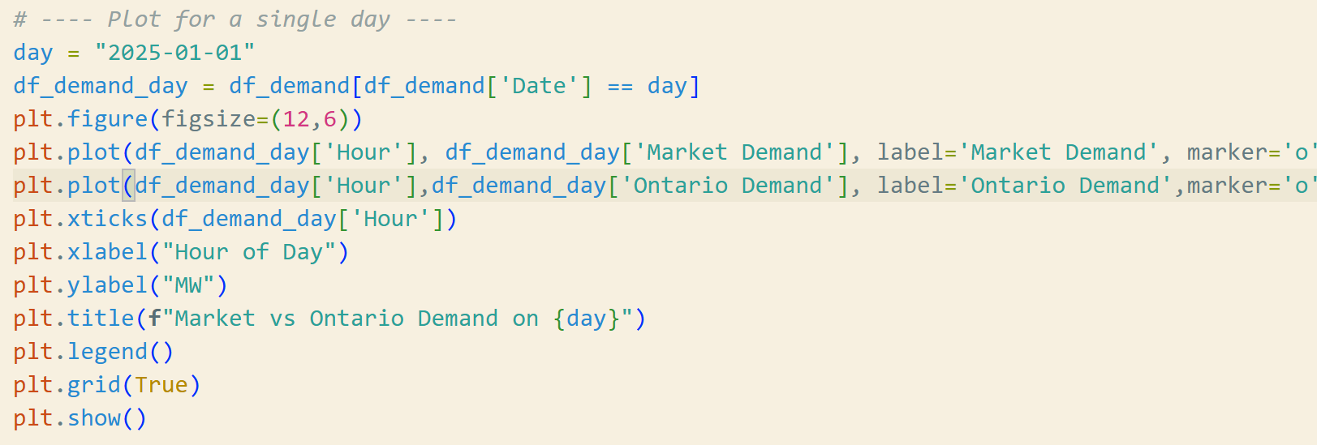
Demands on January 1st, 2025

Slide 10
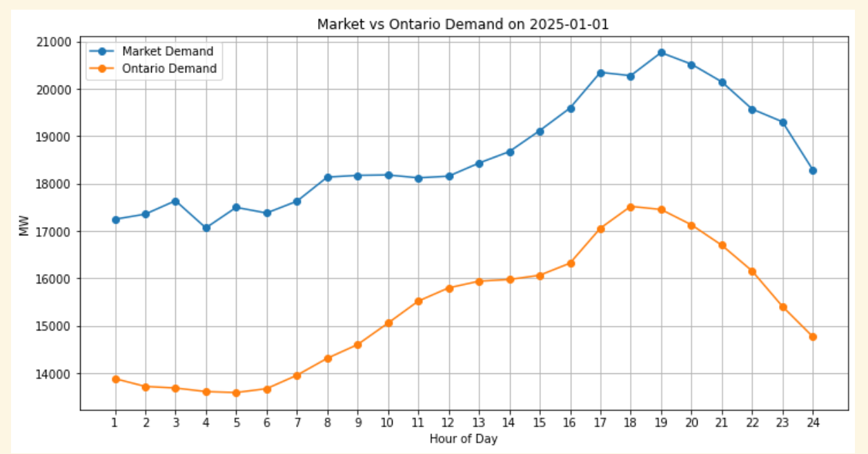
Demands on January 1st, 2025

Slide 11
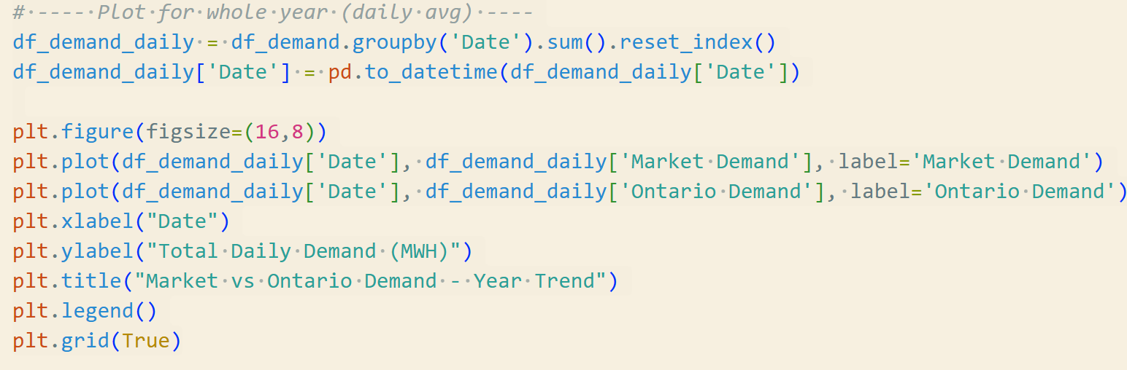
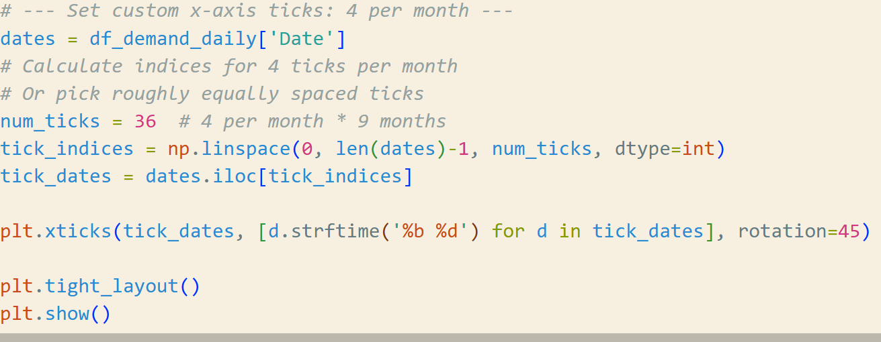
Daily Energy Consumption – 2025
Notes:
our energy demand is measured in MW (megawatts), which is a rate of power at a point in time.
When you sum hourly MW values over a day, you are effectively integrating power over time.
Since 1 MW × 1 hour = 1 MWh (megawatt-hour), summing 24 hourly MW readings gives the daily energy in MWh.
✅ So your daily demand will indeed be in MWh, not MW.

Slide 12
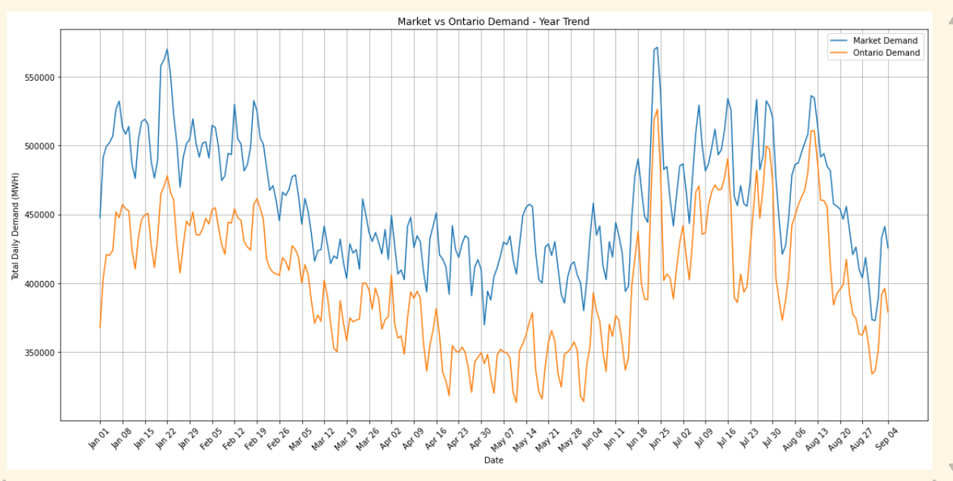
Daily Energy Consumption – 2025
Notes:
our energy demand is measured in MW (megawatts), which is a rate of power at a point in time.
When you sum hourly MW values over a day, you are effectively integrating power over time.
Since 1 MW × 1 hour = 1 MWh (megawatt-hour), summing 24 hourly MW readings gives the daily energy in MWh.
✅ So your daily demand will indeed be in MWh, not MW.

Slide 13
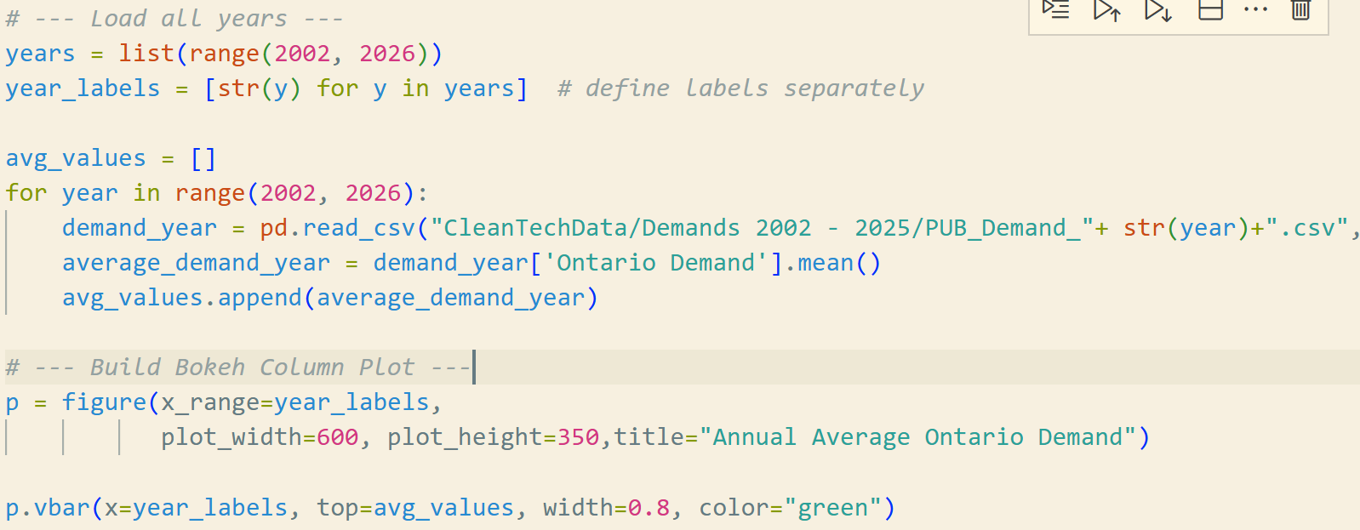
Annual Average Electricity Demand,
2002 to 2025
Notes:
our energy demand is measured in MW (megawatts), which is a rate of power at a point in time.
When you sum hourly MW values over a day, you are effectively integrating power over time.
Since 1 MW × 1 hour = 1 MWh (megawatt-hour), summing 24 hourly MW readings gives the daily energy in MWh.
✅ So your daily demand will indeed be in MWh, not MW.

Slide 14
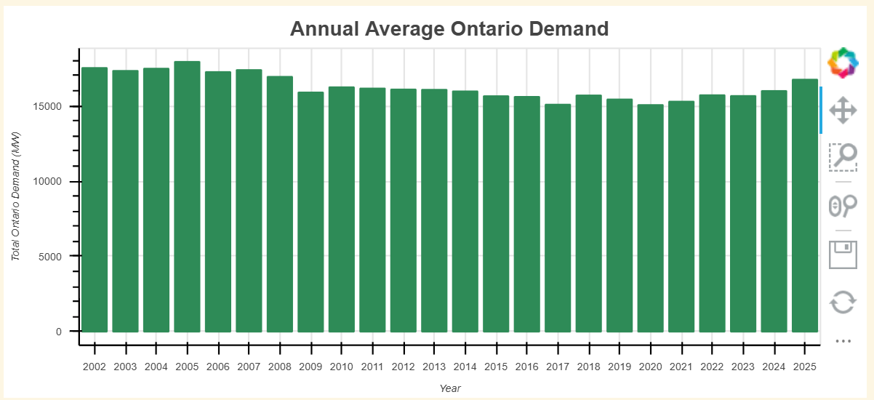
Annual Average Electricity Demand,
2002 to 2025
Notes:
our energy demand is measured in MW (megawatts), which is a rate of power at a point in time.
When you sum hourly MW values over a day, you are effectively integrating power over time.
Since 1 MW × 1 hour = 1 MWh (megawatt-hour), summing 24 hourly MW readings gives the daily energy in MWh.
✅ So your daily demand will indeed be in MWh, not MW.

Slide 15
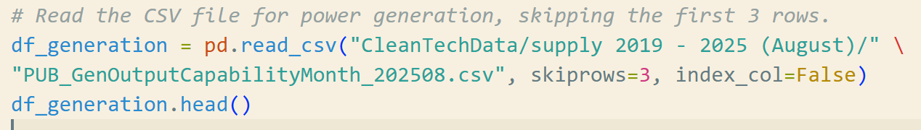
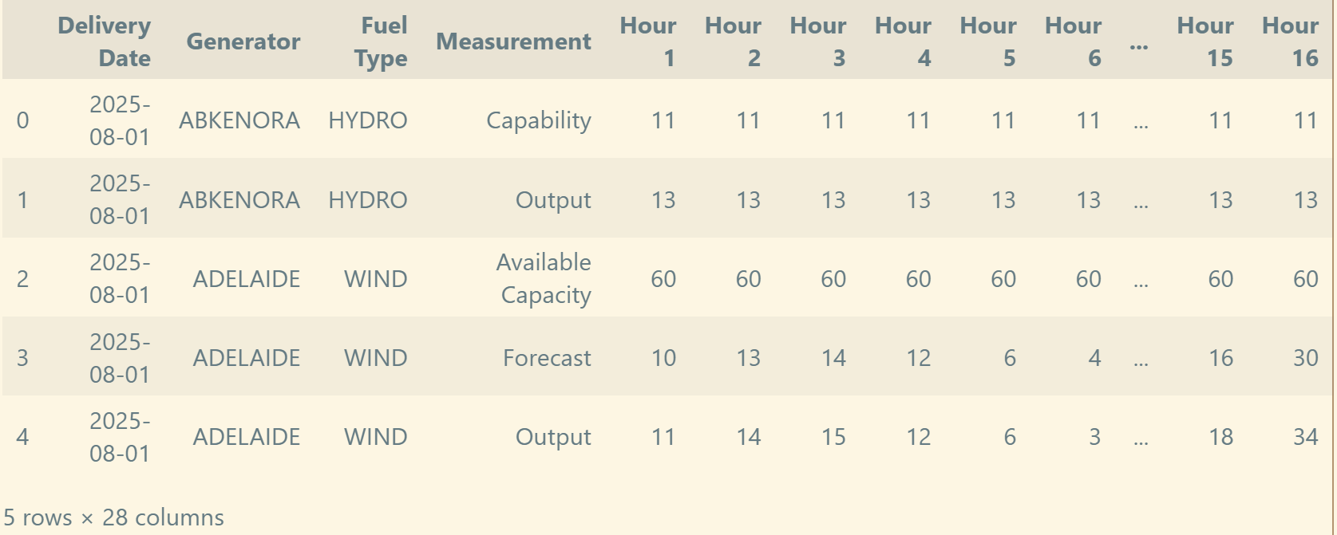
Energy Supply Analysis

Slide 16
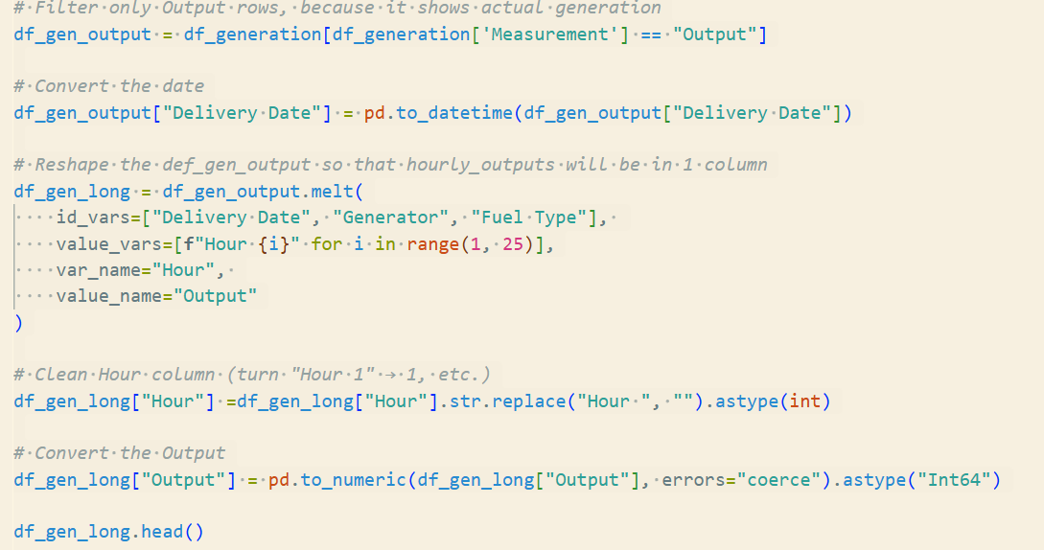
Energy Supply Analysis

Slide 17
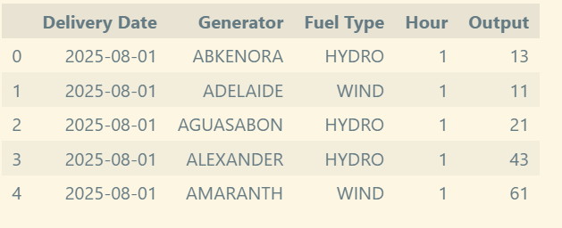
Energy Supply Analysis

Slide 18


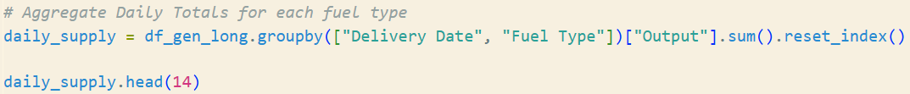
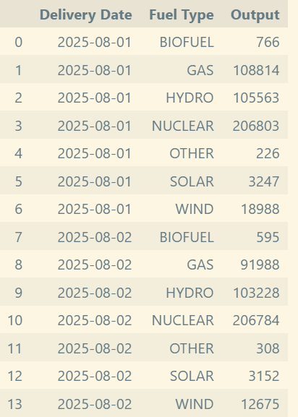



Daily Energy Supply for each Fuel

Slide 19
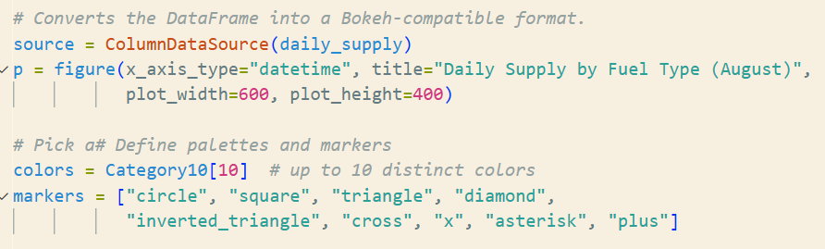
Daily Energy Supply for each Fuel

Slide 20
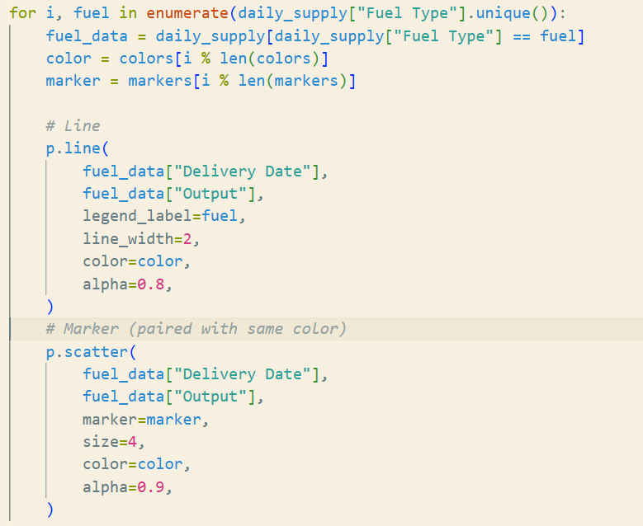
Daily Energy Supply for each Fuel

Slide 21
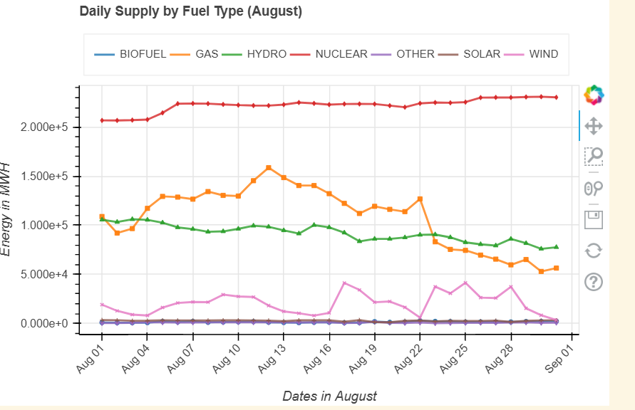
Daily Energy Supply for Each Fuel

Slide 22

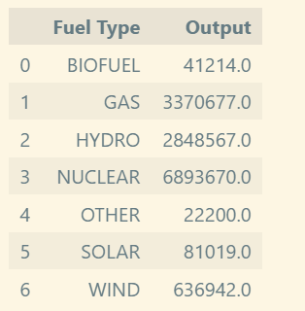
Total Energy Supply for each Fuel over the month of August, 2025

Slide 23
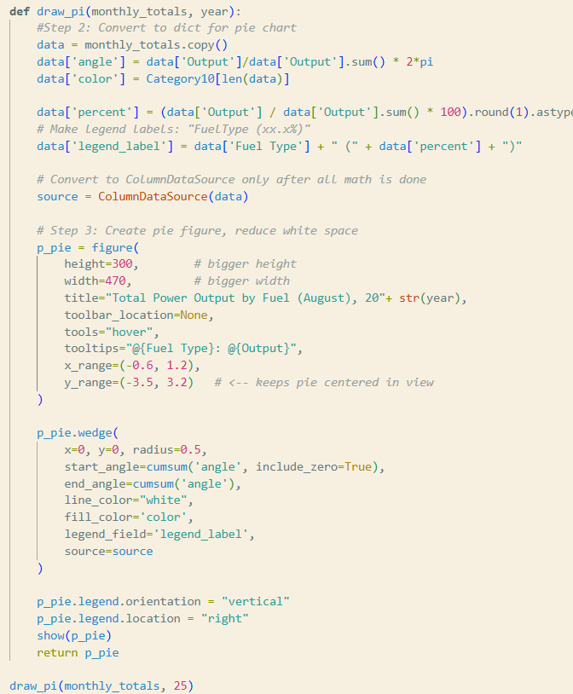
Total Energy Supply for each Fuel over the month of August, 2025

Slide 24
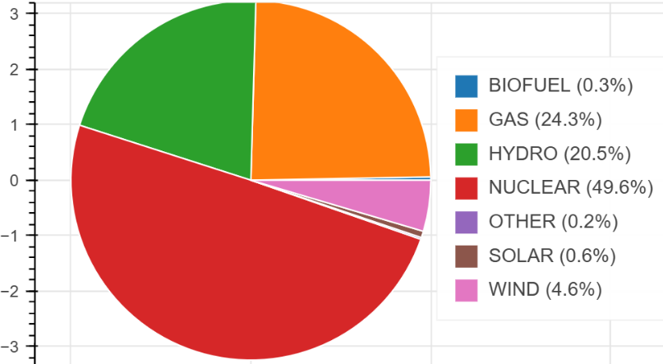
Total Energy Supply for each Fuel over the month of August, 2025

Slide 25
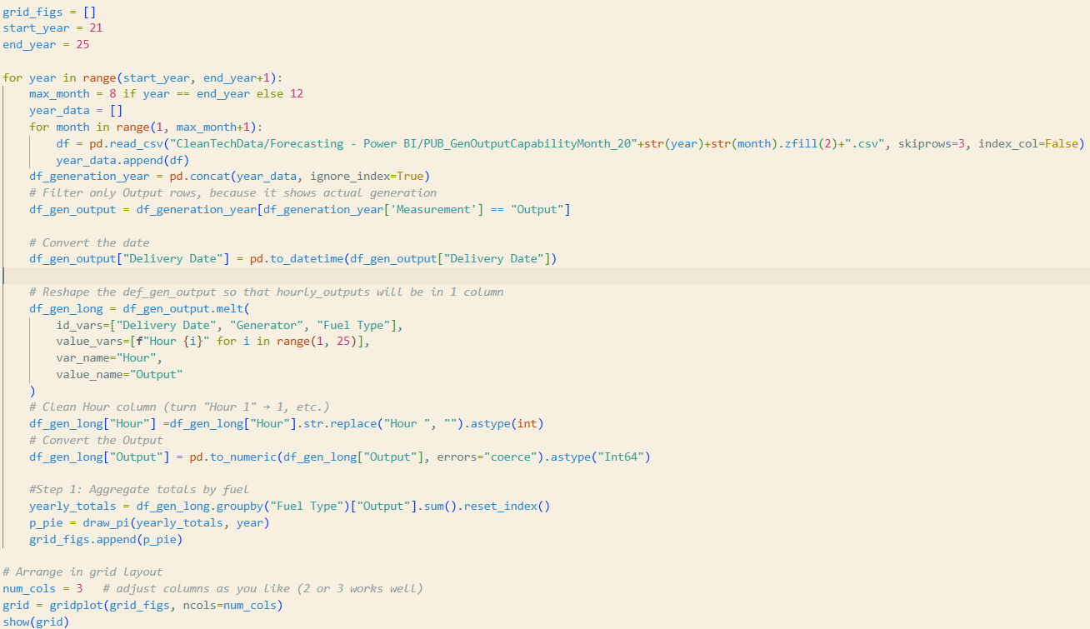
Total Energy Supply for each Fuel for years 2021 - 2025

Slide 26
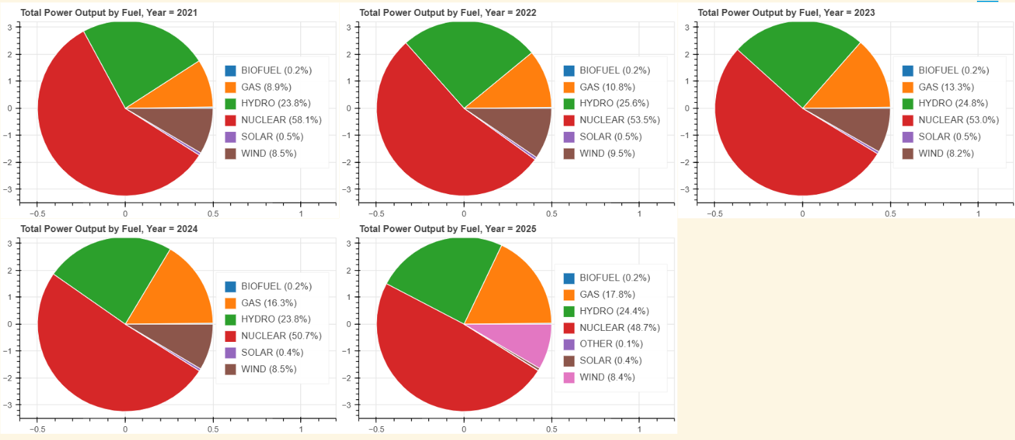
Total Energy Supply by each Fuel for years 2021 - 2025

Slide 27
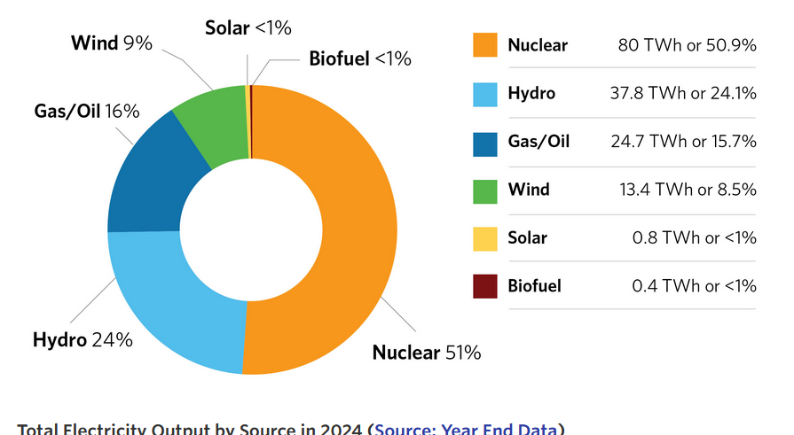
Total Electricity Output In Ontario in 2024 (Actual)
Source: https://www.ieso.ca/Learn/Ontario-Electricity-Grid/Supply-Mix-and-Generation

Slide 28
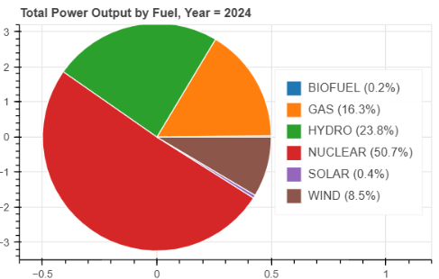
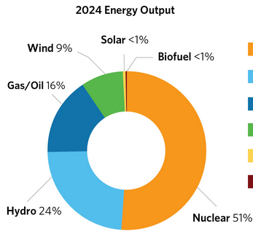
Comparison of Total Electricity Output in 2024

Slide 29
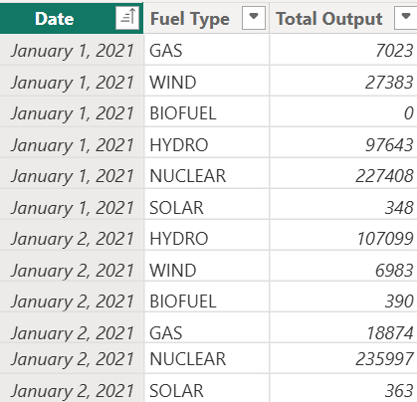
Total Energy Supply for each Fuel for years 2021 – 2025 (Power BI Analysis)
2021 – 2024
– 1 CSV/ month
- 48 Files
2025 – Jan – Aug
– 8 Files

Slide 30
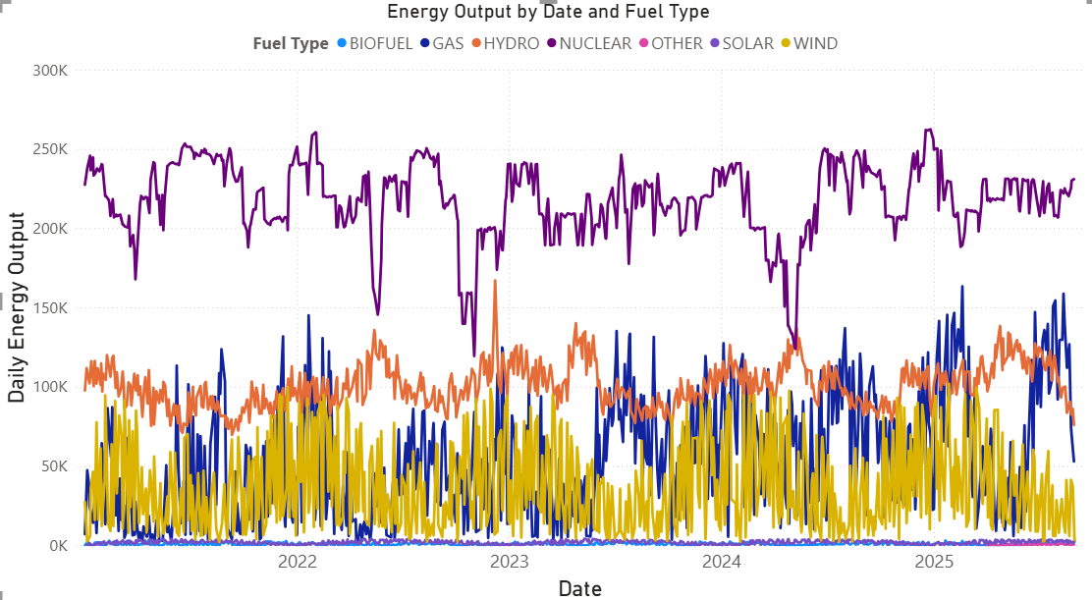
Total Energy Supply for each Fuel for years 2021 – 2025 (Power BI Analysis)

Slide 31
Key Findings
Ontario demand has remained relatively stable from 2002–2025
Peak demand occurs in summer (June–August), mainly driven by air conditioning loads, and in winter evenings.
Nuclear power remains the backbone of Ontario’s supply, contributing nearly half of total generation.
Gas and hydro act as balancing sources, adjusting output to meet peak demand, while solar, wind, and biofuels contribute smaller but growing shares.

Slide 32
Future Steps – Applying AI in Energy Analysis
Renewable Output Forecasting
  Apply AI to predict solar and wind generation more accurately by integrating weather forecasts, satellite data, and historical patterns.
Time-Series Forecasting:
  Electricity demand and renewable outputs (like solar and wind) are time-dependent, showing daily, weekly, and seasonal patterns.

Slide 33
Thank you!

