Slide 2
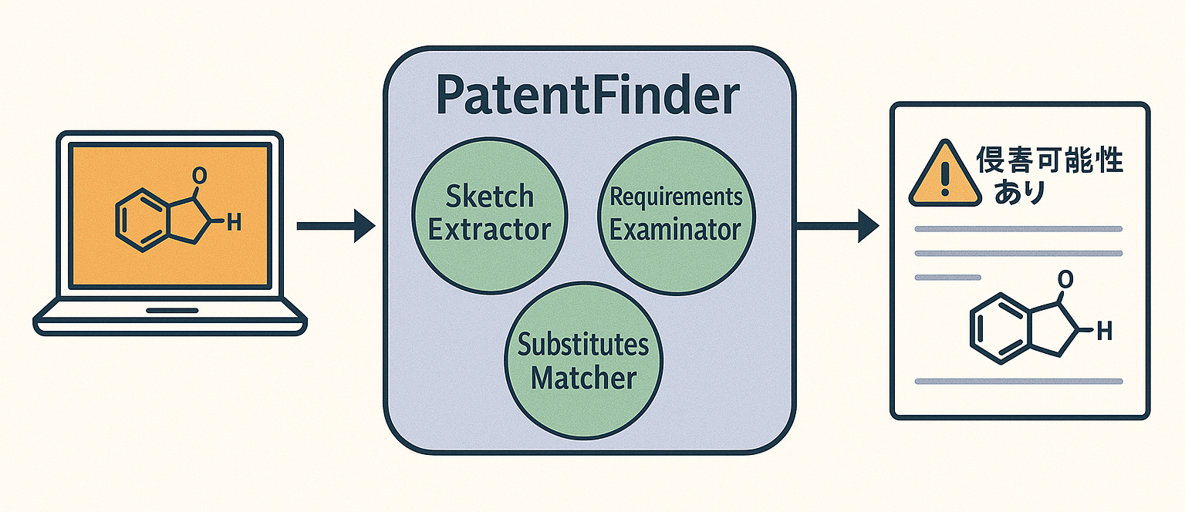
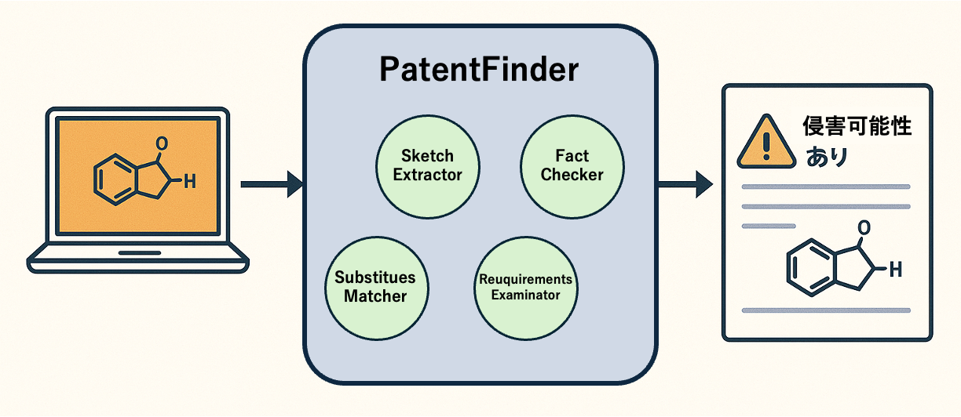
PatentFinder
侵害可能性
Sketch
Extractor
Fact
Checker
Substitues
Matcher
Reuquirements
Examinator

