Slide 1
Slide 1: Vertical Alignment (top / center / bottom)
TOP aligned text
(anchor=t)
CENTER aligned text
(anchor=ctr)
BOTTOM aligned text
(anchor=b)
Large insets (lIns=36pt, tIns=36pt)

Slide 2
Slide 2: Paragraph Spacing & Indent
Paragraph 1: No special spacing or indent.
Paragraph 2: spcBef=24pt (gap above this line)
Paragraph 3: marL=1in (indented from left)
Paragraph 4: spcAft=18pt (gap below this line)
Paragraph 5: After the 18pt gap. Should be visibly separated from P4.

Slide 3
Slide 3: Bullets & Auto-Numbering
First bullet item
Second bullet item
Third with dash
Fourth with arrow
Arabic period
Second item
Third item
Fourth item
Roman upper item
Another item
Third one
Alpha lower a
Alpha lower b
Alpha lower c

Slide 4
Slide 4: Run Decorations
This text has single underline
This text has strikethrough
Both underline AND strikethrough
E = mc²
H₂O (water)
Bold Italic BoldItalicUnderline

Slide 5
Slide 5: Combined Features
Center-anchored box with bullets
Second item with spacing
Third item with underline run

Slide 6
Slide 6: Inherits master navy bg
Navy bg (#1B3A6B) = inheritance OK
White bg = inheritance FAILED

Slide 7
Slide 7: Placeholder Title (inherits 44pt ctr white)
Level 0: Should inherit 24pt white from master bodyStyle
  Level 1: Should inherit 20pt lightgray from master bodyStyle lvl2
Level 0 again: back to 24pt white
^ Title should be 44pt centered white. Body bullets should be 24pt/20pt white/gray.

Slide 8
Slide 8: Explicit green bg (#228B22) — overrides master
This slide has an explicit green background. It should NOT show the master's navy.
If you see green, explicit bg override is working correctly.

Slide 9
Slide 9: East Asian Fonts & Theme References
日本語テキスト（MS PGothic）
テーマ参照: +mj-ea / +mj-lt
マイナーフォント: +mn-ea / +mn-lt
Mixed: ABC + あいう + 123
Verify: EA fonts should appear in font-family. Theme refs (+mj-ea/+mn-ea) should resolve to Yu Gothic.

Slide 10
Slide 10: Line Spacing (a:lnSpc)
Line 1: 150% spacing
Line 2: wider gap above
Line 3: still 150%
Line 1: 36pt absolute
Line 2: fixed height
Line 3: still 36pt
Tight: 80% spacing
Lines should be close together
Third tight line

Slide 11
Slide 11: Character Spacing & lstStyle
Normal spacing (spc=0)
Wide spacing (spc=300, 3pt)
Very wide (spc=1000, 10pt)
Tight spacing (spc=-100, -1pt)
lstStyle lvl1: inherits 20pt bold #003366 Meiryo
Second paragraph: should also inherit lstStyle defaults

Slide 12
Slide 12: normAutofit (fontScale / lnSpcReduction)
fontScale=80%
Line 2: scaled down
Line 3: smaller text
Line 4: fits in box
62.5% + lnSpc 20%
Line 2: even smaller
Line 3: tighter spacing
Line 4: compact text
normAutofit default
Line 2: no scaling
Line 3: same as original
No autofit (ref)
Line 2: original size
Line 3: may overflow
Compare: top-left (80%) should be visibly smaller than bottom-right (no autofit). Top-right (62.5%+20%) should be smallest and tightest.

Slide 13
Slide 13: Text Wrapping
This is a long paragraph of Latin text that should automatically wrap at the shape boundary. Word-level wrapping should break at spaces.
Another paragraph with a very long sentence that exercises the wrapping algorithm more thoroughly, including multiple lines of content.
日本語テキストの折り返しテスト。文字単位で折り返されるべきです。漢字とひらがなが混在しています。
Mixed テキスト: ABC あいう 123 日本語 English words and 漢字が混在
wrap=none: This text should NOT wrap even though it is long and exceeds the box width
Large font in narrow box
Should wrap to multiple lines

Slide 14
Slide 14: Bullet Formatting (buFont / buSzPct / buSzPts / buClr)
Wingdings bullet font
Symbol bullet font
Default font bullet
buSzPct=150000 (150%)
buSzPct=75000 (75%)
buSzPts=3200 (32pt)
buSzPts=800 (8pt)
Red bullet
Green bullet
Blue bullet
No bullet color (inherits)
Combined: Wingdings + 120% + red
Normal bullet for comparison

Slide 15
Slide 15: Capitalization (a:rPr cap)
cap=all: This Should Be All Caps
Mixed: all caps part and normal part
No cap: Regular text for comparison
cap=small: Small Caps Text
No cap: Regular text
Bold Small Caps
cap=all: lowercase a-z should display as UPPERCASE A-Z. cap=small: should display with SVG font-variant=small-caps.

Slide 16
Color Map Override: bg1=dk1, tx1=lt1
This slide has clrMapOvr swapping bg1/tx1. Text using scheme color tx1 should appear light (white) because tx1 maps to lt1.

Slide 17
Complex Script Font (Arabic style)
Symbol Font Text
Kerning enabled at 1200 hundredths-pt

Slide 18
Rotated text (45 degrees)
Col1 Col2 Col3

Slide 19
Vertical text
EA Vertical
This is column text that spans multiple columns. The text should flow from the first column to the second column when it reaches the bottom.

Slide 20
Click here to visit example.com
RTL paragraph text (right-to-left)

Slide 21
Image bullet paragraph 1
Image bullet paragraph 2

Slide 22
Click link
Hover link
Both links

Slide 23
Linear 0deg
Linear 90deg
Linear 45deg

Slide 24
Radial circle
Radial rect
Ellipse grad

Slide 25
Gradient Background

Slide 26
Alpha 50%
Alpha Gradient

Slide 28
ltDnDiag
smCheck
dkHorz

Slide 29
tileFlip=x
tileFlip=y
tileFlip=xy

Slide 30
pct50
dnDiag
cross
lgCheck
solidDmnd
trellis

Slide 31
Tile fill

Slide 32
Slide 32: Line Stroke Styles
dash
dot
dashDot
lgDash
sysDot
sysDash
custDash

Slide 33
Slide 33: Arrow Lines
triangle head + stealth tail
dash + round cap + round join
diamond head + oval tail
lgDash + sq cap + bevel join
arrow head + triangle tail (sm)
miter join (lim=800000)
Rect: dashDot + rnd cap
Compound: dbl
Line noFill

Slide 34
Slide 34: Group Shapes
Child 1 (red)
Outer bg
Nested A
Nested B
Child 2 (teal)
Left: simple group (red rect + teal ellipse). Right: nested group (outer bg + inner circle + rounded rect).

Slide 35
Slide 35: Connectors (p:cxnSp)
Left: straight + diagonal. Right: bent (green) + curved (orange).

Slide 36
triangle
diamond
pentagon
hexagon
rightArrow
star5
heart
plus
flowChartDecision
chevron
parallelogram
octagon
rightArrow
star5
Preset geometry: triangle, diamond, pentagon, hexagon, rightArrow, star5, heart, plus, flowChartDecision, chevron, parallelogram, octagon

Slide 37
Custom geometry (a:custGeom): freeform star, bezier curve, guide-based rect

Slide 38
Gear shapes: gear6 (default), gear9 (default), gear6 (adj=50000 deeper teeth)

Slide 39
Text in Triangle
Diamond
Arrow
Text rectangles: triangle (text in lower half), diamond (text inscribed), right arrow (text in shaft)

Slide 40
Start
End
Connection points: connector with stCxn/endCxn refs, custom geom with a:cxnLst

Slide 41
Merged 2 cols |  | Normal cell
Merged 2 rows | Cell B2 | Cell C2
 | Cell B3 (large margin) | Cell C3 (top anchor)
Table: cell merge (gridSpan/rowSpan/vMerge) + borders + margins + anchor

Slide 42
TL-BR diagonal | BL-TR diagonal | Both diagonals
Band row 1 | Normal | Normal
Band row 2 | Normal | Last row cell
Table: diagonal borders (lnTlToBr/lnBlToTr) + tblPr flags + tblStyleId

Slide 43
Slide 43: Image crop (srcRect) + alpha (alphaModFix)

Slide 44
Slide 44: External image reference (TargetMode=External)
Left: Wikimedia Commons PNG
Right: picsum.photos (id=237)

Slide 45
Slide 45: Image effects — brightness/contrast (a:lum)
Left: bright +50% | Center: contrast -30% | Right: bright +20% contrast +40%

Slide 46
Slide 46: Duotone (a:duotone) + Color change (a:clrChange)
Left: Duotone (navy→yellow) | Right: clrChange (red→green, data preserved)

Slide 47
Slide 47: Background pattern fill (ltDnDiag)

Slide 48
Slide 48: Line gradient fill + Line pattern fill
Gradient stroke
Pattern stroke

Slide 49
Slide 49: Shape hyperlinks + Color modifiers (comp/inv/hueMod)
Click me (shape link)
comp(#FF6600) = complementary hue
inv(#3366CC) → #CC9933
hueMod 50% of red

Slide 50
Slide 50: Shape effects (outerShdw / innerShdw / glow / softEdge)
Outer Shadow
Glow Effect
Inner Shadow
Soft Edge

Slide 51
Slide 51: 3D effects (bevel/extrusion/scene3d) + text shadow/glow
3D Bevel
Text with Shadow
Text with Glow
3D Extrusion

Slide 52
Slide 52: Column chart (clustered)

Slide 53
Slide 53: Line chart

Slide 54
Slide 54: Pie chart

Slide 55
Slide 55: Bar chart (horizontal) + Donut chart

Slide 56
Slide 56: Column chart with data labels

Slide 57
Slide 57: Pie chart with custom colors + % labels

Slide 58
Slide 58: Line chart with series colors + data labels

Slide 59
Slide 59: Scatter chart + Area chart

Slide 60
Slide 60: Radar chart

Slide 61
Slide 61: Bubble chart

Slide 62
Slide 62: Stock chart (OHLC)

Slide 63
Slide 63: All chart types overview

Slide 64
Slide 64: Line chart with linear trendline

Slide 65
Slide 65: Column chart with error bars (±8)

Slide 66
Slide 66: Composite chart (column + line)

Slide 67
Slide 67: Surface chart (2D heatmap)

Slide 68
Slide 68: Pie of pie chart (ofPieChart)

Slide 69
Slide 69: 3D bar chart (view3D preserved)

Slide 70
Slide 70: Text outline (a:rPr/a:ln)
Red Outlined Text
Blue Outlined (thin)

Slide 71
Slide 71: Text gradient fill (a:rPr/a:gradFill)
Gradient Text
Green-Blue Grad
Pattern Text

Slide 72
Slide 72: Text warp (a:prstTxWarp)
Wave Text
Arch Up
Deflate Text

Slide 73
Slide 72b: Additional text warp presets
Slant Up
Curve Up
Inflate
Chevron
Circle Text Example

Slide 74
Slide 73: Stacked / Percent-stacked bar charts

Slide 75
Slide 74: Speaker notes + comments
This slide has speaker notes and comments attached.
Notes and comments are metadata not rendered on slide, but preserved in round-trip export.
Notes:
These are the speaker notes for slide 74.
Second paragraph of notes with key points.
Remember to mention the round-trip preservation.

Slide 76
Slide 75: SmartArt Fallback (mc:AlternateContent)

Slide 77
Slide 76: OLE Embedded Object (p:oleObj)

Slide 78
Slide 77: Media (Video with Poster Frame)

Slide 79
Slide 78: Math Equation (OMML)

Slide 80
Slide 79: Transition + Timing (round-trip)
This slide has a fade transition and timing data for round-trip.

Slide 81
Slide 80: Hidden Slide
This slide is marked as hidden (show='0').

Slide 82
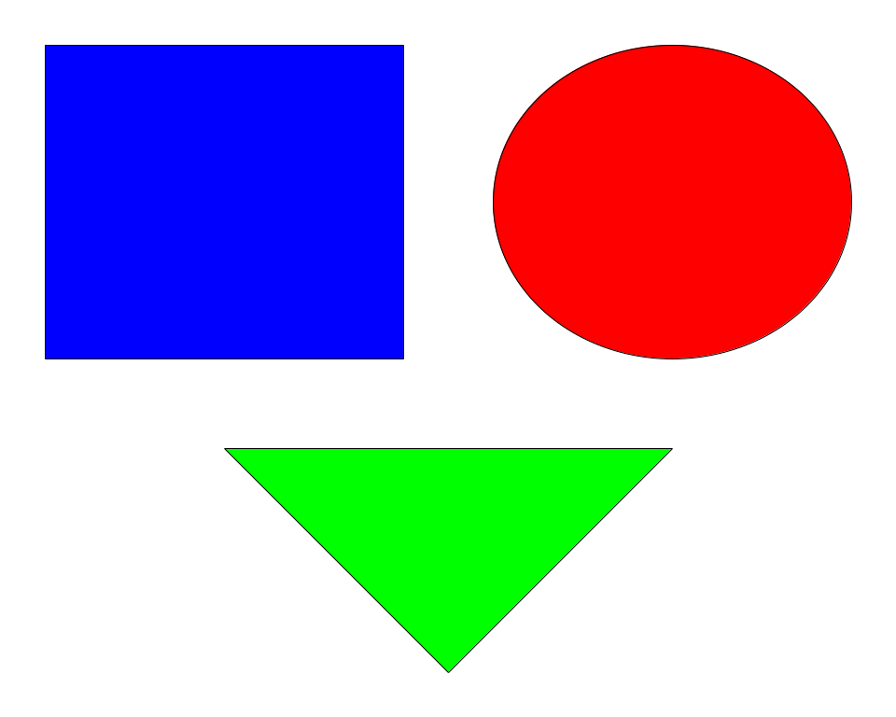

Slide 83
Slide 82: OMML — Large Operators + Delimiters

Slide 84
Slide 83: OMML — Matrix + Delimiters

Slide 85
Slide 84: OMML — Accent + Bar + SubSup

Slide 86
Slide 85: Blur Effect (a:blur)
Blur Effect

Slide 87
Slide 86: Preset Shadow (a:prstShdw)
shdw1 (Bottom Right)
shdw2 (Bottom)

Slide 88
Slide 87: Fill Overlay (a:fillOverlay)
over
mult
screen
darken
lighten

Slide 89
Slide 88: Justified Text (algn="just")
This is a justified paragraph with enough text to wrap across multiple lines. The word spacing should be adjusted so that each line extends to fill the full width of the text box evenly.
Short last line.
均等割り付けのテスト文章です。日本語テキストはスペースがないため文字間隔で調整されます。

Slide 90
Slide 89: Waterfall Chart (cx:chart)

Slide 91
Slide 90: Treemap Chart (cx:chart)

Slide 92
Slide 91: Sunburst Chart (cx:chart)

Slide 93
Slide 92: Histogram Chart (cx:chart)

Slide 94
Slide 93: Box & Whisker Chart (cx:chart)

Slide 95
Slide 94: Funnel Chart (cx:chart)

Slide 96
Reference rect (prstGeom)

Slide 98
double wavy dotted dblstrike

Slide 99
FlipH
FlipV
FlipHV

Slide 106
Revenue

