Slide 1
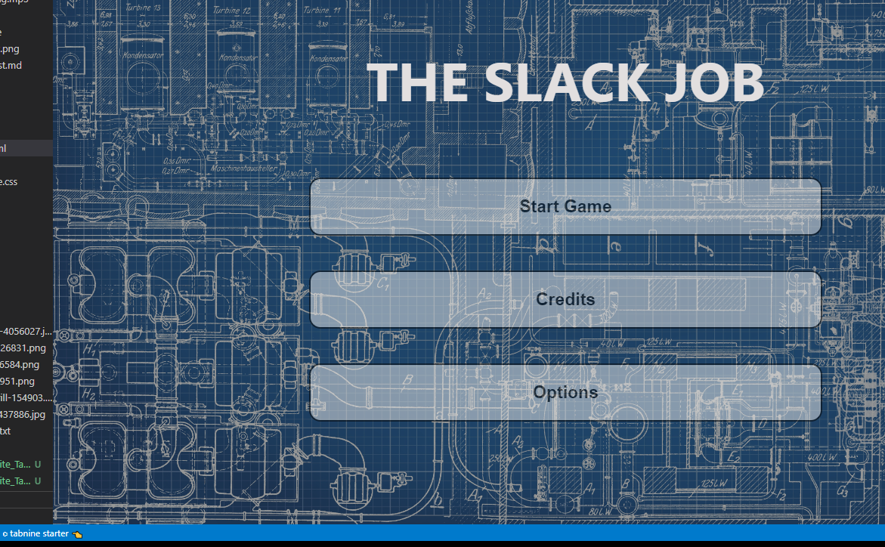
“The slack job”
By Adam Stafford (40365651), Taylor Walker (40363068), Michael Waite (40371294), Caleb Connor (40375909) and Thomas Dillion (40363297)

Slide 2
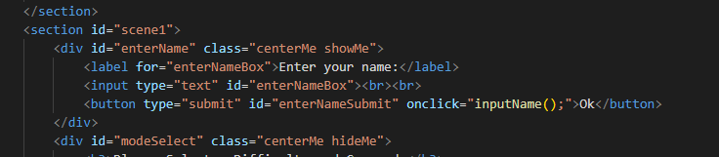
Showing the collection of data in a HTML form (code)
This is the code contained within the form prompts the user to input a name. This is stored within session storage and allows the name be called later on in the story.
This function will be called throughout the game to give it a personal touch.

Slide 3
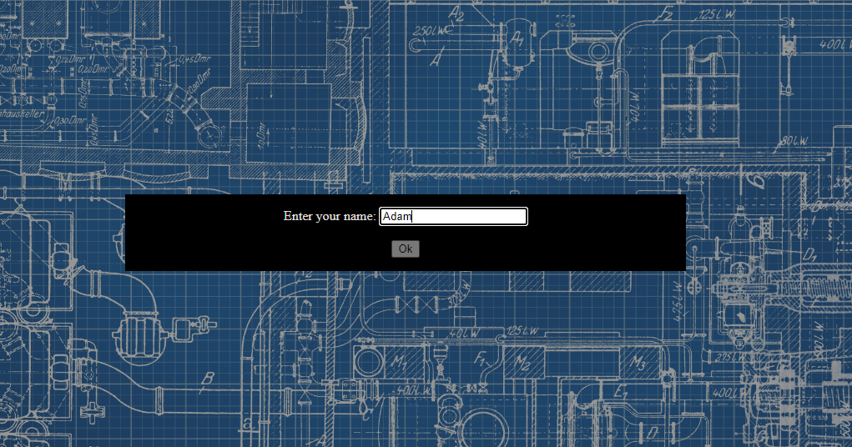
Showing the collection of data in a HTML form (game)
The name of the user is collected before the game to always have personalisation include in the game.

Slide 4
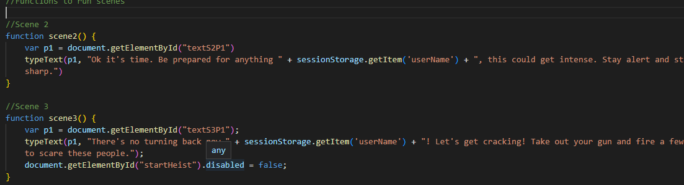
Showing how the collection of data aids in personalisation (code)
The use of “sessionStorage.getItem(‘userName’)” is prevalent throughout ‘The slack job’, with most scenes calling the player of the game their ‘username’ to add a personal touch.

Slide 5
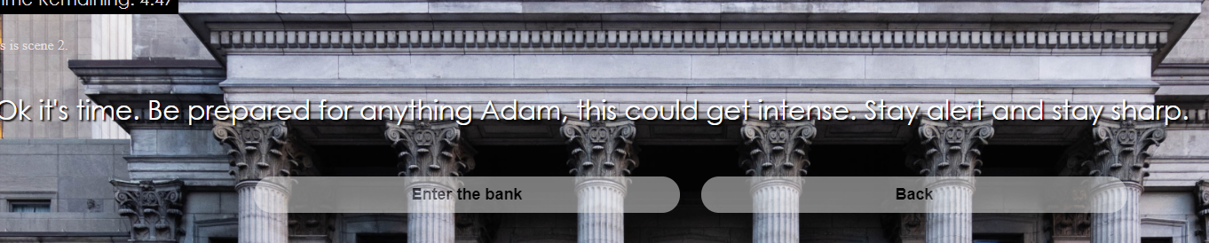
Showing how the collection of data aids in personalisation (game)
This is one such instant of the player being called by their ‘username’. This being in scene 2 before the heist commences.

Slide 6
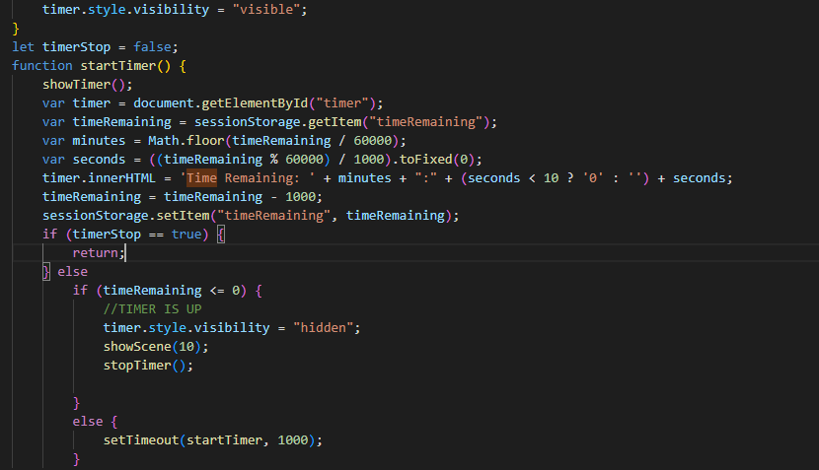
Illustrating the operation of JS timed events (code)
Someone explain whats going on here

Slide 7
Illustrating the operation of JS timed events (game)

Slide 8
Illustrating the operation of the text adventure elements (code)

Slide 9
Illustrating the operation of the text adventure elements (game)

Slide 10
Statistics generated for players (code)

Slide 11
Statistics generated for players (game)

Slide 12
Game accessibility (code)

Slide 13
Game accessibility (game)

