Slide 1
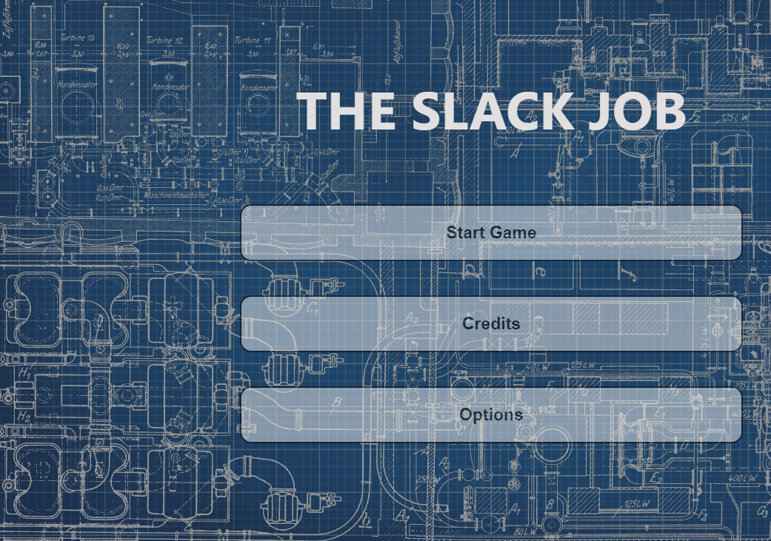
THE SLACK JOB
Adam Stafford 40365651
Taylor Walker 40363068
Michael Waite 40371294
Caleb Connor 40375909
Thomas Dillion 40363297

Slide 2
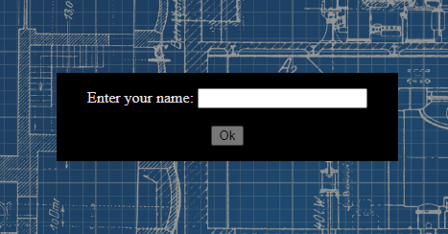
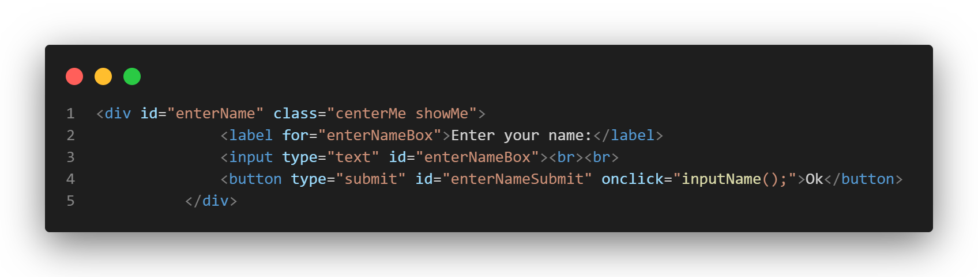
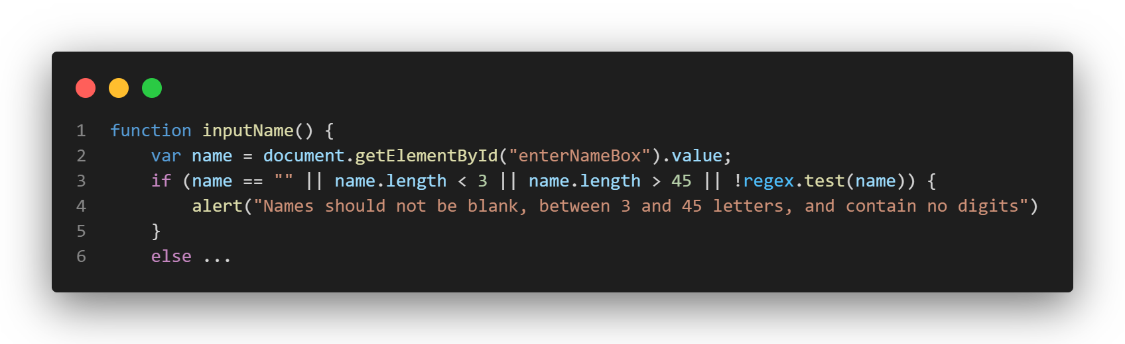
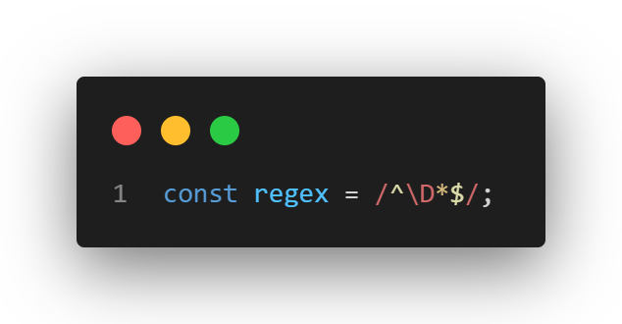
Data Collection Using HTML Form Elements
When the user begins the game there are prompted to enter their name, this aids in adding a personalised touch to the user experience
The information is taken in using an HTML input element, then submitted using a button which calls a JS method called inputName();
This method which is called by the button, fetches the information inputted into the HTML element by referencing it’s ID within the document, the method then verifies that the name is not blank, between 3 and 45 characters and ensures it contains no digits (0,1,2 etc.) using a regex statement declared earlier in the code

Slide 3
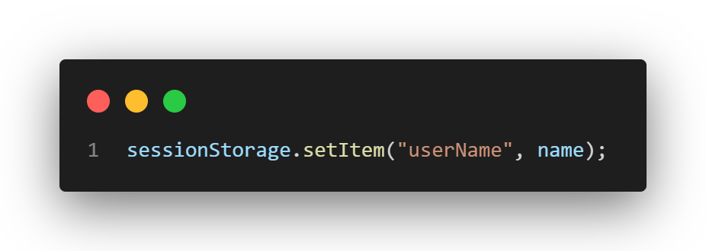
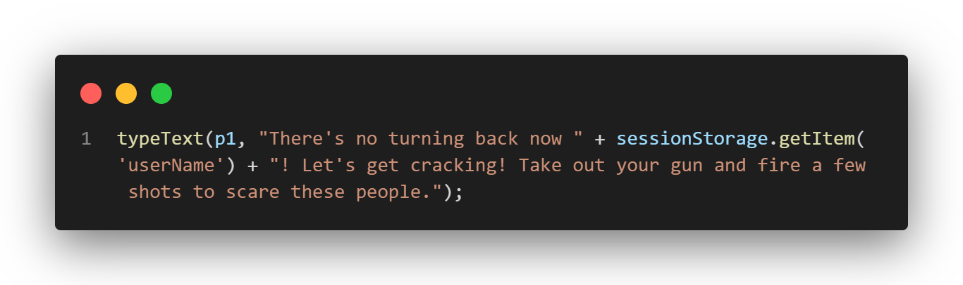

Game Personalisation using Previously Collected Data
Once the JS method we looked at previously verifies that the name is valid, it saves it to the browser’s session storage, this is essentially a place where a developer can store data for a website to be used between different pages, but which resets once the user closes every instance of the page
Now that the name is saved in the session storage, it is able to be referred back to at any later point in the code, for example, it’s used in this page of the game within the typeText method (will be touched on later) to customise the output text in the viewport to be specific to the user
Which then results in the user seeing the name they have entered being incorporated into the game text

Slide 4
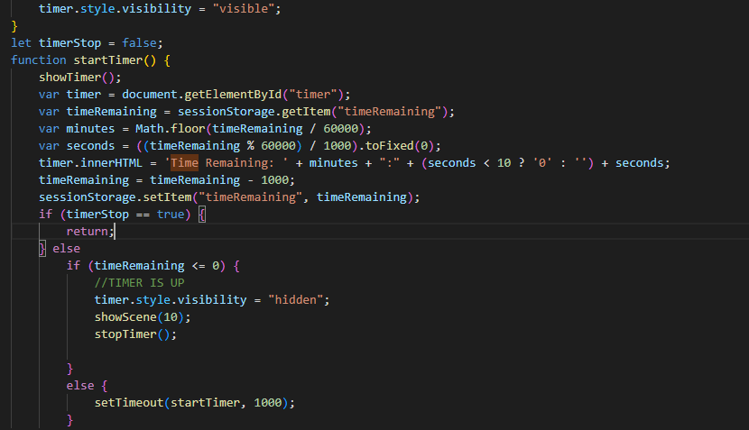
Illustrating the operation of JS timed events (code)
Someone explain whats going on here

Slide 5
Illustrating the operation of JS timed events (game)

Slide 6
Illustrating the operation of the text adventure elements (code)

Slide 7
Illustrating the operation of the text adventure elements (game)

Slide 8
Statistics generated for players (code)

Slide 9
Statistics generated for players (game)

Slide 10
Game accessibility (code)

Slide 11
Game accessibility (game)

