Slide 1
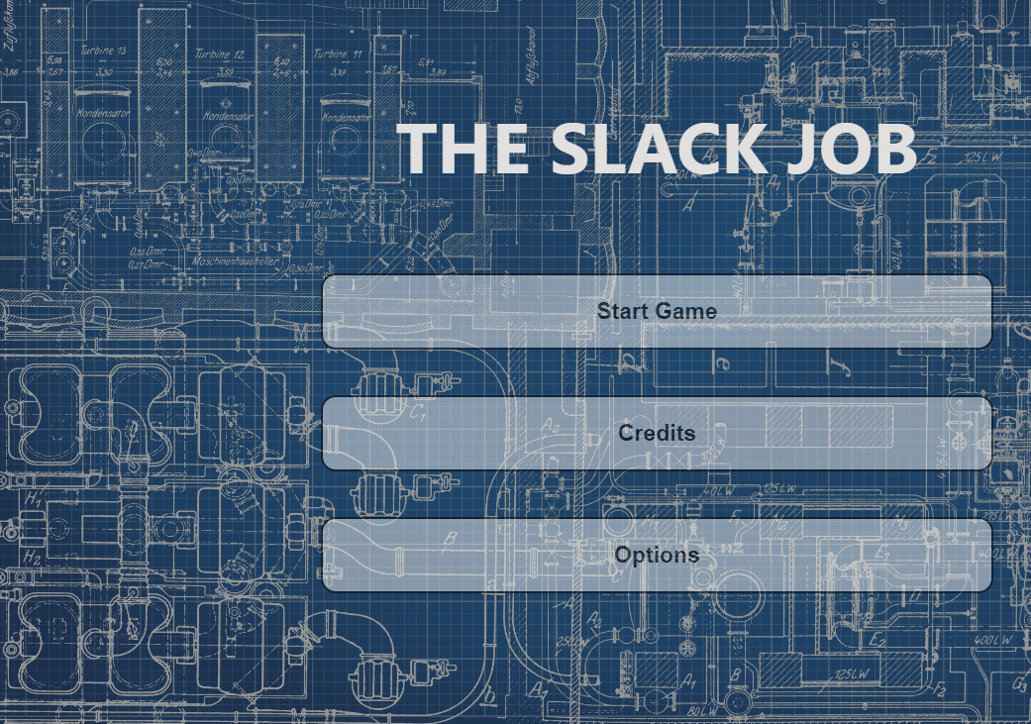
THE SLACK JOB
Adam Stafford 40365651
Taylor Walker 40363068
Michael Waite 40371294
Caleb Connor 40375909
Thomas Dillion 40363297

Slide 2
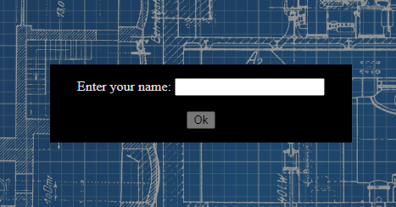
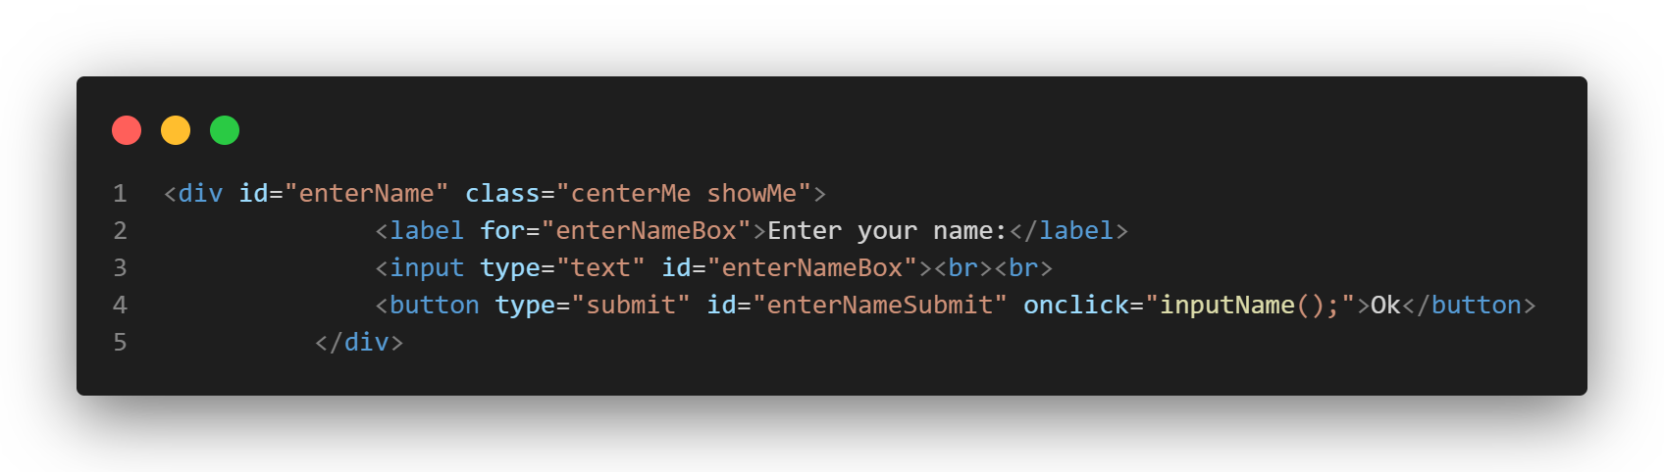
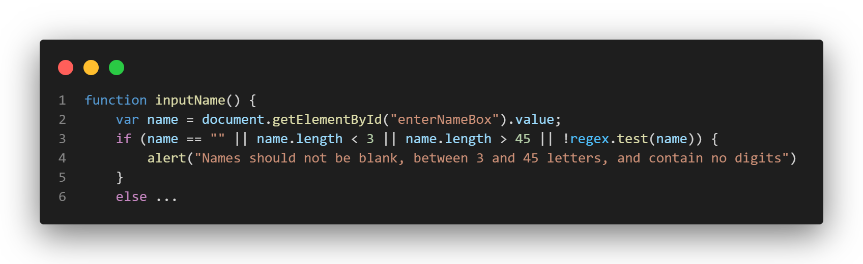
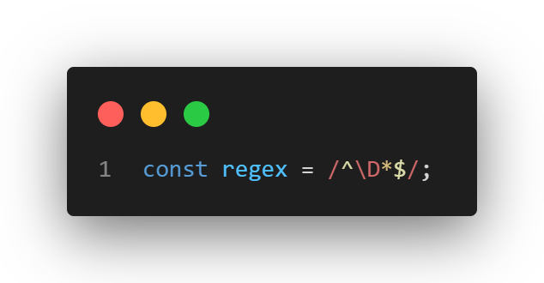
Data Collection Using HTML Form Elements
When the user begins the game there are prompted to enter their name, this aids in adding a personalised touch to the user experience
The information is taken in using an HTML input element, then submitted using a button which calls a JS method called inputName();
This method which is called by the button, fetches the information inputted into the HTML element by referencing it’s ID within the document, the method then verifies that the name is not blank, between 3 and 45 characters and ensures it contains no digits (0,1,2 etc.) using a regex statement declared earlier in the code

Slide 3
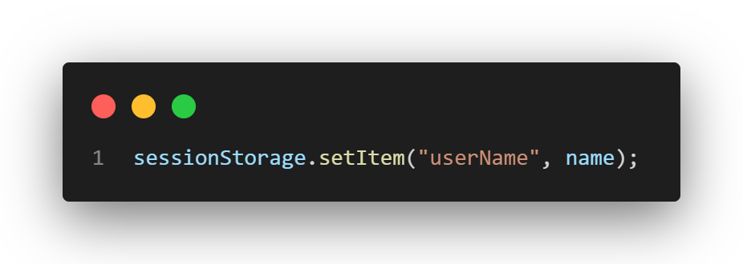
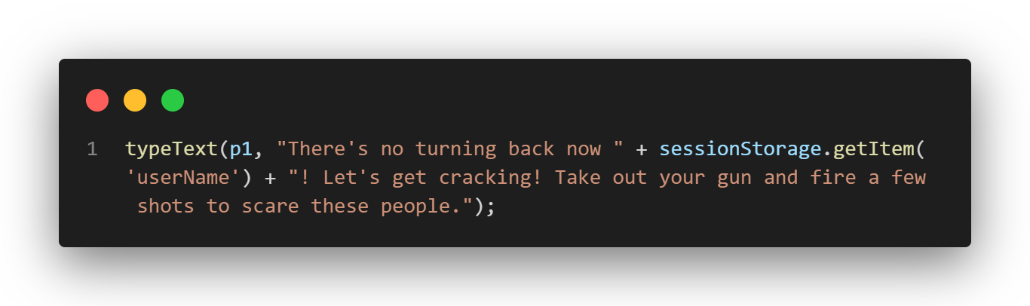

Game Personalisation using Previously Collected Data
Once the JS method we looked at previously verifies that the name is valid, it saves it to the browser’s session storage, this is essentially a place where a developer can store data for a website to be used between different pages, but which resets once the user closes every instance of the page
Now that the name is saved in the session storage, it is able to be referred back to at any later point in the code, for example, it’s used in this page of the game within the typeText method (will be touched on later) to customise the output text in the viewport to be specific to the user
Which then results in the user seeing the name they have entered being incorporated into the game text

Slide 4

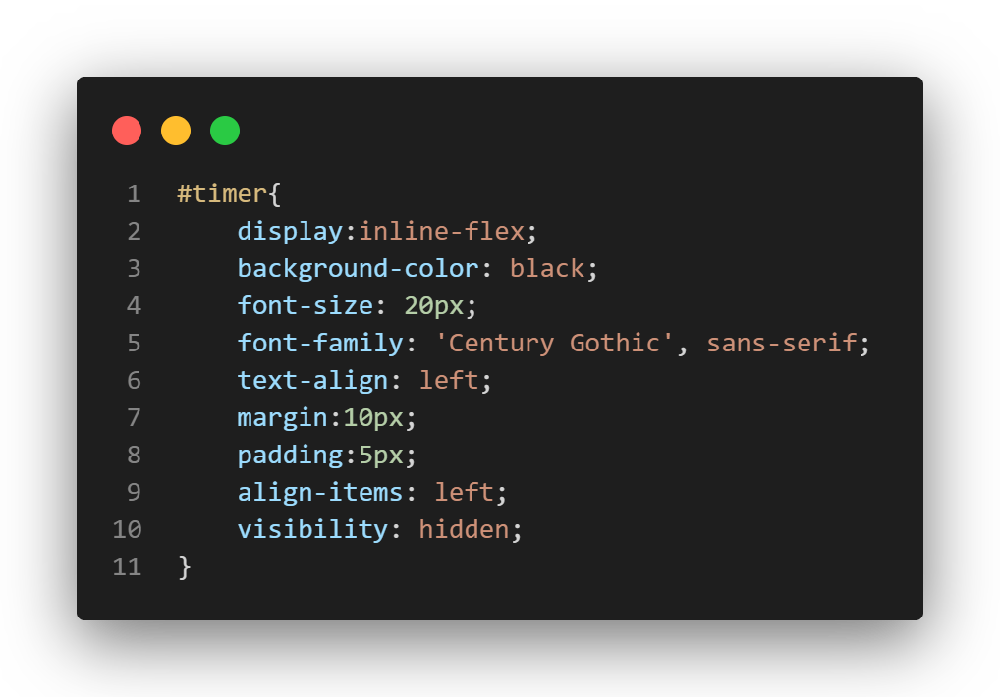
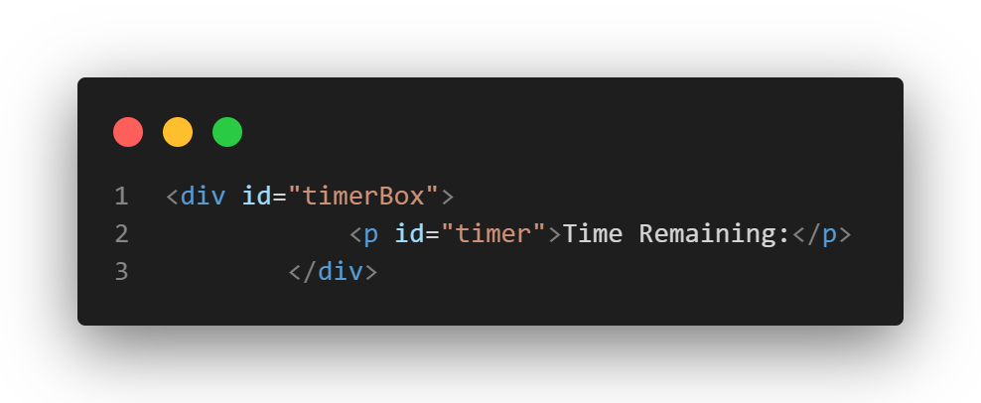
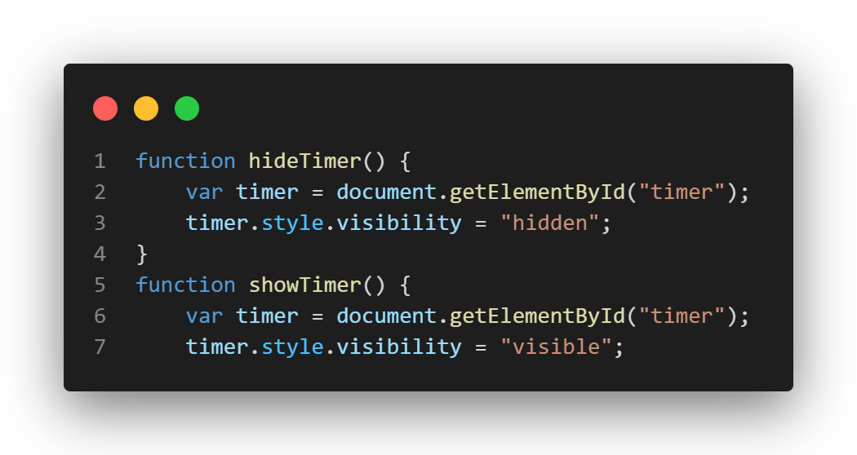
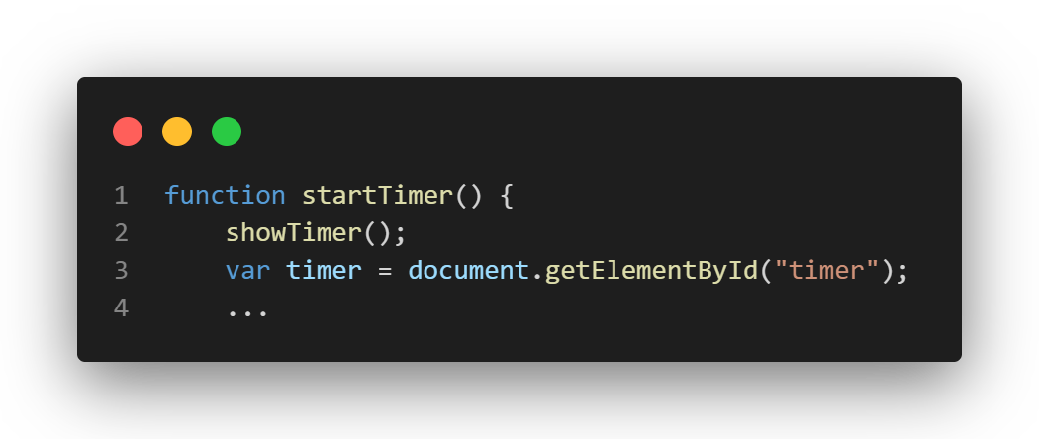
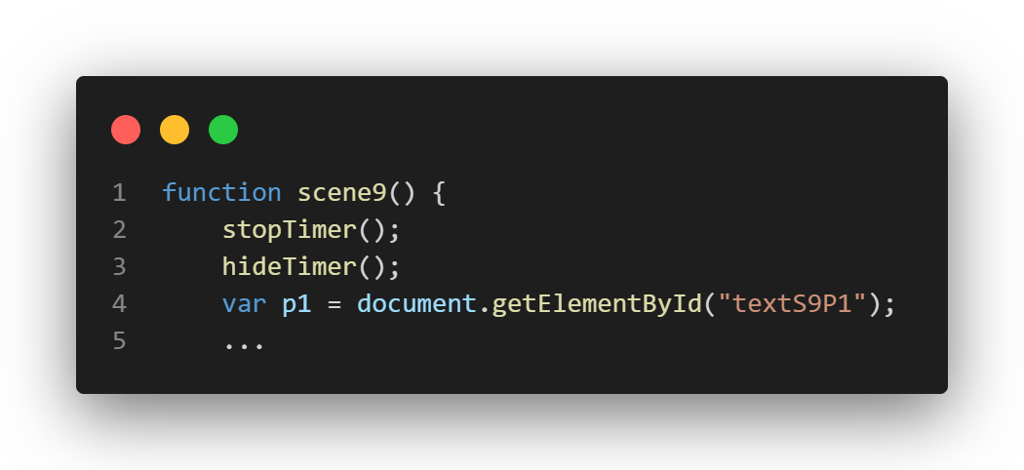
JS Timed Events
When the user begins the game, they are shown the time remaining. Their starting time is based on what difficulty they select in the in the starting menu. The timer consists of a simple div containing a <p> element which will be the text within out timer. The black background and positioning are all coded in CSS.
Within the code the timer is shown and hidden using these JS methods which are called at certain points in the game signifying the start and the end of gameplay. They function by changing the timer box’s visibility

Slide 5
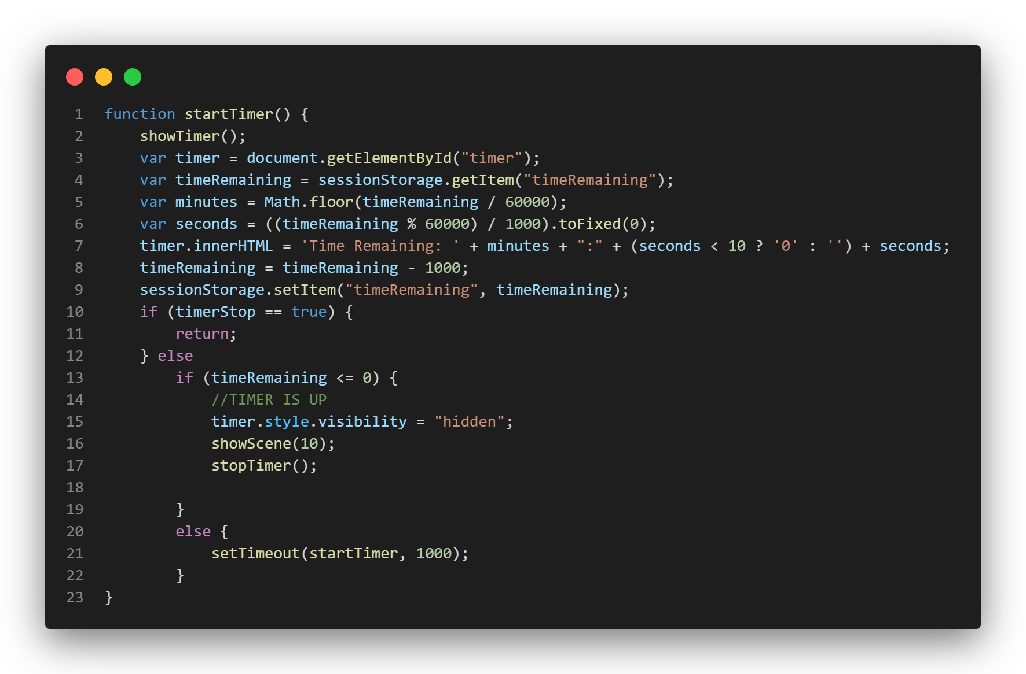
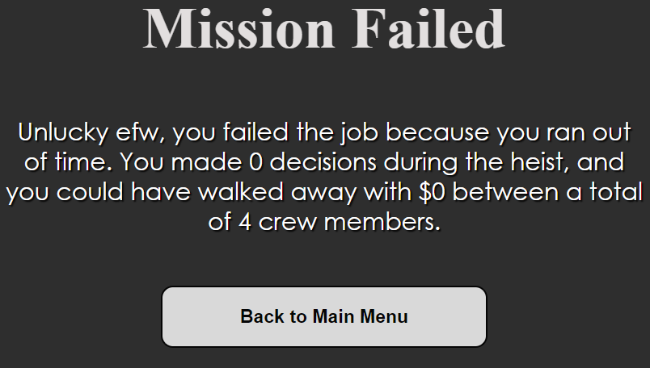
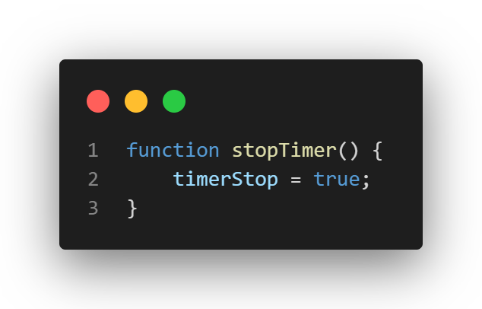
JS Timed Events Cont.
The functionality of the timer is programmed within the startTimer() method. The method begins by showing the timer, as it is hidden to begin with. It next created a variable called timer which is set to the <p> element which will contain the text for the timer. The function then calculates how long is left by accessing the session storage to read the time remaining, which is set earlier in the game based on difficulty, the function then converts this time from seconds into minutes and seconds through the use of Math.floor() tool to calculate the whole minutes left & the mod function (%) of JS calculate the remaining amount of seconds. The function then updates the text of the timer <p> element and the session storage to the new value. After this the method checks to see if the timerStop boolean value is set to true, if it is the timer stop counting by returning out of the method, if not then the timer also checks if the time remaining is less than or equal to 0, if so the timer is hidden and stopped and the game switches to the failure scene. If none of the previous conditions are met then the timer sets a delay of 1000ms (1s) using the setTimeout function within JS, creating the timed event, this then calls the method all over again, which will repeat until another condition is met.

Slide 6
Operation of Game Text Adventure Elements

Slide 7
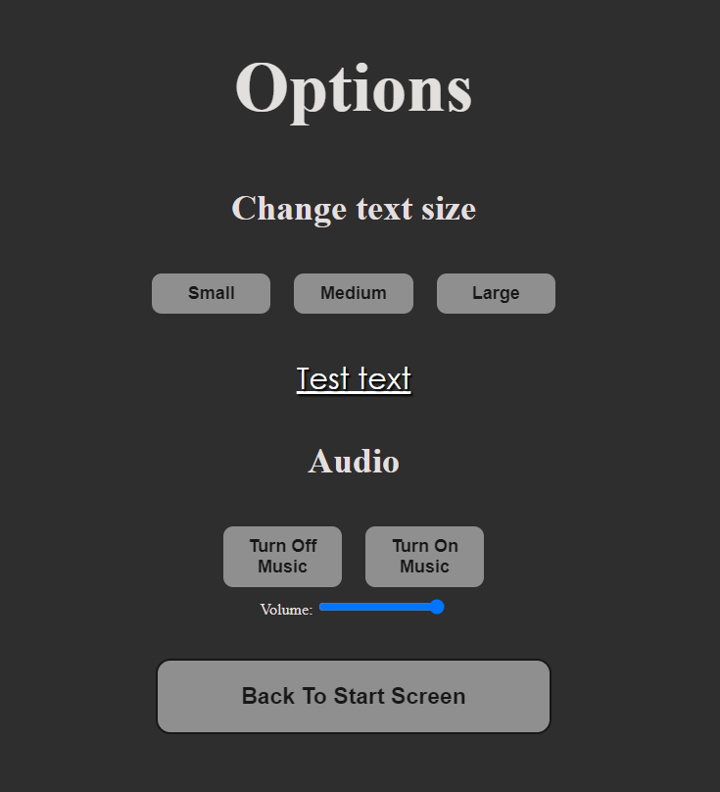
Accessibility Features

Slide 8
APIs

Slide 9
Top Features

Slide 10
Copyright

