Slide 1
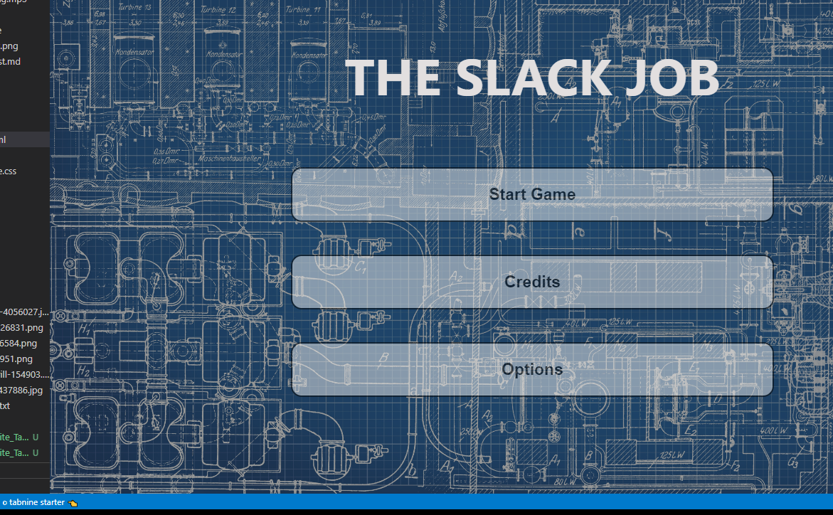
“The slack job”
By Adam Stafford (40365651), Taylor Walker (40363068), Michael Waite (40371294), Caleb Connor (40375909) and Thomas Dillion (40363297)

Slide 2
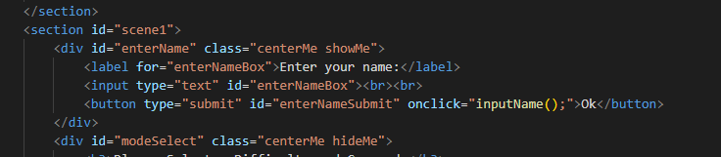
Showing the collection of data in a HTML form
This is the code contained within the form prompts the user to input a name. This is stored within session storage and allows the name be called later on in the story.
This function will be called throughout the game to give it a personal touch.

Slide 3
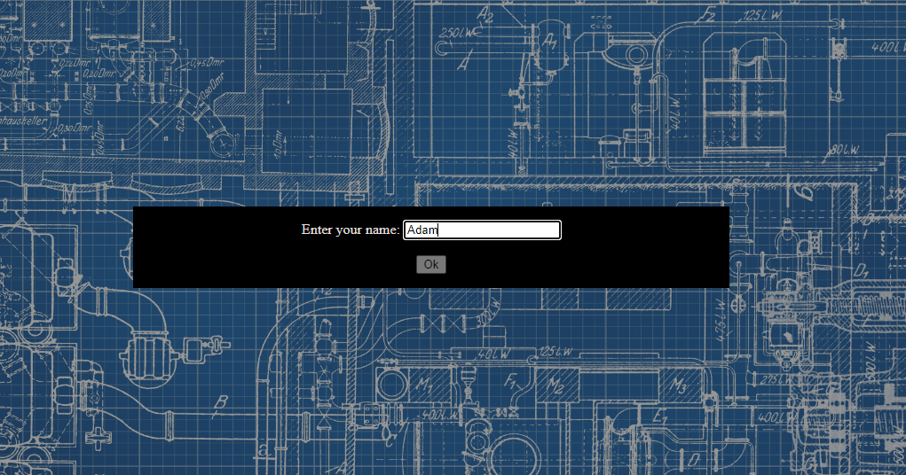
Showing the collection of data in a HTML form

Slide 4
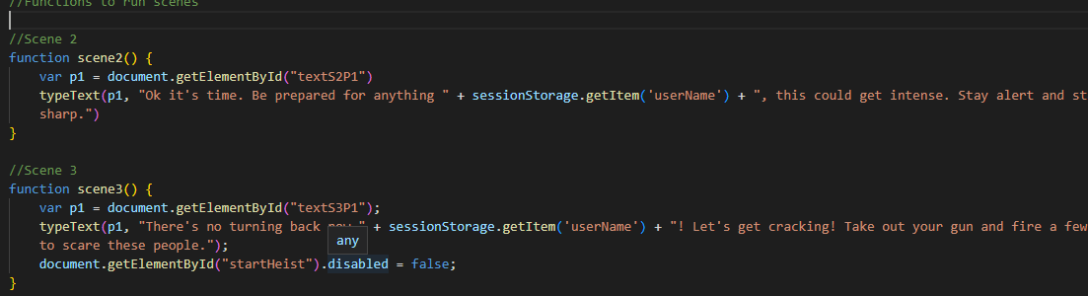
Showing how the collection of data aids in personalisation

Slide 5

Showing how the collection of data aids in personalisation

Slide 6
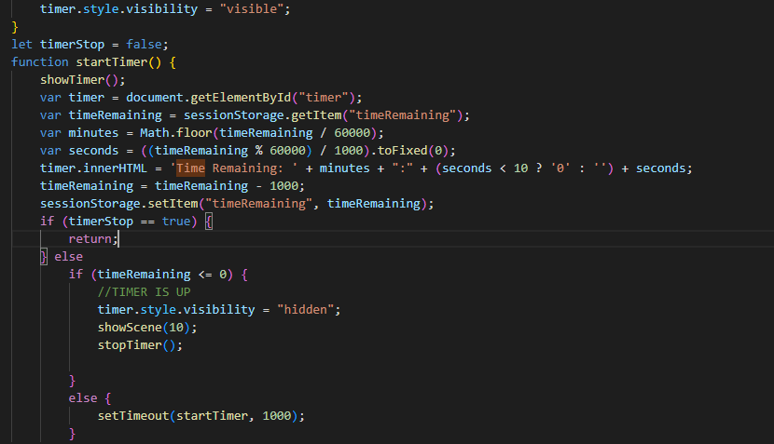
Illustrating the operation of JS timed events

Slide 7
Illustrating the operation of JS timed events

Slide 8
Illustrating the operation of the text adventure elements

Slide 9
Illustrating the operation of the text adventure elements

