Slide 1
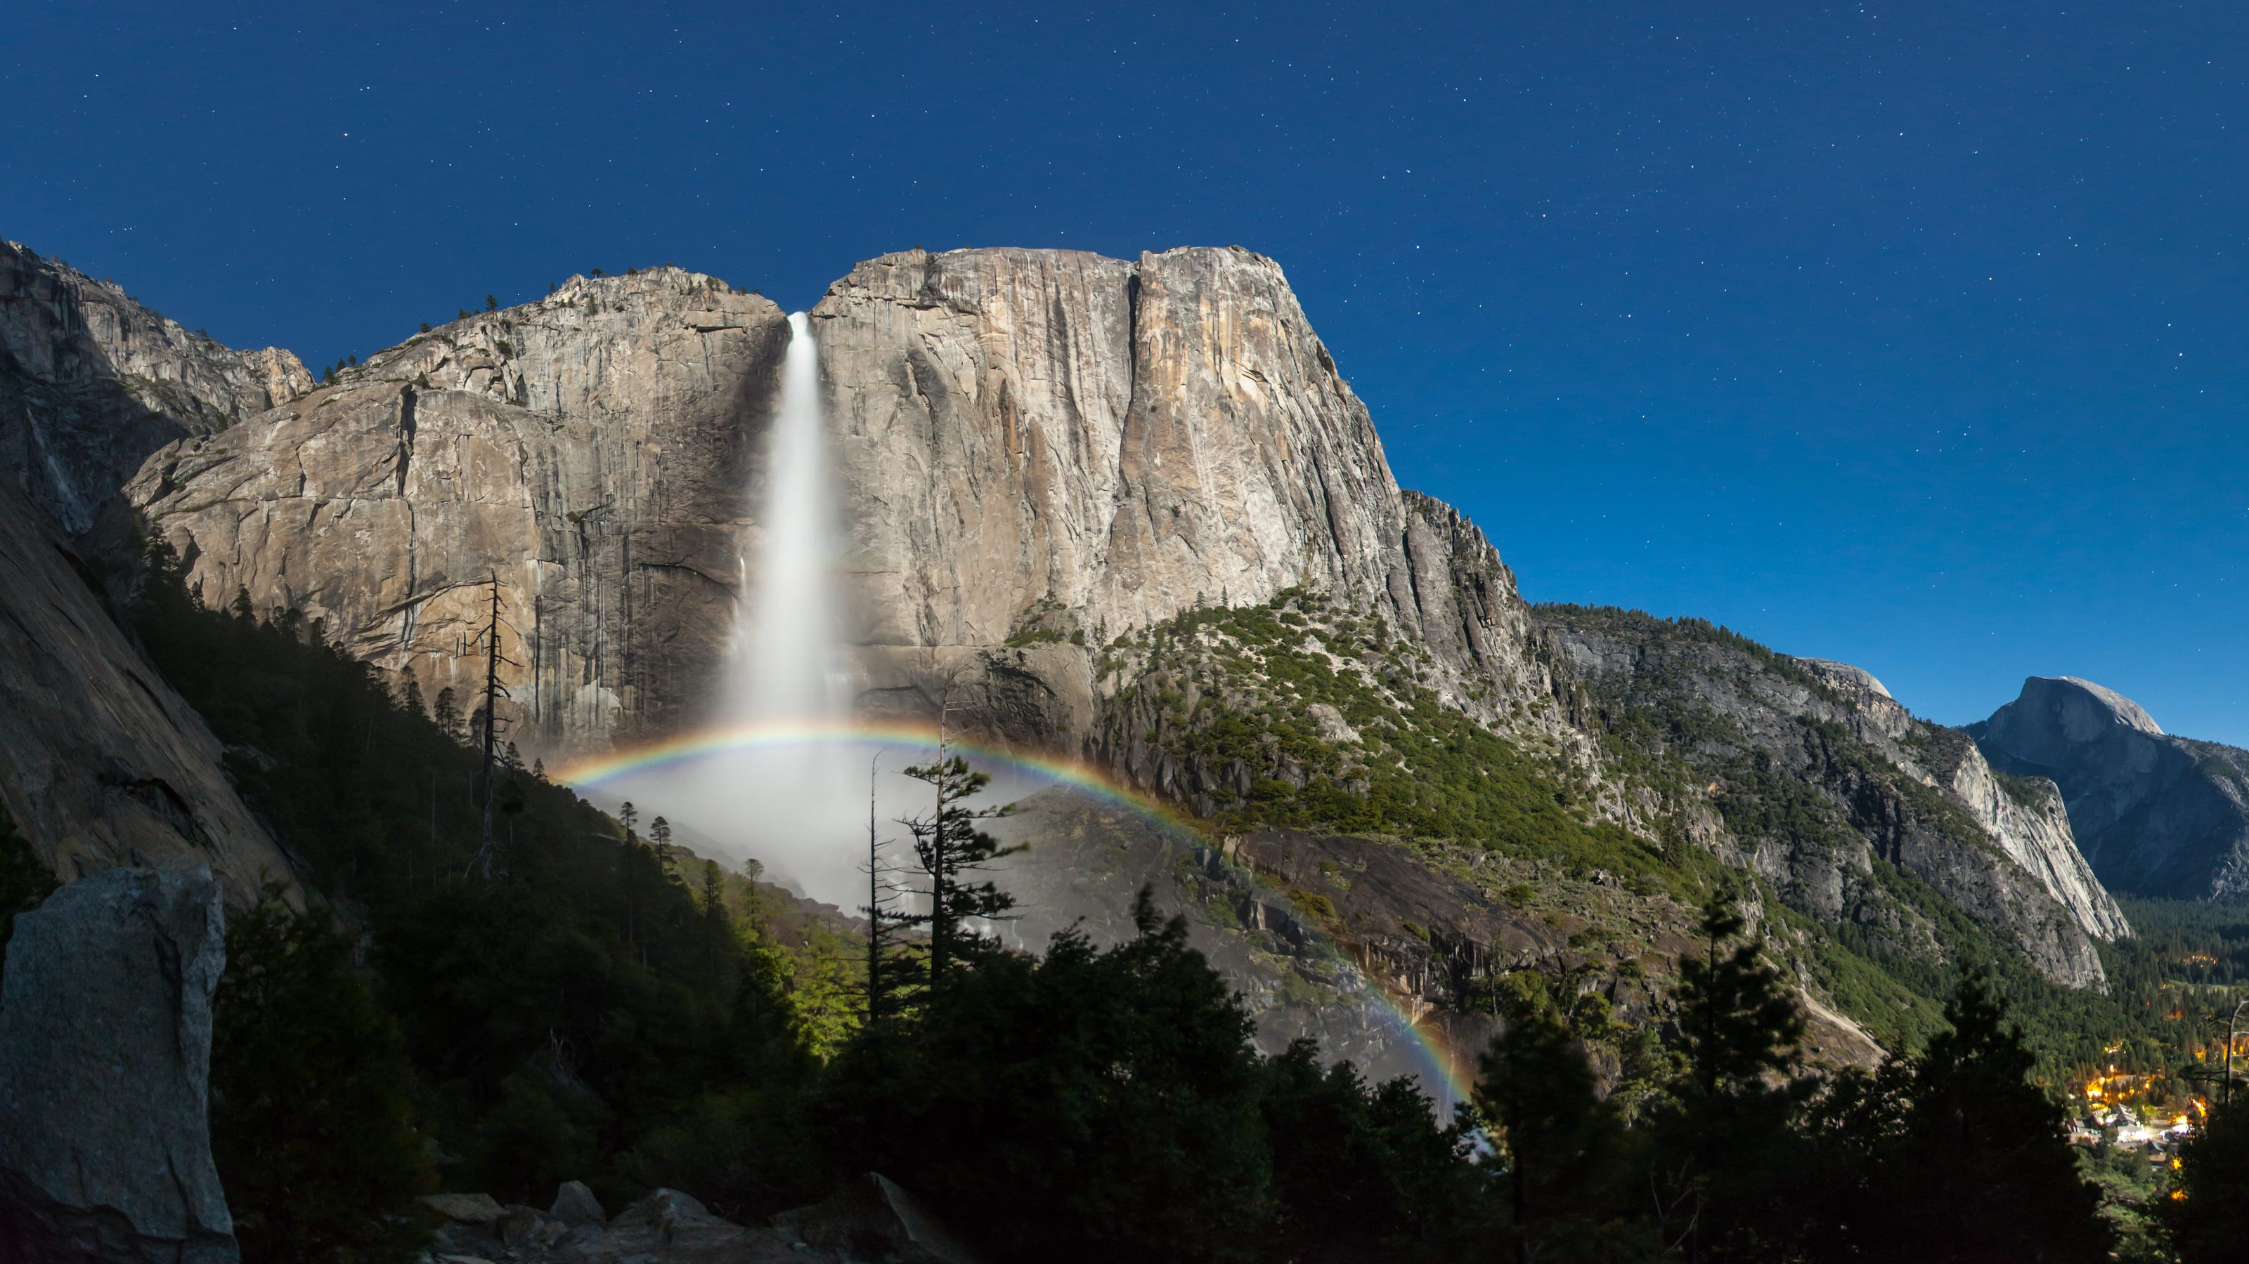
Biodiversity in National Parks
7 Day Observations

Slide 2

Data Sources
Data from National Park Service regarding conservation status of species found in the parks * species_info.csv
Observations taken over a 7-day period by park rangers of species in parks * observations.csv

Slide 3
Process
Species data separated into seven categories of plants and animals (i.e. Birds, Mammals, etc.) and notes where species are considered at risk (i.e.Of Concern, Threatened, Endangered, and Recovering)
Observation data notes the scientific name of the species observed, and how many times each was observed over a seven day period.
In both cases, there are some duplicate entries that were scrubbed prior to analysis.

Slide 4

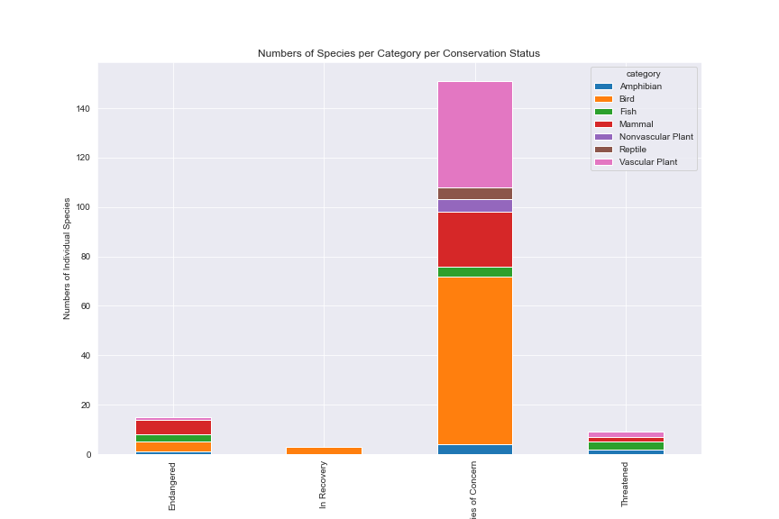

Analysis
Vascular Plants, Mammals, and Birds are the groups with the highest numbers of species listed ‘Of Concern’.
Mammals, Fish, and Birds are the groups with the highest numbers of species listed as ‘Endangered.
Mammals and Birds have the highest percentage of species placed in an ‘Of Concern’ category, approximately 17% and 15.3%.

Slide 5
Analysis (cont.)
All groups in comparison to the Vascular and Non Vascular plants show statistical differences in conservation percentages.
Otherwise, there are statistical differences in conservation percentages between Bird and Fish, Fish and Mammal, and Mammal and Reptile.

Slide 6
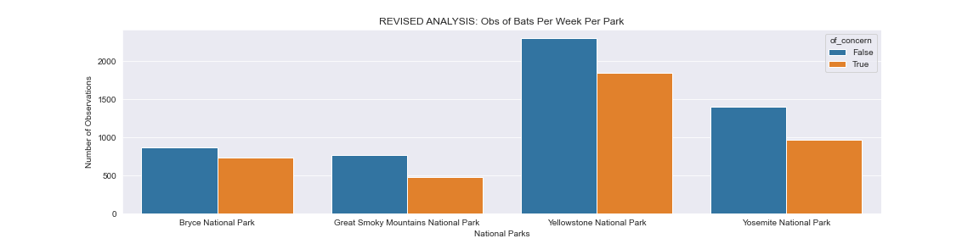
Analysis (cont.)
‘Bats’ are the most prevalent in the common names of species of Mammals. Note however that this only means that there are more common name that include the term ‘Bat’, but this does not mean that Bats are the most common species in itself.
Of the species with ‘Bat’ in their common name, they were most often observed in Yellowstone and species not any ‘of concern’ list were most observed. There may be more observations in Yellowstone simply because it is larger than the other parks. Also, it can be assumed that more ‘Not Endangered’ species would be more prevalent than those that are ‘Of Concern’.

Slide 7
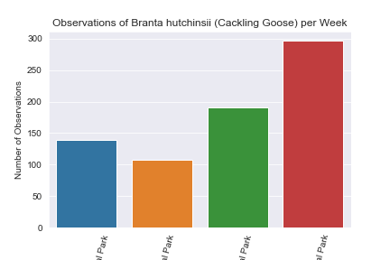
Analysis (cont.)
When analyzing the scientific names of species, Branta hutchinsii, the Cackling Goose, was the single species with the most observations at all parks.
As before, the most observations were recorded at Yellowstone.

Slide 8
Conclusions
For further research, it may be beneficial to included the size of the parks in the analysis.
Also, likewise with Bats it may be useful to explore the number of observations of other animal groups such as the Canis (wolves, foxes, coyotes, etc.) and Felis (cougars, lynx, etc.)
If specific endangered animals are specifically tracked over many years, the efficacy of protection efforts could be inferred.

