Slide 1
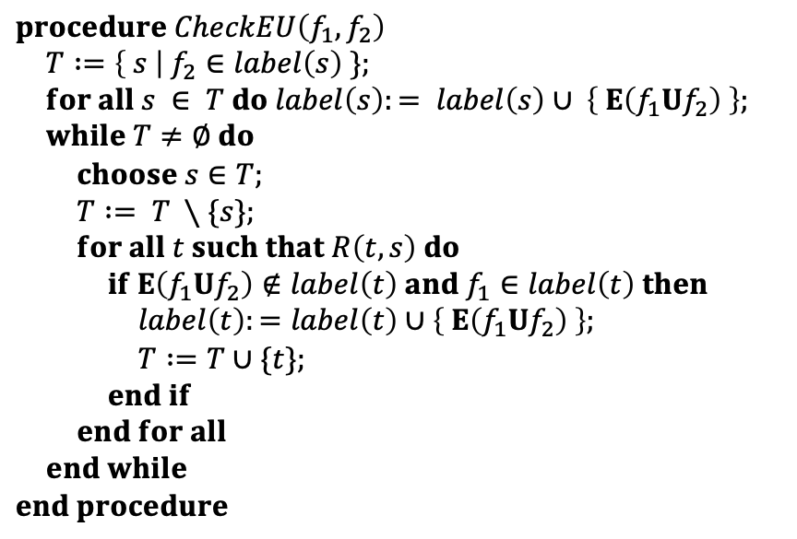
$$procedure CheckEU\left(f_{1},f_{2}\right)$$
$T :=\left\{ s \right| f_{2}∈label\left(s\right) \};$
$for all s ∈ T do label\left(s\right):= label\left(s\right)∪ \left\{ E\left(f_{1}Uf_{2}\right) \right\};$
$while T≠∅ do$
$choose s∈T;$
$T := T ∖\{s\};$ $for all t such that R\left(t,s\right) do$
$if E\left(f_{1}Uf_{2}\right)∉label\left(t\right) and f_{1}∈label\left(t\right) then$
$label\left(t\right):=label\left(t\right)∪\left\{ E\left(f_{1}Uf_{2}\right) \right\};$
$T :=T∪\{t\};$
$end if$
$end for all$
$end while$
$$end procedure$$

Slide 2
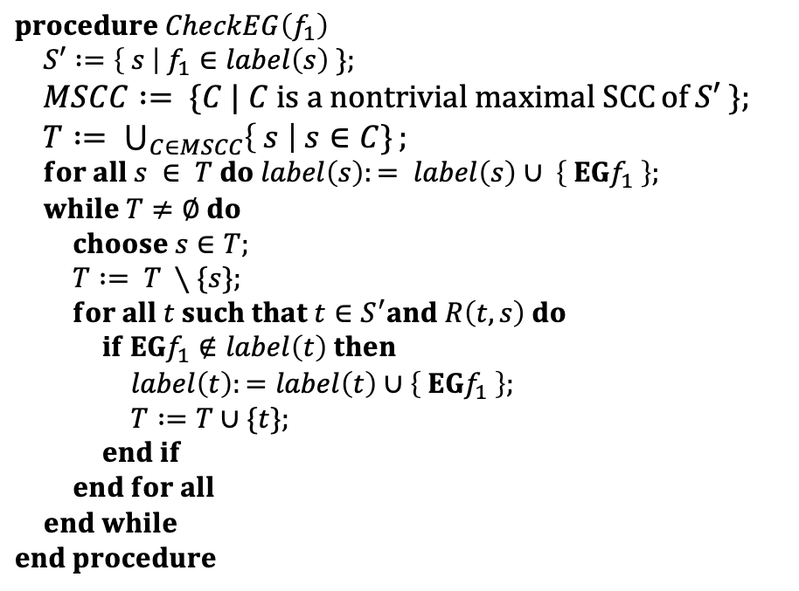
$$procedure CheckEG\left(f_{1}\right)$$
$S′ :=\left\{ s \right| f_{1}∈label\left(s\right) \};$
$MSCC := \{C | C is a nontrivial maximal SCC⁡of S′ \};$
$T := \bigcup_{C∈MSCC}{\left\{ s \right| s∈C\}};$ $for all s ∈ T do label\left(s\right):= label\left(s\right)∪ \left\{ EGf_{1} \right\};$
$while T≠∅ do$
$choose s∈T;$
$T := T ∖\{s\};$ $for all t such that t∈S^{′}and R\left(t,s\right) do$
$if EGf_{1}∉label\left(t\right) then$
$label\left(t\right):=label\left(t\right)∪\left\{ EGf_{1} \right\};$
$T :=T∪\{t\};$
$end if$
$end for all$
$end while$
$$end procedure$$

Slide 3
~Start
~Close
~Heat
~Error
start oven
open door
close door
open door
cook
Start
~Close
~Heat
Error
~Start
Close
~Heat
~Error
~Start
Close
Heat
~Error
done
open door
close door
reset
start oven
start cooking
Start
Close
~Heat
Error
Start
Close
~Heat
~Error
Start
Close
Heat
~Error
warmup

