Slide 1
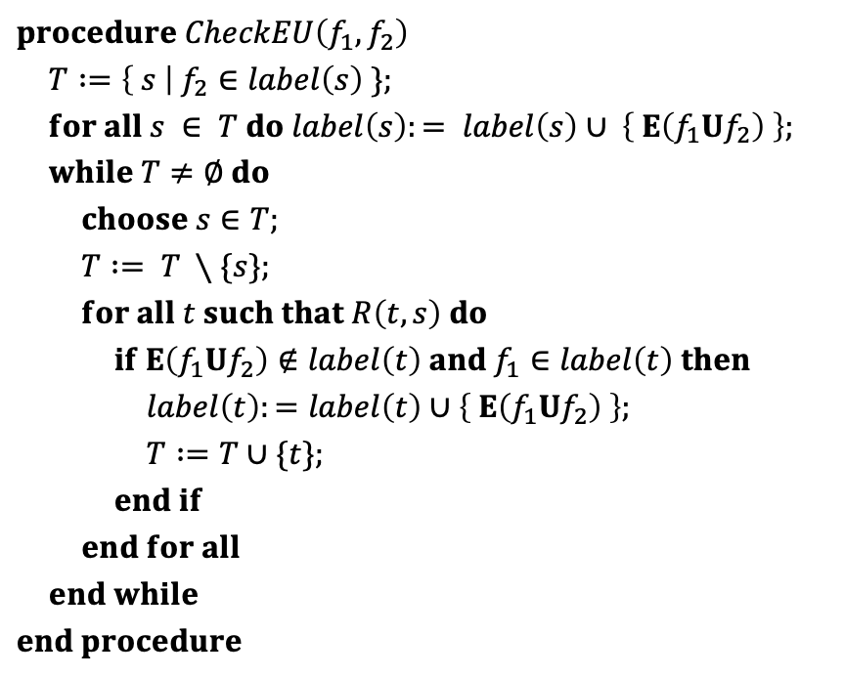
$$procedure CheckEU\left(f_{1},f_{2}\right)$$
$T :=\left\{ s \right| f_{2}∈label\left(s\right) \};$
$for all s ∈ T do label\left(s\right):= label\left(s\right)∪ \left\{ E\left(f_{1}Uf_{2}\right) \right\};$
$while T≠∅ do$
$choose s∈T;$
$T := T ∖\{s\};$ $for all t such that R\left(t,s\right) do$
$if E\left(f_{1}Uf_{2}\right)∉label\left(t\right) and f_{1}∈label\left(t\right) then$
$label\left(t\right):=label\left(t\right)∪\left\{ E\left(f_{1}Uf_{2}\right) \right\};$
$T :=T∪\{t\};$
$end if$
$end for all$
$end while$
$$end procedure$$

Slide 2
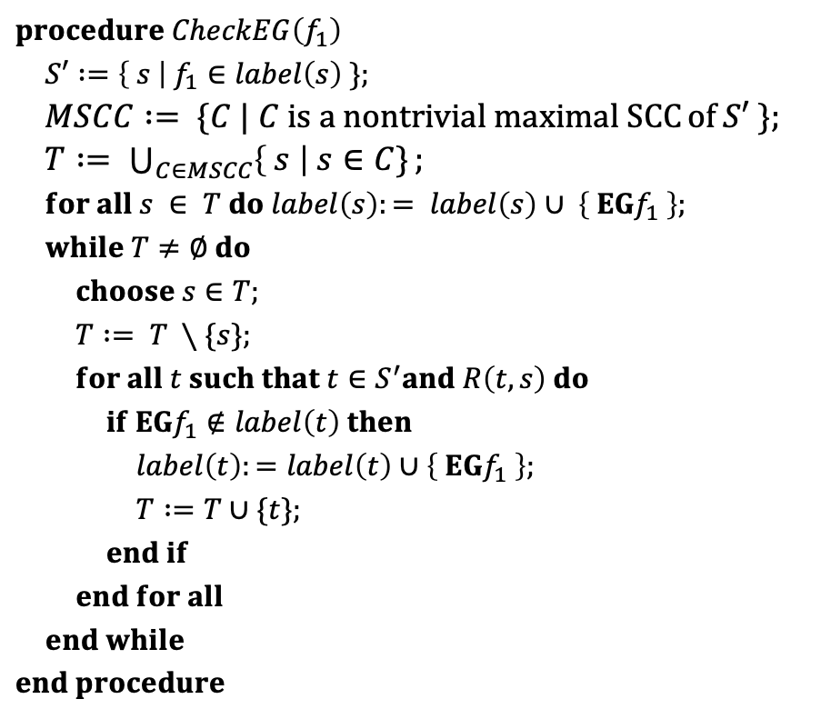
$$procedure CheckEG\left(f_{1}\right)$$
$S′ :=\left\{ s \right| f_{1}∈label\left(s\right) \};$
$MSCC := \{C | C is a nontrivial maximal SCC⁡of S′ \};$
$T := \bigcup_{C∈MSCC}{\left\{ s \right| s∈C\}};$ $for all s ∈ T do label\left(s\right):= label\left(s\right)∪ \left\{ EGf_{1} \right\};$
$while T≠∅ do$
$choose s∈T;$
$T := T ∖\{s\};$ $for all t such that t∈S^{′}and R\left(t,s\right) do$
$if EGf_{1}∉label\left(t\right) then$
$label\left(t\right):=label\left(t\right)∪\left\{ EGf_{1} \right\};$
$T :=T∪\{t\};$
$end if$
$end for all$
$end while$
$$end procedure$$

Slide 3
~Start
~Close
~Heat
~Error
start oven
open door
close door
open door
cook
Start
~Close
~Heat
Error
~Start
Close
~Heat
~Error
~Start
Close
Heat
~Error
done
open door
close door
reset
start oven
start cooking
Start
Close
~Heat
Error
Start
Close
~Heat
~Error
Start
Close
Heat
~Error
warmup

Slide 4
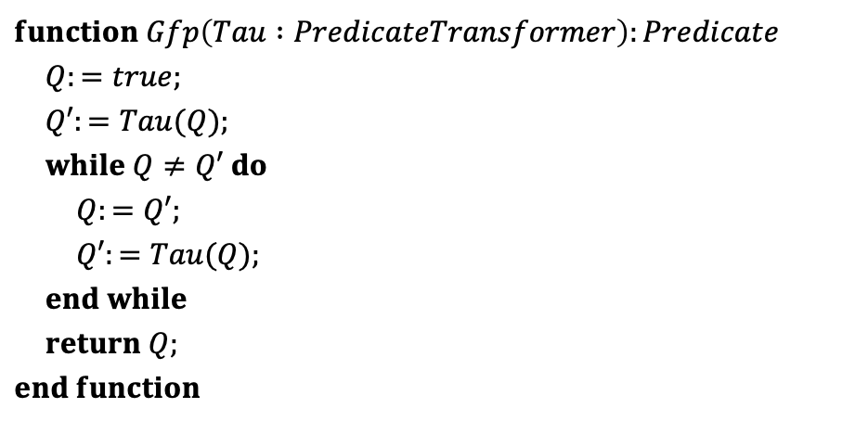
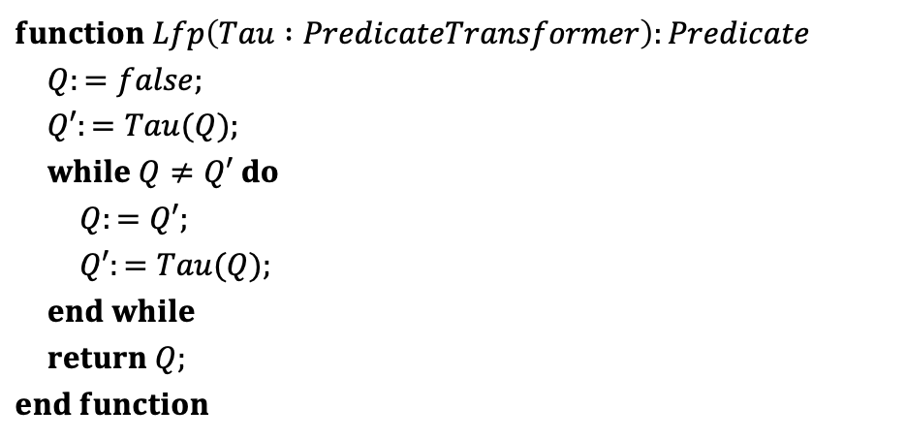
$$function Lfp\left(Tau :PredicateTransformer\right):Predicate$$
$Q:=false;$
$Q′:=Tau(Q);$
$while Q≠Q′ do$
$Q:=Q′;$
$Q′:=Tau(Q);$ $end while$
$return Q;$
$$end function$$
$$function Gfp\left(Tau :PredicateTransformer\right):Predicate$$
$Q:=true;$
$Q′:=Tau(Q);$
$while Q≠Q′ do$
$Q:=Q′;$
$Q′:=Tau(Q);$ $end while$
$return Q;$
$$end function$$

Slide 5



$$post\text{-}image(post\text{-}image\left(S_{0}\right))$$
$$post\text{-}image(S_{0})$$
$$S_{0}$$

Slide 6
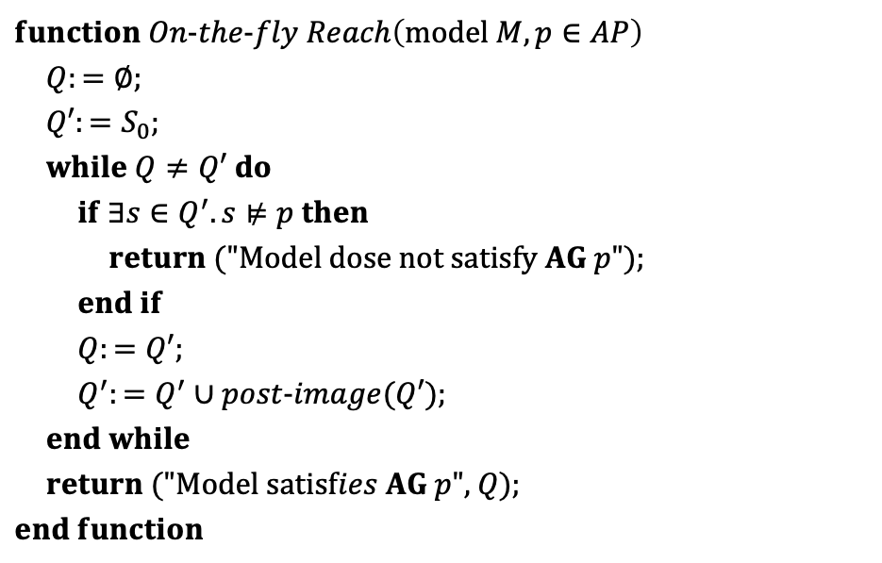
$$function On\text{-}the\text{-}fly Reach\left(\text{model} M, p∈AP\right)$$
$Q:=∅;$
$Q′:=S_{0};$
$while Q≠Q′ do$
$if ∃s∈Q^{′}.s⊭p then$
$return \text{(}\text{"}\text{Model} \text{dose} \text{not} \text{satisfy} AG p\text{"}\text{);}$
$end if$
$Q:=Q′;$
$Q^{′}:=Q^{′}∪post\text{-}image(Q′);$ $end while$
$return \text{("}\text{Model} \text{satisf}ies AG p\text{"}\text{, }Q\text{);}$
$$end function$$

Slide 7


















$$p$$
$$q$$
$$p$$
$$q$$
$$s0$$
$$p$$
$$s0$$
$$p$$
クリプキ構造
$$τ1(false)$$
$$p$$
$$q$$
$$p$$
$$q$$
$$s0$$
$$p$$
$$s0$$
$$p$$
$$τ2(false)$$
$$τ3(false)$$

