Slide 1

Prometheus Metrics and Labeling Best Practices

Slide 2
Use labels to add meaningful information
labels are used to provide additional context and meaning to metrics. By adding labels to a metric, you can add more information to each data point, making it easier to query and analyse your data. For example, suppose you have a metric that measures the number of requests per second. Adding labels such as "environment" (e.g., production or staging) and "service" (e.g., web server or database) can help you quickly identify where the requests are coming from and what services they are targeting.
It's important to keep label names consistent across all metrics in your system, so that you can easily query and compare data points between different metrics. Additionally, you should try to keep label names short but descriptive, so that they are easy to read and understand. By using labels effectively, you can make it much easier to understand the behavior of your system and to diagnose and resolve issues as they arise.

Slide 3
Avoid using labels for dimensions with high cardinality
Labels are used to identify and group metrics, but when labels have high cardinality (i.e., many different values), it can lead to a large number of time series being created in the Prometheus database. This can cause performance issues as well as making it difficult to query for specific data points.
To avoid this issue, try to use labels only for dimensions (specific attributes or characteristics of a metric) with low cardinality. For example, if you’re monitoring web servers, you could label them by environment (production, staging, etc.), rather than labels for dimensions with high cardinality, such as server hostnames or process IDs.

Slide 4
An increase in cardinality means you now need more infrastructure and compute to store and process these time series. This in turn has a direct impact on how much you spend on your observability platform. Recently this has been top of mind for operators and centralized observability teams. It also impacts the performance of your observability platform itself. As your database grows, so does the number of time series accessed on any given queries, which can radically slow down your system when you query or visualize the data. Dashboards that are slow to load or queries that are slow to return data prolong MTTR(Mean Time To Repair, which is a metric used to measure the average amount of time it takes to repair a failed system or component. ) when troubleshooting outages. Note: The advantage of using a cloud native observability platform, like Grafana Cloud, which is powered by the most scalable time series database Grafana Mimir, is that you won’t experience these performance issues as your count of time series increases (https://grafana.com/blog/2022/10/20/how-to-manage-high-cardinality-metrics-in-prometheus-and-kubernetes/)

Slide 5
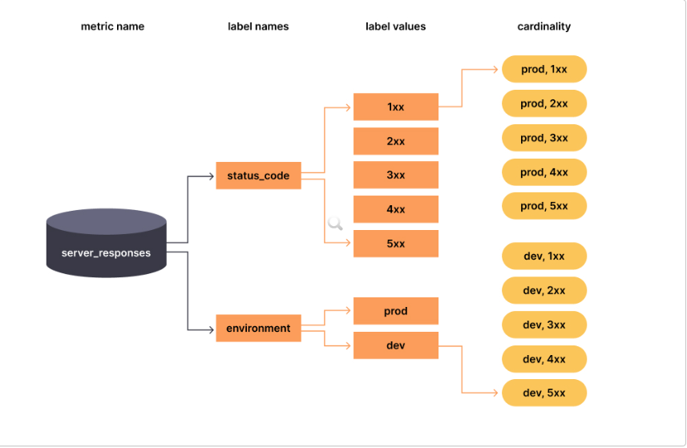

Slide 6
Keep your metric and label names short but descriptive
Prometheus labels are used to identify and group metrics, so it’s important that they be easy to read and understand. If your metric or label names are too long, they can become difficult to parse and interpret. Additionally, longer names take up more space in the Prometheus database, which can lead to slower query performance.
To ensure your metric and label names are short but descriptive, use abbreviations when possible and avoid using overly complex words. This will help make sure your labels are both readable and concise.
Must have a single unit (i.e. do not mix seconds with milliseconds, or seconds with bytes).

Slide 7
Use consistent naming conventions across all metrics
When you use consistent naming conventions, it makes it easier to query and analyse your metrics. For example, if all of your labels have the same prefix or suffix, then you can easily filter out specific metrics with a single query. This also helps when creating dashboards since you don’t need to manually enter each label name.
Additionally, using consistent naming conventions across all metrics ensures that everyone in your organization is on the same page when it comes to understanding what each metric means. This reduces confusion and allows for more efficient collaboration between teams.
http_request_duration_seconds
node_memory_usage_bytes
http_requests_total
process_cpu_seconds_total

Slide 8
Don’t use underscores or dots at the start of metric or label names
When choosing label names, it's generally recommended to use lowercase letters and separate words with underscores, as this is a common convention in the Prometheus ecosystem. For example, if you have a metric that tracks the response time of a web application endpoint you could use the label: http_request_duration_seconds
Using underscores in label names helps make them more readable and easier to understand, especially if they contain multiple words. However, it's important to note that label names should not start with an underscore or a dot, as these characters have special meanings in Prometheus and can cause issues with certain tools and queries.

Slide 9
Only use allowed characters in metric and label names
Prometheus labels are used to identify and group metrics, so it’s important that they are consistent and easy to read. Allowed characters include alphanumeric characters (A-Z, 0-9), underscores (_), dots (.) and colons (:). Unallowed characters include spaces, hyphens (-), and other special characters.
Using only allowed characters in metric and label names helps ensure consistency across your Prometheus environment.

Slide 10
Avoid using reserve label names
Prometheus has several reserved label names that have special meanings, such as "job", "instance", and "quantile". For example, the "job" label is used to identify a specific target that is being monitored, and the "instance" label is used to identify a specific instance of a target (such as a particular process or container). If you use these reserved label names for your own labels, it can cause conflicts and confusion when working with your metrics.

