Slide 1

Monitoring Tools

Slide 2
Deciding on a Monitoring Tool
When picking a monitoring tool, there are several factors you should consider to ensure that it meets your specific needs. Some of the most important factors to consider include: Type of system, Ease of use, Scalability, Alerting capabilities, Data Retention Integrations, Community Support and Cost.
Here's how Prometheus stacks up against each of the factors above:
Type of system: Prometheus is a good fit for monitoring a wide range of systems, including servers, containers, and cloud services. It can also be used to monitor specific components such as databases, middleware, and network devices. Not suitable for monitoring Infrastructure components
Ease of use: Prometheus has a relatively simple installation process, and its configuration language is designed to be user-friendly. However, some users may find a steep learning curve for advanced features like alerting and recording rules.

Slide 3
Scalability: Prometheus is designed to be highly scalable and can handle large-scale deployments. However, it does require additional configuration and setup when used in a high-availability setup.
Alerting capabilities: Prometheus has Alertmanaager, a powerful alerting systerm, that can send notifications to a range of services, including email, Slack, and PagerDuty. However, some users may find the alerting rules configuration to be complex.
Data retention: By default, Prometheus has a limited data retention period, which can be a problem if you need to keep data for longer periods or for compliance purposes. Retention period and amount of data to retain is configureable. However, users may need to scale storage resources as the amount of data grows.
Integrations: Prometheus has a large number of integrations with other tools and services, including Grafana for visualization, Alertmanager for alerting, and Kubernetes for container orchestration.
Community support: Prometheus has a large and active community of users and developers, which provides a wealth of knowledge and support.
Cost: Prometheus is open-source software and is free to use, making it a cost-effective solution for many organizations.

Slide 4
When does it fit?
Monitoring cloud-native applications: Prometheus is well-suited for monitoring cloud-native applications and microservices architectures. It can be used to monitor both containerized and non-containerized workloads, and provides robust support for Kubernetes.
Monitoring infrastructure: Prometheus is also a good fit for monitoring infrastructure components such as servers, databases, and network devices. It can collect and aggregate metrics from a variety of sources, and provides a flexible query language for analyzing and visualizing this data.
Scaling monitoring: If you need to scale your monitoring solution to handle a large number of systems, Prometheus can help. It is designed to be highly scalable and can handle large-scale deployments with millions of metrics.
Custom metrics: If you have custom metrics that you need to monitor, Prometheus provides a flexible and extensible data model that can handle a wide range of data types. It also has a large and active community that has developed many integrations and libraries for working with different data sources.

Slide 5
When does it not fit?
Legacy systems: If you are monitoring legacy systems that do not provide metrics in a format that Prometheus can understand, you may need to consider a different monitoring tool. In this case, you may need to use a tool that can collect metrics through other means, such as log files or SNMP.
Real-time analytics: While Prometheus can provide near real-time monitoring, it is not designed for real-time analytics or complex event processing. If you need to perform complex analytics on your data in real time, you may need to consider a more specialized tool.
Distributed systems with high cardinality: While Prometheus is highly scalable, it may struggle with distributed systems with a high number of unique metrics, also known as high cardinality. In this case, you may need to consider a different monitoring tool that can handle this level of complexity.
Large-scale enterprise deployments: While Prometheus is highly scalable, large-scale enterprise deployments may require a more comprehensive monitoring solution that can handle a wide range of systems, services, and applications.
Monitoring infrastructure components: Lacks support for some essential features of infrastructure monitoring, such as automatic discovery of devices, device status polling, and SNMP support.

Slide 6
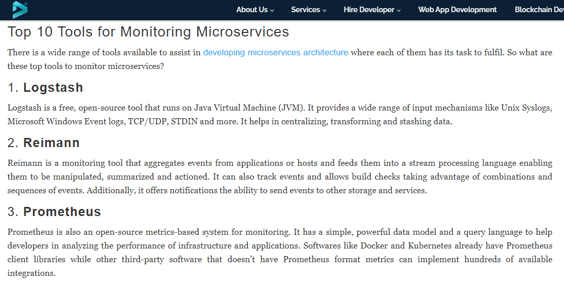
Recommendations: DecipherZone

Slide 7
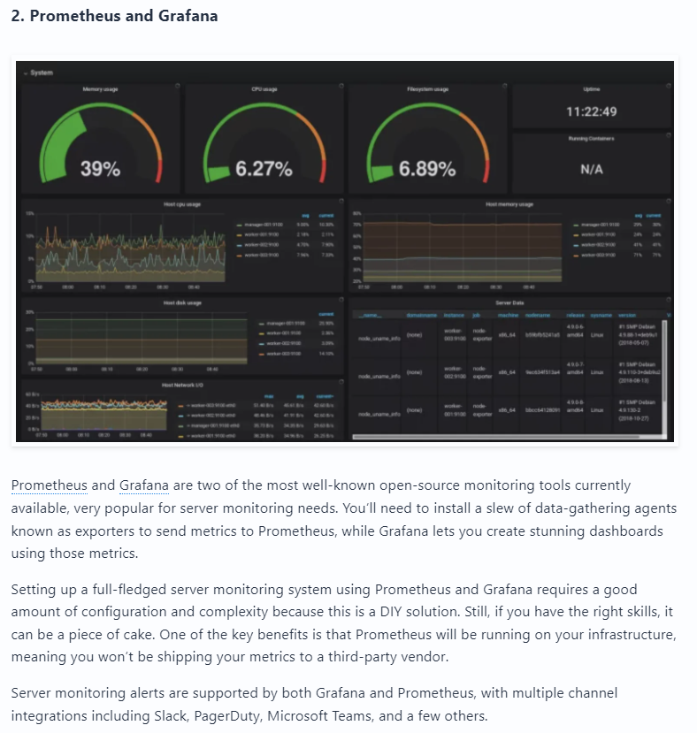
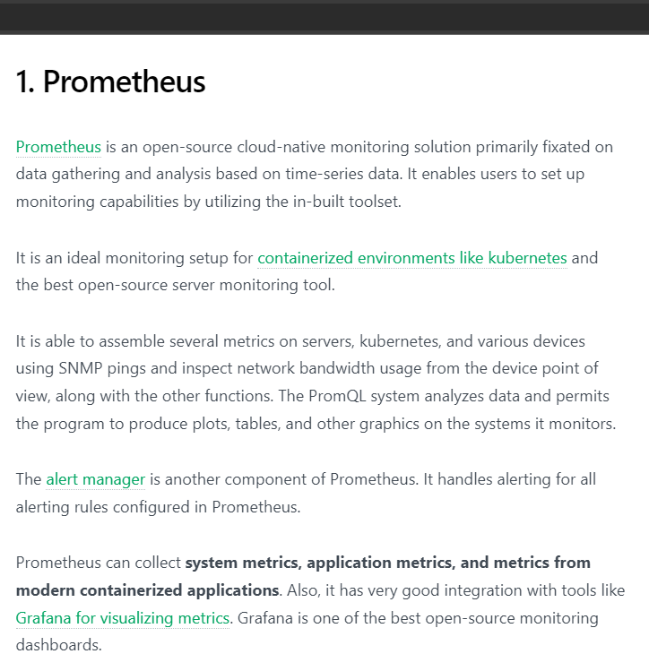
Sematext DevOps Cube
*Sematext Number 1

Slide 8
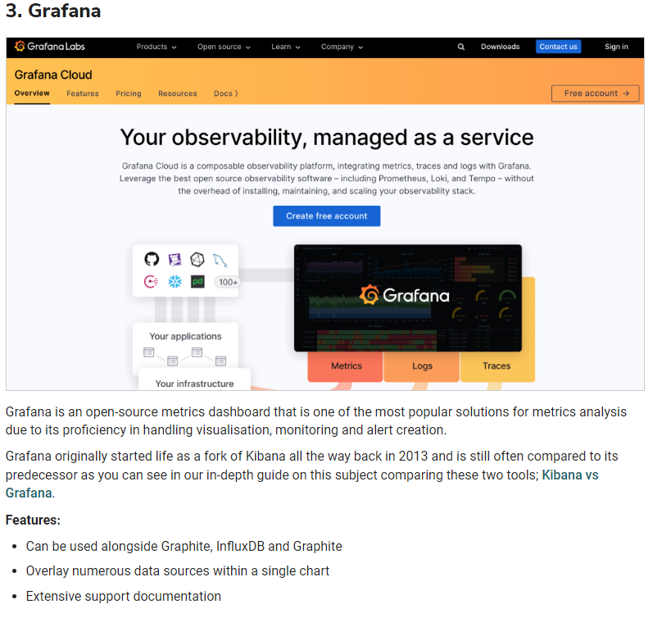
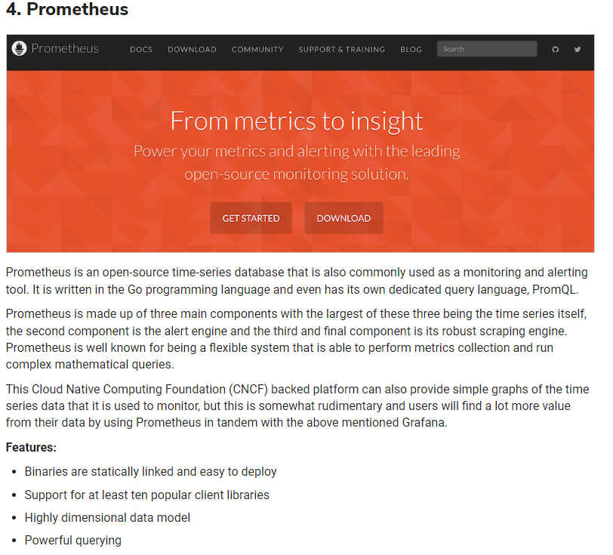
Logit.io

Slide 9
(February 2023) DB-Engines Ranking of Time Series DBMS
Popularity Rank | DBMS | Database Model | Score
1 | InfluxDB | Time Series, Multi-Model | 29.44
2 | Kdb | Time Series, Multi-Model | 7.31
3 | Prometheus | Time Series | 7.06
4 | Graphite | Time Series | 6.75
5 | TimescaleDB | Time Series, Multi-Model | 4.51
12 | QuestDB | Time Series, Multi-Model | 1.95
*Popularity rank is measured by the following parameters: Number of mentions of the system on websites, general interest in the system, frequency of technical discussions about the system, number of job offers in which the system is mentioned, number of profiles in professional networks, in which the system is mentioned and relevance in social networks.

Slide 10
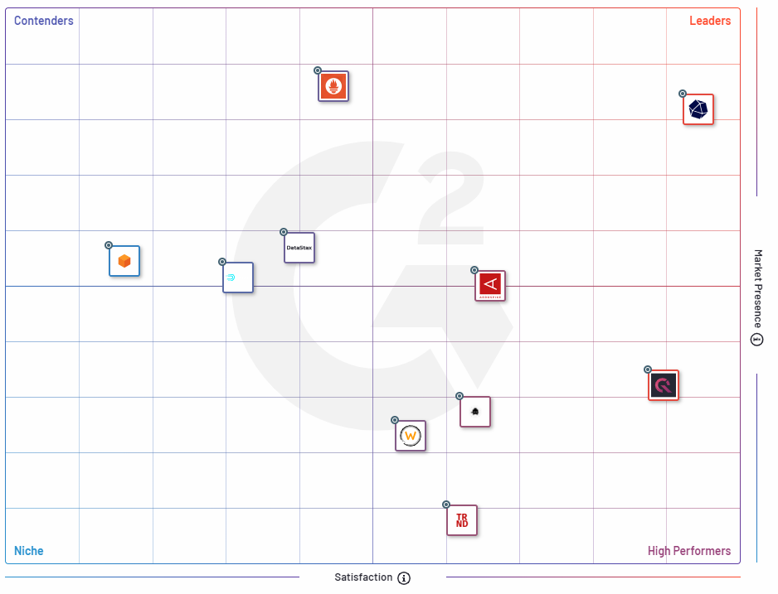
G2 Grid for Time Series Databases
*Based on reviews gathered from their user community , as well as data aggregated from online sources and social networks.
Summary
Influx DB seems to be the leader
Prometheus is the most used database but satisfaction levels are average
QuestDB is one of the best performers but is not popular choice by companies.

Slide 11
Prometheus V Alternatives (StackShare)
Tool | Stacks | Followers | Votes | GitHub Stars
Prometheus | 3.4k | 3.5k | 239 | 46.6k
InfluxDB | 971 | 1.1k | 172 | N/A
Nagios | 815 | 1k | 102 | 59
Graphite | 387 | 411 | 42 | 5.6k
TimeScaleDB | 195 | 336 | 41 | 14.5k
Sensu | 202 | 243 | 55 | 2.9k
OpenTSDB | 30 | 66 | 0 | 4.8k
OpenTelemetry | 96 | 100 | 1 | N/A
QuestDB | 17 | 45 | 17 | 10.1k

Slide 12
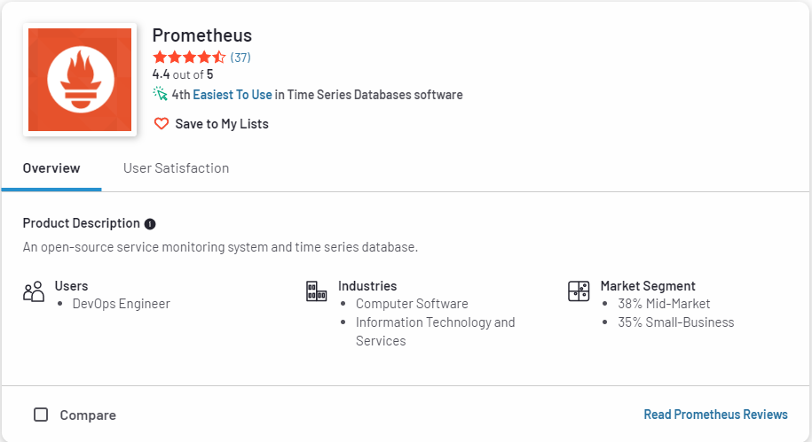
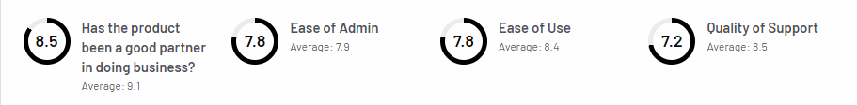
Prometheus Overview (G2)

Slide 13
Prometheus V InfluxDB
There are many similarities between the systems. If monitoring is what you’re most interested in, Prometheus is your safest bet because of its many integrations and scalable model. If you’re more likely to be using a time series database for IoT, sensors, or analytics, then you’ll probably want to choose InfluxDB.
Where InfluxDB is better:
If you're doing event logging.
Commercial option offers clustering for InfluxDB, which is also better for long term data storage.
Eventually consistent view of data between replicas.
Where Prometheus is better:
If you're primarily doing metrics.
More powerful query language, alerting, and notification functionality.
Higher availability and uptime for graphing and alerting.

Slide 14
Prometheus V Graphite
Graphite is merely a storage and graphing framework while Prometheus is a complete monitoring system.
Where Graphite is better:
If you want a clustered solution that can hold historical data of any sort long term.
May be preferred if your existing infrastructure already uses collection tools like fluentd, collectd, or statd, because Graphite supports them.
Where Prometheus is better:
Offers a richer data model and query language, in addition to being easier to run and integrate into your environment.
There is a slightly longer learning curve with Prometheus. However, the time invested will pay for itself in not having to maintain separate tools for collection and alerting, for example.

Slide 15
Prometheus V OpenTelemetry
Where OpenTelemetry is better:
OpenTelemetry client libraries provide a one-stop solution to generate logs, metrics, and traces. Prometheus can only generate metrics.
OpenTelemetry provides the fundamental layer to build your observability practices, which is now critical for microservices-based architecture. If you use Prometheus in your observability stack, you will have to select other tools for traces and logs.
OpenTelemetry is a more expansive and flexible standard.
Where Prometheus is better:
Prometheus provides short-term storage, and users can use solutions like Cortex or Thanos for long-term data storage. OpenTelemetry does not provide any storage solution. It provides exporters which can be configured to send data to a backend analysis tool of your choice.
Prometheus will give you a battle-tested system.
Good choice if you're looking for a robust, easy-to-use system for monitoring and alerting.

