Slide 1


Slide 2
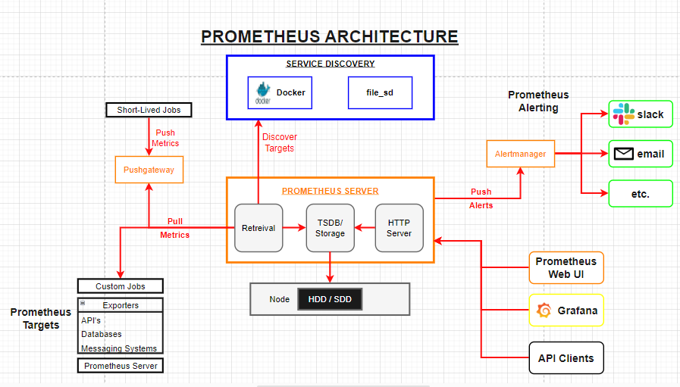

Slide 3
Prometheus Server
Divided into 3 Parts: Retrieve, Storage, HTTP
RETRIEVE: Responsible for gathering metrics from any system or applications. This process is known as scraping. The date is then kept in storage. The scrape interval can be configured to set how often Prometheus retrieves metrics.
STORAGE: All the metrics it retrieves are stored in a local database, either in HDD (Hard Disk Drive) or SSD (Solid-State Drive). Prometheus uses a custom database called TSDB (Time Series Database) that is optimized for storing and querying time series data. Prometheus also allows users to configure retention policies, which determine how long data will be stored in the database.
HTTP SERVER: Responsible for providing a web interface for querying and analyzing the metrics stored in the TSDB. It allows users to access the stored metrics using the PromQL query language and HTTP APIs. Prometheus can be configured to provide authentication and authorization mechanisms to limit access to its API and web interface.

Slide 4
Prometheus – Pull Metrics
Most monitoring services use push metrics to gather data. However, Prometheus uses pull metrics (scraping).
A Prometheus server pulls from two endpoints. (Targets & Push gateway)
A target refers to an endpoint that exposes metrics in a format that Prometheus can scrape. Targets can be custom jobs, other Prometheus servers and exporters. E.g. APIs, Databases, Messaging systems etc.
Push Gateway is a simple service that allows to push metrics to Prometheus from short-lived jobs. It acts as a buffer between the short-lived jobs and Prometheus. The gateway receives metrics from the jobs and stores them until they are scraped by the Prometheus server. E.g. A script that runs once a day to process data and generate a report.

Slide 5
Pull Metrics
ADVANTAGES | DISADVANTAGES
Flexibility: Prometheus can scrape metrics from a wide variety of systems, and the configuration can be easily updated to add or remove targets as needed. | Latency: The pull model can introduce some latency into the system, as Prometheus must wait for the next scrape interval to collect metrics from the target.
Decoupling: Server is decoupled from the systems it's monitoring. Prometheus can be easily updated, maintained or replaced without affecting the monitored systems.. | Limited scalability: Pulling metrics can become less efficient as the number of targets increases, Prometheus must scrape metrics from more targets.
Efficient: Prometheus can scrape metrics from multiple targets in parallel (same-time).

Slide 6
Service Discovery
The process of automatically discovering and configuring targets to scrape metrics from.
Useful when the list of targets is dynamic, for example, when new targets are added or removed frequently.
Makes the monitoring process more dynamic and efficient. Additionally, it makes it easier to scale the monitoring system.
Prometheus supports several service discovery mechanisms, such as: File-based, DNS-based, Docker API, Kubernetes, Consul and EC2.

Slide 7
Data Visualization
Process of converting raw data into visual representations, such as charts, graphs, and maps.
Prometheus allows for many visualization tools to be used. These include the Prometheus Web UI, Grafana & API Clients.
Visualization tools send a HTTP request to the Prometheus server, specifying the query in the PromQL query language.
Prometheus processes the query and returns the results in a format such as JSON, which can be easily parsed and visualized by the visualization tool.

Slide 8
Alert Manager
Responsible for handling and routing alerts.
It receives alerts from the Prometheus server, and it is responsible for deduplicating, grouping, and routing them to the appropriate receiver such as email, PagerDuty, Slack and more.
Alerts can be routed to different receivers based on the labels of the alerts defined by routing rules.
Alerts can be configured to be sent based on certain conditions, such as when a metric exceeds a certain threshold or when a metric is missing by configuring alerting rules.
Can be integrated with other systems, such as Grafana, which allows to create alerting panels in Grafana and show the status of the alerts.

Slide 9
RabbitMQ Clustering
RabbitMQ clustering is a feature that allows multiple RabbitMQ nodes to be connected together to form a single logical broker. This allows for increased scalability, availability, and fault tolerance.
When a RabbitMQ cluster is formed, each node in the cluster is aware of the other nodes and automatically synchronizes its state with them. This means that messages, exchanges, queues, and other objects that are created on one node are automatically propagated to the other nodes in the cluster.
If one node in the cluster goes down, the other nodes continue to operate and the queues and messages on the failed node are automatically failed over to other nodes in the cluster. This allows for a higher level of availability and fault tolerance, as the messaging system can continue to operate even if one or more nodes go down.

Slide 10
Additionally, clustering allows for increased scalability as more nodes can be added to the cluster to handle increased load.
A cluster of RabbitMQ can be created by configuring multiple nodes to use the same cookie and then joining them together. The cookie is a shared secret that allows nodes to authenticate each other. Once the nodes are joined together, they form a cluster and start to replicate data between them.
Prometheus and RabbitMQ can be used together in a clustered configuration to provide increased scalability and reliability. By clustering Prometheus, multiple instances of the software can work together to scrape metrics from a larger number of sources. This allows for a higher level of availability and fault tolerance, as if one instance goes down, others can continue to scrape metrics and keep the monitoring system running.

Slide 11
Types of clustering
Master-slave clustering: In this configuration, one node acts as the master and handles all incoming connections and messages, while the other nodes act as slaves and replicate the master's state. This configuration provides increased availability, as the slaves can take over if the master goes down.
Peer-to-peer clustering: In this configuration, all nodes are equal and handle connections and messages independently. This allows for load balancing and increased scalability, but does not provide the same level of availability as master-slave clustering.
Distributed queues: In this configuration, queues are mirrored across multiple nodes in the cluster, allowing for increased availability and fault tolerance. This can be used in combination with either master-slave or peer-to-peer clustering.
Shovels and Federation: These are plugins that allow for messages to be moved between clusters or to external systems, providing an additional layer of scalability and flexibility.
High-Availability Queues: These queues ensure that messages are never lost even in case of node failure. This type of clustering is also known as "Active-Passive" clustering as it gives active-passive replication of queues.

Slide 12
Clustering v Non-Clustering
ADVANTAGES | DISADVANTAGES
Scalability: Additional nodes can be added to a cluster to handle increased workloads. | Complexity: Clustering can add complexity to the system, as it requires additional infrastructure and coordination between nodes.
High availability: Clustering can provide redundancy and failover capabilities. | Increased hardware costs: Clustering requires multiple nodes, which can increase hardware costs.
Load balancing: Distribute the workload across multiple nodes, which can improve performance and reduce the risk of bottlenecks. | Single point of failure: A failure in a shared component, such as a load balancer or shared storage, can take the entire cluster down.

Slide 13
When not to use
Monitoring systems with high-frequency metrics: Prometheus is designed to handle metrics with lower frequency. This can cause issues with the storage and querying of metrics.
Monitoring systems that need real-time metrics: Prometheus is designed to scrape metrics at a regular interval. Not ideal as it can introduce some latency into the system.
Monitoring systems that have strict data retention requirements: Prometheus is designed to retain data for a certain period. It may not support the required data retention policy.
Monitoring of systems that have strict data compliance requirements: Prometheus is an open-source software and may not meet strict data compliance requirements, such as GDPR or HIPAA.

Slide 14
Summary
Prometheus is an open-source monitoring and alerting system
Prometheus uses a pull-based model to collect metrics from targets
Prometheus uses the PromQL query language to query and aggregate metrics
Prometheus has built-in service discovery mechanisms to automatically discover new targets
Prometheus has a built-in web interface for data visualization and alerting
Prometheus can be integrated with other visualization and alerting tools, such as Grafana
Prometheus may not be the best choice when monitoring systems with high-frequency or real time metrics.

Slide 15
FAQs
High Frequency systems - The size of the system that it can handle depends on various factors, such as the hardware resources available, the frequency of data collection, and the number of metrics. According to the Prometheus FAQ page, Prometheus can handle tens of millions of active series.
FAQ | Prometheus

Slide 16
Ibrahim Khalid Joseph Diggins
THANK YOU

