Slide 1
CS 145 Final Review
Final Review
The Best Of Collection (Master Tracks), Vol. 2

Slide 2
Course Summary
Lecture 17 > Section 3
1. Intro
2-3. SQL
4. ER Diagrams
5-6. DB Design
7-8. TXNs
11-12. IO Cost
14-15. Joins
16. Rel. Algebra
We learned…
How to design a database
How to query a database, even with concurrent users and crashes / aborts
How to optimize the performance of a database
We got a sense (as the old joke goes) of the three most important topics in DB research:
Performance, performance, and performance

Slide 3
Course Summary
Lecture 17 > Section 3
1. Intro
2-3. SQL
4. ER Diagrams
5-6. DB Design
7-8. TXNs
11-12. IO Cost
14-15. Joins
16. Rel. Algebra
We learned…
How to design a database
How to query a database, even with concurrent users and crashes / aborts
How to optimize the performance of a database
We got a sense (as the old joke goes) of the three most important topics in DB research:
Performance, performance, and performance

Slide 4
Course Summary
Lecture 17 > Section 3
1. Intro
2-3. SQL
4. ER Diagrams
5-6. DB Design
7-8. TXNs
11-12. IO Cost
14-15. Joins
16. Rel. Algebra
We learned…
How to design a database
How to query a database, even with concurrent users and crashes / aborts
How to optimize the performance of a database
We got a sense (as the old joke goes) of the three most important topics in DB research:
Performance, performance, and performance

Slide 5
Course Summary
Lecture 17 > Section 3
1. Intro
2-3. SQL
4. ER Diagrams
5-6. DB Design
7-8. TXNs
11-12. IO Cost
14-15. Joins
16. Rel. Algebra
We learned…
How to design a database
How to query a database, even with concurrent users and crashes / aborts
How to optimize the performance of a database
We got a sense (as the old joke goes) of the three most important topics in DB research:
Performance, performance, and performance

Slide 6
High-level: Disk vs. Main Memory
Lecture 7 > Section 3 > Our model
Disk:
Slow
Sequential access
(although fast sequential reads)
Durable
We will assume that once on disk, data is safe!
Cheap
Cylinder
Spindle
Disk head
Tracks
Sector
Arm movement
Platters
Arm assembly

Slide 7
Lecture 7 > Section 3 > Our model
High-level: Disk vs. Main Memory
Random Access Memory (RAM) or Main Memory:
Fast
Random access, byte addressable
~10x faster for sequential access
~100,000x faster for random access!
Volatile
Data can be lost if e.g. crash occurs, power goes out, etc!
Expensive
For $100, get 16GB of RAM vs. 2TB of disk!

Slide 8
Transactions: Basic Definition
Lecture 7 > Section 1 > Transactions Basics
A transaction (“TXN”) is a sequence of one or more operations (reads or writes) which reflects a single real-world transition.
In the real world, a TXN either happened completely or not at all
START TRANSACTION
UPDATE Product SET Price = Price – 1.99 WHERE pname = ‘Gizmo’
COMMIT

Slide 9
Motivation for Transactions
Lecture 7 > Section 1 > Motivation
Grouping user actions (reads & writes) into transactions helps with two goals:
Recovery & Durability: Keeping the DBMS data consistent and durable in the face of crashes, aborts, system shutdowns, etc.
Concurrency: Achieving better performance by parallelizing TXNs without creating anomalies
This lecture!
Next lecture

Slide 10
Transaction Properties: ACID
Lecture 7 > Section 2
Atomic
State shows either all the effects of txn, or none of them
Consistent
Txn moves from a state where integrity holds, to another where integrity holds
Isolated
Effect of txns is the same as txns running one after another (ie looks like batch mode)
Durable
Once a txn has committed, its effects remain in the database
ACID continues to be a source of great debate!

Slide 11
Basic Idea: (Physical) Logging
Lecture 7 > Section 3 > Motivation & basics
Record UNDO information for every update!
Sequential writes to log
Minimal info (diff) written to log
The log consists of an ordered list of actions
Log record contains:
<XID, location, old data, new data>
This is sufficient to UNDO any transaction!
Notes:
7

Slide 12
Why do we need logging for atomicity?
Lecture 7 > Section 3 > Motivation & basics
Couldn’t we just write TXN to disk only once whole TXN complete?
Then, if abort / crash and TXN not complete, it has no effect- atomicity!
With unlimited memory and time, this could work…
However, we need to log partial results of TXNs because of:
Memory constraints (enough space for full TXN??)
Time constraints (what if one TXN takes very long?)
We need to write partial results to disk!
…And so we need a log to be able to undo these partial results!
Notes:
7

Slide 13
Transaction Commit Process
Lecture 7 > Section 3 > Logging commit protocol
FORCE Write commit record to log
All log records up to last update from this TX are FORCED
Commit() returns
Transaction is committed once commit log record is on stable storage

Slide 14
Write-ahead Logging (WAL) Commit Protocol
Lecture 7 > Section 3 > Logging commit protocol
This time, let’s try committing after we’ve written log to disk but before we’ve written data to disk… this is WAL!
T: R(A), W(A)
A: 0→1
Main Memory
T
A=1
Log
B=5
OK, Commit!
If we crash now, is T durable?
Data on Disk
Log on Disk
A=0

Slide 15
Write-ahead Logging (WAL) Commit Protocol
Lecture 7 > Section 3 > Logging commit protocol
This time, let’s try committing after we’ve written log to disk but before we’ve written data to disk… this is WAL!
T: R(A), W(A)
T
Main Memory
OK, Commit!
A: 0→1
If we crash now, is T durable?
Data on Disk
Log on Disk
A=0
A=1
USE THE LOG!

Slide 16
Write-Ahead Logging (WAL)
Lecture 7 > Section 3 > Logging commit protocol
DB uses Write-Ahead Logging (WAL) Protocol:
Must force log record for an update before the corresponding data page goes to storage
Must write all log records for a TX before commit
Each update is logged! Why not reads?
→ Atomicity
→ Durability

Slide 17
Why Interleave TXNs?
Lecture 8 > Section 1 > Interleaving & scheduling
Interleaving TXNs might lead to anomalous outcomes… why do it?
Several important reasons:
Individual TXNs might be slow- don’t want to block other users during!
Disk access may be slow- let some TXNs use CPUs while others accessing disk!
All concern large differences in performance

Slide 18
Scheduling Definitions
Lecture 8 > Section 1 > Interleaving & scheduling
A serial schedule is one that does not interleave the actions of different transactions
A and B are equivalent schedules if, for any database state, the effect on DB of executing A is identical to the effect of executing B
A serializable schedule is a schedule that is equivalent to some serial execution of the transactions.
The word “some” makes this definition powerful & tricky!

Slide 19
Conflict Types
Lecture 8 > Section 1 > Interleaving & scheduling
Two actions conflict if they are part of different TXNs, involve the same variable, and at least one of them is a write
Thus, there are three types of conflicts:
Read-Write conflicts (RW)
Write-Read conflicts (WR)
Write-Write conflicts (WW)
Why no “RR Conflict”?
Interleaving anomalies occur with / because of these conflicts between TXNs (but these conflicts can occur without causing anomalies!)
See next section for more!

Slide 20
Conflicts
Lecture 8 > Section 2 > Conflict Serializability
Two actions conflict if they are part of different TXNs, involve the same variable, and at least one of them is a write
T₁
R(A)
W(A)
R(B)
W(B)
W-W Conflict
T₂
W-R Conflict
R(A)
W(A)
R(B)
W(B)

Slide 21
Conflicts
Lecture 8 > Section 2 > Conflict Serializability
Two actions conflict if they are part of different TXNs, involve the same variable, and at least one of them is a write
T₁
R(A)
W(A)
R(B)
W(B)
T₂
R(A)
W(A)
R(B)
W(B)
All “conflicts”!

Slide 22
Conflicts
Lecture 8 > Section 2 > Conflict Serializability
Two actions conflict if they are part of different TXNs, involve the same variable, and at least one of them is a write
T₁
W(A)
W(B)
T₂
W(A)
W(B)
All “conflicts”!

Slide 23
Lecture 8 > Section 2 > Conflict Serializability
What can we say about “good” vs. “bad” conflict graphs?
Serial Schedule:
Interleaved Schedules:
T₁
T₂
T₁
T₂
X
Simple!
T₁
T₂
Theorem: Schedule is conflict serializable if and only if its conflict graph is acyclic

Slide 24
DAGs & Topological Orderings
Lecture 8 > Section 2 > Topological orderings
Ex: What is one possible topological ordering here?
0
1
There is none!
2
3

Slide 25
Strict Two-phase Locking (Strict 2PL) Protocol:
Lecture 8 > Section 2 > Strict 2PL
TXNs obtain:
An X (exclusive) lock on object before writing.
If a TXN holds, no other TXN can get a lock (S or X) on that object.
An S (shared) lock on object before reading
If a TXN holds, no other TXN can get an X lock on that object
All locks held by a TXN are released when TXN completes.
Note: Terminology here- “exclusive”, “shared”- meant to be intuitive- no tricks!

Slide 26
Picture of 2-Phase Locking (2PL)
Lecture 8 > Section 2 > Strict 2PL
# Locks the TXN has
Lock Acquisition
Lock Release
On TXN commit!
0 locks
Time
Strict 2PL

Slide 27
Deadlocks
Lecture 8 > Section 2 > Deadlocks
Deadlock: Cycle of transactions waiting for locks to be released by each other.
Two ways of dealing with deadlocks:
Deadlock prevention
Deadlock detection

Slide 28
High-Level: Lecture 11
Final Review > Lecture 11
The buffer & simplified filesystem model
Shift to IO Aware algorithms
The external merge algorithm

Slide 29
High-level: Disk vs. Main Memory
Final Review > Lecture 11
Cylinder
Spindle
Disk head
Tracks
Sector
Arm movement
Platters
Arm assembly
Disk:
Slow: Sequential block access
Read a blocks (not byte) at a time, so sequential access is cheaper than random
Disk read / writes are expensive!
Durable: We will assume that once on disk, data is safe!
Cheap
Random Access Memory (RAM) or Main Memory:
Fast: Random access, byte addressable
~10x faster for sequential access
~100,000x faster for random access!
Volatile: Data can be lost if e.g. crash occurs, power goes out, etc!
Expensive: For $100, get 16GB of RAM vs. 2TB of disk!

Slide 30
The Buffer
Final Review > Lecture 11
Main Memory
Buffer
A buffer is a region of physical memory used to store temporary data
Key Idea: Reading / writing to disk is SLOW, need to cache data in main memory
Can read into buffer, flush back to disk, release from buffer
DBMS manages its own buffer for various reasons (better control of eviction policy, force-write log, etc.)
We use a simplified model:
A page is a fixed-length array of memory; pages are the unit that is read from / written to disk
A file is a variable-length list of pages on disk
1,0,3
Disk
File
1,0,3
1,0,3
Page

Slide 31
IO Aware
Final Review > Lecture 11
Key idea: Reading from / writing to disk- e.g. IO operations- is thousands of times slower than any operation in memory
→ We consider a class of algorithms which try to minimize IO, and effectively ignore cost of operations in main memory
“IO aware” algorithms!

Slide 32
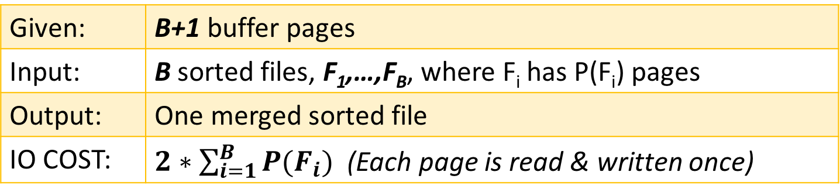
External Merge Algorithm
Final Review > Lecture 11
Goal: Merge sorted files that are much bigger than buffer
Key idea: Since the input files are sorted, we always know which file to read from next!
Details:
Given: | B+1 buffer pages
Input: | B sorted files, F₁,…,F_{B}, where F_{i} has P(F_{i}) pages
Output: | One merged sorted file
IO COST: | $2∗\sum_{i=1}^{B}{P(F_{i})}$ (Each page is read & written once)

Slide 33
High-Level: Lecture 12
Final Review > Lecture 12
External Merge Sort Algorithm
Basic algorithm (including (B+1)-length initial runs & B-way merging)
Repacking optimization for longer initial runs
Indexes Part I: Basics

Slide 34
External Merge Sort Algorithm
Final Review > Lecture 12
See L13:11-27!
Goal: Sort a file that is much bigger than the buffer
Key idea:
Phase 1: Split file into smaller chunks (“initial runs”) which can be sorted in memory
Phase 2: Keep merging (do “passes”) using external merge algorithm until one sorted file!
Unsorted input file
Phase 1
Sorted initial runs
Merge pass
Phase 2
Merge pass
Sorted!

Slide 35
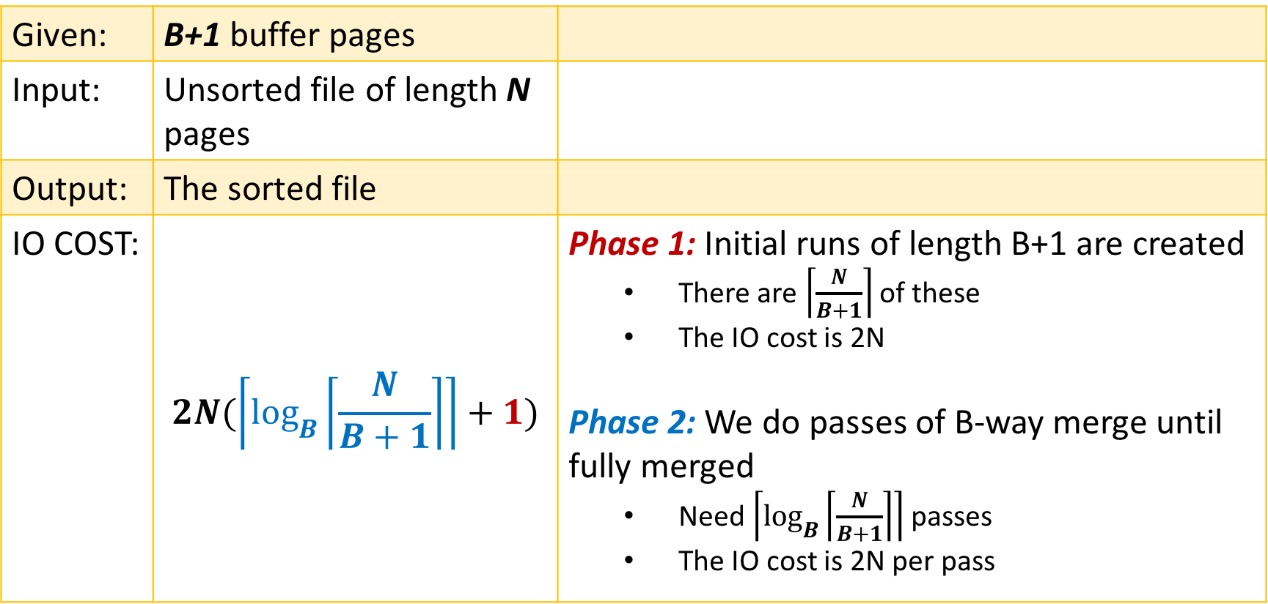
External Merge Sort Algorithm
Final Review > Lecture 12
Given: | B+1 buffer pages
Input: | Unsorted file of length N pages
Output: | The sorted file
IO COST: | $$2N(\left\lceil \log_{B}\left\lceil \frac{N}{B+1}\right\rceil \right\rceil +1)$$ | Phase 1: Initial runs of length B+1 are created There are $\left\lceil \frac{N}{B+1}\right\rceil$ of these The IO cost is 2N Phase 2: We do passes of B-way merge until fully merged Need $\left\lceil \log_{B}\left\lceil \frac{N}{B+1}\right\rceil \right\rceil$ passes The IO cost is 2N per pass

Slide 36
Indexes
Final Review > Lecture 12
An index on a file speeds up selections on the search key fields for the index.
Where the search key could be any subset of fields, and does not need to be the same as key of a relation
By_Yr_Index
Russian_Novels
Published | BID
1866 | 002
1869 | 001
1877 | 003
BID | Title | Author | Published | Full_text
001 | War and Peace | Tolstoy | 1869 | …
002 | Crime and Punishment | Dostoyevsky | 1866 | …
003 | Anna Karenina | Tolstoy | 1877 | …
By_Author_Title_Index
Note this is the logical setup, not how data is actually stored!
Author | Title | BID
Dostoyevsky | Crime and Punishment | 002
Tolstoy | Anna Karenina | 003
Tolstoy | War and Peace | 001
An index is covering for a specific query if the index contains all the needed attributes
Notes:
7

Slide 37
High-Level: Lectures 14-15
Final Review > Lectures 14-15
Indexes Pt. 2:
B+ Trees
Clustered vs. unclustered
Join Algorithms:
Nested Loop Join Variants: NLJ, BNLJ, INLJ
SMJ
Hash Join

Slide 38
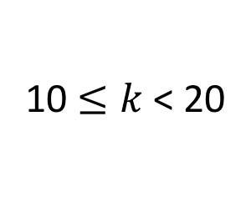
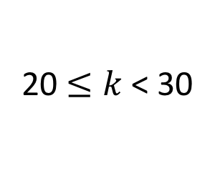
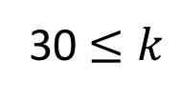
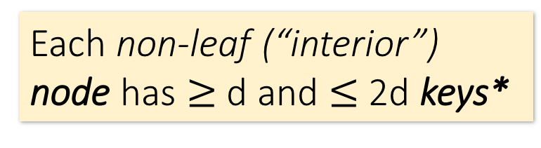
B+ Tree Basics
Final Review > Lectures 14-15
Parameter d = the degree
Non-leaf or internal node
Each non-leaf (“interior”) node has $≥$ d and $≤$2d keys*
10 |  | 20 |  | 30
30 $≤k$
The n keys in a node define n+1 ranges
k < 10
20 $≤k$< 30
10 $≤k$< 20
22 |  | 25 |  | 28
*except for root node, which can have between 1 and 2d keys
For each range, in a non-leaf node, there is a pointer to another node with keys in that range

Slide 39
B+ Tree Basics
Final Review > Lectures 14-15
Leaf nodes also have between d and 2d keys, and are different in that:
Non-leaf or internal node
Their key slots contain pointers to data records
10 |  | 20 |  | 30
They contain a pointer to the next leaf node as well, for faster sequential traversal
Leaf nodes
12 |  | 17
22 |  | 25 |  | 28 |  | 29
32 |  | 34 |  | 37 |  | 38
Name: Jake
Age: 15
Name: Bess
Age: 22
Name: Sally
Age: 28
Name: Sue
Age: 33
Name: Jess
Age: 35
Name: Alf
Age: 37
Name: Joe
Age: 11
Name: John
Age: 21
Name: Bob
Age: 27
Name: Sal
Age: 30

Slide 40
Searching a B+ Tree
Final Review > Lectures 14-15
See L14-15:17-18!
SELECT name
FROM people
WHERE age = 27
10 |  | 20 |  | 30
SELECT name
FROM people
WHERE 27 <= age
AND age <= 35
12 |  | 17
22 |  | 25 |  | 28 |  | 29
32 |  | 34 |  | 37 |  | 38
Name: Jake
Age: 15
Name: Bess
Age: 22
Name: Sally
Age: 28
Name: Sue
Age: 33
Name: Jess
Age: 35
Name: Alf
Age: 37
Name: Joe
Age: 11
Name: John
Age: 21
Name: Bob
Age: 27
Name: Sal
Age: 30

Slide 41
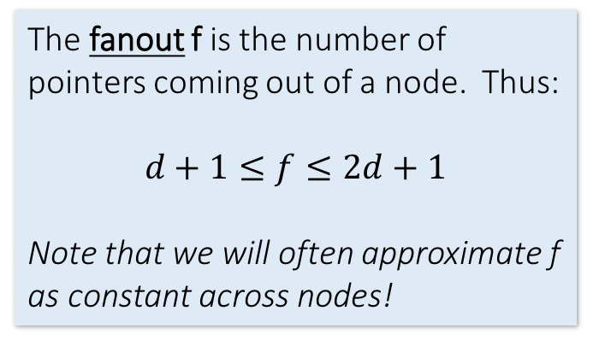
B+ Tree Range Search
Final Review > Lectures 14-15
Note that exact search is just a special case of range search (R = 1)
Goal: Get the results set of a range (or exact) query with minimal IO
Key idea:
A B+ Tree has high fanout (d ~= 10²-10³), which means it is very shallow → we can get to the right root node within a few steps!
Then just traverse the leaf nodes using the horizontal pointers
Details:
One node per page (thus page size determines d)
Fill only some of each node’s slots (the fill-factor) to leave room for insertions
We can keep some levels of the B+ Tree in memory!
The fanout f is the number of pointers coming out of a node. Thus:
$$d+1≤f≤2d+1$$
Note that we will often approximate f as constant across nodes!
We define the height of the tree as counting the root node. Thus, given constant fanout f, a tree of height h can index f^{h} pages and has f^{h-1} leaf nodes

Slide 42
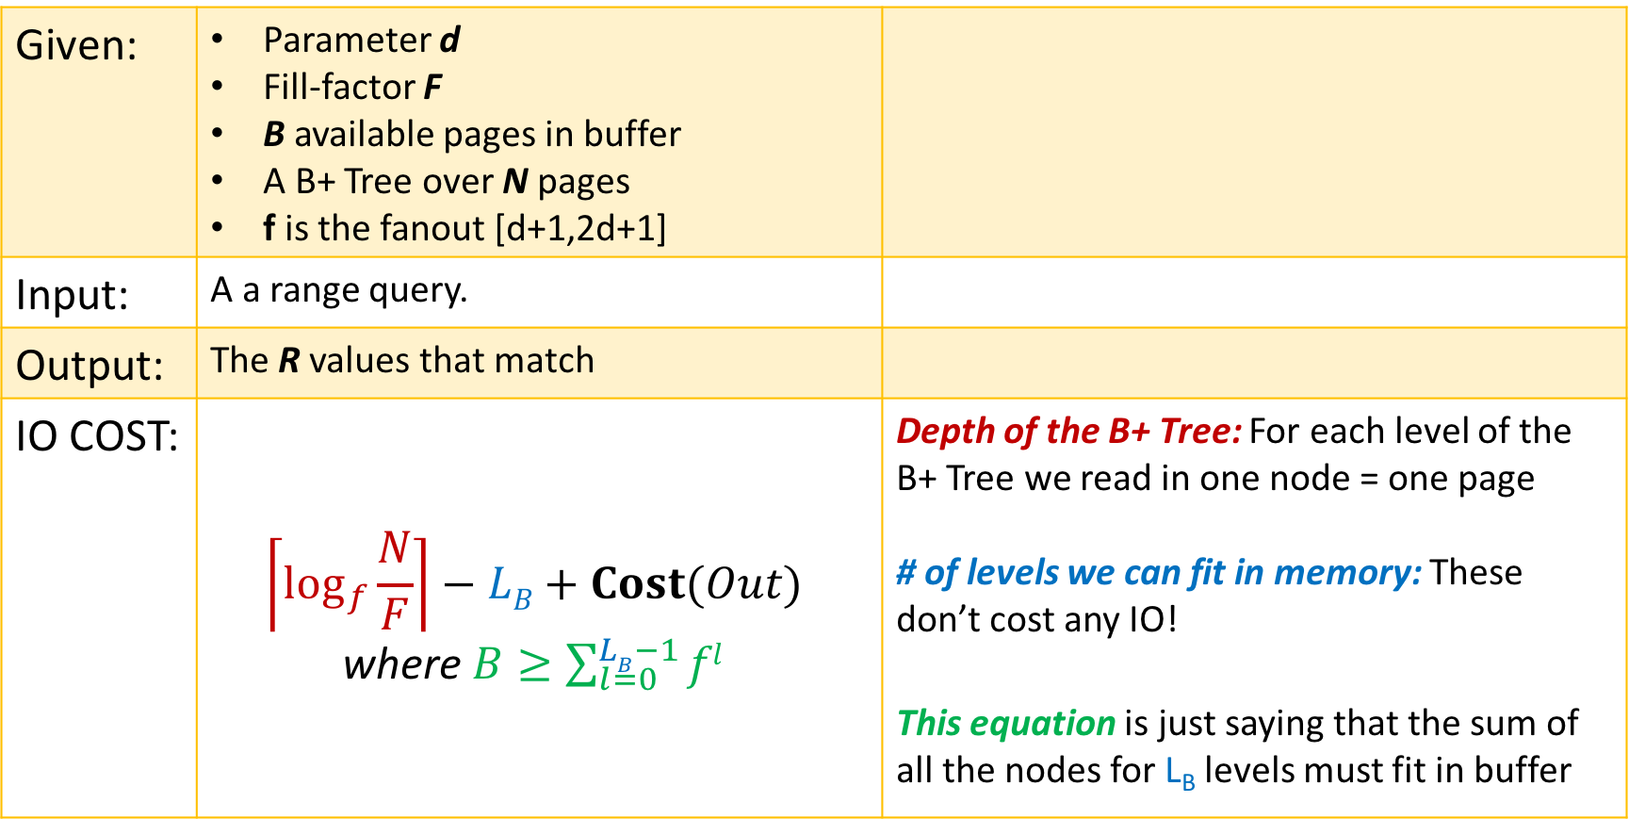
B+ Tree Range Search
Final Review > Lectures 14-15
See L14-15:22-24!
Given: | Parameter d Fill-factor F B available pages in buffer A B+ Tree over N pages f is the fanout [d+1,2d+1]
Input: | A a range query.
Output: | The R values that match
IO COST: | $$\left\lceil \log_{f}{\frac{N}{F}}\right\rceil −LB+Cost(Out)$$ where $B≥\sum_{l=0}^{LB−1}{fl}$ | Depth of the B+ Tree: For each level of the B+ Tree we read in one node = one page # of levels we can fit in memory: These don’t cost any IO! This equation is just saying that the sum of all the nodes for L_{B} levels must fit in buffer

Slide 43
Clustered vs. Unclustered Index
Final Review > Lectures 14-15
30
30
Index Entries
22 |  | 25 |  | 28 |  | 29
32 |  | 34 |  | 37 |  | 38
22 |  | 25 |  | 28 |  | 29
32 |  | 34 |  | 37 |  | 38
19
22
27
28
30
33
35
37
19
33
27
22
37
28
35
30
Data Records
Clustered
Unclustered
1 Random Access IO + Sequential IO
(# of pages of answers)
Random Access IO for each value (i.e. # of tuples in answer)
Clustered can make a huge difference for range queries!

Slide 44
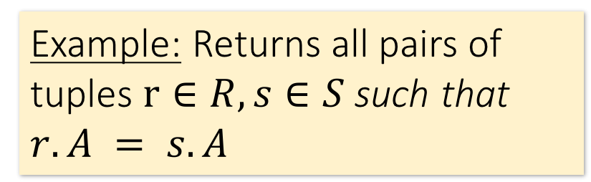
Joins: Example
Final Review > Lectures 14-15
$R⋈S$
SELECT R.A,B,C,D FROM R, S
WHERE R.A = S.A
Example: Returns all pairs of tuples $r∈R, s∈S$such that $r.A = s.A$
R
S
A | B | C
1 | 0 | 1
2 | 3 | 4
2 | 5 | 2
3 | 1 | 1
A | D
3 | 7
2 | 2
2 | 3
A | B | C | D
2 | 3 | 4 | 2
2 | 3 | 4 | 3
2 | 5 | 2 | 2
2 | 5 | 2 | 3
3 | 1 | 1 | 7

Slide 45
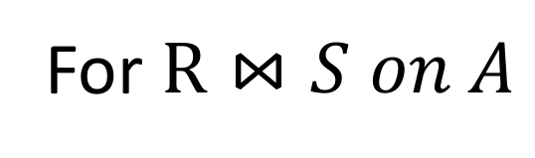
Join Algorithms: Overview
Final Review > Lectures 14-15
For $R⋈S on A$
NLJ: An example of a non-IO aware join algorithm
BNLJ: Big gains just by being IO aware & reading in chunks of pages!
SMJ: Sort R and S, then scan over to join!
HJ: Partition R and S into buckets using a hash function, then join the (much smaller) matching buckets
Quadratic in P(R), P(S)
I.e. O(P(R)*P(S))
Given sufficient buffer space, linear in P(R), P(S)
I.e. ~O(P(R)+P(S))
By only supporting equijoins & taking advantage of this structure!

Slide 46
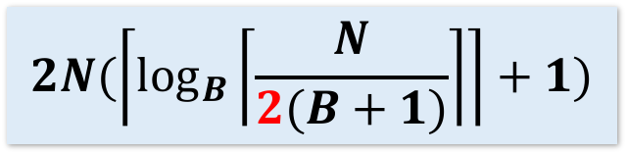
Nested Loop Join (NLJ)
Final Review > Lectures 14-15
Cost:
Compute $R⋈S on A$:
for r in R:
for s in S:
if r[A] == s[A]:
yield (r,s)
P(R) + T(R)*P(S) + OUT
Loop over the tuples in R
For every tuple in R, loop over all the tuples in S
Check against join conditions
Write out (to page, then when page full, to disk)
Note that IO cost based on number of pages loaded, not number of tuples!
Have to read all of S from disk for every tuple in R!

Slide 47
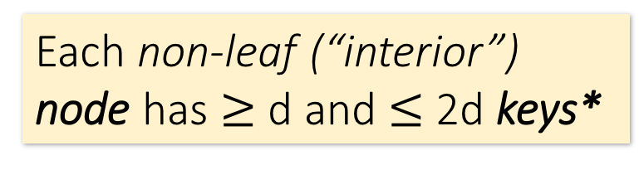
Block Nested Loop Join (BNLJ)
Final Review > Lectures 14-15
Given B+1 pages of memory
Cost:
Compute $R⋈S on A$:
for each B-1 pages pr of R:
for page ps of S:
for each tuple r in pr:
for each tuple s in ps:
if r[A] == s[A]:
yield (r,s)
$P\left(R\right)+ \frac{P\left(R\right)}{B−1}P(S)$ + OUT
Load in B-1 pages of R at a time (leaving 1 page each free for S & output)
For each (B-1)-page segment of R, load each page of S
Check against the join conditions
Write out
Again, OUT could be bigger than P(R)*P(S)… but usually not that bad

Slide 48
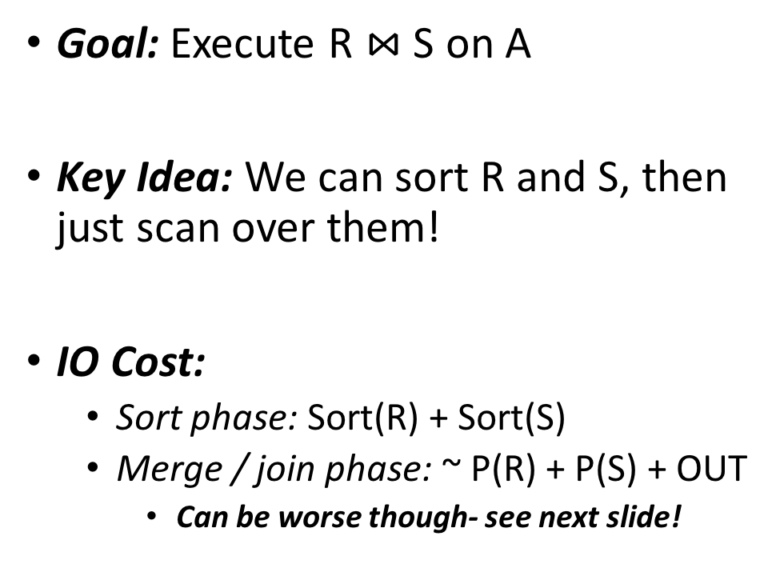
Sort Merge Join (SMJ)
Final Review > Lectures 14-15
See L14-15:63-69!
Unsorted input relations
Goal: Execute R $⋈$ S on A
Key Idea: We can sort R and S, then just scan over them!
IO Cost:
Sort phase: Sort(R) + Sort(S)
Merge / join phase: ~ P(R) + P(S) + OUT
Can be worse though- see next slide!
R
S
Split & sort
Merge
Merge
R
S

Slide 49
Simple SMJ Optimization
Final Review > Lectures 14-15
See L14-15:78-81!
Given B+1 buffer pages
Unsorted input relations
Sort Phase
(Ext. Merge Sort)
R
S
Split & sort
Split & sort
Merge
Merge
<= B total runs
B-Way Merge / Join
Merge / Join Phase
This allows us to “skip” the last sort & save 2(P(R) + P(S))!

Slide 50
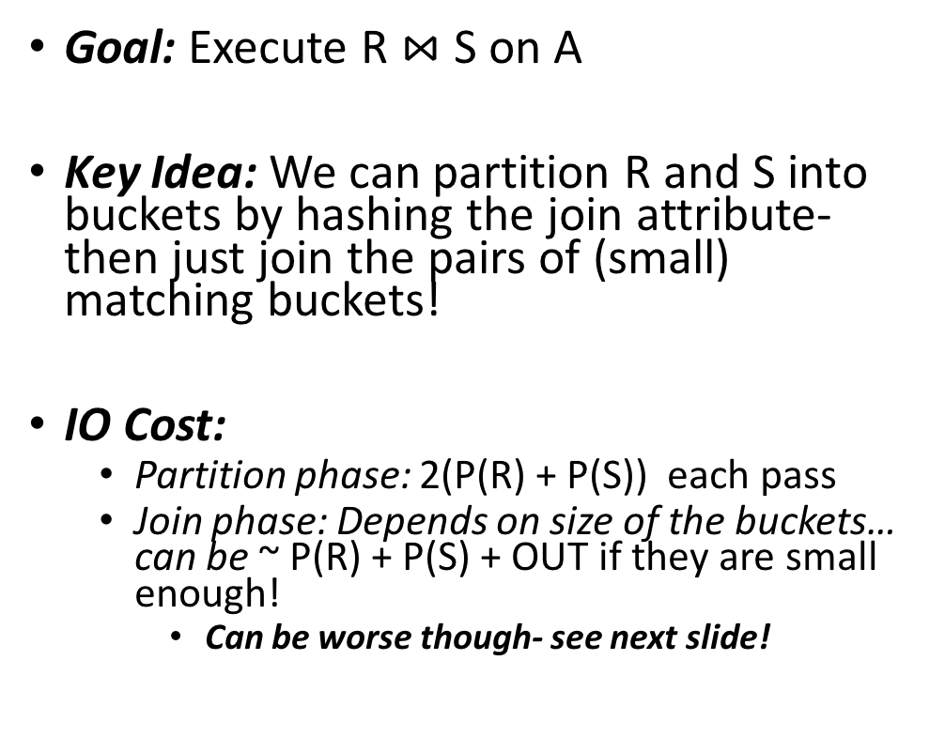
Hash Join
Final Review > Lectures 14-15
See L14-15:88-!
Goal: Execute R $⋈$ S on A
Key Idea: We can partition R and S into buckets by hashing the join attribute- then just join the pairs of (small) matching buckets!
IO Cost:
Partition phase: 2(P(R) + P(S)) each pass
Join phase: Depends on size of the buckets… can be ~ P(R) + P(S) + OUT if they are small enough!
Can be worse though- see next slide!
Unsorted input relations
R
S
Partition
h
h
1
2
1
2
Partition
h'
h'
1
2
3
4
1
2
3
4
Join matching buckets

Slide 51
HJ: Skew
Final Review > Lectures 14-15
See L14-15:109-112!
Ideally, our hash functions will partition the tuples uniformly
However, hash collisions and duplicate join key attributes can cause skew
For hash collisions, we can just partition again with a new hash function
Duplicates are just a problem… (Similar to in SMJ!)
R
1
2
3
4
R
1
2
3
4

Slide 52
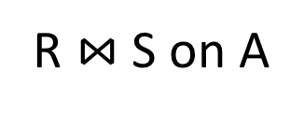
Overview: SMJ vs. HJ
Final Review > Lectures 14-15
R $⋈$ S on A
SMJ
HJ
Note:
Ext. Merge Sort!
We create initial sorted runs
We keep merging these runs until we have one sorted merged run for R, S
We scan over R and S to complete the join
We keep partitioning R and S into progressively smaller buckets using hash functions h, h’, h’’…
We join matching pairs of buckets (using BNLJ)
How many of these passes do we need to do?

Slide 53
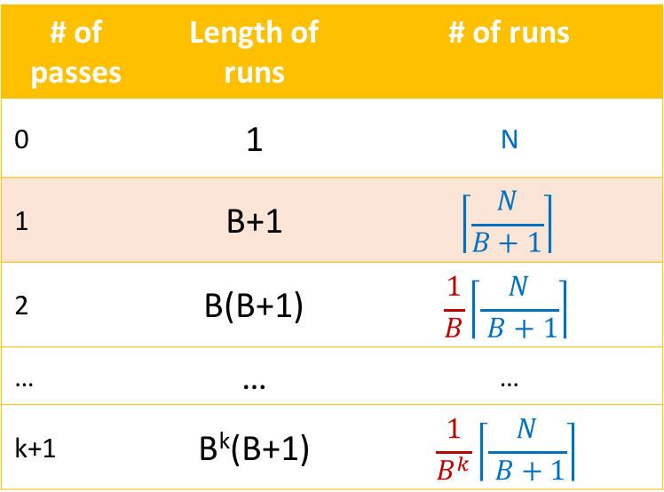
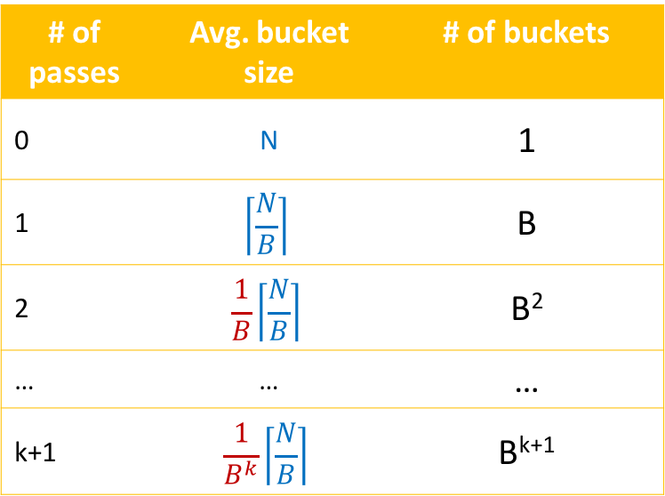
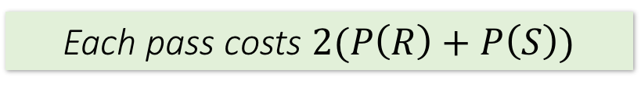
How many passes do we need?
Final Review > Lectures 14-15
R $⋈$ S on A
SMJ
HJ
# of passes | Length of runs | # of runs
0 | 1 | N
1 | B+1 | $$\left\lceil \frac{N}{B+1}\right\rceil$$
2 | B(B+1) | $$\frac{1}{B}\left\lceil \frac{N}{ B+1}\right\rceil$$
… | … | …
k+1 | B^{k}(B+1) | $$\frac{1}{B^{k}}\left\lceil \frac{N}{ B+1}\right\rceil$$
# of passes | Avg. bucket size | # of buckets
0 | N | 1
1 | $$\left\lceil \frac{N}{B}\right\rceil$$ | B
2 | $$\frac{1}{B}\left\lceil \frac{N}{B}\right\rceil$$ | B²
… | … | …
k+1 | $$\frac{1}{B^{k}}\left\lceil \frac{N}{B}\right\rceil$$ | B^{k+1}
Initial sorted runs
Each pass, we get:
Fewer, longer runs by a factor of B
More, smaller buckets by a factor of B
Each pass costs $2(P\left(R\right)+P\left(S\right))$
Notes:
We’re being slightly sloppy here- the exponent in length of runs for k+1 passes should be (k-1)_+

Slide 54
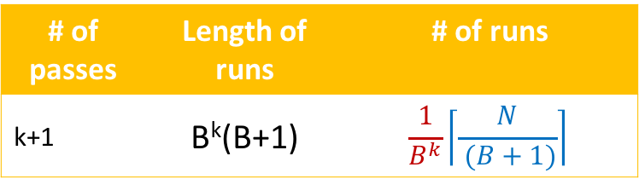
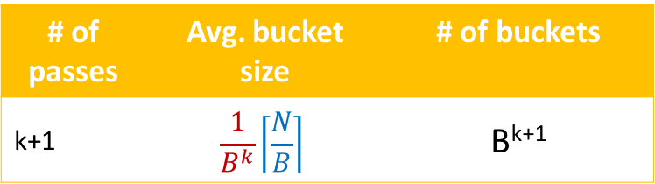
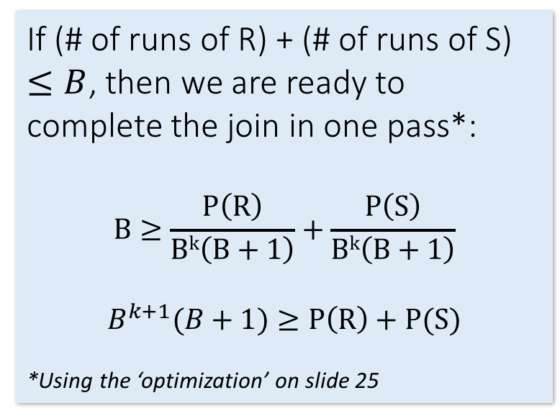
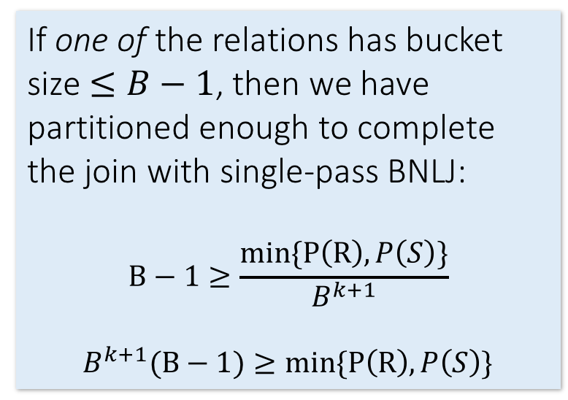
How many passes do we need?
Final Review > Lectures 14-15
R $⋈$ S on A
SMJ
HJ
# of passes | Length of runs | # of runs
k+1 | B^{k}(B+1) | $$\frac{1}{B^{k}}\left\lceil \frac{N}{ (B+1)}\right\rceil$$
# of passes | Avg. bucket size | # of buckets
k+1 | $$\frac{1}{B^{k}}\left\lceil \frac{N}{B}\right\rceil$$ | B^{k+1}
If (# of runs of R) + (# of runs of S) $≤B$, then we are ready to complete the join in one pass*:
$$B≥\frac{P\left(R\right)}{Bk\left(B+1\right)}+\frac{P\left(S\right)}{Bk\left(B+1\right)}$$
$$B^{k+1}(B+1)≥P\left(R\right)+P(S)$$
*Using the ‘optimization’ on slide 25
If one of the relations has bucket size $≤B−1$, then we have partitioned enough to complete the join with single-pass BNLJ:
$$B−1≥\frac{min\{P\left(R\right),P\left(S\right)\}}{B^{k+1}}$$
$$B^{k+1}(B−1)≥min\{P\left(R\right),P\left(S\right)\}$$
Notes:
In the SMJ calculation, we simplified B^{k+1}(B+1) ~= B^{k+2}, and similarly with the HJ equation

Slide 55
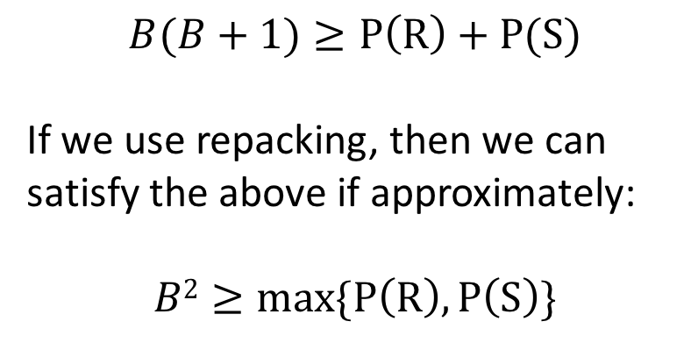
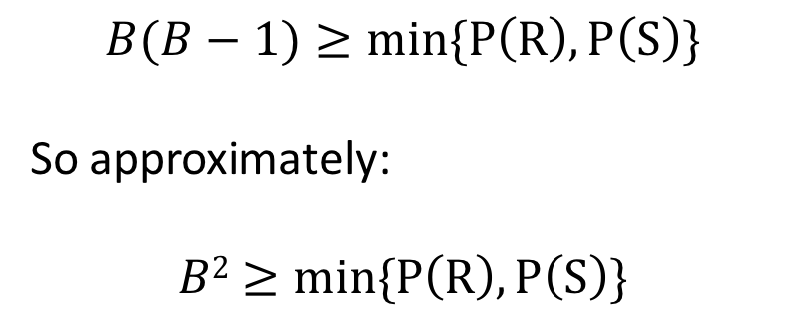
How many buffer pages for nice behavior?
Final Review > Lectures 14-15
R $⋈$ S on A
Let’s consider what B we’d need for k+1 = 1 passes (plus the final join):
SMJ
HJ
$$B(B+1)≥P\left(R\right)+P(S)$$
If we use repacking, then we can satisfy the above if approximately:
$$B2≥max\{P\left(R\right),P\left(S\right)\}$$
$$B(B−1)≥min\{P\left(R\right),P\left(S\right)\}$$
So approximately:
$$B2≥min\{P\left(R\right),P\left(S\right)\}$$
→ Total IO Cost = 3(P(R) + P(S)) + OUT!

Slide 56
Overview: SMJ vs. HJ
Final Review > Lectures 14-15
HJ:
PROS: Nice linear performance is dependent on the smaller relation
CONS: Skew!
SMJ:
PROS: Great if relations are already sorted; output is sorted either way!
CONS:
Nice linear performance is dependent on the larger relation
Backup!

Slide 57
High-Level: Lecture 16
Final Review > Lectures 16
Check out the Relational Algebra practice exercises notebook!!
Overall RDBMS architecture
The Relational Model
Relational Algebra

Slide 58
RDBMS Architecture
Final Review > Lectures 16
How does a SQL engine work ?
SQL Query
Relational Algebra (RA) Plan
Optimized RA Plan
Execution
Declarative query (from user)
Translate to relational algebra expression
Find logically equivalent- but more efficient- RA expression
Execute each operator of the optimized plan!

Slide 59
The Relational Model: Data
Final Review > Lectures 16
The number of tuples is the cardinality of the relation
Student
An attribute (or column) is a typed data entry present in each tuple in the relation
sid | name | gpa
001 | Bob | 3.2
002 | Joe | 2.8
003 | Mary | 3.8
004 | Alice | 3.5
A tuple or row (or record) is a single entry in the table having the attributes specified by the schema
The number of attributes is the arity of the relation
A relational instance is a set of tuples all conforming to the same schema

Slide 60
Final Review > Lectures 16
Relational Algebra (RA)
Five basic operators:
Selection: σ
Projection: Π
Cartesian Product: ×
Union: ∪
Difference: -
Derived or auxiliary operators:
Intersection, complement
Joins (natural,equi-join, theta join, semi-join)
Renaming: ρ
Division

Slide 61
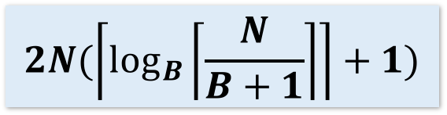
Final Review > Lectures 16
1. Selection ($σ$)
Students(sid,sname,gpa)
SQL:
Returns all tuples which satisfy a condition
Notation: σ_{c}(R)
The condition c can be =, <, >, <>
SELECT *
FROM Students
WHERE gpa > 3.5;
RA:
$$σ_{gpa >3.5}(Students)$$

Slide 62
Final Review > Lectures 16
2. Projection ($Π$)
Students(sid,sname,gpa)
SQL:
Eliminates columns, then removes duplicates
Notation: Π _{A1,…,An} (R)
SELECT DISTINCT
sname,
gpa
FROM Students;
RA:
$$Π_{sname,gpa}(Students)$$

Slide 63

Final Review > Lectures 16
3. Cross-Product ($×$)
Students(sid,sname,gpa)
People(ssn,pname,address)
SQL:
Each tuple in R1 with each tuple in R2
Notation: R1 × R2
Rare in practice; mainly used to express joins
SELECT *
FROM Students, People;
RA:
$$Students × People$$

Slide 64

Final Review > Lectures 16
Renaming ($ρ$)
Students(sid,sname,gpa)
SQL:
Changes the schema, not the instance
A ‘special’ operator- neither basic nor derived
Notation: ρ _{B1,…,Bn} (R)
Note: this is shorthand for the proper form (since names, not order matters!):
ρ _{A1→B1,…,An→Bn} (R)
SELECT
sid AS studId,
sname AS name,
gpa AS gradePtAvg
FROM Students;
RA:
$$ρ_{studId,name,gradePtAvg}(Students)$$
We care about this operator because we are working in a named perspective

Slide 65


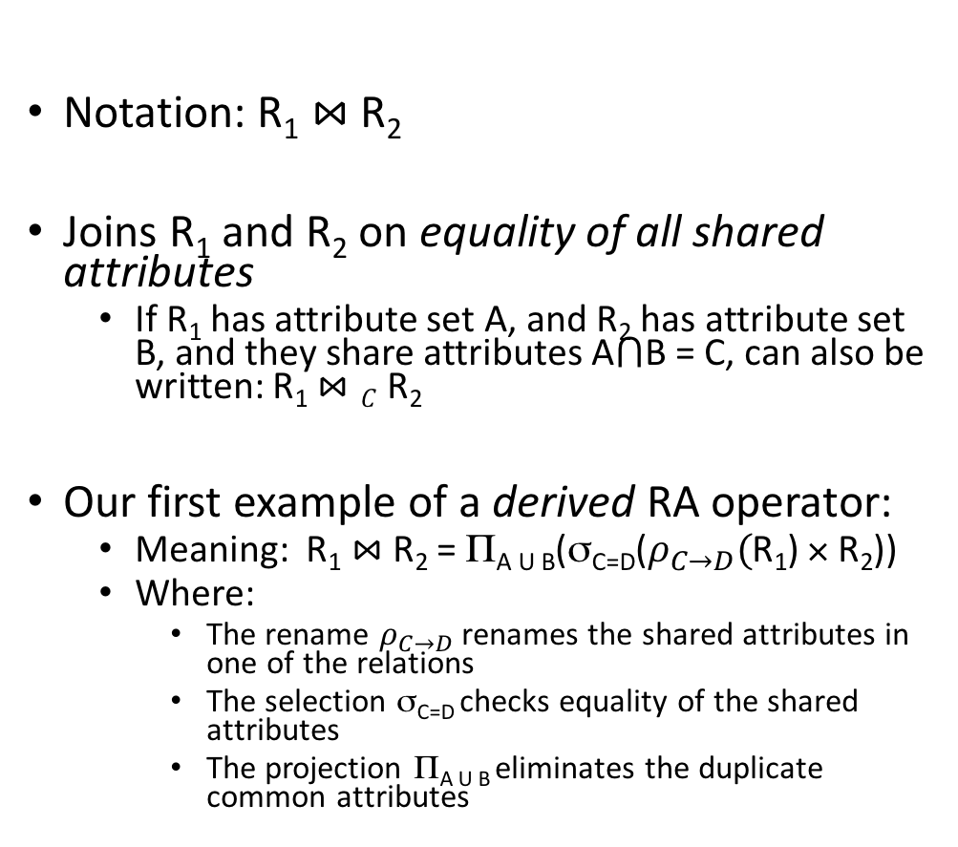
Final Review > Lectures 16
Natural Join ($⋈$)
Students(sid,name,gpa)
People(ssn,name,address)
SQL:
Notation: R₁ $⋈$R₂
Joins R₁ and R₂ on equality of all shared attributes
If R₁ has attribute set A, and R₂ has attribute set B, and they share attributes A$⋂$B = C, can also be written: R₁ $⋈C$R₂
Our first example of a derived RA operator:
Meaning: R₁ $⋈$ R₂ = Π_{A U B}(σ_{C=D}($ρ_{C→D}($R₁) × R₂))
Where:
The rename $ρ_{C→D}$ renames the shared attributes in one of the relations
The selection σ_{C=D} checks equality of the shared attributes
The projection Π_{A U B} eliminates the duplicate common attributes
SELECT DISTINCT
ssid, S.name, gpa,
ssn, address
FROM
Students S,
People P
WHERE S.name = P.name;
RA:
$$Students ⋈ People$$

Slide 66
Converting SFW Query -> RA
Final Review > Lectures 16
SELECT DISTINCT A₁,…,A_{n}
FROM R₁,…,R_{m}
WHERE c₁ AND … AND c_{k};
$$Π_{A1,…,An}(σ_{c1}…σ_{ck}(R1⋈…⋈Rm))$$
Why must the selections “happen before” the projections?

Slide 67
High-Level: Lecture 17
Final Review > Lecture 17
Logical optimization
Physical optimization
Index selections
IO cost estimation

Slide 68
Logical vs. Physical Optimization
Final Review > Lecture 17
SQL Query
Relational Algebra (RA) Plan
Logical optimization:
Find equivalent plans that are more efficient
Intuition: Minimize # of tuples at each step by changing the order of RA operators
Physical optimization:
Find algorithm with lowest IO cost to execute our plan
Intuition: Calculate based on physical parameters (buffer size, etc.) and estimates of data size (histograms)
Optimized RA Plan
Execution

Slide 69
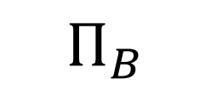
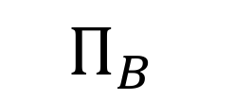
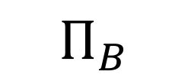
Logical Optimization: “Pushing down” projection
Final Review > Lecture 17
$Π_{B}$
$Π_{B}$
$$Π_{B}$$
R(A,B)
S(B,C)
R(A,B)
S(B,C)
Why might we prefer this plan?

Slide 70
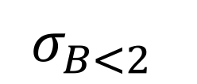
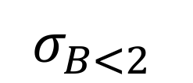
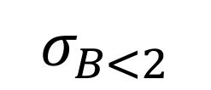
Logical Optimization: “Pushing down” selection
Final Review > Lecture 17
$σ_{B<2}$
$$σ_{B<2}$$
$$σ_{B<2}$$
R(A,B)
S(B,C)
R(A,B)
S(B,C)
Why might we prefer this plan?

Slide 71
RA commutators
Final Review > Lecture 17
The basic commutators:
Push projection through (1) selection, (2) join
Push selection through (3) selection, (4) projection, (5) join
Also: Joins can be re-ordered!
Note that this is not an exhaustive set of operations
This covers local re-writes; global re-writes possible but much harder
This simple set of tools allows us to greatly improve the execution time of queries by optimizing RA plans!

Slide 72
Index Selection
Final Review > Lecture 17
Input:
Schema of the database
Workload description: set of (query template, frequency) pairs
Goal: Select a set of indexes that minimize execution time of the workload.
Cost / benefit balance: Each additional index may help with some queries, but requires updating
This is an optimization problem!

Slide 73
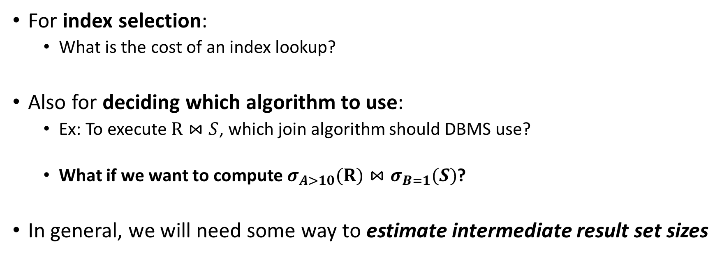
IO Cost Estimation via Histograms
Final Review > Lecture 17
For index selection:
What is the cost of an index lookup?
Also for deciding which algorithm to use:
Ex: To execute $R⋈S$, which join algorithm should DBMS use?
What if we want to compute $σ_{A>10}(R)⋈σ_{B=1}(S)$?
In general, we will need some way to estimate intermediate result set sizes
Histograms provide a way to efficiently store estimates of these quantities

Slide 74
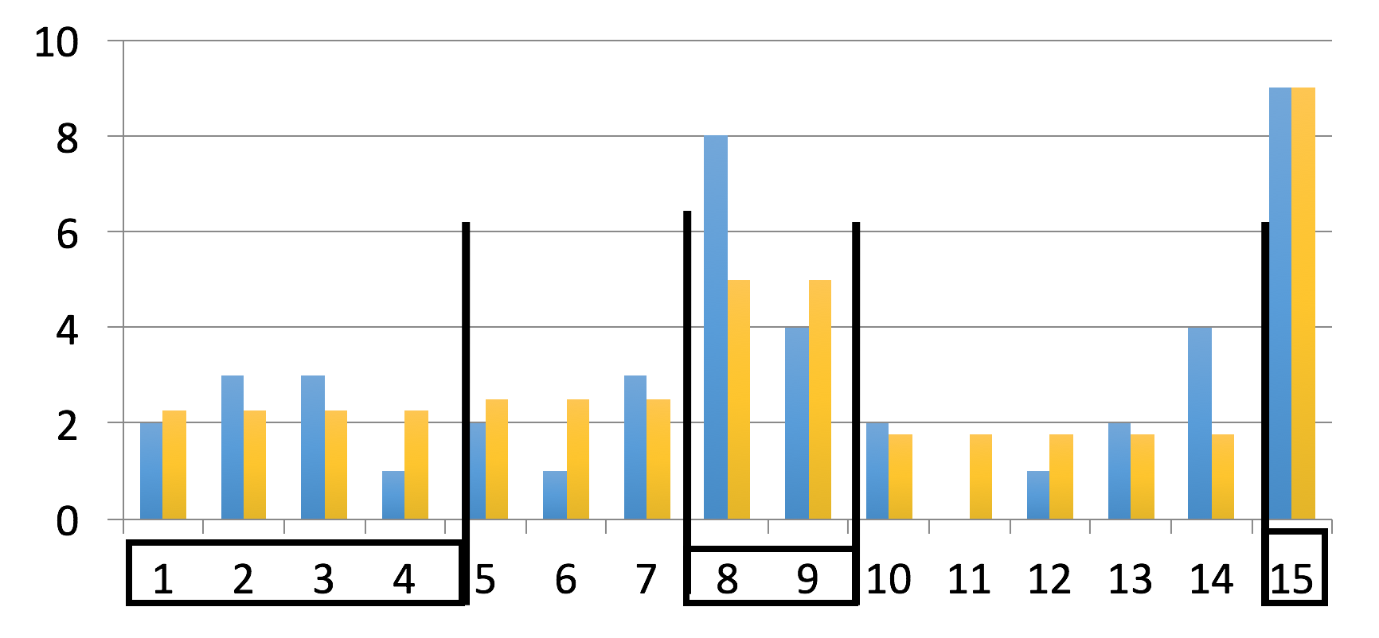
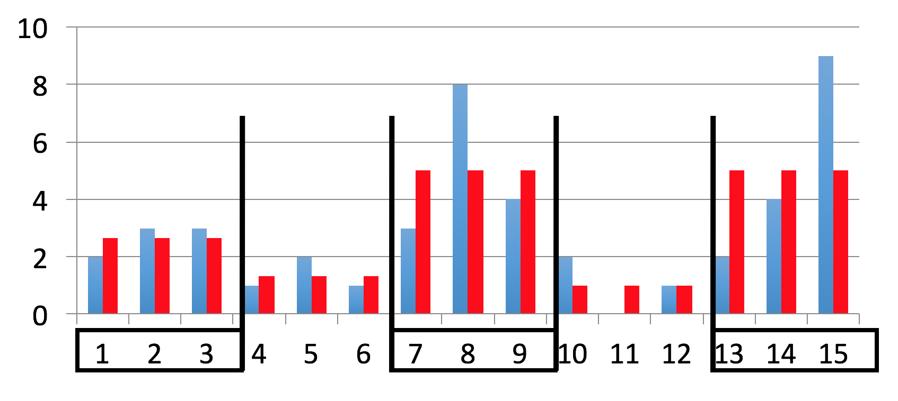
Histogram types
Final Review > Lecture 17
Equi-depth
All buckets contain roughly the same number of items (total frequency)
Equi-width
All buckets roughly the same width

