Slide 1
Chapter 8: Understanding Alchemy News
Learning Bluemix & Cognitive
Bob Dill, IBM Distinguished Engineer, CTO Global Technical Sales

Slide 2
What is Alchemy
A lot of APIs …
News API
Sentiment Analysis
Taxonomy
Concept Tagging
Entity Extraction
Keyword Extraction
Relation Extraction
Text Extraction
Face Detection
Image Link Extraction
Image Tagging
Author Extraction
Authors Extraction
Language Detection
Feed Detection
Microformats Parsing
Combined Call
Date Extraction API
Emotion Analysis
Publication Date
What’s going on in the world?
Identifies attitude, opinions, or feelings in the content that is being analyzed.
categorizes input text, HTML or web-based content into a hierarchical taxonomy up to five levels deep
Beyond keywords, what are the concepts inherent in what was just said or written
returns items such as persons, places, and organizations that are present in the input text. Entity extraction adds semantic knowledge to content to help understand the subject and context of the text that is being analyzed
important topics in your content that are typically used when indexing data, generating tag clouds, or when searching
identifies subject, action, and object relations within sentences in the input content.
Retrieve text from documents or web pages
Image support - find faces
…
…
Find The author
Find the Authors
What language are you speaking /writing
extracts any links to web feeds that are embedded in a web page
processes microformat information that is included in the HTML of some webpages to add semantic information and to enable easier scanning and processing of those pages by software
…
extracts natural language date/time expressions from text, normalizes them to an ISO date string (such as "20040104T000000"), and identifies concepts with which those dates are associated.
Detects anger, disgust, fear, joy, and sadness implied in English text.
extracts publication date information, if present, from web pages.

Slide 3
What’s the story for this tutorial?
Type Company name, names, abbreviations, etc.
Get a news feed for that company, exclude non-company results
List the news feed
Select a document
View the selected document

Slide 4
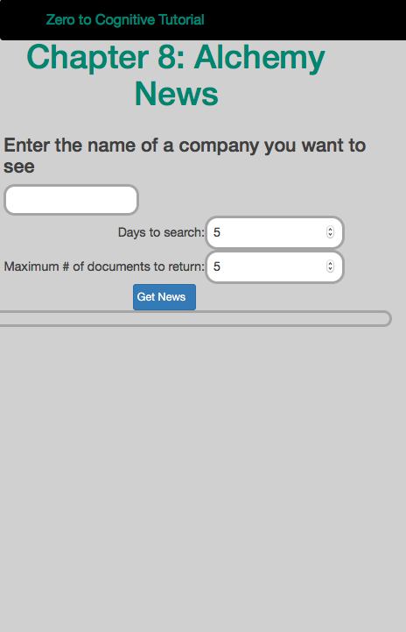
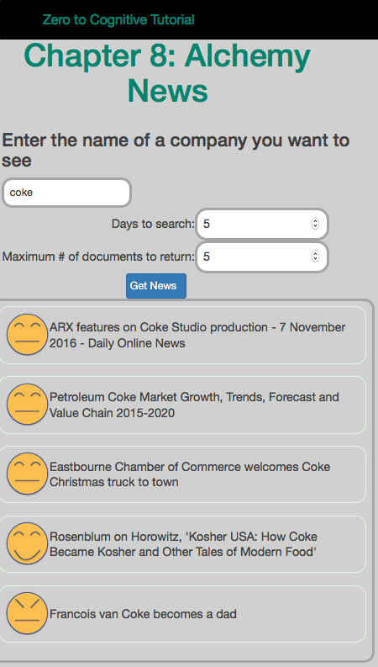
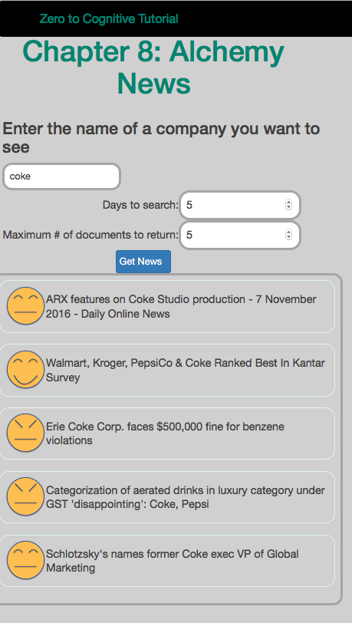
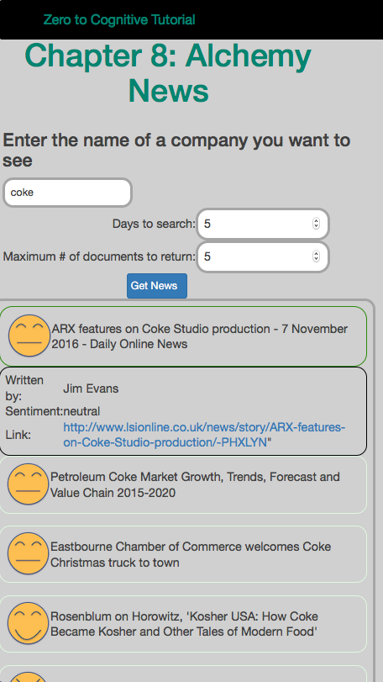
What are we building?
A tool which allows anyone to find current information on the company of their choice.
Display the title of the article and the sentiment
When clicked, expand the view to show the author and link.
When link is clicked, open a new tab to display the article.
Enabling search to understand concepts like “coke as a company and not coke as a person” yields better results.
Not a company

Slide 5
The Plan: 30 minute Chapters with an hour or two of practice
The Story, Architecture for this app
Setting up Bluemix
Building your first Watson App (Watson Speech to Text)
Getting Watson to talk back (Watson Text to Speech)
Understanding Classifiers (Watson NLC)
Creating a custom dialog with Watson (custom Q&A, session management)
Authentication (puts C2 thru 6 together)
Alchemy News (Watson Alchemy)
Visual Recognition and Images (Watson Visual Recognition)
Watson Conversations (Watson Conversations)
Rank & Retrieve (Watson Alchemy + Rank & Retrieve)
Getting started on my first client prototype Design Thinking, Stories, Architecture, Keeping it simple
Supporting Complex environments Public Bluemix and Docker
Supporting Complex environments II Bluemix Dedicated and CloudFoundry
Creating an Inference Engine Our Inference Engine in "R"
Finding solutions Integrates C1-10, 13-15)
BlueMix, Watson and Mobile (TBD)
September-October
4Q

Slide 6
Chapter 9: Visual Recognition and Images
Learning Bluemix & Cognitive
Bob Dill, IBM Distinguished Engineer, CTO Global Technical Sales

