Slide 1
Chapter 9: Visual Recognition and Images
Learning Bluemix & Cognitive
Bob Dill, IBM Distinguished Engineer, CTO Global Technical Sales

Slide 2
(Alchemy) Visual Recognition: three basic services:
Find objects or faces in an image
Create classifiers representing objects to be found in an image
Find an image similar to one you’ve provided
Classify an Image
Detect Faces
Classifiers:
Create a classifier
Retrieve list of custom classifiers
Retrieve classifier details
Update a classifier
Delete a Classifier
Collections
Create a collection
List collections
Retrieve Collection Details
Delete a Collection
Add images to collection
list images in collection
list image details
delete an image
add or update metadata
list metadata
delete metadata
find similar images
Classify an Image based on default or custom classifiers
Analyze faces in images and get data about them, such as estimated age, gender, plus names of celebrities. Images must be in .jpeg, or .png format. This functionality is not trainable, and does not support general biometric facial recognition.
Train a new multi-faceted classifier on the uploaded image data:
A new custom classifier can be trained by several compressed (.zip) files, including files containing positive or negative images (.jpg, or .png). You must supply at least two compressed files, either two positive example files or one positive and one negative example file.
Retrieve a list of user-created classifiers
Retrieve information about a specific classifier.
Update an existing classifier by adding new classes, or by adding new images to existing classes.You cannot update a custom classifier with a free API Key.r
Delete a custom classifier with the specified classifier ID
Beta. Create a new collection, add images to that collection, and then use Similarity Search to search the collection for similar images.
Create a new collection of images to search. You can create a maximum of 5 collections.
List all custom collections.
Retrieve information about a specific collection.
Delete a user created collection.
Add images to a collection. Each collection can contain 1000000 images. It takes 1 second to upload 1 image.
List 100 images in a collection. This returns an arbitrary selection of 100 images.
List details about a specific image in a collection.
Delete an image from a collection.
Add metadata to a specific image in a collection. Use metadata for your own reference to identify images.
View the metadata for a specific image in a collection.
Delete all metadata associated with an image.
Upload an image to find similar images in your custom collection.

Slide 3
What’s the story for this tutorial?
Create a series of classifiers.
In the demo, we’ll create a series of classifiers based on type of painting. The classification categories are (arbitrarily)
abstract, beach, buildings, collage, forest, garden, still-life, vista, water
Create a page which accepts a dropped image, uploads it for classification and returns the classification results
Optionally
Create a series of collections based on the same classification taxonomy
Select a collection based on the classification result
Find a similar painting in the targeted collection
display the found painting with confidence results.

Slide 4
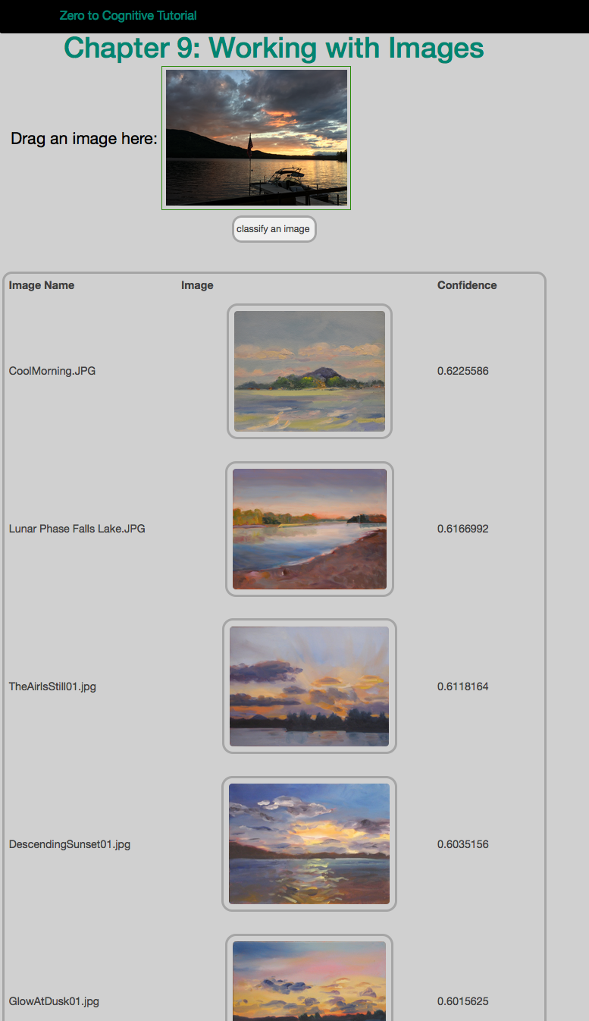
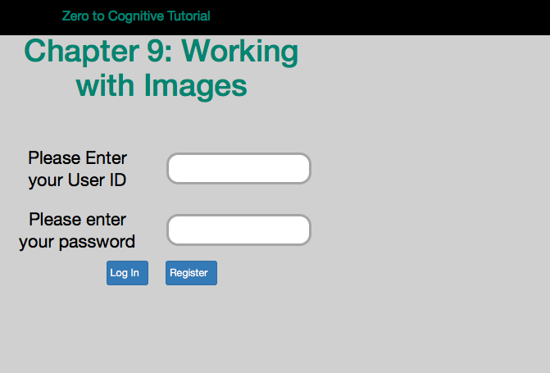
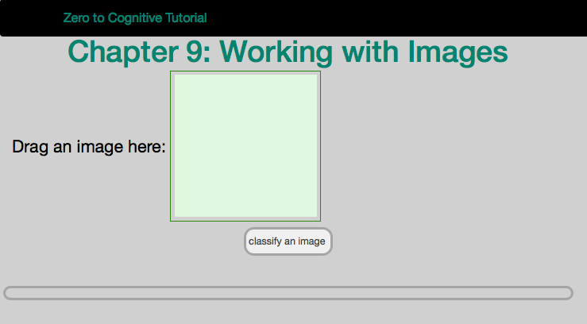
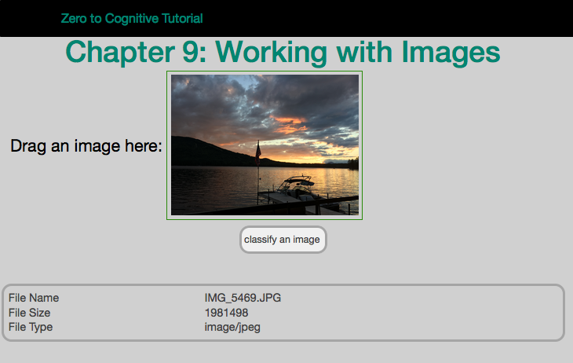
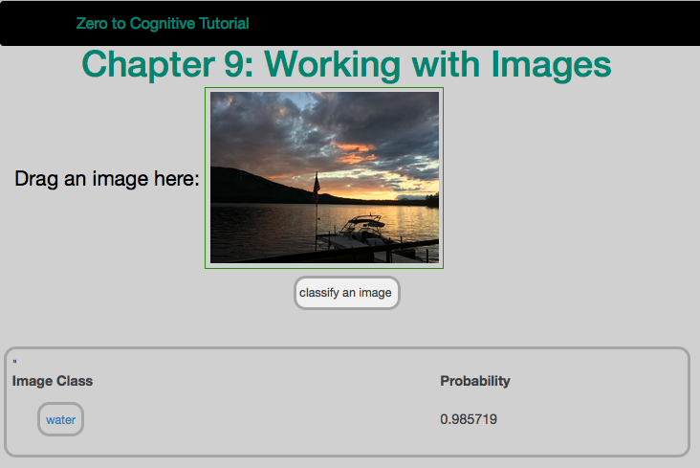
What are we building?
Drag and drop image onto web page
Check if ok to upload
Classify the image
Find similar images
4
1
2
3

Slide 5
The Plan: 30 minute Chapters with an hour or two of practice
The Story, Architecture for this app
Setting up Bluemix
Building your first Watson App (Watson Speech to Text)
Getting Watson to talk back (Watson Text to Speech)
Understanding Classifiers (Watson NLC)
Creating a custom dialog with Watson (custom Q&A, session management)
Authentication (puts C2 thru 6 together)
Alchemy News (Watson Alchemy)
Visual Recognition and Images (Watson Visual Recognition)
Watson Conversations (Watson Conversations)
Rank & Retrieve (Watson Alchemy + Rank & Retrieve)
Getting started on my first client prototype Design Thinking, Stories, Architecture, Keeping it simple
Supporting Complex environments Public Bluemix and Docker
Supporting Complex environments II Bluemix Dedicated and CloudFoundry
Creating an Inference Engine Our Inference Engine in "R"
Finding solutions Integrates C1-10, 13-15)
BlueMix, Watson and Mobile (TBD)
September-October
4Q

Slide 6
Chapter 10: Watson Conversations
Learning Bluemix & Cognitive
Bob Dill, IBM Distinguished Engineer, CTO Global Technical Sales

