Slide 1

Extensive Facial Landmark Localization with Coarse-to-fine Convolutional Neural Network
Erjin Zhou Haoqiang Fan Zhimin Cao Yuning Jiang Qi Yin
Megvii Inc., Beijing

Slide 2

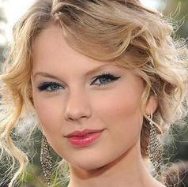
Problem
2-Eyes Detection

Slide 3
Problem
5-Corners Detection
2-Eyes Detection

Slide 4
Problem
23-Points Detection

Slide 5

Problem
More and more landmarks are required!
68-Points Detection

Slide 6
Idea I
Single Predictor
Disadvantage: the difficulty of localizing each point is quite different, and it is hard to optimize all points by a single model.

Slide 7
Idea II
Predictor 1
Predictor 2
Predictor 3
Predictor 4
Predictor 5
……
Disadvantages: no geometric constrains; heavy computational burden.

Slide 8
Idea III
Predictor 1
Predictor 2
Predictor 3
Predictor 4
…
Advantage: component contexts are considered.

Slide 9
Observation
However, do we really need the mouth to locate the eye corners?

Slide 10

Our Intuition
Predictor 1
Predictor 2
Component estimator
Predictor 3
Predictor 4
…

Slide 11
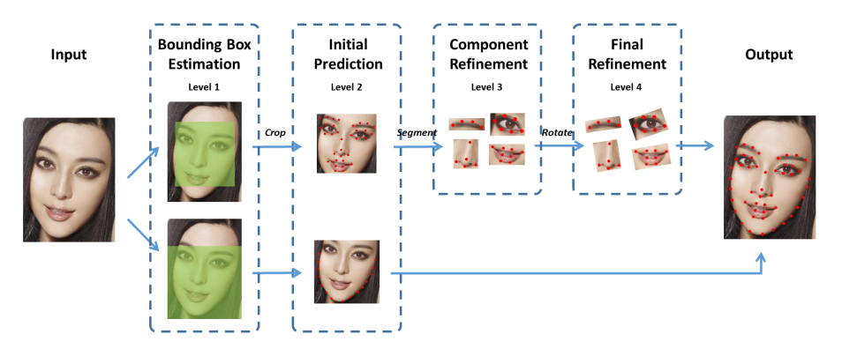
Framework

Slide 12
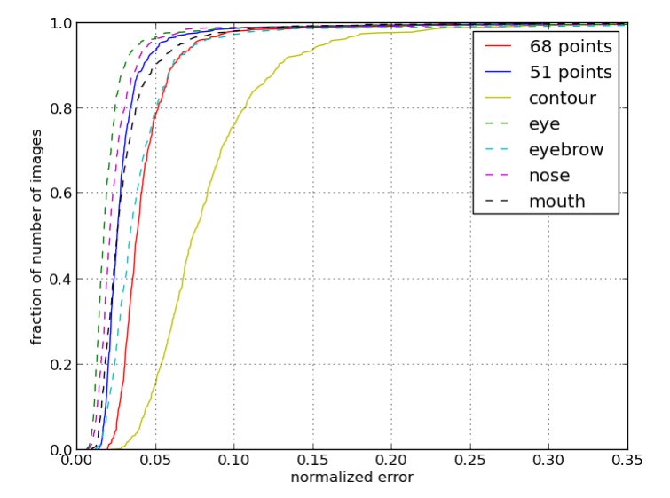
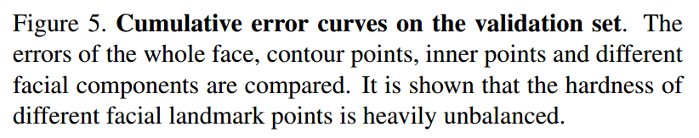
Experiments

Slide 13
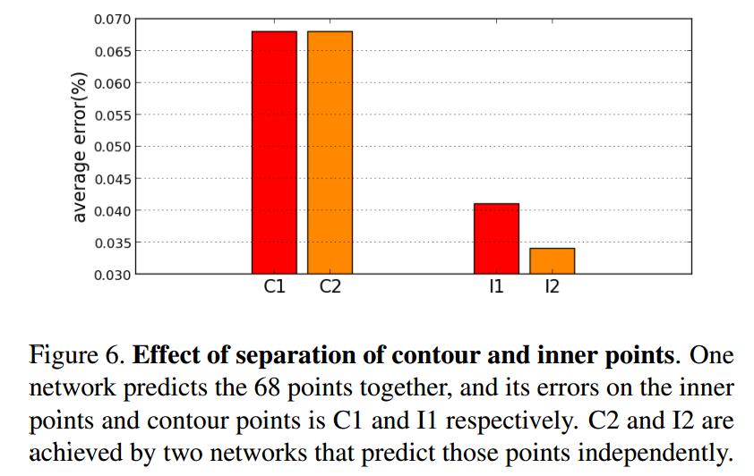
Experiments

Slide 14
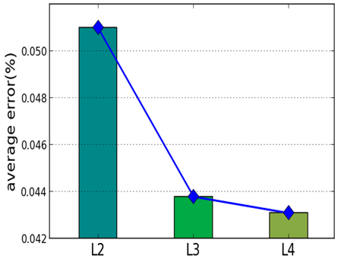
Experiments
Level 2
Level 3
Level 4
Average error on each level of CNN.

Slide 15
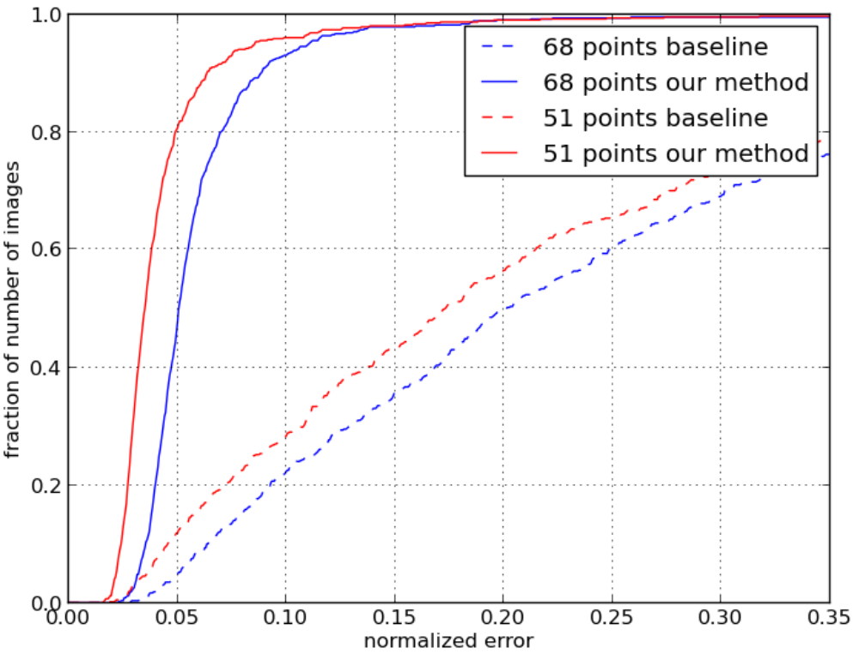
Results on 300-W

Slide 16
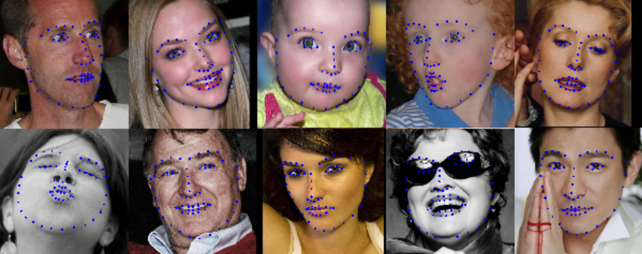
Results on 300-W

Slide 17

About us

Slide 18
Thanks!

