Slide 1

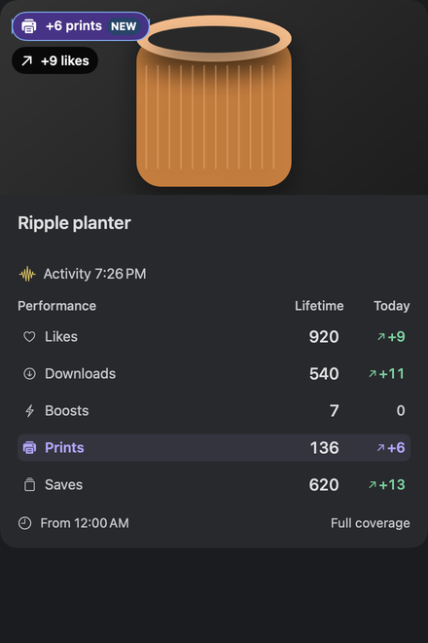
MAKERGLANCE / CREATOR ANALYTICS
See what moved.
Keep the history.
Your MakerWorld creator workspace,
at home on the Mac.
Local observations. Clear comparisons.
More time for making.
Notes:
MAKERGLANCE / CREATOR ANALYTICS
[Figure: Original MakerGlance app icon]
See what moved.
Keep the history.
Your MakerWorld creator workspace,
at home on the Mac.
Local observations. Clear comparisons.
More time for making.
[Figure: Readable native fictional model card showing violet print growth and a separate blue latest-check NEW marker, with explanatory demo captions.]
All demo identities and values are fictional. No account balances or private inbox are pictured.

Slide 2
MAKERGLANCE / THE WORKFLOW
Make the next check useful.
Move from changing totals to a repeatable creator workflow.
01
02
03
Observe
Compare
Prioritize
Keep local snapshots of your
profile and watched models.
Separate the latest successful
check from the growth in your
chosen window.
Bring actual model changes to
the front, then return to making.
Profile totals and some reports overlap with MakerWorld. MakerGlance brings local history, monitoring choices and native desktop actions together.
Notes:
MAKERGLANCE / THE WORKFLOW
Make the next check useful.
Move from changing totals to a repeatable creator workflow.
01
Observe
Keep local snapshots of your
profile and watched models.
02
Compare
Separate the latest successful
check from the growth in your
chosen window.
03
Prioritize
Bring actual model changes to
the front, then return to making.
Profile totals and some reports overlap with MakerWorld. MakerGlance brings local history, monitoring choices and native desktop actions together.
All demo identities and values are fictional. No account balances or private inbox are pictured.

Slide 3
MAKERGLANCE / PRINTS & LATEST CHECK
Put print growth in the spotlight.
Two useful signals.
PRINTS
The selected window's print increase. A printer symbol and
signed value reinforce the color.
NEW
An increase in the latest successful comparable check. The
period total remains separate.
Notes:
MAKERGLANCE / PRINTS & LATEST CHECK
Put print growth in the spotlight.
[Figure: Fictional model card with violet print growth, a separate blue NEW marker and lifetime/Today metric rows.]
Two useful signals.
PRINTS
The selected window's print increase. A printer symbol and
signed value reinforce the color.
NEW
An increase in the latest successful comparable check. The
period total remains separate.
All demo identities and values are fictional. No account balances or private inbox are pictured.

Slide 4
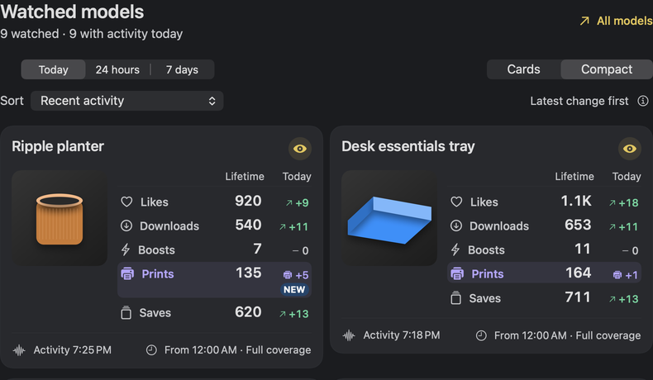
MAKERGLANCE / CARDS / COMPACT
One watchlist. Two ways to see it.
Same observations.
Your preferred density.
Sort by prints, saves, boosts,
downloads or likes. Choose
lifetime totals or gains in your
selected window.
Cards or Compact. All observations preserved.
Same observations, selection and activity order. Persistent view choice. Text size from 85–150%.
Notes:
MAKERGLANCE / CARDS / COMPACT
One watchlist. Two ways to see it.
[Figure: Native Compact watched-model section, with all metric rows and original fictional model illustrations.]
Same observations.
Your preferred density.
Sort by prints, saves, boosts,
downloads or likes. Choose
lifetime totals or gains in your
selected window.
Cards or Compact. All observations preserved.
Same observations, selection and activity order. Persistent view choice. Text size from 85–150%.
All demo identities and values are fictional. No account balances or private inbox are pictured.

Slide 5
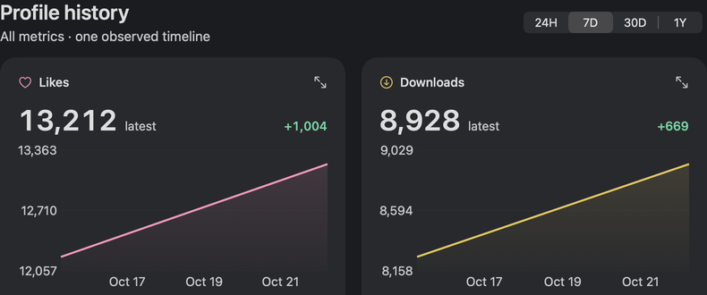
MAKERGLANCE / YOUR TIMELINE
Your observations become a timeline.
Today
Rolling windows
Server reports
Local calendar midnight to midnight, with
explicit observation coverage.
24 hours and 7 days show observed changes
in the selected period.
Available Creator Center reports keep their
UTC dates separate.
Notes:
MAKERGLANCE / YOUR TIMELINE
Your observations become a timeline.
[Figure: Native local history mosaic showing fictional metrics on independent scales with one shared date range.]
Today
Local calendar midnight to midnight, with
explicit observation coverage.
Rolling windows
24 hours and 7 days show observed changes
in the selected period.
Server reports
Available Creator Center reports keep their
UTC dates separate.
All demo identities and values are fictional. No account balances or private inbox are pictured.

Slide 6
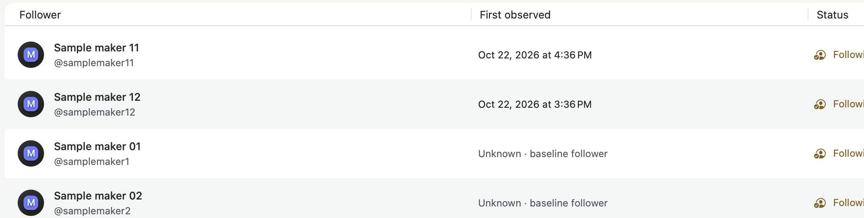
MAKERGLANCE / COMMUNITY
Remember first seen. Keep dates honest.
Baseline
First observed
Search & sort
Existing follower dates stay unknown.
New accounts get a local observation
time.
Bring order to the community list.
First observed is never presented as the original follow-relationship date.
Notes:
MAKERGLANCE / COMMUNITY
Remember first seen. Keep dates honest.
[Figure: Native fictional follower table showing first-observed new accounts and an unknown baseline follower date.]
Baseline
Existing follower dates stay unknown.
First observed
New accounts get a local observation
time.
Search & sort
Bring order to the community list.
First observed is never presented as the original follow-relationship date.
All demo identities and values are fictional. No account balances or private inbox are pictured.

Slide 7
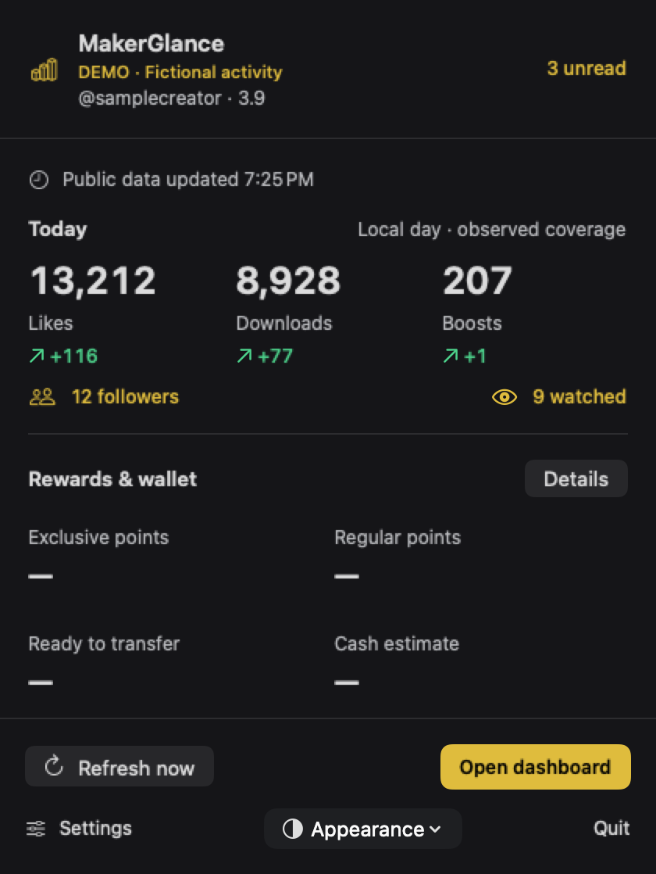
MAKERGLANCE / DESKTOP WORKFLOW
Your studio, a menu-bar click away.
Scan unread activity
See Today changes and recent updates.
Jump back into a model
Refresh, open details or return to the dashboard.
Keep the window closed
Monitoring continues while the app is running.
Local notifications need macOS permission. Quitting or sleeping pauses checks.
Notes:
MAKERGLANCE / DESKTOP WORKFLOW
Your studio, a menu-bar click away.
Scan unread activity
See Today changes and recent updates.
Jump back into a model
Refresh, open details or return to the dashboard.
Keep the window closed
Monitoring continues while the app is running.
[Figure: Native fictional menu-bar summary with unread count, Today metrics, unavailable balance placeholders and quick actions.]
Local notifications need macOS permission. Quitting or sleeping pauses checks.
All demo identities and values are fictional. No account balances or private inbox are pictured.

Slide 8
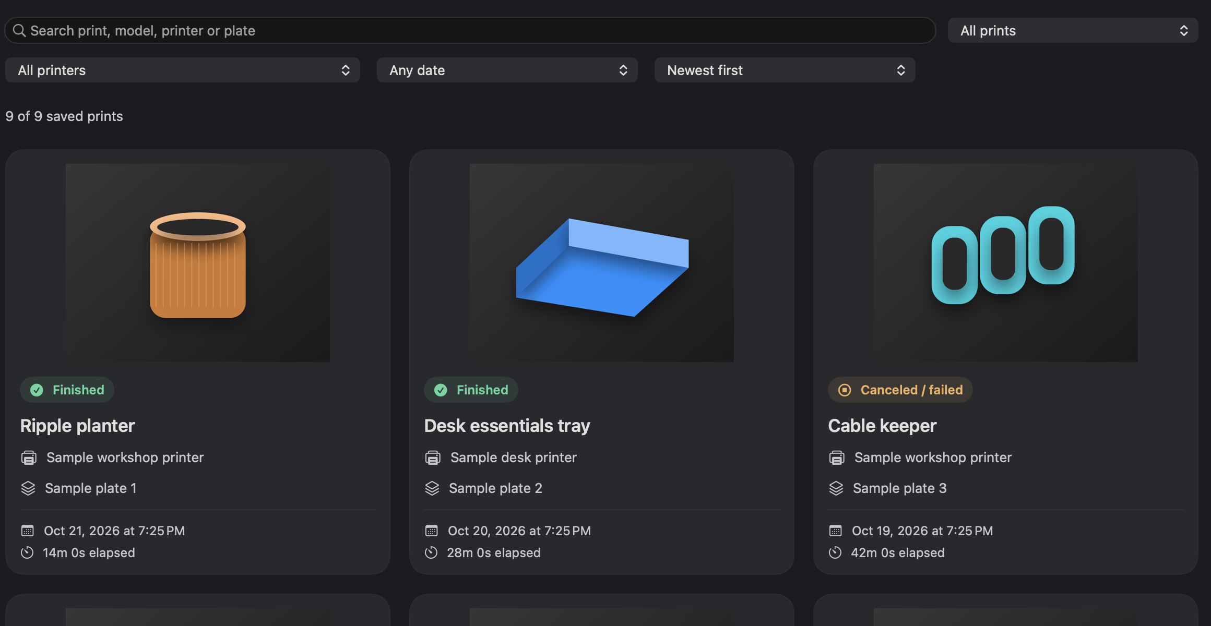
MAKERGLANCE / MY PRINTS
Your own prints. A useful history.
Find the job.
Search and filter your private
cloud history by model, printer,
plate, status or date.
Keep the facts clear.
Recorded elapsed time stays
separate from slice estimates.
Read-only, account-scoped local history. Cloud coverage varies; this is not live printer telemetry or public model print totals.
Notes:
MAKERGLANCE / MY PRINTS
Your own prints. A useful history.
[Figure: Native fictional My Prints history, with thumbnail cards, printer/plate context and finished or stopped statuses.]
Find the job.
Search and filter your private
cloud history by model, printer,
plate, status or date.
Keep the facts clear.
Recorded elapsed time stays
separate from slice estimates.
Read-only, account-scoped local history. Cloud coverage varies; this is not live printer telemetry or public model print totals.
All demo identities and values are fictional. No account balances or private inbox are pictured.

Slide 9
MAKERGLANCE / TRUST & BOUNDARIES
Local data. Clear boundaries.
History on your Mac
Sessions in Keychain
SQLite observations and preferences. The app does
not encrypt the database.
User-initiated sign-in, creator validation and no saved
password.
Read-only monitoring
Undocumented services
No redemption, withdrawal, transfer or
server-message-read actions.
Availability and schemas can change. Missing data and
reasons stay explicit.
Independent, unofficial companion. Not affiliated with or endorsed by Bambu Lab or MakerWorld.
Notes:
MAKERGLANCE / TRUST & BOUNDARIES
Local data. Clear boundaries.
History on your Mac
SQLite observations and preferences. The app does
not encrypt the database.
Sessions in Keychain
User-initiated sign-in, creator validation and no saved
password.
Read-only monitoring
No redemption, withdrawal, transfer or
server-message-read actions.
Undocumented services
Availability and schemas can change. Missing data and
reasons stay explicit.
Independent, unofficial companion. Not affiliated with or endorsed by Bambu Lab or MakerWorld.
All demo identities and values are fictional. No account balances or private inbox are pictured.

Slide 10
MAKERGLANCE / GET STARTED
Build your creator workspace.
Native macOS. One focused view of what you observed.
swift test
bash scripts/build.sh
open dist/MakerGlance.app
MakerGlance
Source preview · MIT
github.com/t0nyz0/MakerGlance
macOS 14+ target · Swift 6 · Xcode 16+
Private preparation. No public binary or notarized release is being advertised.
Notes:
MAKERGLANCE / GET STARTED
Build your creator workspace.
Native macOS. One focused view of what you observed.
swift test
bash scripts/build.sh
open dist/MakerGlance.app
[Figure: Original MakerGlance app icon]
MakerGlance
Source preview · MIT
github.com/t0nyz0/MakerGlance
macOS 14+ target · Swift 6 · Xcode 16+
Private preparation. No public binary or notarized release is being advertised.
All demo identities and values are fictional. No account balances or private inbox are pictured.

