Slide 1
Md. Hamidul Islam
Reg:

Slide 3
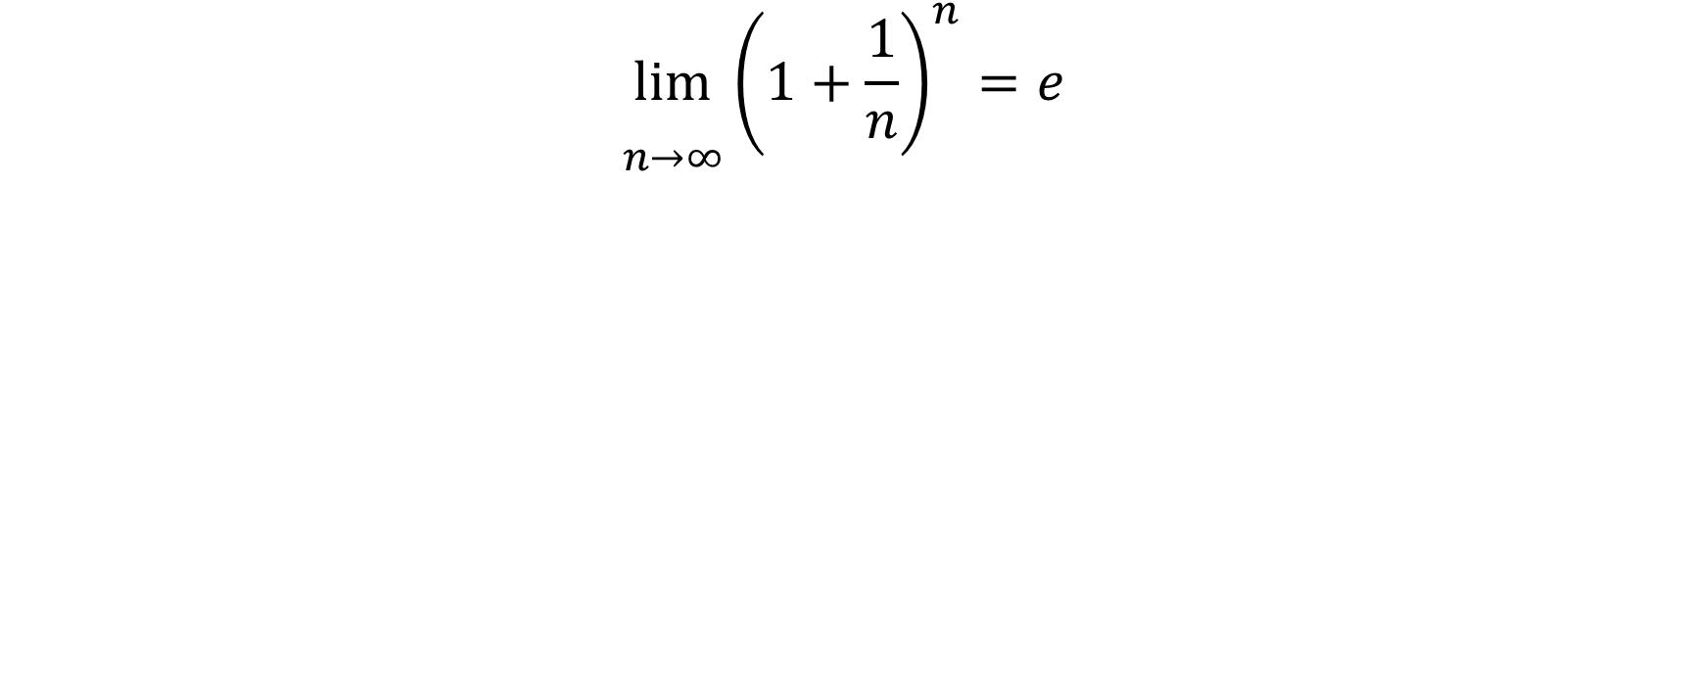
Equation
$$\lim_{\begin{aligned} \\ n→∞\end{aligned}}{{\left(1+\frac{1}{n}\right)}^{n}}=e$$

Slide 4
Task analysis
CBC
CBLM
CS
Infographic

Slide 6
Thank You

