Slide 1
機器學習報告
工管三乙106370233葉松錞

Slide 2
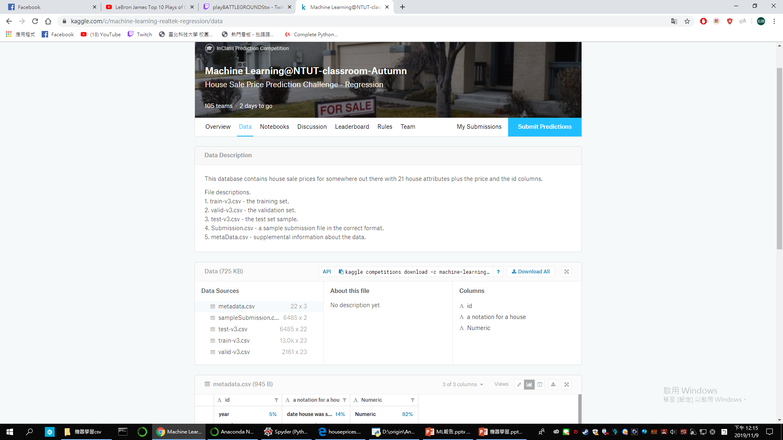
抓檔案

Slide 3
需要安裝的工具
Python
Keras
Tensorflow
Pandas
Numpy
Sklearn等等..

Slide 4
程式方塊圖
讀檔
正規化
跑模型
修改模型
預測結果

Slide 5
匯入模組
import pandas as pd
import numpy as np
from keras.models import Sequential
from keras import optimizers
from keras.layers import *
from keras.callbacks import *
from sklearn.preprocessing import *

Slide 6
讀取檔案
df_train = pd.read_csv('train-v3.csv')
df_valid = pd.read_csv('valid-v3.csv')
df_test = pd.read_csv('test-v3.csv')

Slide 7
選擇要的位置轉成numpy檔+預處理
data_title=['bedrooms','bathrooms', 'sqft_living', 'sqft_lot', 'floors', 'waterfront', 'view','condition', 'grade', 'sqft_above', 'sqft_basement', 'yr_built','yr_renovated', 'zipcode', 'lat', 'long', 'sqft_living15','sqft_lot15']
df_train.drop(['id'],inplace = True,axis=1)
df_valid.drop(['id'],inplace = True,axis=1)
df_test.drop(['id'],inplace = True,axis=1)
Y_train = df_train["price"].values
X_train = df_train[data_title].values
Y_valid = df_valid["price"].values
X_valid = df_valid[data_title].values
X_test = df_test[data_title].values
X_train_normal = scale(X_train)
X_valid_normal = scale(X_valid)
X_test_normal = scale(X_test)

Slide 8
第一次(沒有用模型預測)
regr = LinearRegression()
regr.fit(X_train, Y_train)
regr.coef_
regr.intercept_
regr.score(X_train,Y_train)
y_test=regr.predict(X_valid)
((Y_valid - regr.predict(X_valid))**2).sum()
final=regr.predict(X_test)
final=pd.DataFrame(final)

Slide 9
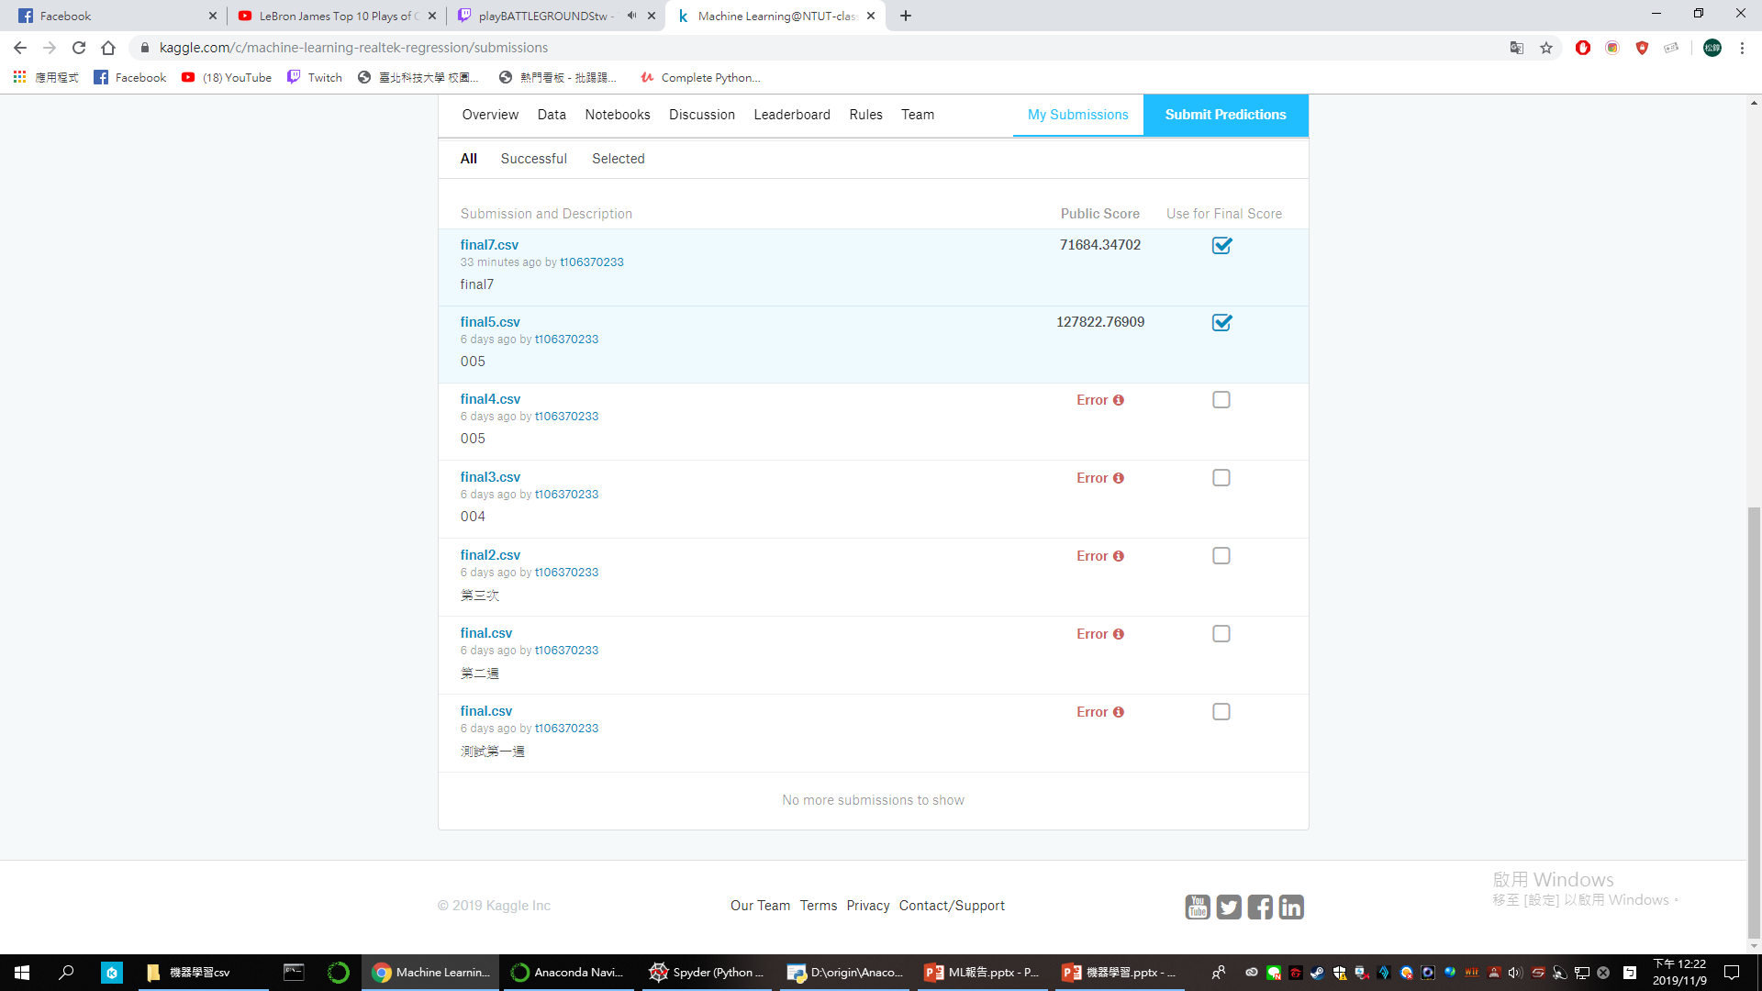
沒用模型預測的結果
沒用模型去預測的情況下MAE只有127822

Slide 10
訓練模型
model = Sequential()
model.add(Dense(40, input_dim=X_train.shape[1], kernel_initializer='normal',activation='relu'))
model.add(Dense(80, kernel_initializer='normal',activation='relu'))
model.add(Dense(100, kernel_initializer='normal',activation='relu'))
model.add(Dense(80, kernel_initializer='normal',activation='relu'))
model.add(Dense(40, kernel_initializer='normal',activation='relu'))
model.add(Dense(1, kernel_initializer='normal'))
model.compile(loss='MAE', optimizer='adam')

Slide 11
訓練模型
nb_epoch = 500
batch_size = 32
file_name=str(nb_epoch)+'_'+str(batch_size)
TB=TensorBoard(log_dir='logs/'+file_name, histogram_freq=0)
model.fit(X_train_normal, Y_train, batch_size=batch_size, nb_epoch=nb_epoch,verbose=1, validation_data=(X_valid_normal, Y_valid),callbacks=[TB])
#%%

Slide 12
儲存檔案
Y_predict = model.predict(X_test_normal)
np.savetxt('test_16.csv', Y_predict, delimiter = ',')
Y_predict=pd.DataFrame(Y_predict)
Y_predict.to_csv('final7.csv')

Slide 13
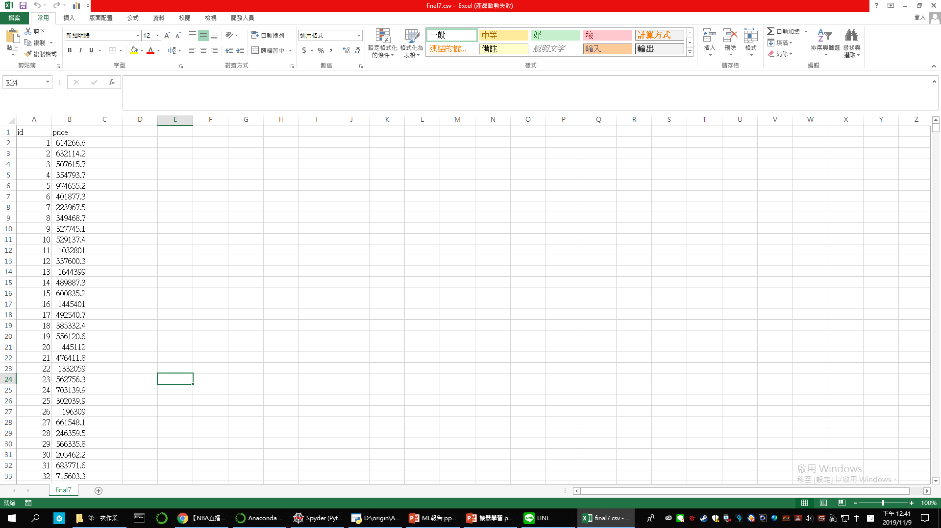
最後的檔案
加入id
加入price
修改id的數字

Slide 14
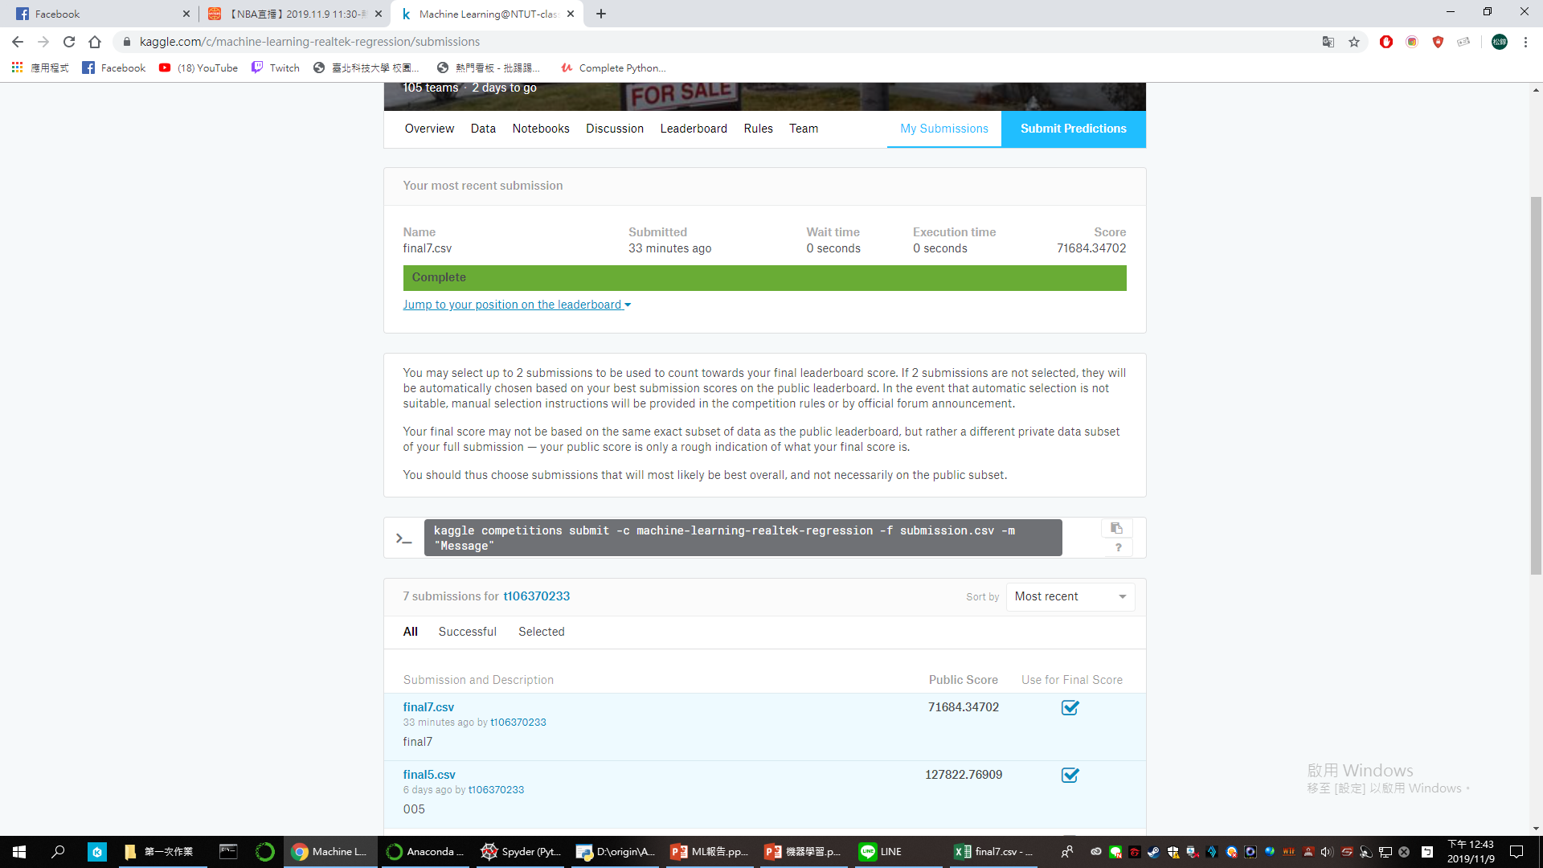
最後的分數
從12萬多的MAE變成7萬的多的MAE下降了5萬多

Slide 15


