Slide 1
Lab 1 Cadence Tutorial:
Getting Started
VLSI Design and Lab

Slide 2
Objective
The objective of this lab is to get the student familiar with the Cadence toolset we will be using in this course. Schematic Capture and Virtuoso layout will be used.

Slide 3
Getting Started
You will need access to your Linux account.

Slide 4
Some general unix commands
Here are some general commands you might use.
  Remove a file -> “rm <filename>”
  Copy a file -> “cp <filename> <destination>”
  Make a directory -> “mkdir <dir. Name>”
  To bring up another window -> “xterm &”
  The most important one to start Cadence
    Type “icfb &” : Note the “&” brings up another window so that you have access to the root directory in addition to Cadence.

Slide 5
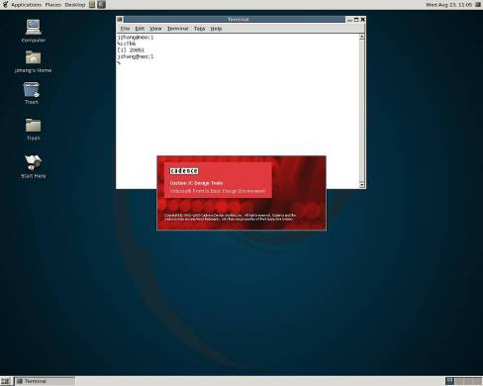
Starting Up
Step 1 : Create a new folder name “project”.
Step 2 : Enter the project folder.
Step 3: Now type “ icfb &” to start cadence in the command prompt. A screen like this should pop up with the Cadence display:

Slide 6
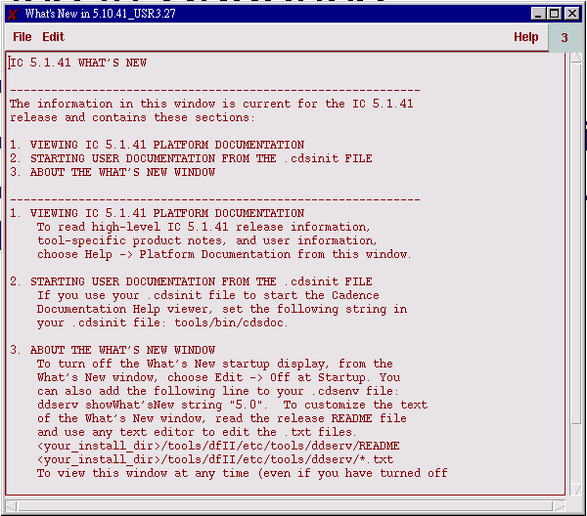
Once in Cadence
A “Cadence Update” and “Whats New” windows will pop up.
Read them if you wish. You can close these windows thereafter.

Slide 7
Once in Cadence
There are 2 windows of utmost importance.
  The log window
    Provides a log of all your actions. Most design rule messages or errors will pop up in this window.
  The library manager
    Access your design files

Slide 8
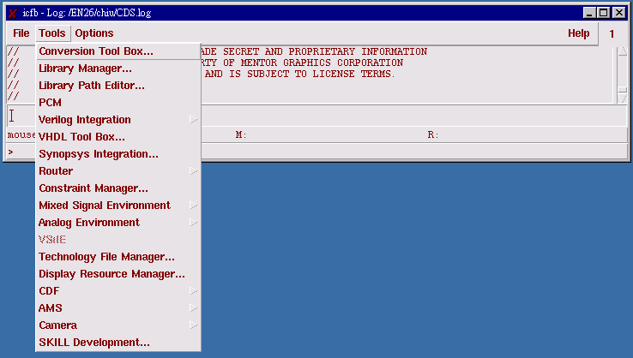
Log window
All kind of tools are under the Tools Tab.

Slide 9
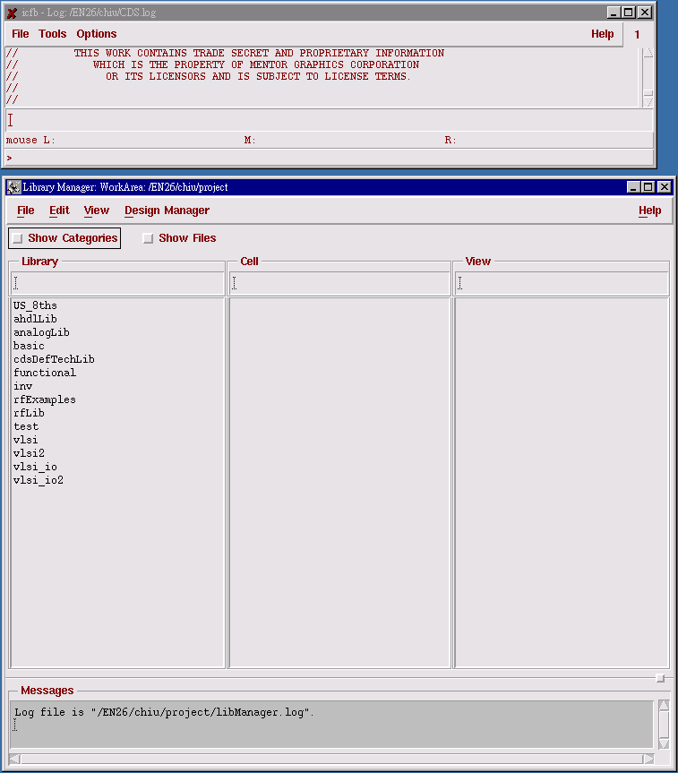
Library Manager

Slide 10
Prepare for a project
Create this folder project folder.
Copy files from the /VLSI01/EELAB/techfile to you project folder.
1. model_course.scs => This is a model file
2. display => This a display file
3. techfile.tf => a technology file

Slide 11
Setting up an new Library

Slide 12
Adding vlsi_lab Library
Browse in the library manager menu to :
  File->New>Library
  A “Create Library” Window should pop up.

Slide 13
Adding vlsi_lab Library
Browse in the library manager menu to :
  Type in vlsi_lab for the new library name.
  No attachment is necessary, select ok to complete.
  The inv folder should now show up in your library manager.

Slide 14
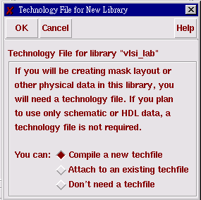
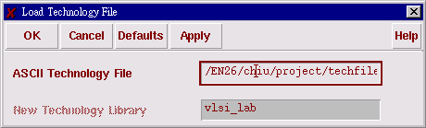
Lets create a library
It should look something like this. You can choose any Library new you want.
Press Ok in top left corner to continue.

Slide 15
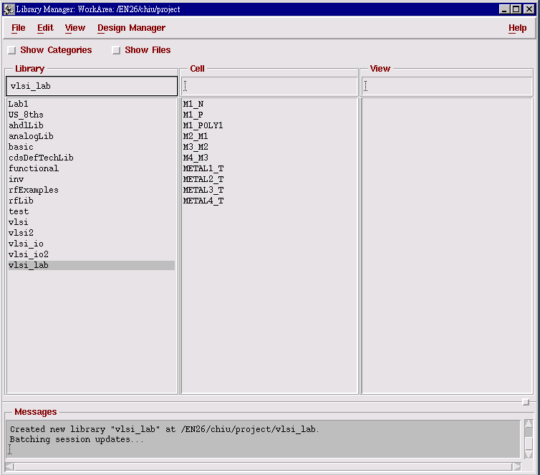
Lets create a library
If everything was inputted correctly (vlsi_lab) should show up in the library manager.
EE7356

Slide 16
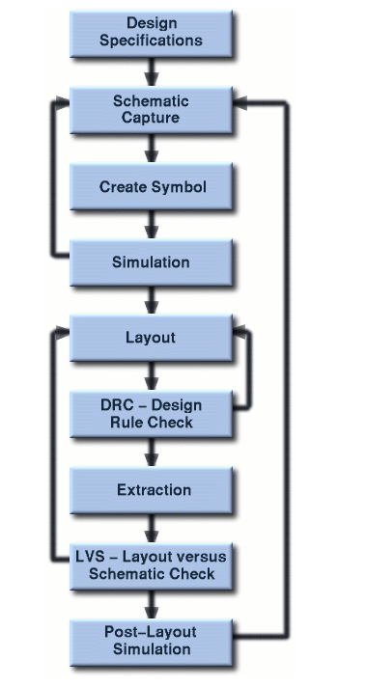
Design Flow
This is the normal design flow.

Slide 17
Designing an NMOS design in
Virtuoso Schematic Editor

Slide 18
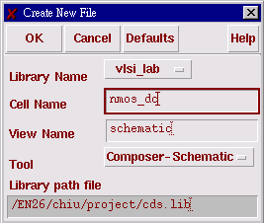
Virtuoso Schematic Editor
First we will start with a schematic.
In the Library Manager window click on your new created library “vlsi_lab”
  Next click on File->New->Cell view
  A window like the one below should pop up. Proceed to enter a cell view name “nmos_dc” . Make sure in View Name it says “schematic” and in Tool it says “Composer-Schematic”. Press Ok to continue.

Slide 19
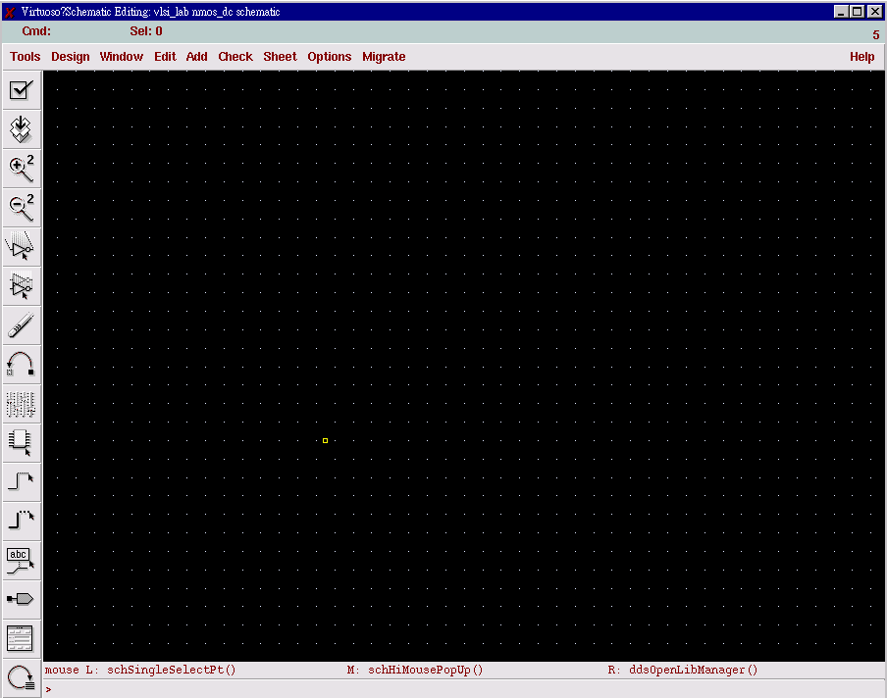
Virtuoso Schematic Editor
If you did everything correctly we can now layout an inverter schematic. You should have a screen like this:

Slide 20
Virtuoso Schematic Editor

Slide 21
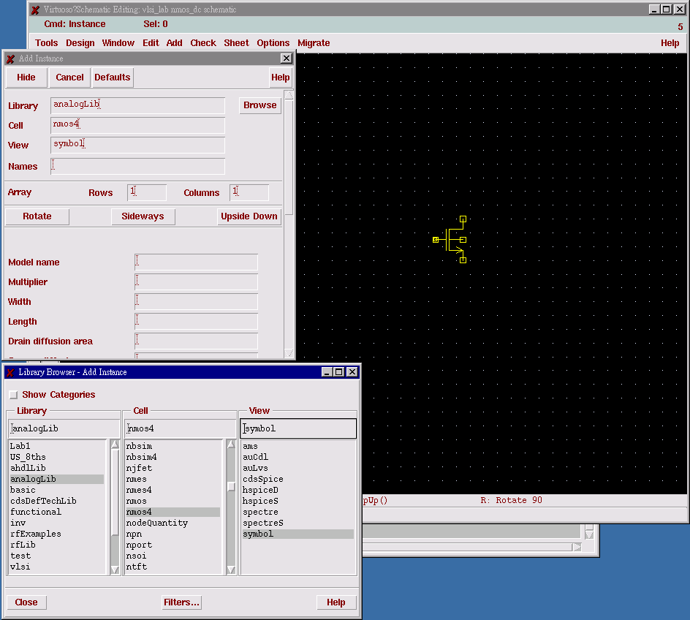
Virtuoso Schematic Editor
Now browse to
  Add->Instance. The windows below should pop up. Make sure in the Component Browser window that you select analogLib as the library.

Slide 22
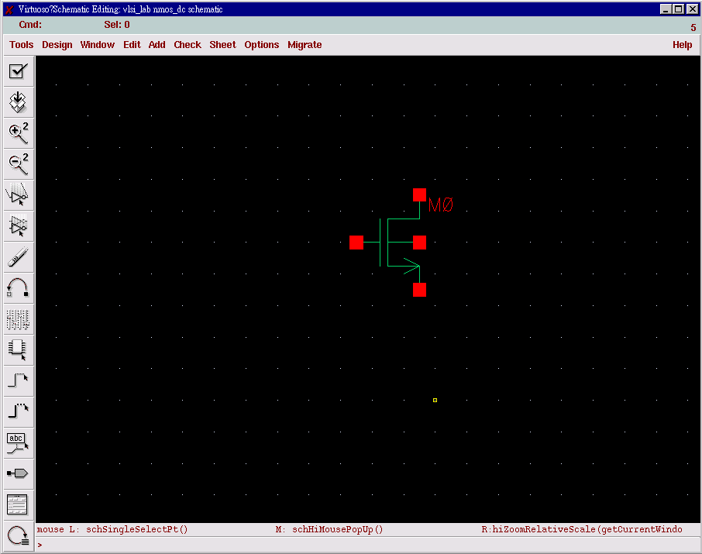
Virtuoso Schematic Editor
In the Library browser select: analogLib->nmos4->symbol
Then put the symbol of the nmos in your schematic.

Slide 23
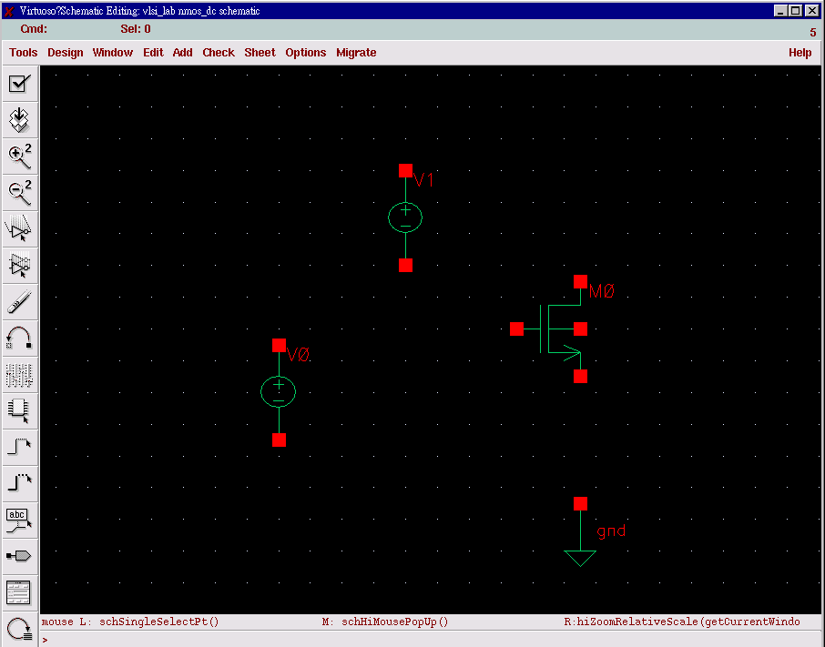
Virtuoso Schematic Editor
Add DC source and gnd in the schematic.

Slide 24
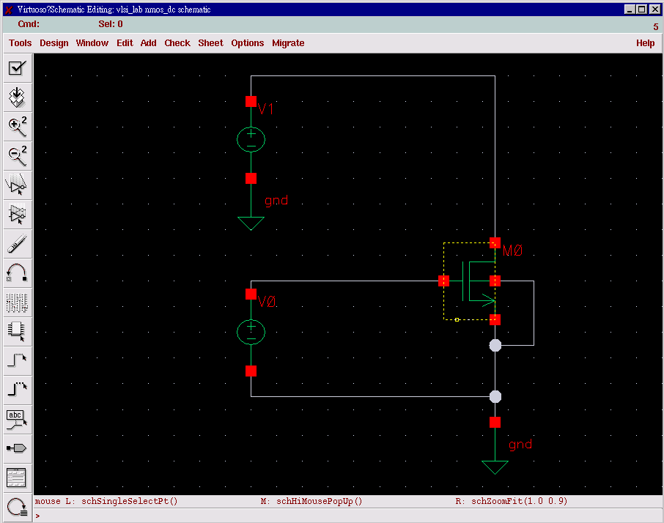
Virtuoso Schematic Editor
Connect each node with Wire (w).

Slide 25
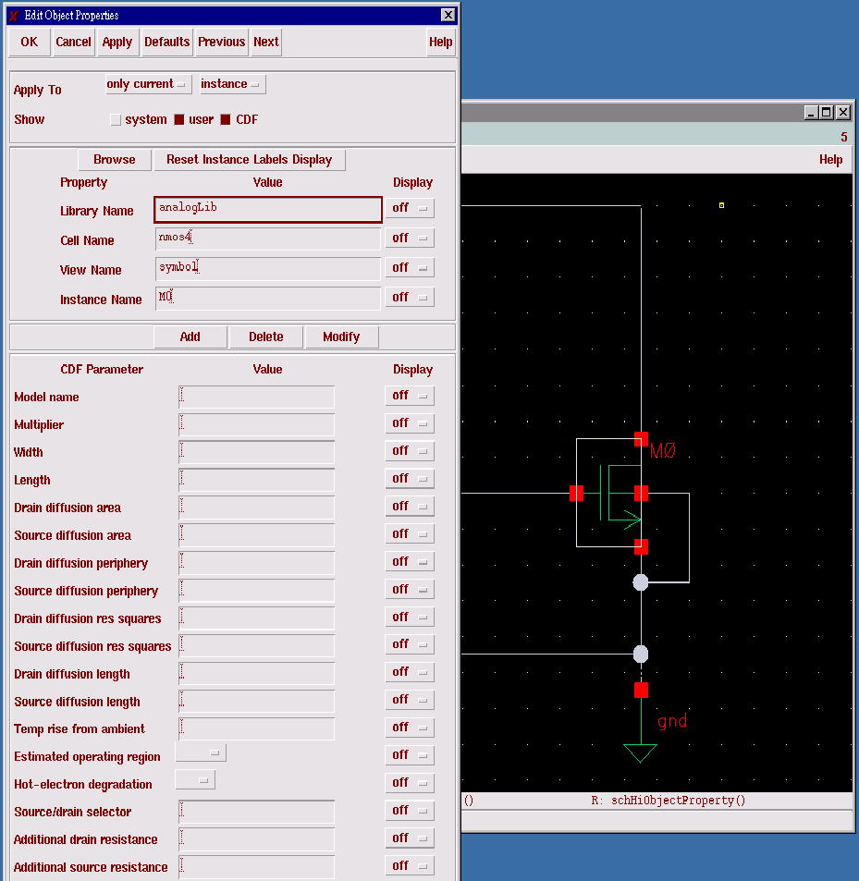
Device property
You can set the width 10u and length 350n in the property table of the device. You have one finger since m=1(one strip of poly).
You should have something that looks like this:

Slide 26
Virtuoso Schematic Editor
A simple setup of DC analysis for a NMOS.
  V_{DD} = 3V
  V_{G} = 1V
  W = 10um
  L = 0.35um
  M = 1
  Model name : nch
* ( nch for NMOS, pch for PMOS)

Slide 27
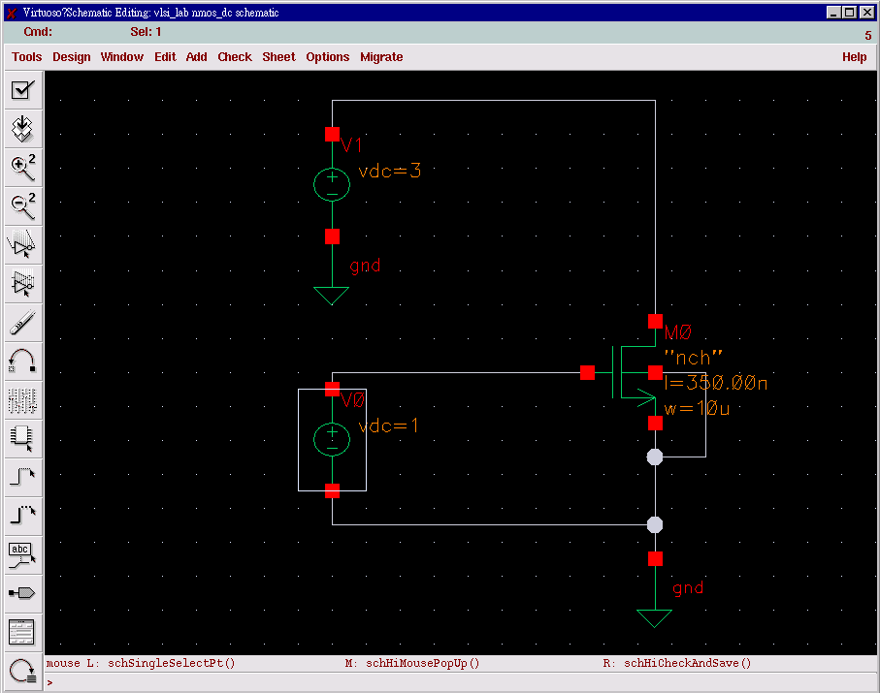
Schematic Capture
Once you have your schematic drawn click the “Check and Save” icon on the short but tool bar. In the log window it should report no errors. If you have errors follow the error report in the log file and fix the error and run “Check and Save” again.
You should end up with something like this:

Slide 28
Hot key in Schematic Editor
This concludes the schematic capture.
For reference here are a list of quick keys
Break out of a command | ESC
Undo | u
Redo | U
Copy | c
Move | m
Fit the design to the window | f
Edit Properties of an object | q
Descend (readonly) into the object (hierarchy) | e
Descend (editable) into the object (hierarchy) | E
Return (move back up hierarchy) | CTRL+
Redraw (refresh) | F6
Add Instance | i
Add Wire | w
Add Wide Wire | W
Add Wire Name | l
Add Pin | p

Slide 29
DC Analysis

Slide 30
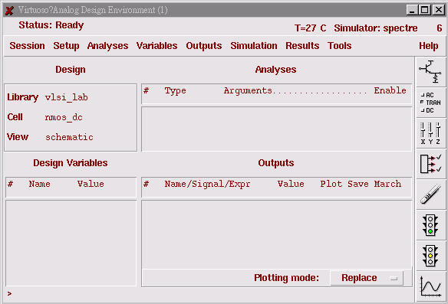
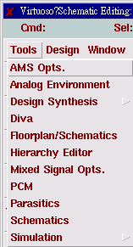
Analog Design Enviroment

Slide 31
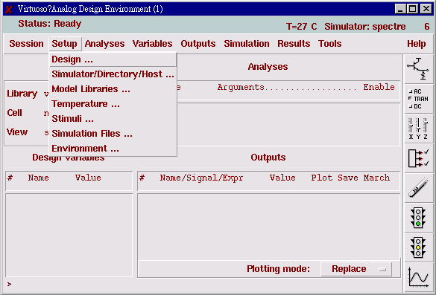
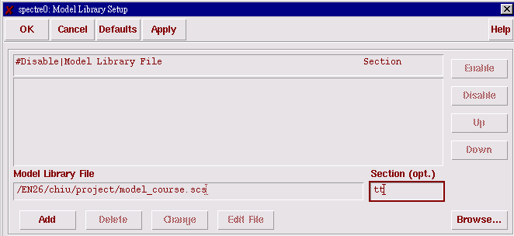
Analog Design Enviroment
Setup the model name and section

Slide 32
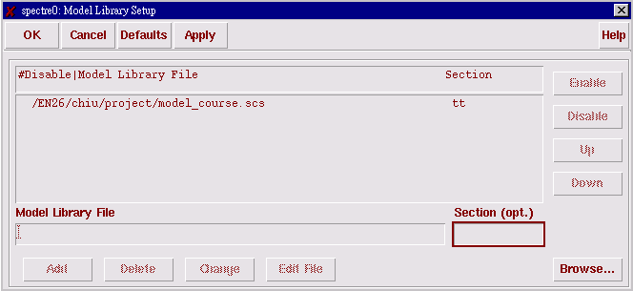
Model Library Setup
Use the Brower… in the right lower corner to choose your model_course.scs.
Type “tt” in the seciton
Click Add button

Slide 33
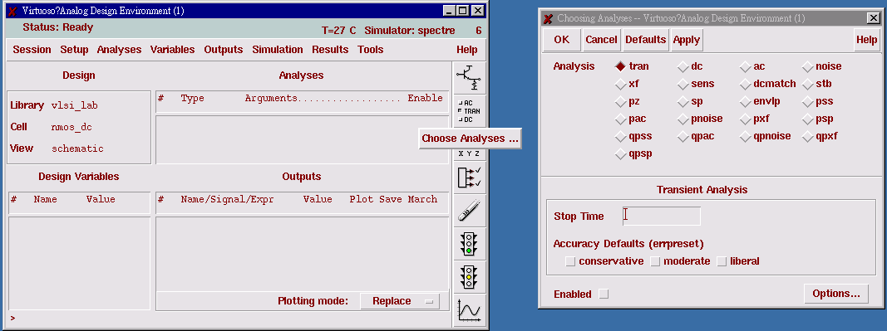
Choose Analysis
DC Analysis

Slide 34
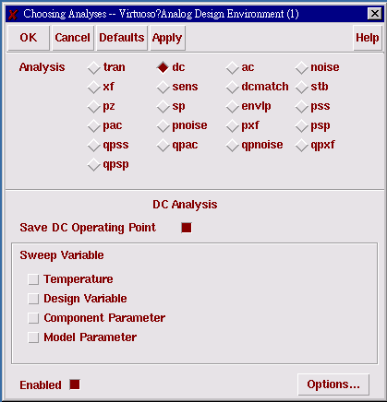
Setup DC Analysis
Choose the dc for DC Analysis
Check the “Enable” and “Save DC Operating Point”

Slide 35
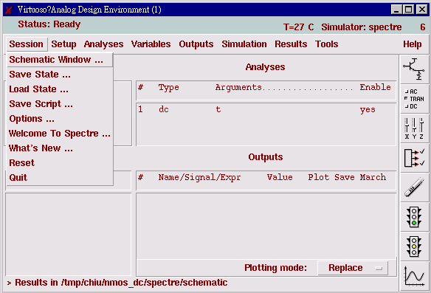
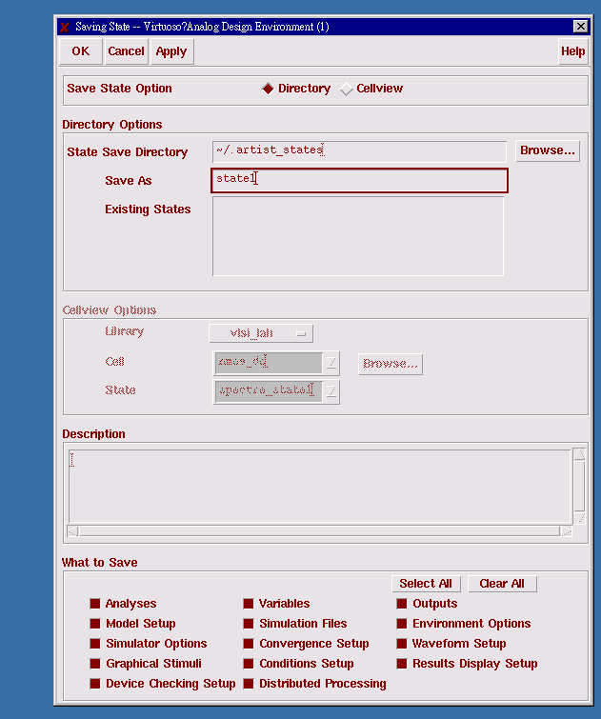
Save State

Slide 36
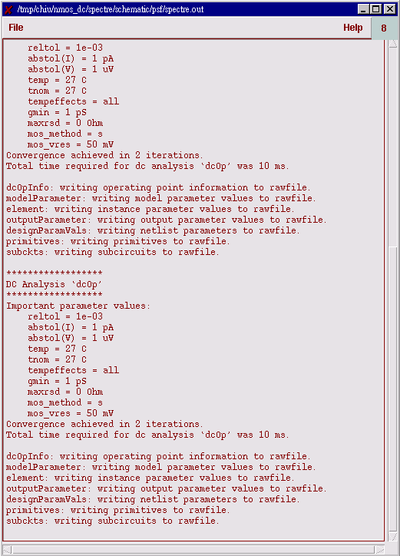
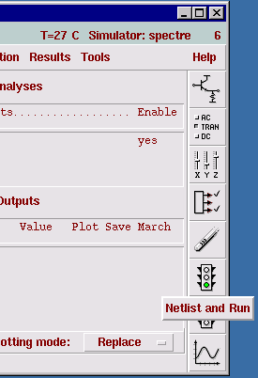
Begin simulation
Netlist and Run

Slide 37
Watch Results

Slide 38
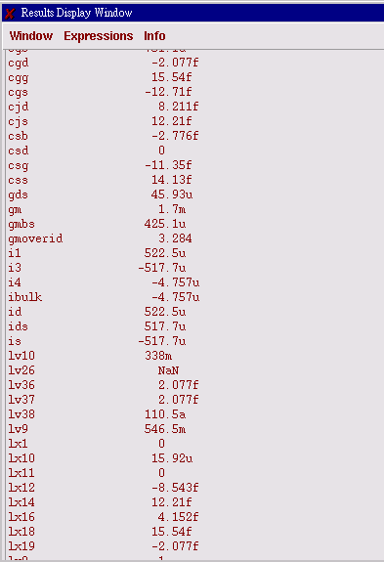
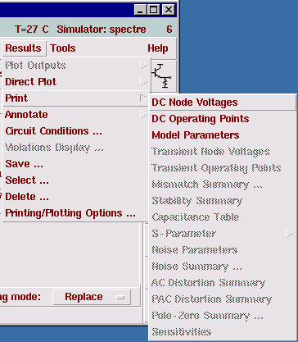
We got the current value

Slide 39
Excise1
Please find out the PMOS current.
*This PMOS also has the same device size and bias condition (vsg =1V, Vsd = 3.3V) with previous NMOS.

