Slide 1
Lab 2 Spectre Simulation
VLSI Design and Lab

Slide 2
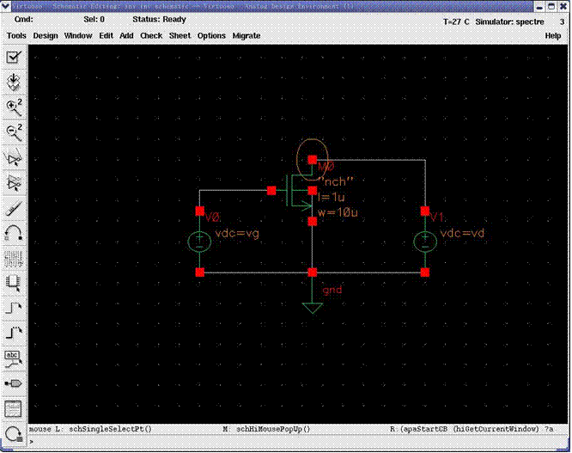
NMOS

Slide 3
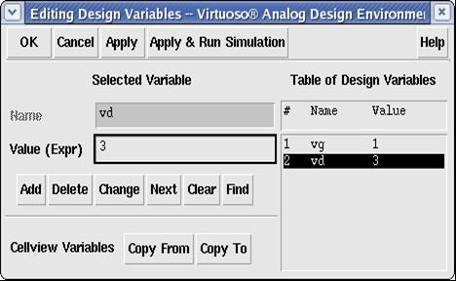
Variable Setup

Slide 4
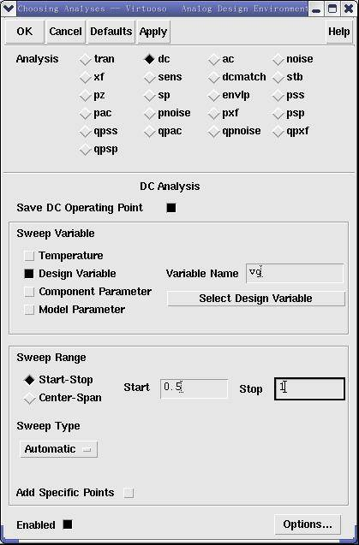
DC Source Setup
Variable sweeping method 1

Slide 5
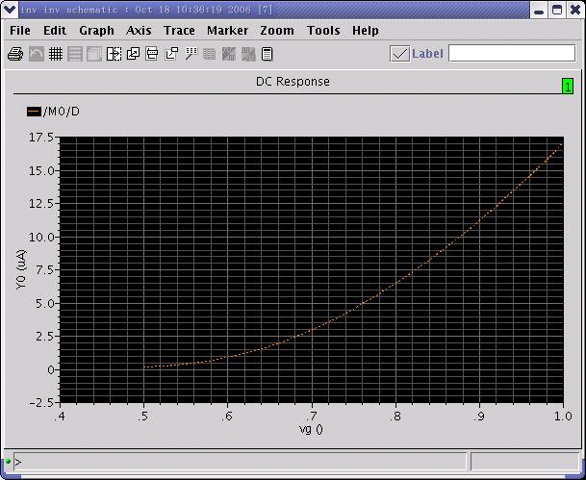
DC Response plot
Vg – Id characteristics

Slide 6
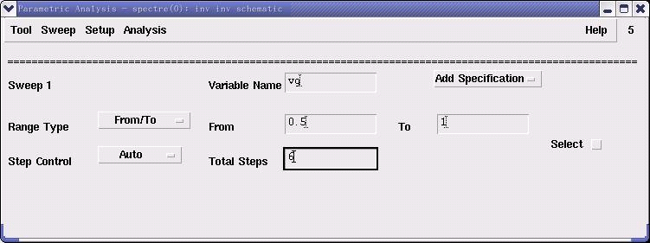
Parameter Analysis
Variable sweeping method 2

Slide 7
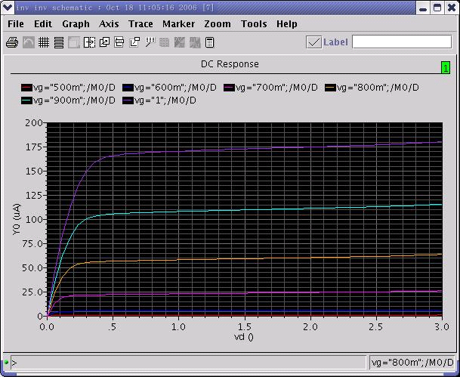
Lab 2 Excise
Plot the IV curve of a NMOS with device size of W=10u, L=1u, like this graph.

