Slide 1
Lab 3: Inverter Simulation
VLSI Design and Lab

Slide 2
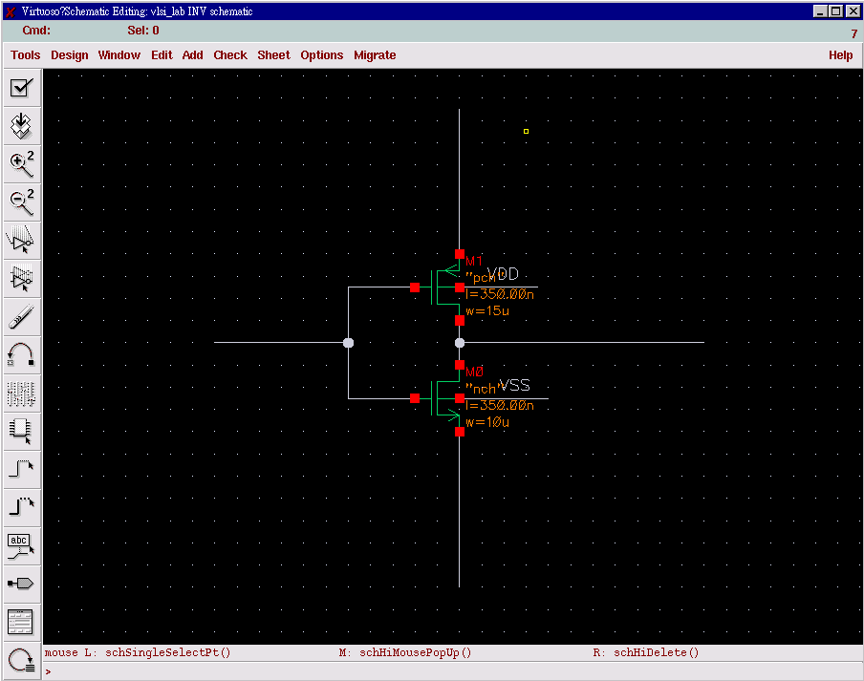
Create an INV schematic

Slide 3
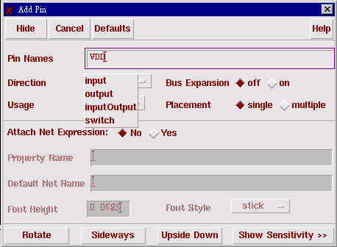
Add pin on the schematic
Hotkey “p” to add pin
Four directions : they are used to check circuit connectivities.

Slide 4
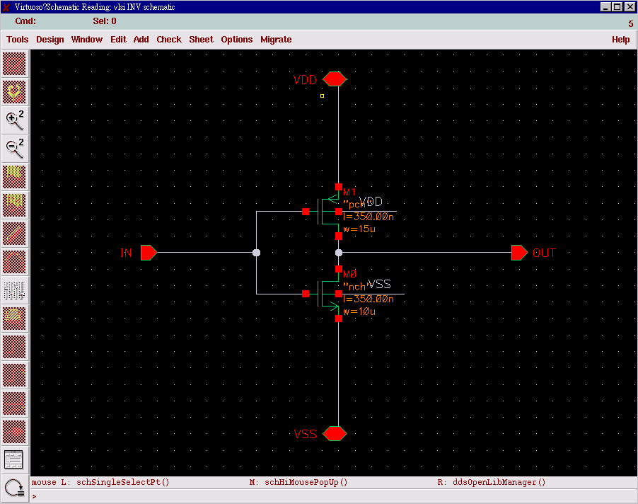
Create an INV schematic
Add Pin with a hotkey ‘

Slide 5
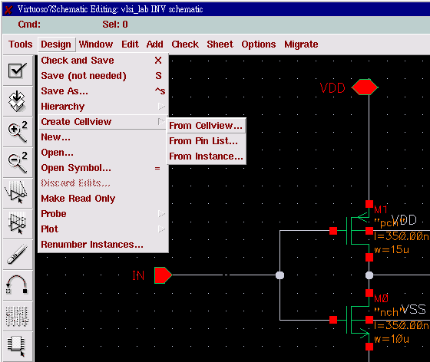
Create Symbol view

Slide 6
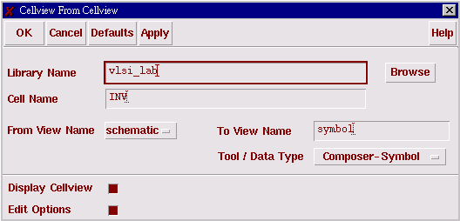
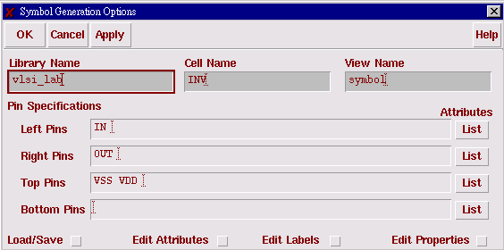
Create Symbol view
These settings will create the pin location automatically

Slide 7
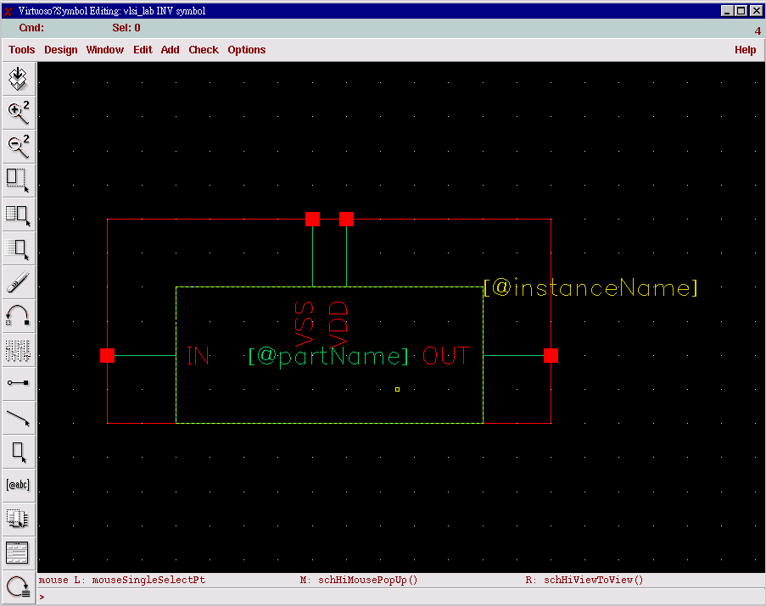
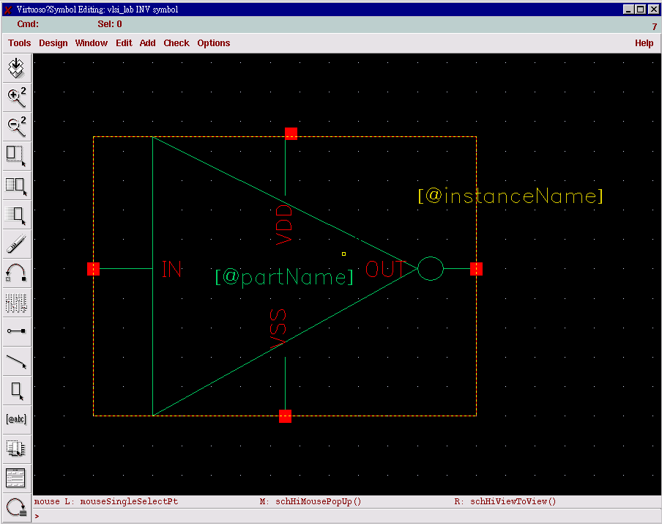
Create Symbol view
usable but not reasonable
usable and visiable

Slide 8
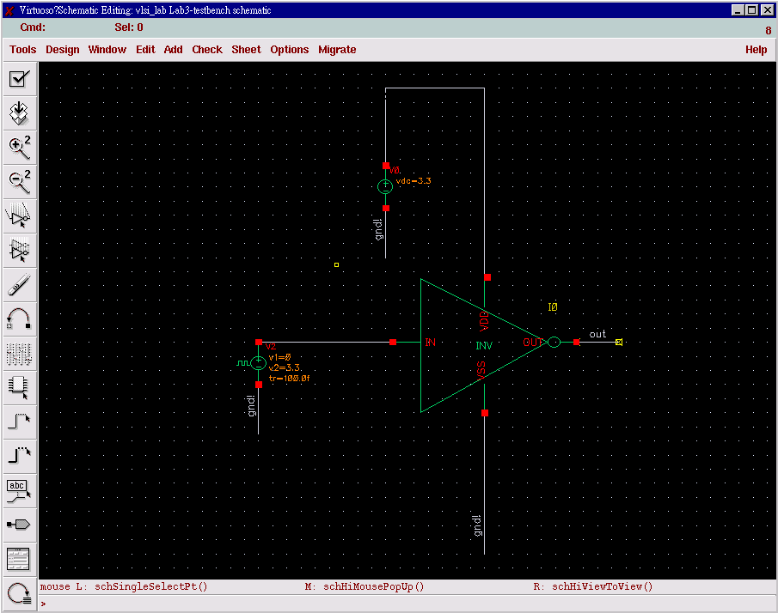
Test bench for INV simulation

Slide 9
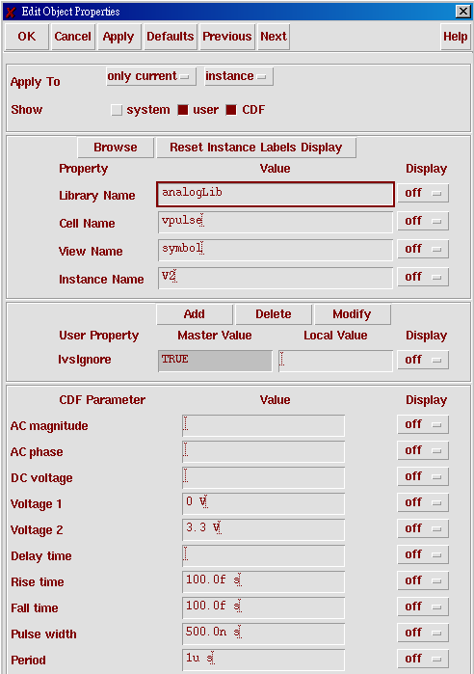
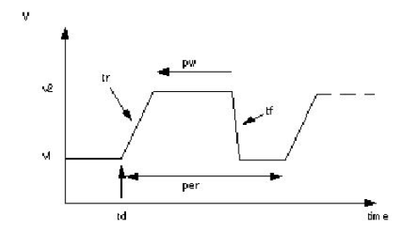
Pulse setup

Slide 10
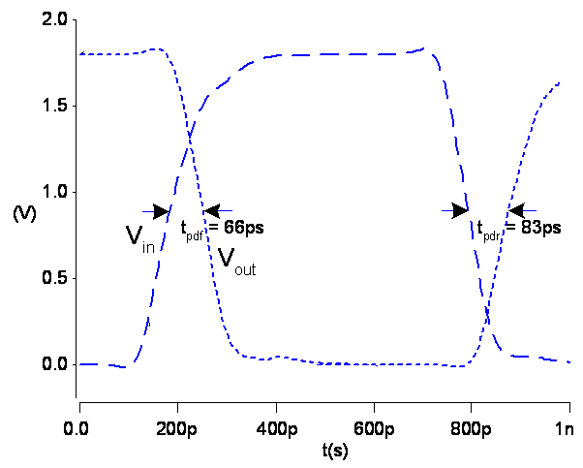
tpHL(tpdf),tpLH(tpdr)
Rising time
90%VDD
falling time
90%VDD
10%VDD
10%VDD

Slide 11
Lab3
Please design an inverter and meet the following specifications together :
  Please tune the device size and plot the transfer function with Vth=0.5*Vdd=1.65V.
  Measure the propagation delay tpHL(tpf),tpLH(tpr), which both are < 30ps.
  Measure rising time and falling, which both are < 40ps.

