Slide 1
Lab 4: Ring Oscillator Simulation
VLSI Design and Lab

Slide 2
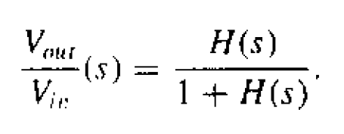
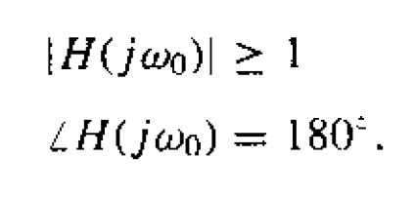

How to oscillate?
Barkhausen criteria

Slide 3
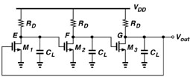
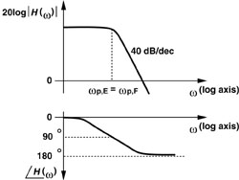
Three stages ring oscillator

Slide 4
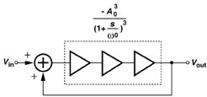
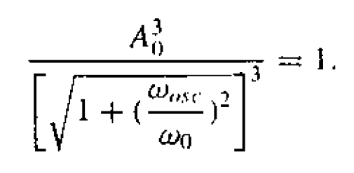



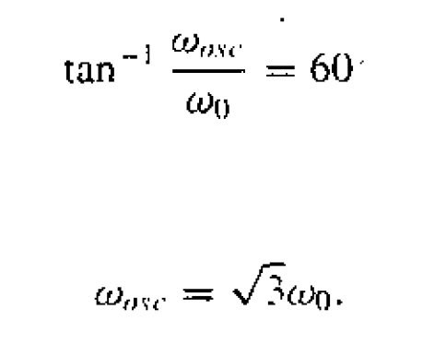
Barkhausen criteria
Let it oscillate

Slide 5
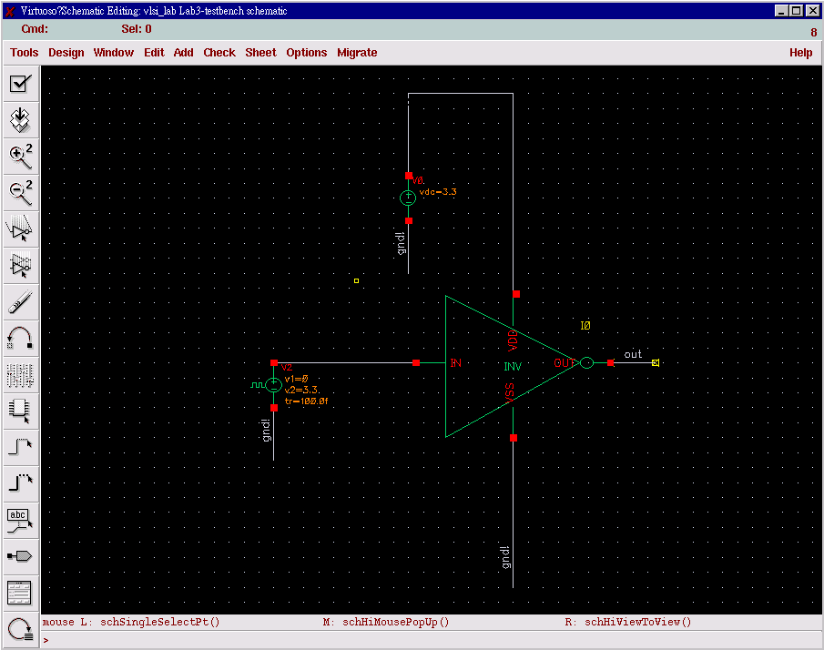
Test bench for INV simulation

Slide 6

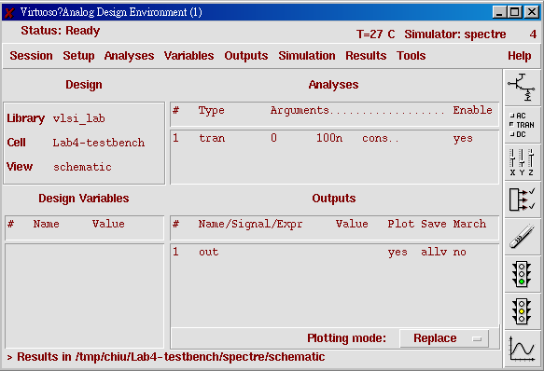
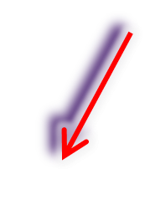
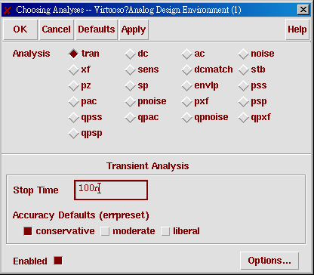
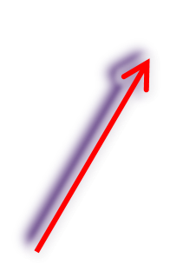
Transcient Analysis
1. Setup model
2. Setup tran analysis
3. Setup outputs

Slide 7
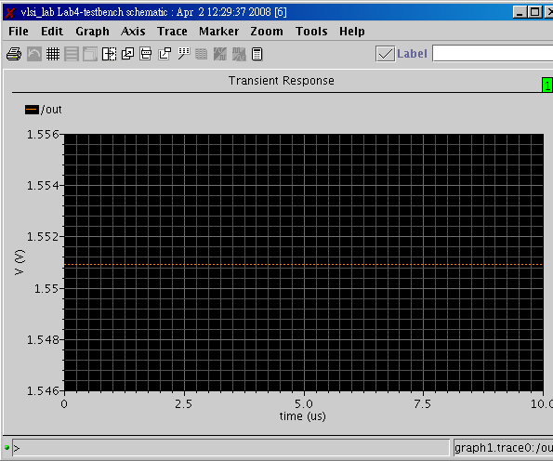
Not oscillating?

Slide 8
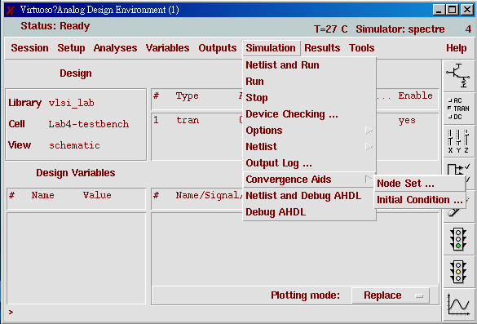
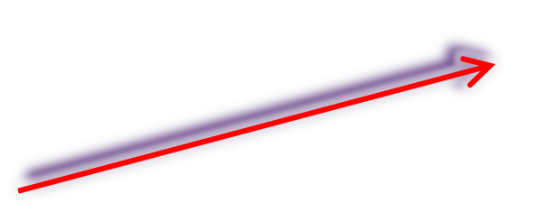
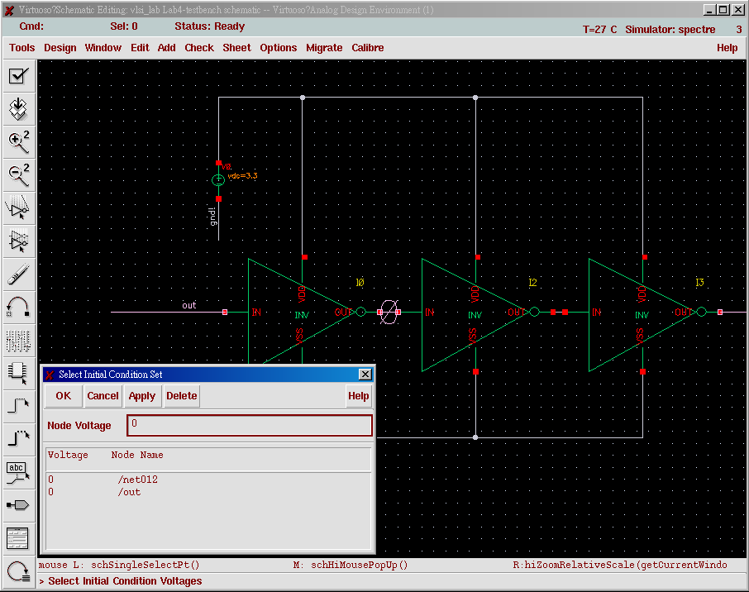
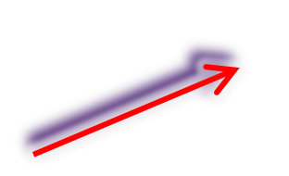
Initial
condition
1. Convergence Aids -> Initial Condition
2. Set node initial voltage

Slide 9
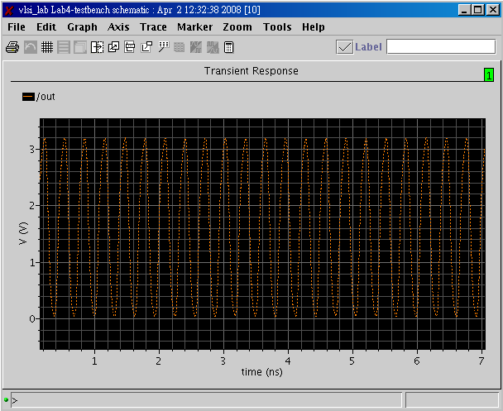
Oscillating

Slide 10
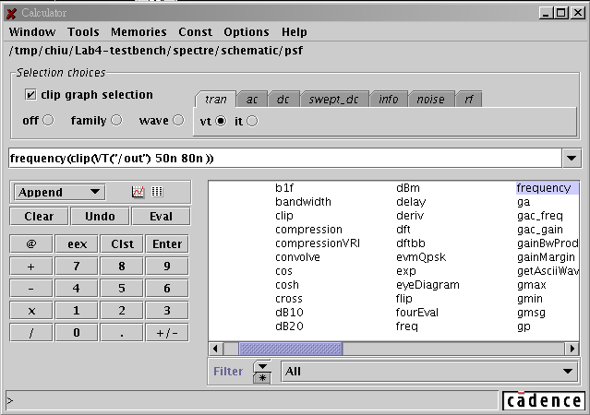
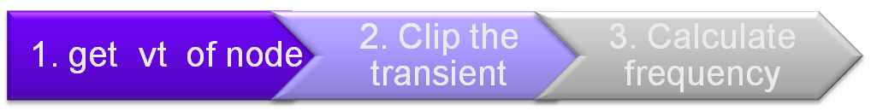
Calculate Frequency
Call Calculator

Slide 11
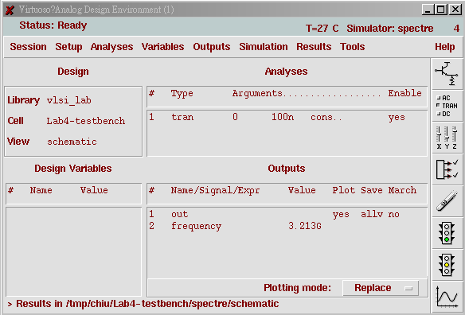
Get frequency in the Output

Slide 12
Lab4
Please use inverter to design a ring oscillator with 0.35um process. Its oscillating frequency must be located 2.4GHz within 10M offset.

