Slide 1
Lab 5: Voltage controlled Oscillator (VCO) Simulation
VLSI Design and Lab

Slide 2
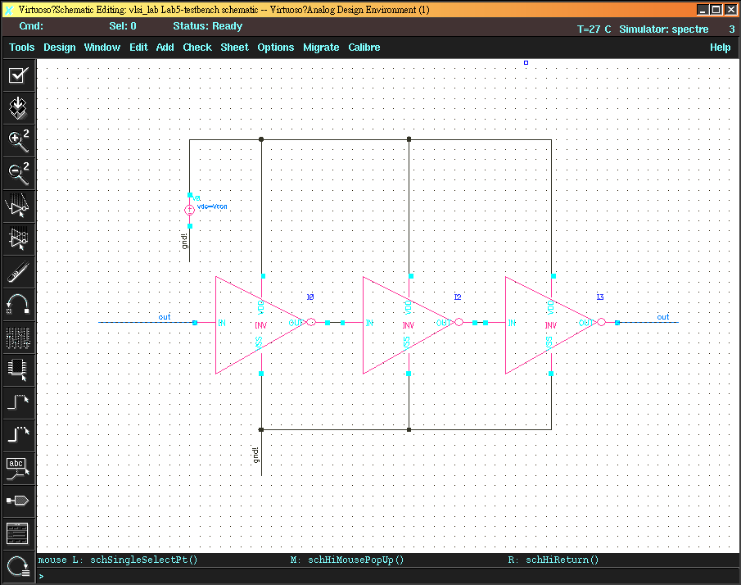
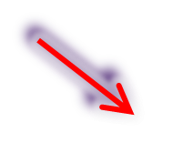
VDD-Controlled VCO
Vcon

Slide 3
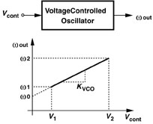
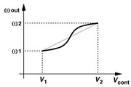
VCO Characteristics
Frequency range
Input control range
Note : KVCO is an important parameter to PLL design

Slide 4
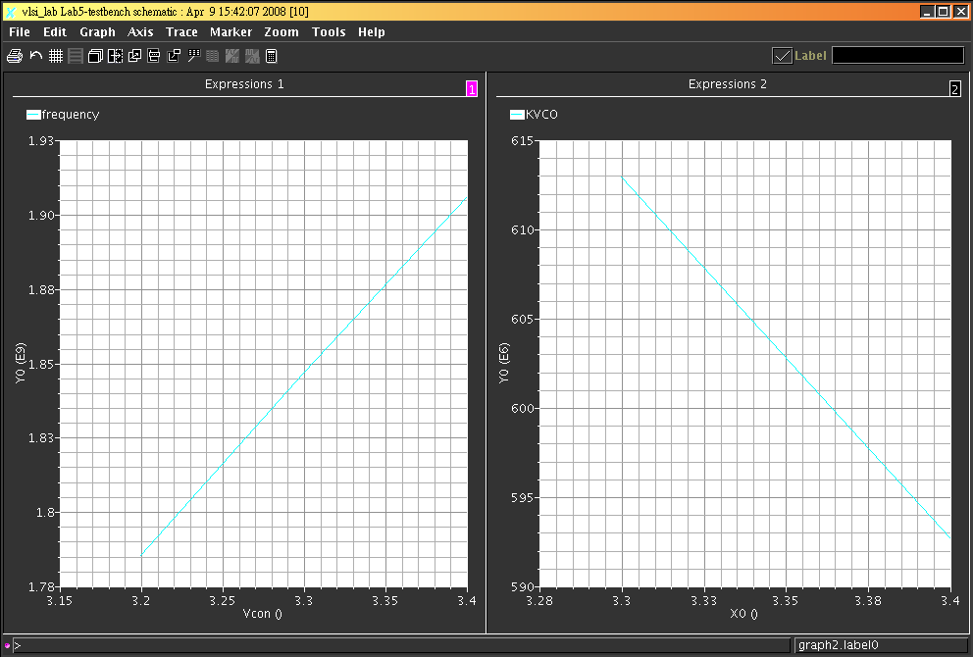
VCO Characteristics
Note : The KVCO can be calculated with “deriv” function defined in the Calculator tools

Slide 5
Lab5A
Please use inverter to design a VDD-controlled VCO with 0.35um process to meet all the following spec..
  In addition , the VDD control range is only from 3.2 ~ 3.4 V.
  Its oscillating frequency range is located between 1.8GHz ~ 1.9GHz(GSM band).
  KVO must be lower than 700MHz/V to reduce noise.

Slide 6
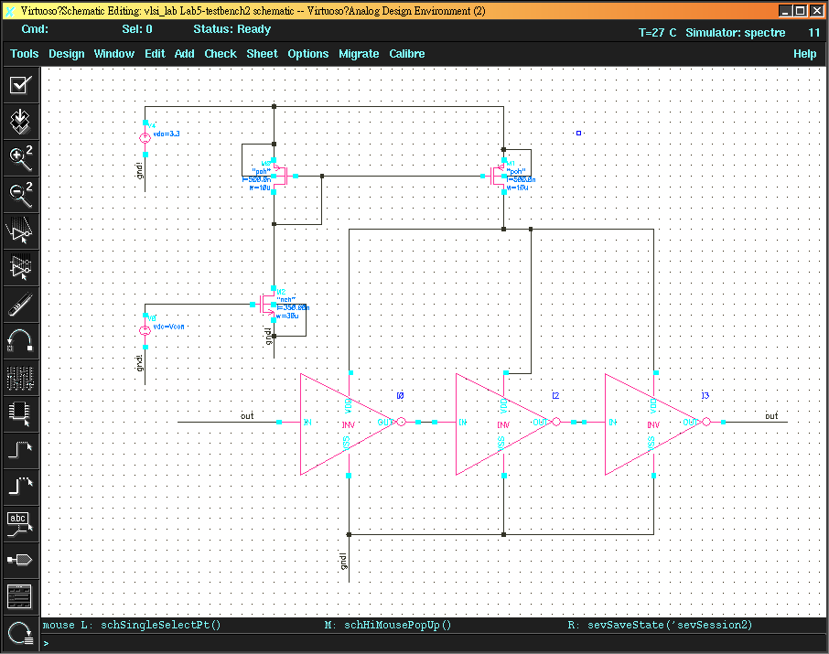
current-controlled VCO
Vcon

Slide 7
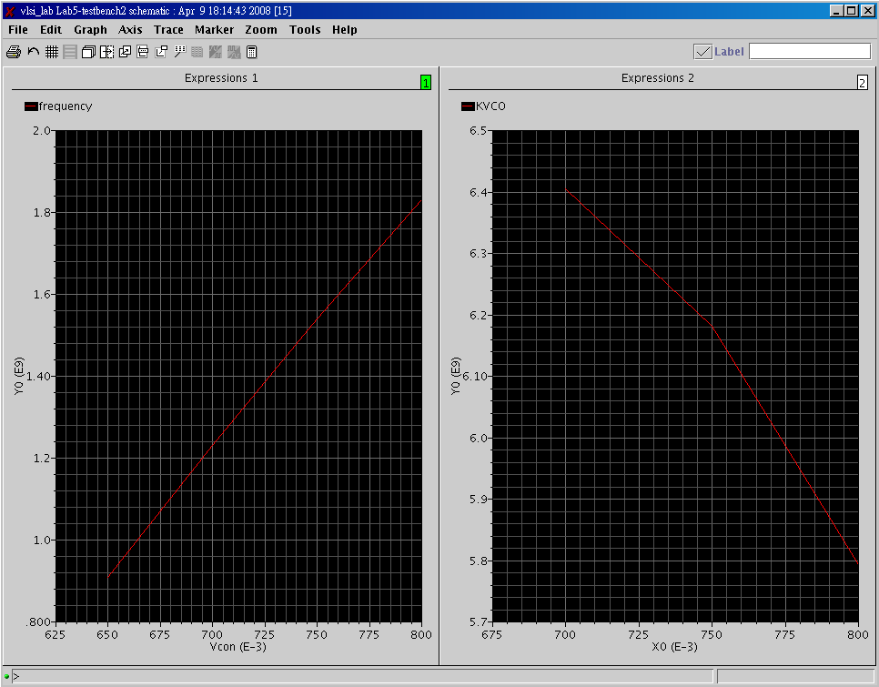
VCO characteristics

Slide 8
Lab5B
Please use inverter to design a current-controlled VCO with 0.35um process to meet all the following specifications. In addition , the Vcon control range is only from 0.6~0.9V.
  Its oscillating frequency range is located between 0.7GHz ~ 2.6GHz( 4G LTE band).
  KVO must be Higher than 5500MHz/V.

