Slide 1
Lab 6: Operation Amplifier Simulation
VLSI Design and Lab

Slide 2
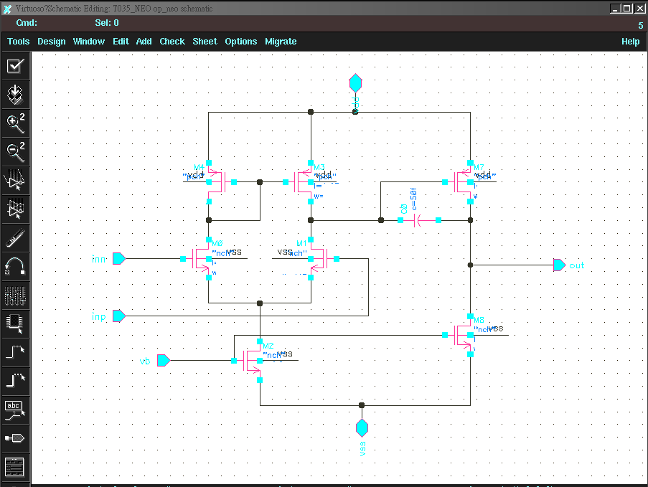
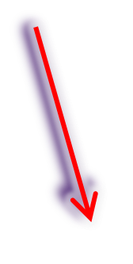
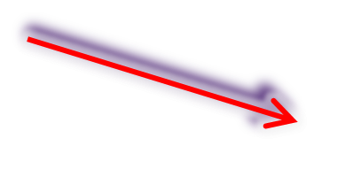
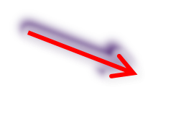

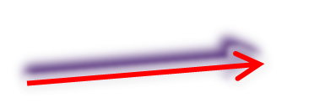
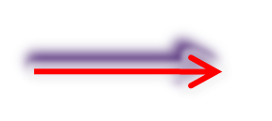

Two stages OP Circuit
compensation
Amplifier stage
Load &
differential to single
Differential pairs
Current source
Load & current source

Slide 3
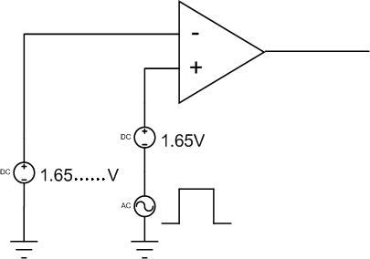
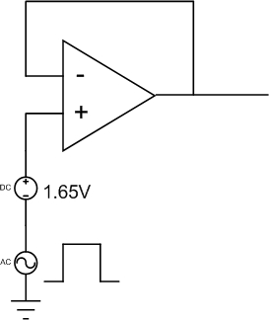
Testbench for op
DC , AC , Transient testbench for op
DC , Transient
AC

Slide 4

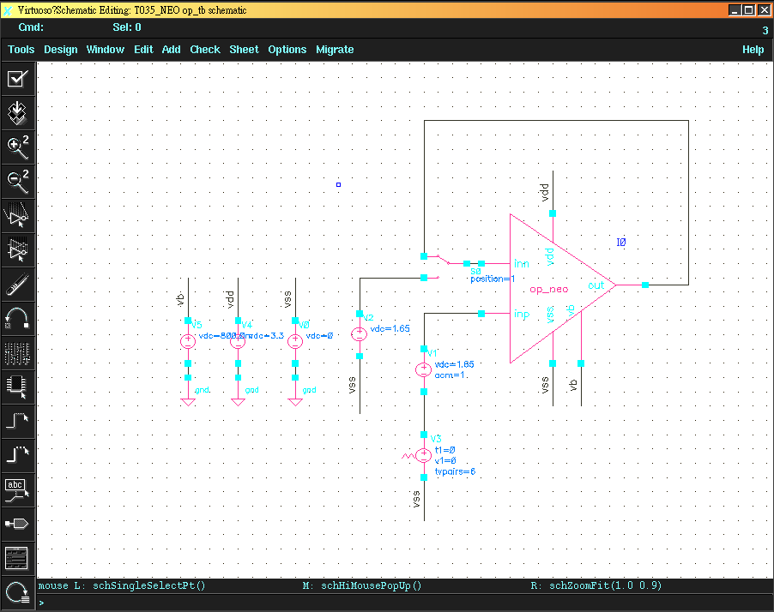
OP testbench
Load &
differential to single

Slide 5
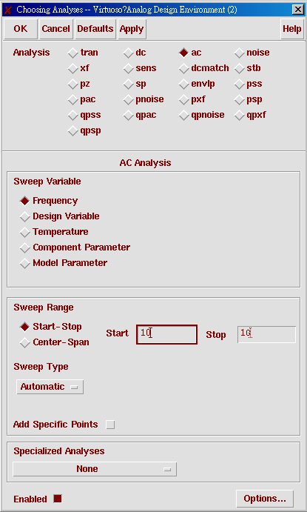
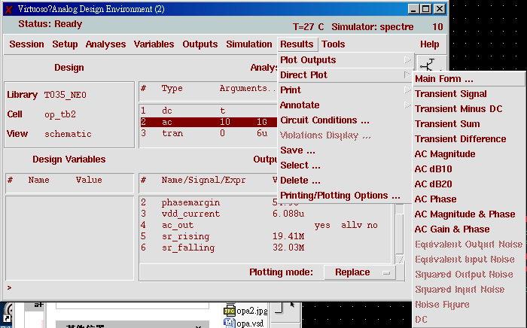
OP setup

Slide 6
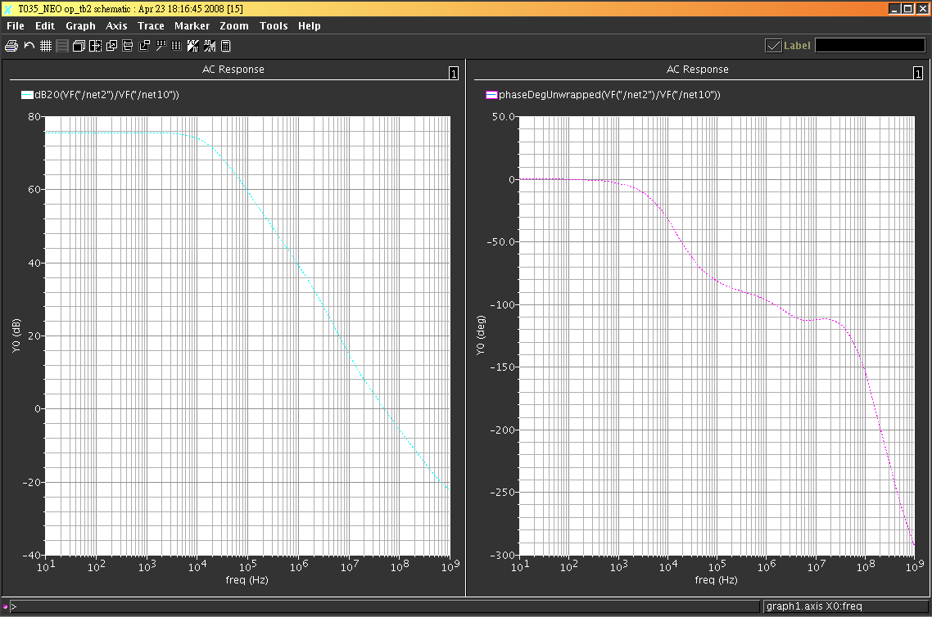
AC Mag & phase

Slide 7
Lab6A
Please use inverter to design a two stages OP with 0.35um process to meet all the following spec.. .
  DC gain > 60dB
  PM > 60 degree
  DC current consumption < 100uA

