Slide 1
Lab 7: Operation Amplifier Simulation(II)
VLSI Design and Lab

Slide 2
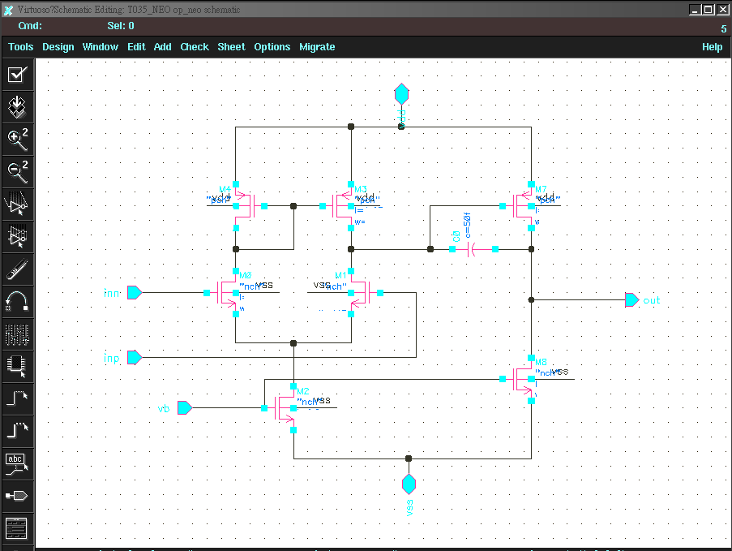


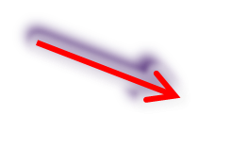


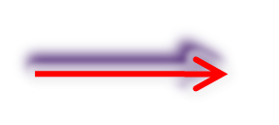

Two stages OP Circuit
compensation
Amplifier stage
Load &
differential to single
Differential pairs
Current source
Load & current source

Slide 3
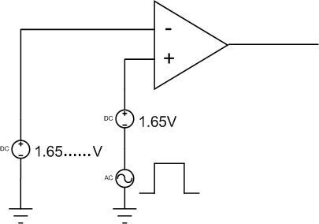
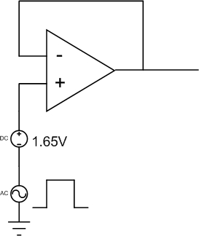
Testbench for op
DC , AC , Transient testbench for op
DC , Transient
AC

Slide 4
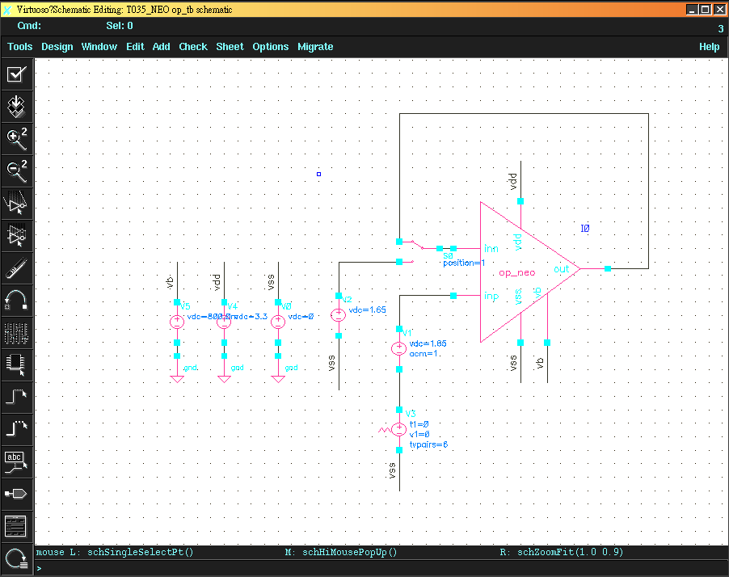
OP testbench
Load &
differential to single

Slide 5
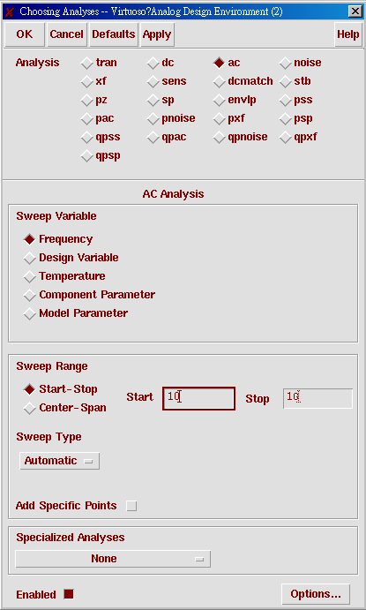
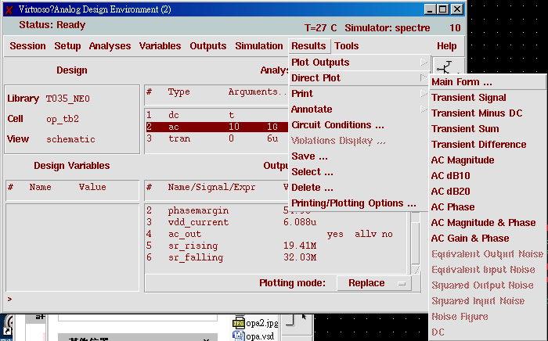
OP setup

Slide 6
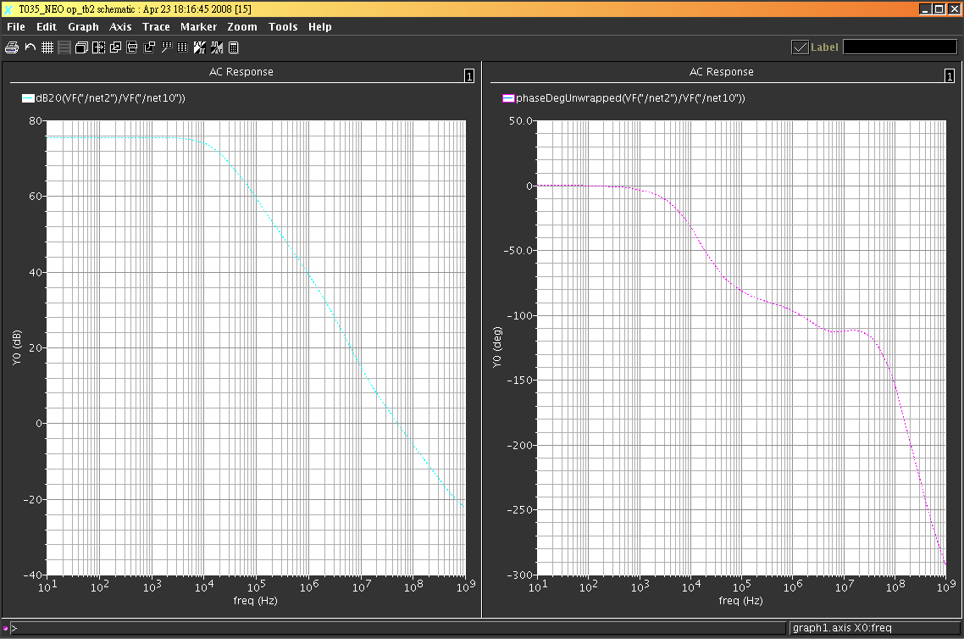
AC Mag & phase

Slide 7
TRANSIENT ANALYSIS

Slide 8
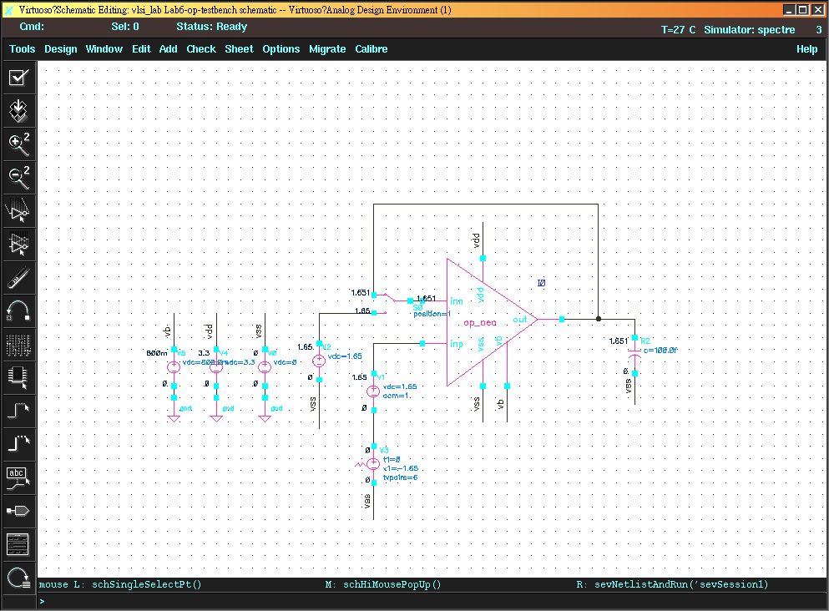

OP testbench for
Transient Analysis
Loading Capacitance 0.1pf
Step function setup

Slide 9
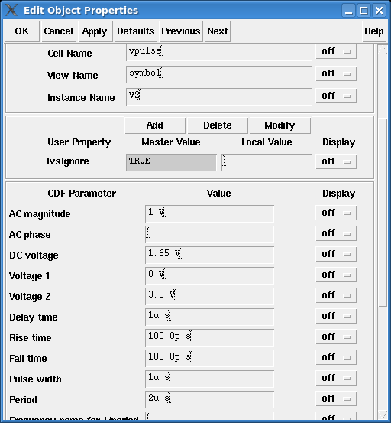
Vpulse setup

Slide 10
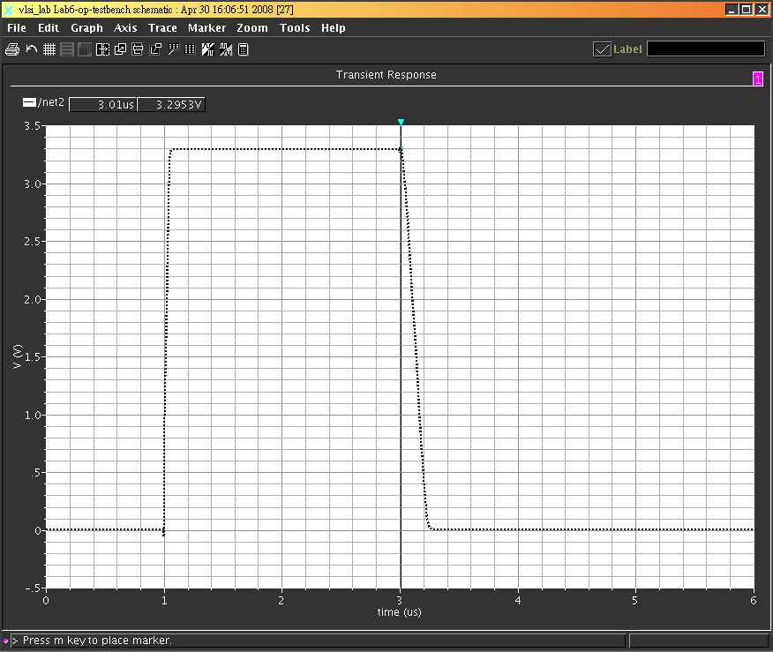
Output transient

Slide 11
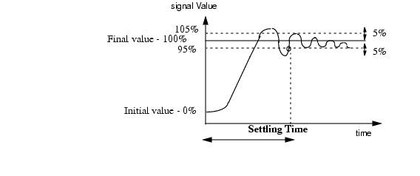
Settling time

Slide 12
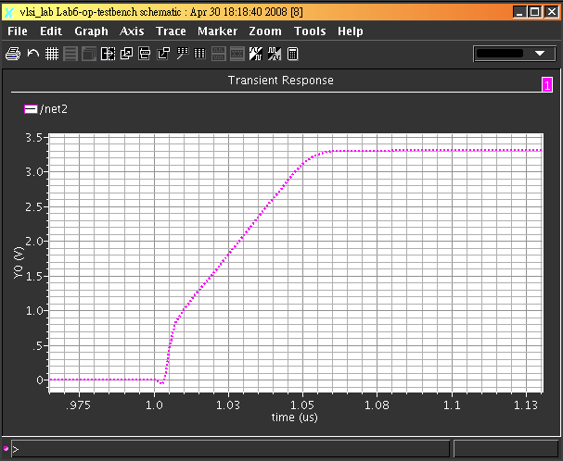
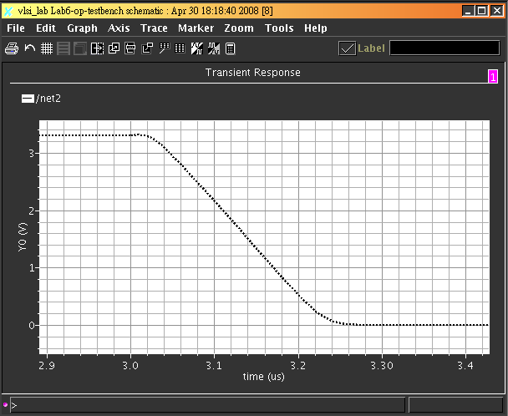
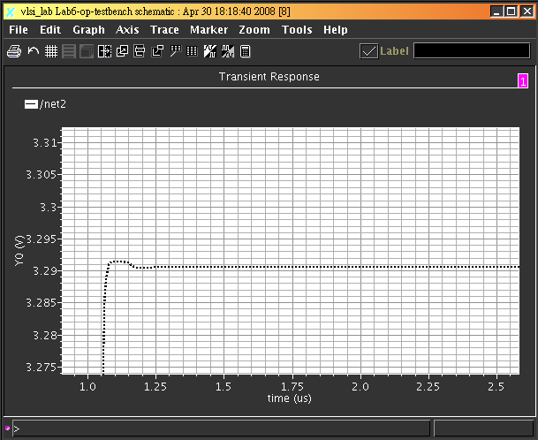
Transient analysis

Slide 13
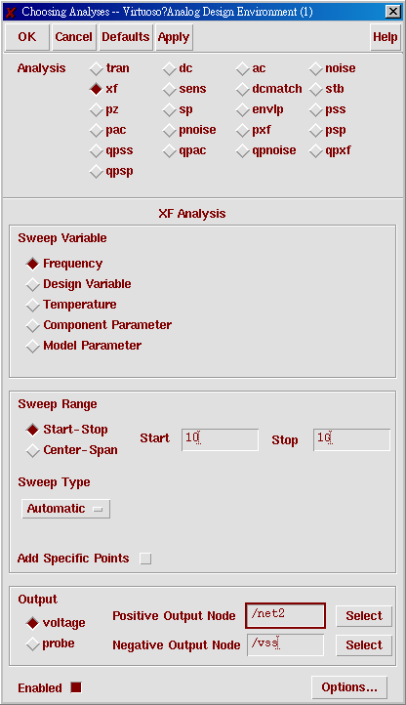
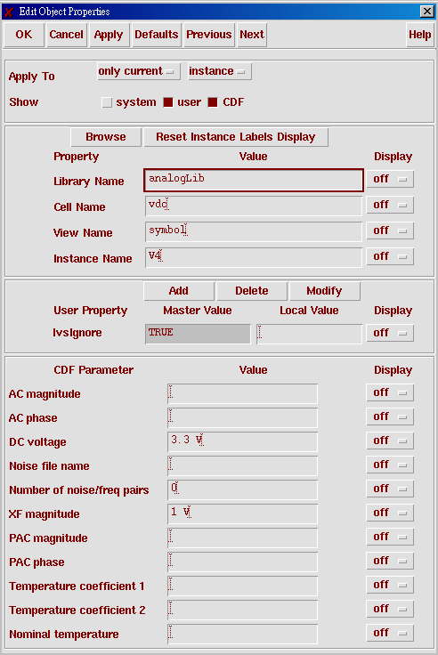

OP testbench for PSRR
XF source setup
Get XF gain of the output node

Slide 14
Final Report
請設計一個OP同時符合如下規格 ，寫成報告。內容請至少包括
(1).設計之方法(最好能符上相對應之公式) . (2). OP 的尺寸 (3).各規格的模擬結果。於2013/1/21前上傳至 http://140.124.70.101/EELAB
Please use inverter to design a two stages OP with 0.35um process to meet all the following spec.. .
  DC gain > 60dB
  PM > 60 degree
  Input offset voltage < 5mV
  DC current consumption < 50uA
  Rising slew rate > 60MV/s
  Falling slew rate > 20MV/s
  CMRR > 40dB => dcgain(dB) - common mode gain(dB)

