Slide 1
ALERT® Training and Technology Transfer Status
DEV: Yuming Liu
OPT: Emerson Chang
V2.1,
Mar 14, 2017
Notes:
7

Slide 2
Contents
ALERT® Technology Transfer Status
Self Assessment
DEV/OPT Action Plan
ALERT’s Follow-up Plan
Development Methodology
Future Work to Build Generic Solution

Slide 3

Training & Technology Transfer

Slide 4
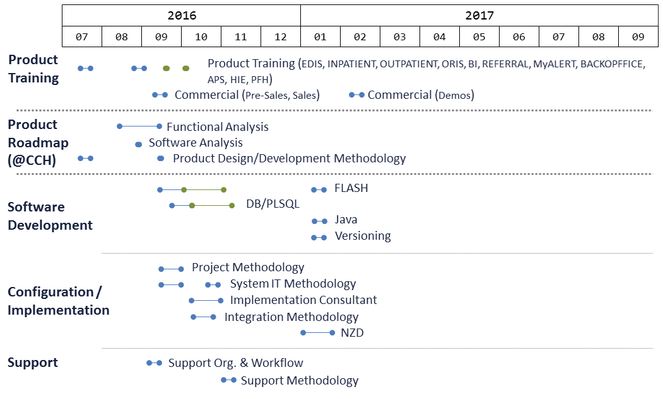
Training & Tech Transfer Activities

Slide 5
ALERT’s Comments
Training & Transfer | Summary
Training | Pre-Sales, Sales and Demos is almost 80% completed
Product Roadmap | Dedicated to CCH/YCH project tasks: Functional analysis Prototype Roadmap definition & planning Compal developers need to complete the Knowhow transfer and certificated by ALERT's experts, then join the CCH project development
Knowhow Transfer | 55~60% completed, needs 3.5~4 months to finish the KhT program

Slide 6
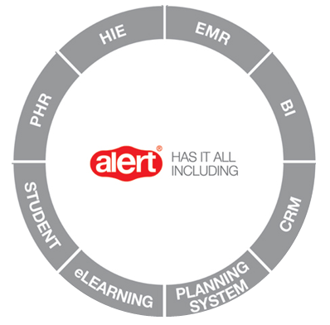
Self Assessment (by Product)
EMR
 | DEMO | DEV
ALERT@PFH
ALERT®TRIAGE | 100% | 50%
ALERT®EDIS | 77% | 65%
ALERT®OBS | 0%
ALERT®AMBULATORY | 60% | 50%
ALERT®WAITING ROOM | --- | ---
ALERT®OUTPATIENT | --- | 50%
ALERT®INPATIENT | 83% | 65%
ALERT®PRESCRIPTION | 0% | 45%
ALERT®DECISION TREE | 10% | 10%
ALERT®ORIS | 70% | 55%
ALERT®CANCER INFO-SYS | 0% | n.a.
ALERT®PRIMARY CARE | 13% | 50%
ALERT®PRIVATE PRACTICE | 10% | 50%
ALERT®REFERRAL | 10% | 30%
ALERT®HOME VISIT | --- | ---
ALERT®PDMS | 50% | 3%
ALERT®PHARMACY | 20% | 40%
ALERT®GP PORTAL | --- | ---
ALERT®eLEARNING | 10% | 0%
ALERT®STANDARD CONTENT | 0% | 70%
INTER-ALERT® | 0% | 70%
 | DEMO | DEV
ALERT®ADT | 17% | 17%
ALERT®SCHEDULER | 10% | 3%
ALERT®CODING | 0% | 0%
ALERT®PATIENT PORTAL | --- | ---
ALERT®CRM | --- | ---
ALERT®BILLING | --- | ---
ALERT®DATA WAREHOUSE | 0% | 0%
ALERT®BI | 43% | 0%
ALERT®PLANING SYSTEM | 10% | 0%
ALERT®AUDIT TRAIL | 0% | 0%
ALERT®HIE | 13% | 0%
ALERT®MyALERT | 37% | 0%
ALERT®STUDENT | 0% | 0%

Slide 7
Self Assessment (by Tech Func)
 | Func Activities Func Team | Training Days | Self Assessment | Comments
 | Function Analysis | 1 | 80% | Better to co-work with ALERT teams
 | Product Design | 1 | 80% | Better to co-work with ALERT teams
 | Flash | 44 | 80% | Few documents, need to trace source code
 | PL/SQL | 23 | 90% | KhT didn’t cover all of PL/SQL programs,
 | Content Creation | 4 | 75% | 10% docs need translation, need APEX tool
 | Content Configuration | 2 | 70% | KhT didn’t include whole contents in ALERT system
 | Versioning | 5 | 70% | Not sure the exact version of source code on SVN
 | Java | 5 | 30% | Scope of KhT is not confirmed yet
 | Integration | 10 | 70% | Need to add ‘Data mapping’ & ‘Data migration’
 | PM | 9 | 100% | ALERT hasn’t provided development schedule
 | Implementation | 15 | 87% | Need ALERT to provide a new template creation tool
 | QA | 0 | 30% | KhT QA course is under arragement
 | Configuration | 9 | 58% | 20-30% unexpected troubleshooting & checklist
 | System IT | 18 | 92% | Need configuration of Crisis machine & NOC Tools
Development Team
Operation Team

Slide 8
Self Assessment (by Source Code)
Product | DEV | # of Source Code |  |  | Summary
 |  | UI | Java | Database
ALERT® TRIAGE | 50% | 106 | 37 | 3,055 + 26,587 (DDL/DML) | Understood, need real practice
ALERT® EDIS | 65% | 229 | 238 |  | Understood, need real practice
ALERT® INPATIENT | 70% | 136 | 358 |  | Understood, need real practice
ALERT® ORIS | 55% | 59 | 394 |  | Understood, need real practice
ALERT® AMBULATORY | 50% | 216 | 7,425
ALERT® PRIMARY CARE | 50% | 216 | 7,425 |  | Based on ALERT® AMBULATORY
ALERT® PRIVATE PRACTICE | 50% | 216 | 7,425 |  | Based on ALERT® AMBULATORY
ALERT® REFERRAL | 30% | 93 | 537
ALERT® DECISION TREE | 10% | 24 | n.a. |  | Not in KhT
ALERT® OBS | 0% | --- | --- |  | No Source code
ALERT® CANCER INFO-SYS | 0% | --- | --- |  | No source code
ALERT® PHR (MyALERT) | 0% | JAVA: (S: 1,024) (M: 10,458) |  |  | Not trained in KhT
ALERT® eLEARNING | 0% | Java: 7,063 |  |  | Not trained in KhT
ALERT® STUDENT | 0% | Java: (S: 139) (M: 10,695) |  |  | Not trained in KhT
UI core files: 5,681

Slide 9
Self Assessment (by Source Code)
Product | DEV | # of Source Code |  |  | Summary
 |  | UI | Java | Database
ALERT® ADT | 17% | 286 | 6,677 | 15 + 2,756 | Not trained in KhT
ALERT® SCHEDULER | 3% | 698 | 5,019 | 8 + 1,196 | Using FLEX, not trained in KhT
ALERT® HIE | 0% | n.a. | 6,834 | 50 + 1,055 | Not Trained in KhT
ALERT® BI | 0% | n.a. | n.a. | 0 + 35 | Not trained in KhT
ALERT® PDMS | 3% | 1,160 | 1,839 | 9 + 379 | Using FLEX, not trained in KhT
ALERT® PLANNING SYSTEM | 0% | 387 | 5,019 | n.a. | Using FLEX, not trained in KhT
ALERT® ADW | 0% | n.a. | n.a. | 0 + 35 | Not trained in KhT
ALERT® PHARMACY | 40% | 24 | 8 | 26 + 66
ALERT® PRESCRIPTION | 45% | 485 | 1,474 | 169 + 2,597 | Medicine prescription in PFH
INTER-ALERT | 70% | n.a. | 6,727 | 78 + 871
ALERT® AUDITTRAIL | 0% | 215 | 25 | 4 + 35 | Using FLEX, not trained in KhT
ALERT® CODING | 0% | n.a. | 5,737 | 96 + 470 | Not trained in KhT
ALERT® STANDARD CONTENT | 60% | n.a. | n.a. | 3,061 + 29,262 | Default content

Slide 10
Follow-Up Plan

Slide 11
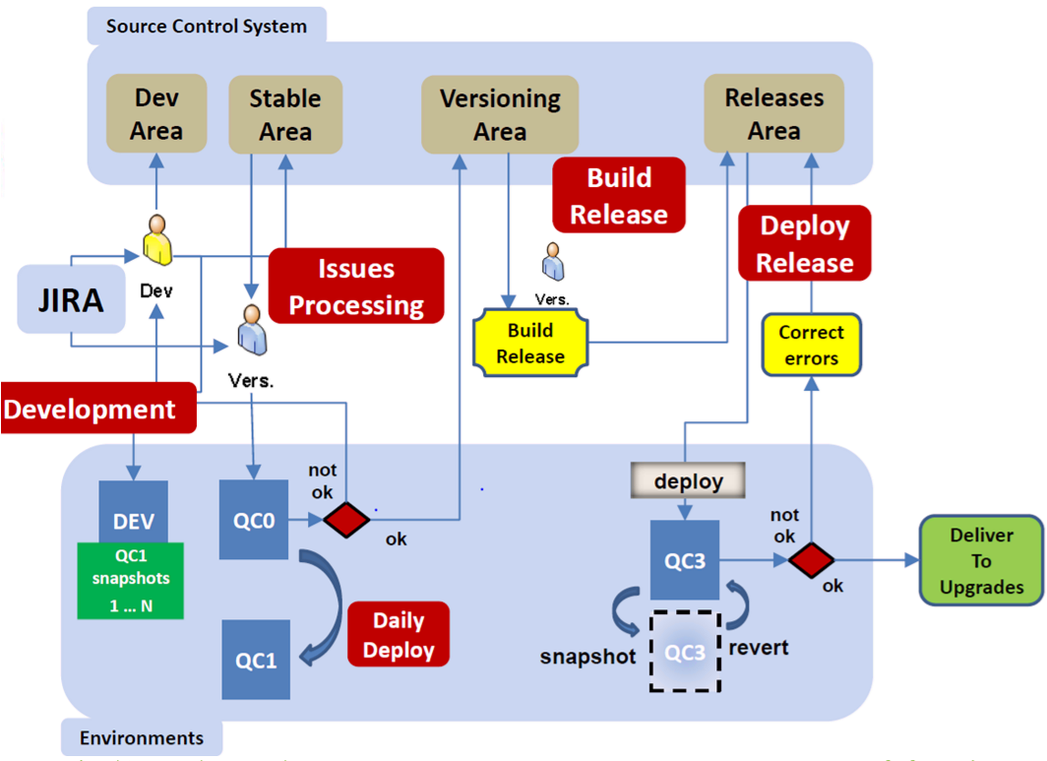
Action Items (Dev Team)
Get missing documents and tools from Alert
Setup a complete development environment
Build and verify the source files completeness
Get complete source files
Setup Dev, QC servers for actual project development

Slide 12
Action Plan (OPT Team)
2016
2017
09
10
11
12
01
02
03
04
05
06
07
08
09
10
11
12
User requirements &
Gap analysis
Implementation
CCHIPD
Training
Test Plan
Testing
UAT
Content Collection
Content Creation & Validation
Test Scripts & Test
Training Scripts
On-site training
Configurations (KhT)
Configuration (CCH)
System IT (KhT)
System IT (CCH)
NZD
NOC

Slide 13
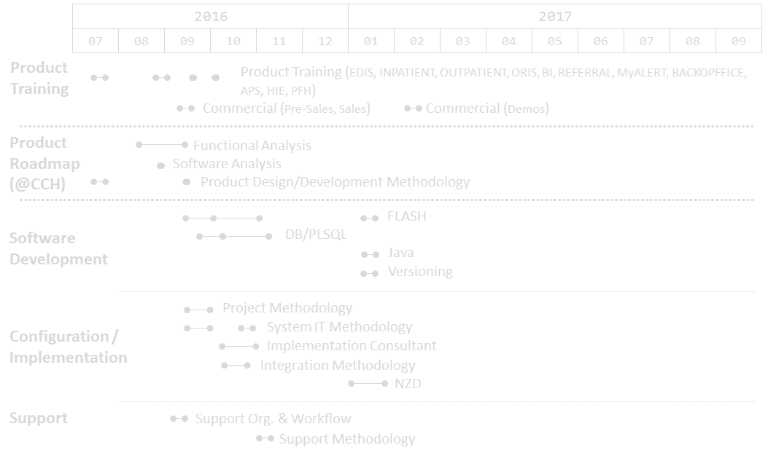
ALERT’s Follow-Up Plan
ALERT will support training material and product brochure by request
ALERT assigns 16 engineers for the development of CCH project
ALERT’s Knowhow Transfer Follow-up Planning: (within 4 months)
New Configuration tool is ready, the tool includes:
Facility management
Standard edition management
Product management
Content management
ALERT suggests having Compal 2~3 resources to work in Portugal with ALERT team for 2~3 weeks to learn the support skills by real case studies

Slide 14
Development Methodology

Slide 15
Development Phases
Developing a new feature Feature development phases & doc outputs
Functional analysis
Design
Code development
Content creation and configuration
Acceptance testing
Versioning
Quality control
Feature spec doc
Acceptance test criteria
Prototype design & flow document
UI artwork
Technical design doc
UI test case and report
Content config. files
Test Report
Performance test report
Build release report
Test plan
Test case
Test Report

Slide 16
SW Development Process Improvements
Simplify content creation/configuration process
Simplify and automate the versioning process
Add/Enforce unit test process
Add/Enforce code review process
Other items to be identified during process execution

Slide 17
Future Work

Slide 18
Build a Generic Solution
In 1st project, make the capability and maturity on ALERT® PFH Solution to reach at least 80%
Finish know-how transfer 100% by end of 2017
Setup a generic version for Taiwan EMR market
Template tool for customer to simulate template requirement
Config. tool for customer to edit content and other configurations
Provide tool or simpler method for customer to edit the documentation format to reduce maintenance efforts
Add new functionalities to fit general requirements for hospitals in Taiwan, for example
Family tree edit and display in graphical format
Integrate with BI solution other than MicroStrategy
Make the documentation blocks to be customizable by client
Leverage HIE to exchange medical data between facilities
Keep improving development process and methodology

Slide 19


