Slide 1

Final Presentation
Summer Internship Program
Team XABD – 3
Anushka Chaudhary Rishabh Taneja Shivang Rana Tushar Bohra
Raghav Parashar Saba Parveen Tanish Garg

Slide 2
Table of Contents –
Introduction
Problem Statement
Methodology
Algorithms used
Data Visualization
Results
Future Enhancements
Conclusion

Slide 3
Introduction –
The sinking of the Titanic in 1912 is a historic event that resulted in the loss of many lives.
The Titanic Survival Prediction project aims to predict whether a passenger on the Titanic survived or not based on various features.
The dataset contains information about passengers' socio-economic status, age, fare, family relationships, gender, and the port they embarked from.
Problem Statement –
Our objective is to build a predictive model using Machine Learning algorithms to help us understand the factors that influenced survival.

Slide 4
Methodology –
Data Acquisition and Preprocessing, Data Visualization and Feature Engineering –
Collect the Titanic dataset, which includes information about passengers such as name, age, gender, socio-economic class, and survival status.
Preprocess the data by handling missing values, transforming categorical variables into numerical representations, and performing any necessary data cleaning.
Analyze the relationships between different variables and survival rates using data visualization. Identify any significant patterns, correlations, or outliers in the data.
Extract and engineer relevant features from the dataset that may impact survival. This includes selecting important variables, creating new features, and transforming data if necessary.

Slide 5
Machine Learning Model Selection and Evaluation and Deployment –
Training and Evaluating Different Machine Learning models on different evaluation matrices.
Choose the most suitable model based on evaluation metrics like accuracy, precision, recall, or F1-score. Train the model using the prepared dataset.
Fine-tune the model parameters and iterate the training process to enhance its predictive accuracy. Handle any issues related to overfitting or underfitting.
Evaluate the model's performance on a separate test dataset and measure its generalization capabilities.

Slide 6
Algorithms Used –
Three Machine Learning Algorithms have been used by us for this project –
XGBoost – XGBoost is an optimized distributed gradient boosting library designed for efficient and scalable training of machine learning models. It is an ensemble learning method that combines the predictions of multiple weak models to produce a stronger prediction. XGBoost stands for “Extreme Gradient Boosting” and it has become one of the most popular and widely used machine learning algorithms due to its ability to handle large datasets and its ability to achieve state-of-the-art performance in many machine learning tasks such as classification and regression.
Logistic Regression – Logistic regression is a supervised machine learning algorithm mainly used for classification tasks where the goal is to predict the probability that an instance of belonging to a given class or not. It is a kind of statistical algorithm, which analyze the relationship between a set of independent variables and the dependent binary variables.
Random Forest – Random Forest is an ensemble technique capable of performing both regression and classification tasks with the use of multiple decision trees and a technique called Bootstrap and Aggregation, commonly known as bagging. The basic idea behind this is to combine multiple decision trees in determining the final output rather than relying on individual decision trees.

Slide 7
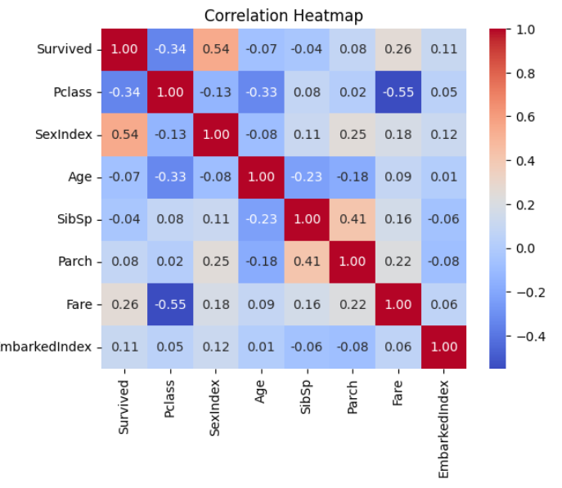
Data Visualization –
We used various data visualization techniques to find correlation between different variables and their effects on survival rate.
Visualized the distribution of passenger classes, age, fare, and survival rates.
Explored the relationship between survival and other features such as gender, family relationships, and the port of embarkation.
Heatmap for Finding Correlation between all the variables –

Slide 8
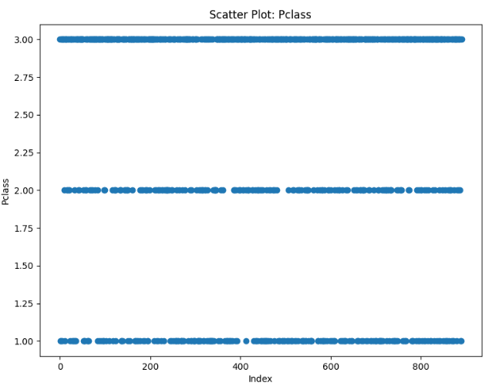
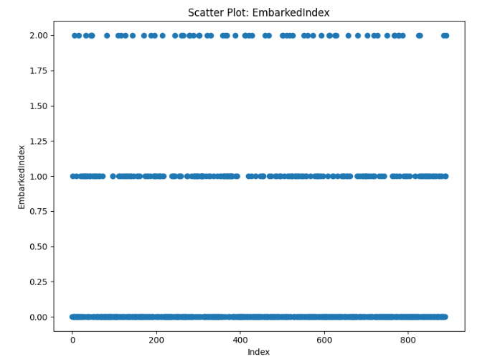
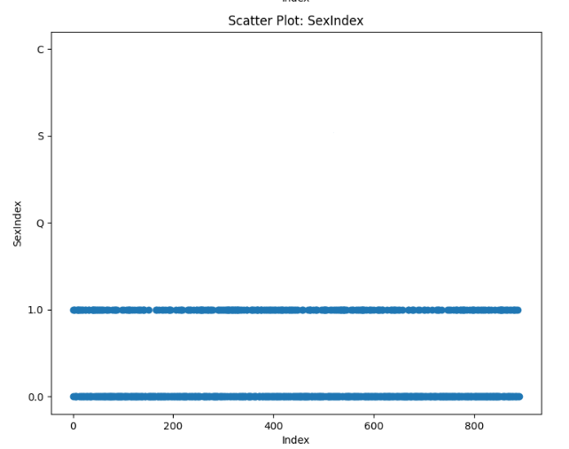
Detecting Outliers -

Slide 9
Reports for Different Datasets created using Pandas Profiling –
For Preprocessed Titanic Dataset
For Feature Engineered Dataset
For Preprocessed Test Dataset

Slide 10
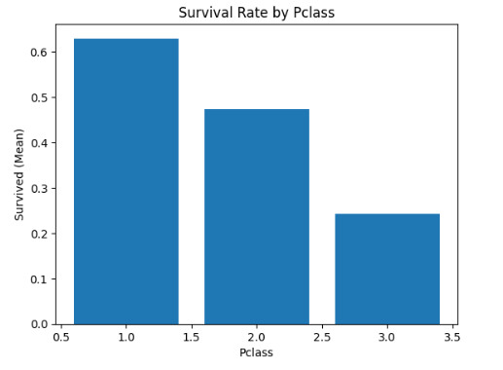
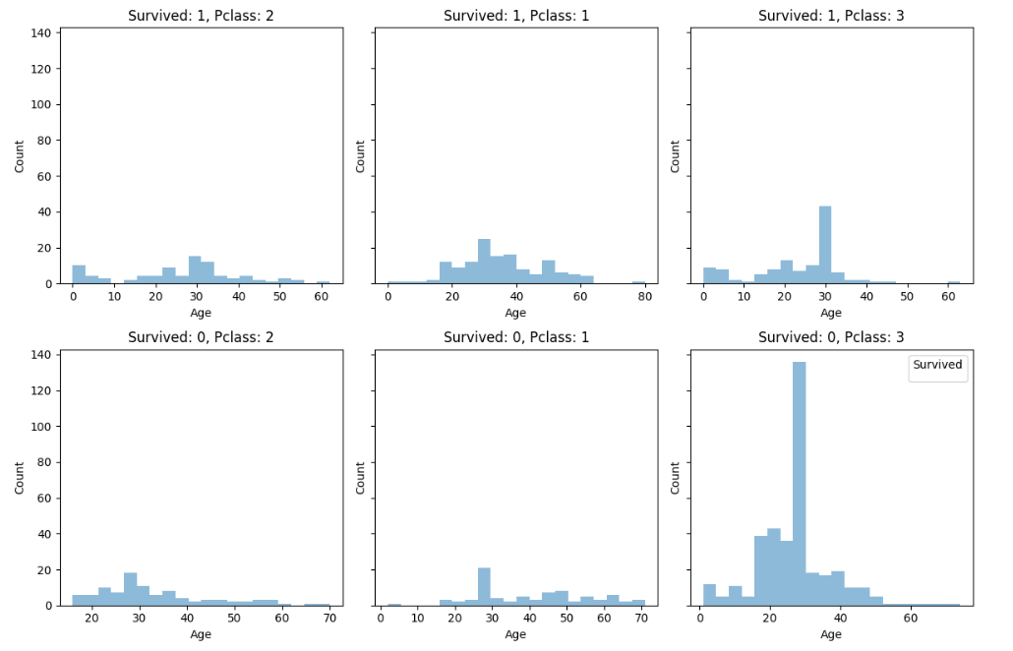
Survival Rate by Passenger Class -

Slide 11
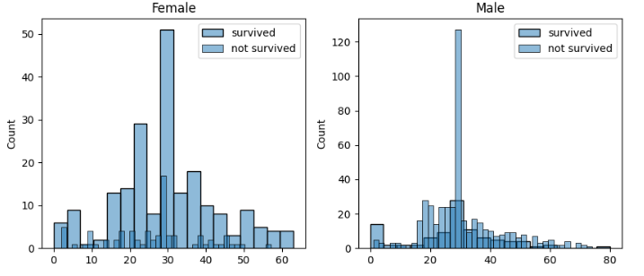
Survival Rate Based on Gender -

Slide 12
Results –
XGBoost Model Evaluated on F1-Score Metric gave F1-Score of 0.75 - According to this model Test dataset has total survival percentage of 30%.
Logistic Regression Evaluated on Accuracy metric giving Accuracy of 79 – 80% - According to it total Survival percentage of test dataset is 32.54%
Random Forest, Evaluated on Loss Metric Gave logloss of 0.61 – According to it Survival percentage is 15.31% (Lowest of them all)
Implementation Using Flask API –
The Flask API serves as the backend for making predictions using the trained models. It provides an HTML-based web interface to interact with the models. The prediction result is then displayed on the web interface. We have provided an interface for all three models separately.
Run the Flask API by executing the command python app.py in the terminal.
The API will start running locally, and you will see a URL for the web interface (usually http://127.0.0.1:5000/).

Slide 13
Future Enhancement –
Further explore and fine-tune hyperparameters to improve model accuracy.
Investigate other advanced Machine Learning algorithms for comparison.
Consider additional feature engineering techniques to capture more relevant information.
Deploy the Flask API and web interface on a cloud platform for wider accessibility.
Conclusion –
The Titanic Survival Prediction project demonstrates the power of Machine Learning in predicting outcomes based on historical data.
Our trained models (Logistic Regression, XGBoost, and Random Forest) achieved promising results in predicting passenger survival.
Feature engineering played a vital role in improving the model's performance.
The interactive web interface allows users to input passenger details and get predictions from all three models.

