Slide 1
CSC131 SP’19 Computer Software Engineering
Introduction

Slide 2
Syllabus
Class time & location
Section 1: Tu/Th, 12:00PM - 1:15PM, Yosemite Hall 119
Section 4: M/W, 4:00PM - 5:15PM, Riverside Hall 1013
Instructor
Homepage: http://www.ecs.csus.edu/csc/yang/
Email: yang@csus.edu
Office: Riverside Hall 3006
Phone: (916) 278-7328
Office hours: TBD

Slide 3
Selected Comments from previous students
“Group Projects and Labs were especially effective for my learning.”
“It was extremely difficult to understand the material presented by the instructor because of the accent. His handwriting is very hard to understand as well because his sentences are all over the board. About 90% was self-study to pass this class.”
“The class is very interactive. So when people ask questions and the instructor gives examples to understand the concept. It has been very useful.”
“Appreciate the effort you put into making sure students learn or take something from this class other than just a grade.”

Slide 4
Selected Comments from previous students
“Passionate teacher but feel like he expects too much from the students and want to cover many things that the class doesn't have enough time to cover it. However, he really listens to student comments and did show the improvement after the midterm.”
“Please do not give this professor a teaching position here. He thinks he is teaching but in fact he is just reading off slides. All of his material can be found online from another college…”
“You're the best professor I had this semester.”

Slide 5
Syllabus (cont.)
Course Content
How to develop high-quality software systems that are delivered on time and within budget using modern development tools.
Two aspects:
Managing the effort and,
Applying effective tools and techniques.
We will survey both aspects and apply them by building a system in teams of 5-6 members during the semester.

Slide 6
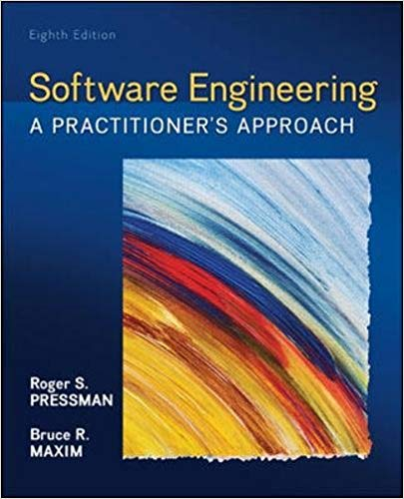
Syllabus (cont.)
Goals
Text Book
Software Engineering: A Practitioner’s Approach,
R. Pressman, 8th edition, 2014, McGraw Hill
Safari books (free through library)
Text (to be posted in Canvas)
Attendance & Participation
Lecture
Labs
In-class activities

Slide 7
Syllabus (cont.)
Grades
Criteria:
No curving
Note: Your overall grade in Canvas grade book will NOT be accurate until all grades (homework, labs, in-class activities, project, exams) are entered. However, it is a good indicator of your current performance.
Assignments | Weight
Labs + In-class Activities | 10%
Homework Assignments | 10%
Team Project | 25%
Midterm Exam | 25%
Final Exam | 30%

Slide 8
Syllabus (cont.)
Labs
Attendance is required.
Homework
Individual work unless advised otherwise
Late homework will be accepted within 2 days after due dates, with 25% penalty for each day.
Project
25% of your grade
Work as teams
Be professional
Peer evaluation

Slide 9
Syllabus (cont.) – Important Notes
Appropriate in-class behaviors are expected, including but not limited to:
Take notes.
Use appropriate language when asking questions or during group discussion.
No laptop/tablet/mobile phone/other computational device usage is allowed unless otherwise instructed.
No eating.
Ask for permission if need to leave in the middle of a lecture.
Email format:
Hi Prof. Yang,
This is Genos in your CSc 131 Section 4. I have a question regarding Assignment……Could you get back to me when you get a chance? Thanks!
Best regards,
Genos

Slide 10
Syllabus (cont.)
Important Dates
Midterm – Week 8 (3/11-15, 2019)
Last day to withdraw – 4/19/2019
Final – Week 16 (5/13-17, 2019 )
Academic Honesty
Reference to others’ work
Questions?
Survey in Canvas

Slide 11
A Question for You
Why do you take this class?
What is this class all about?
Programming skills?
Algorithm analysis?
Team building?
…

Slide 12
The Process
Why does it matter?

Slide 13
A Card Game

Slide 14
Step 1 Preparation
Form your groups
Each group should have 6-7 members
Introduce yourself to your group mates
Shuffle your cards, and exchange with your adjacent groups
Try all means necessary to shuffle the cards. Your goal is to make it hard for the other group to sort the cards

Slide 15
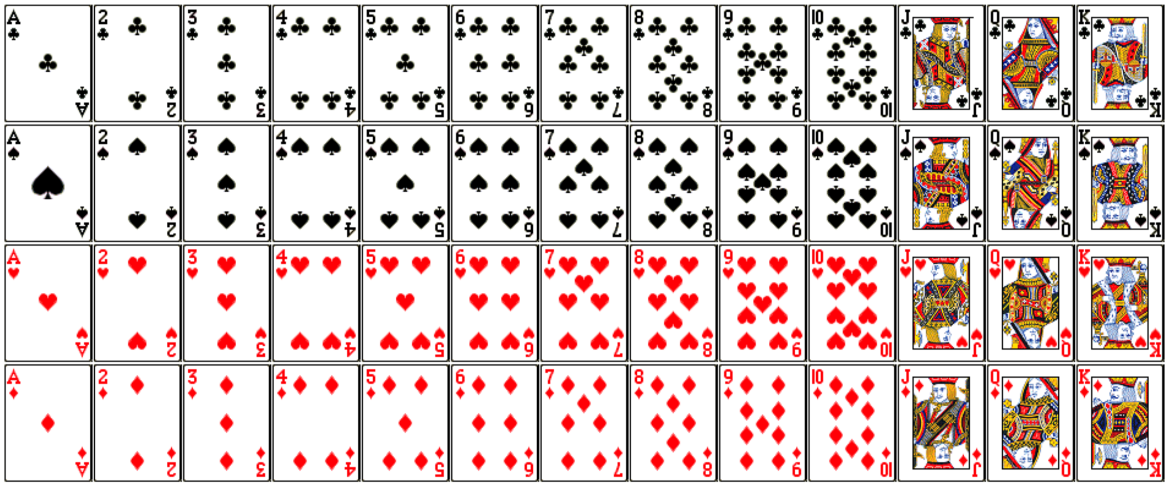
Step 2 Understanding the Rules
Goal – to sort
the cards like
this:
At any moment, only one person can touch one card with one hand only.

Slide 16

Step 3: Assigning Roles & Planning
Company Alpha Plans:
Company Beta
C
D
Player A can spread cards.
Player B can flip cards.
Player C can touch ”Club” only.
Player D can touch ”Spade” only.
Player E can touch “Heart” only.
Player G can touch “Diamond” only.
Order to touch cards: A –> B –> C –> D –> E -> G
B
E
A
G
?
?
?
?
Form your own plan.
?
?

Slide 17
Game Start! You have 2 mins to sort the cards!

Slide 18
Time is up.

Slide 19
Step 5 Reflection
Company Alpha
What went well with the plan?
What went wrong?
What can you do better as an individual?
What can you do better as a team?
Company Beta
Did you like your plan?
What would you like to change? (It is OK if you think your plan is perfect.)

Slide 20
Let’s rematch!

Slide 21
Shuffle Cards

Slide 22
Game Start! You have 2 mins to sort the cards!

Slide 23
Time is up.

Slide 24
A Follow-up Interview
Did you feel like a team?
What would happen if something happened to kill the project 75% of the way through? (Considering a full suit of same rank is a feature)
For Company Alpha, what do you like/dislike about your plan?
For Company Beta, did you change your process after Game 1 at all? How would you change things next time to be even better?

Slide 25
Factors influencing our process
Individual strength
Collaboration
Communication
Risk management
Exception handling
…

Slide 26
To dos
Complete the survey in Canvas
Complete the self-introduction assignment in Canvas
One-Picture-One-Paragraph
Reading assignment in Week01 Module
Introduction.pdf
Programming assignment on CodingBat

Slide 27
Announcement
Office hours:
M/W 2:15pm - 3:45pm
Classroom Change:
Starting from next week (Jan. 28), classes will be given in Riverside 1013
Email format:
Hi Prof. Yang,
This is Genos in your CSc 131 Section 4. I have a question regarding Assignment……Could you get back to me when you get a chance? Thanks!
Best regards,
Genos

Slide 28
1. Introduction to SE

Slide 29
What is Software?
To the Hardware:
A collection of instructions to be executed by a computer/processor
To the Developer:
A collection of human-readable statements (in a language) that can be converted to a collection of instructions to be executed by a computer/processor
To the User?

Slide 30
The Organization of Software
Program:
Any piece of software that can "run on its own" (including utilities, tools, scripts, apps, etc...)
Sub-Program:
A collection of instructions/statements that implement an algorithm for accomplishing a specific task or tasks
Library:
A group of related sub-programs for accomplishing a specific collection of (usually related) tasks

Slide 31
From Software to Software Product
What People (Other than Us) Care About:
Having everything they need to solve one or more problems or achieve one or more goals (i.e., a complete means to one or more ends)
Definition:
A software product is one or more programs, sub-programs, or libraries, along with the data and supporting materials and services, that a client can use to solve problems or achieve goals

Slide 32
Kinds of Software Products
Bespoke:
Software products that are developed (usually under contract) for a specific client
Generic:
Software products that are developed (usually speculatively) and then sold to market clients (either a mass market or a niche market)
Examples?

Slide 33
Software Engineering
Defined:
The application of (scientific) theories, methods and tools to the specification, design, creation, verification/validation, deployment, operation, and maintenance of software products
Scope:
From specification to maintenance
Involves technical and managerial concerns
Involves theories/methods from psychology, mathematics/statistics, computer science, and management (of people and resources)
Consists of science and art

Slide 34
Software Engineering vs. Computer Science/Engineering
Computer Engineering:
The application of theories (often from physics) to the creation of computational devices
Usually thought of as a subset of electrical and electronic engineering
Computer Science:
The theories and methods that underlie computation and the use of computational devices

Slide 35
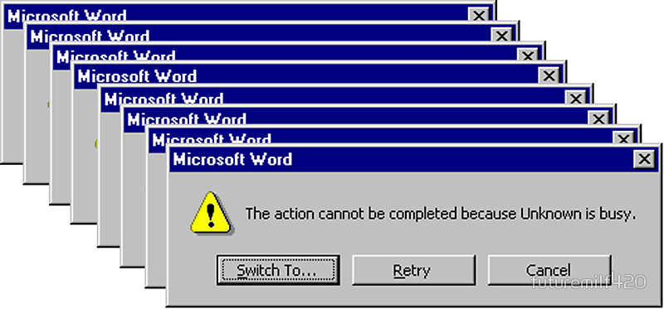
Why Software Engineering?
My experience

Slide 36
2. System

Slide 37
Motivation
Some Commonly Used Phrases:
The systems needs to...
... is a complex system...
An Interesting/Troubling Observation:
Most people can't define the word "system"

Slide 38
Systems
System
A set of entities, their attributes, and the relationships between them.
Entities
The components of the system that are known/observed.
Attributes
The properties of the entities (i.e., the external manifestations of the way the objects are known or observed).
Relationships
The bonds that link entities and attributes

Slide 39
Abstraction
A Definition:
Abstract (verb): To extract what is important
Two Observations:
An object/concept can be conceptualized in an enormous number of ways
The level of detail (which is the inverse of the level of abstraction) is a defining feature of the system
Example: A Car
Low Detail - A source of emissions
Medium Detail - A contributor to traffic congestion at an intersection
High Detail - A mechanical motive device

Slide 40
Systems (cont.)
We gauge the level of detail/abstraction by viewing the system under consideration in relation to:
Example: A Car
Low Detail - A source of emissions
Medium Detail - A contributor to traffic congestion at an intersection
High Detail - A mechanical motive device
Environment | The set of all other systems (also known as the context and the domain)
Subsystems | Parts of the whole which display a richness of interrelationships
Elements/Atoms | The smallest parts of the system (i.e., the black boxes)

Slide 41
Physical and Conceptual Systems
Physical Systems:
Can be "pointed to"
Include entities that exist in space and time
Conceptual Systems:
All other systems

Slide 42
System State
Defined:
An unvarying (over space, and/or time, and/or some other dimension) description or summary of that system
Specification:
All of the attributes (at an appropriate level of abstraction) of the entities that comprise the system

Slide 43
3. Modeling

Slide 44
A Definition
A mini-activity:
A model is a description of a system (that is created to help understand the system)

Slide 45
Modeling Methods
Physical Models:
Paper, clay, plastic, wood, metal, etc...
Conceptual Models:
Mathematical, computational/numerical, diagrammatic/visual/graphical, textual, etc...

Slide 46
Model Types
Static:
Models of the aspects of the system that do not change (sometimes called structural)
Dynamic:
Models of how the system changes over time (sometimes called behavioral)

Slide 47
Importance of Modeling
Some Observations:
Complex systems are hard to understand
Models can be used to make them easier to understand
An Example:
You can probably build a doghouse without a model
A house would be very difficult to build without a model
A skyscraper would be impossible to build without a model

Slide 48
Modeling and Software
A Common Problem:
Start with a doghouse
Keep adding on until you have a skyscraper
What Models Provide:
An understanding of a system (as it is or should be)
A specification of a system
A template for construction
A record of the decisions that were made

Slide 49
Abstraction Revisited
The same object/concept can be conceptualized at different levels of abstraction
A system that is conceptualized at a particular level of abstraction can be modeled at different levels of abstraction
Examples?

Slide 50
Abstraction Revisited: An Example
Viewing a Car as a System:
Low Detail - A source of emissions
Medium Detail - A contributor to traffic congestion at an intersection
High Detail - A mechanical motive device
Modeling a Car as a Source of Emissions
Low Detail - Relate the number of cars to total emissions
Medium Detail - Consider the number of miles and driven and the average drive cycle (e.g., EPA estimates)
High Detail - Consider car following behavior and engine performance

