Slide 1
Jenkins
Jeff Joyce

Slide 2
Jenkins Background
Open source automation server written in Java
CICD - Continuous Integration and Continuous Delivery
Server Based Application

Slide 3
Jenkins Popularity
Easy Installation – Platform agnostic
Easy Configuration – Web UI
Plugins – Large library
Extensible – Ability to combine Plugins
Distributed – Flexible

Slide 4
Jenkins Freestyle Project
Freestyle jobs are can be used for ad hoc or complex tasks
Bash scripts
Ansible Playbooks
Highly flexible and easy-to-use option

Slide 5
Jenkins Pipeline
Jenkins Pipeline is a suite of plugins that supports implementing and integrating continuous delivery pipelines into Jenkins
Pipelines are scripts that give Jenkins one to many jobs in order to do some task.
Jobs can include code, scripts, build languages, plugins, etc.

Slide 6
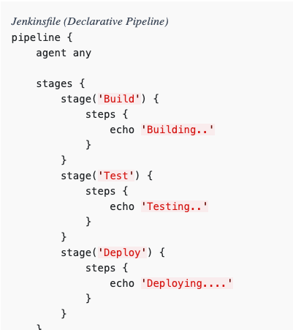
Jenkinsfile
Text file that contains the definition of a Jenkins Pipeline and is checked into source control

Slide 7
Demo Docs
Basic
https://github.com/jenkinsci/docker/blob/master/README.md
https://jenkins.io/doc/book/pipeline/
Advanced
https://jenkins.io/doc/tutorials/build-a-node-js-and-react-app-with-npm/

