Slide 1
Ansible
Jeff Joyce

Slide 2
Devops
DevOps is a set of practices that combines software development and information-technology operations which aims to shorten the systems development life cycle and provide continuous delivery with high software quality
Plan your architecture to be as reusable as possible.
Design the environment so that it is scalable and can be easily manipulated.
Ansible is a tool that can be used for IAC (Infrastructure as Code) or CAC (Configuration as Code)
T1CG we only use it for CAC

Slide 3
Ansible Basics
Ansible delivers simple IT automation that ends repetitive tasks and frees up DevOps teams for more strategic work.
Ansible and it's modules are written in Python. You don’t need any Python knowledge to use Ansible.
Ansible uses SSH to connect to hosts.
Ansible is agentless.

Slide 4
Terminology
Playbook
The entry point of your automation. Files are written in YAML format that instruct Ansible on what to do.
Tasks
They define an operation to be performed in the destination host. Could be installing a package or creating a directory. Files are written in YAML
Inventory
Also known as hosts file, it’s an INI file with the list of groups of hosts that Ansible will use to run playbooks. The file includes hostnames/IPs and variables you pass to playbooks. File Name: inventory.ini
Configuration File
To define a different variables for your inventory file or pass special SSH parameters. File Name: ansible.cfg

Slide 5
Basic scenario
MongoDB Single Server Setup
playbooks
mongodb-install
ansible.cfg
inventory.ini
playbook-mongodb.yml
tasks
mongodb-install
files
mongodb-org.repo
tasks
main.yml

Slide 6
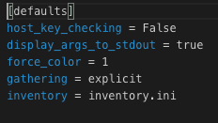
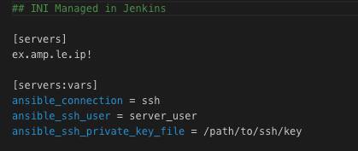
Ansible.cfg Inventory.ini

Slide 7
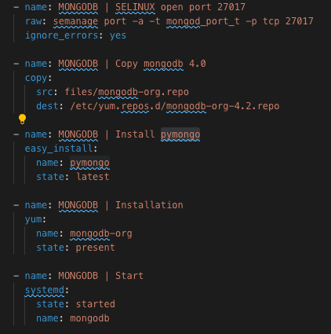
main.yml
Takeaways
Ansible has built in functionality ex. yum, mkdir, chmod, systemd, and copy
Ansible is readable and reusable!!!

Slide 8
Advanced ansible
Usage of variables and hostnames
Directory and Service lookups
Integration with Jenkins and parameterized builds

Slide 9
Advanced scenario
playbooks
tick
ansible.cfg
inventory.ini
playbook-tick.yml
tasks
tick
tasks
chronograf.yml
docker.yml
httplistener.yml
influxdb.yml
k8s.yml
kapacitor.yml
main.yml
mongo.yml
telegraf.yml

Slide 10
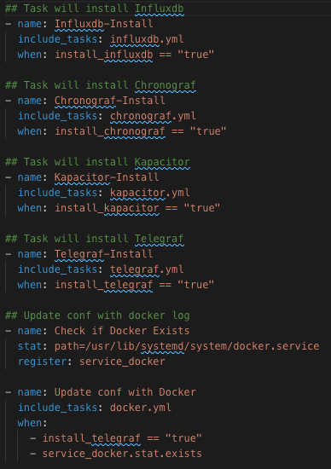
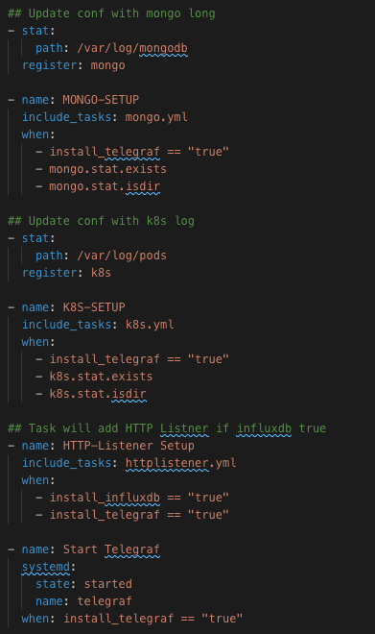
main.yml
Takeaways
Parameterized
Service checks
Directory checks

Slide 11
Conclusion
Ansible delivers automation for repetitive DevOps tasks.
Write Ansible to be reusable.
Ansible is a versatile tool for IAC and CAC.

Slide 12

Questions
This Photo by Unknown Author is licensed under CC BY-NC

