Slide 1
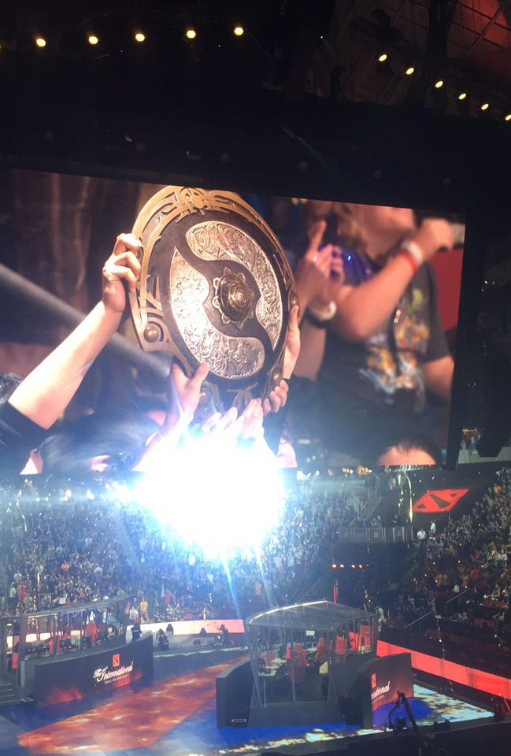
DotA 2 Win rate prediction
Fang Zhou
Runzhou Cao
XiaoHu Zhao

Slide 2
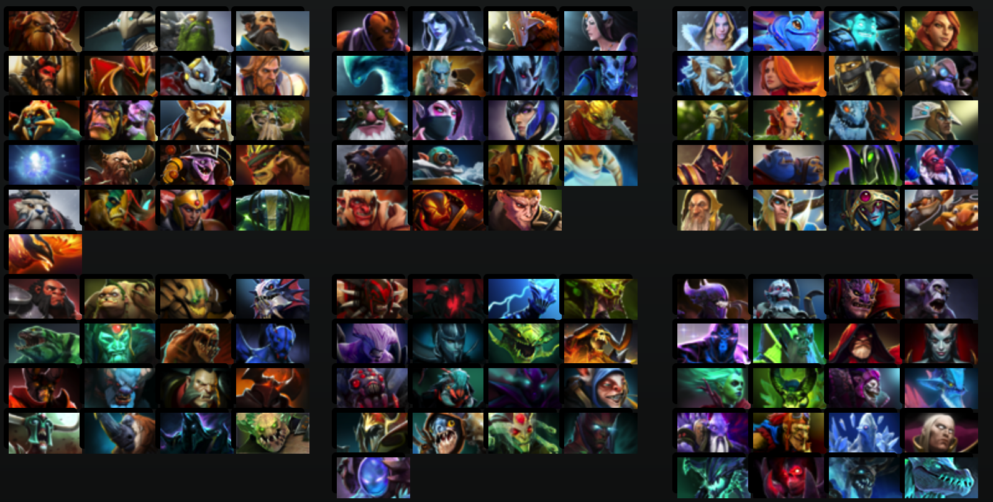
DotA2
Multiplayer Online Role Gaming
5 vs. 5, single map
Goal is to destroy enemy’s base known as the Ancients
Unique heroes
C(110, 10) x C(10, 5)
Notes:
c110

Slide 3
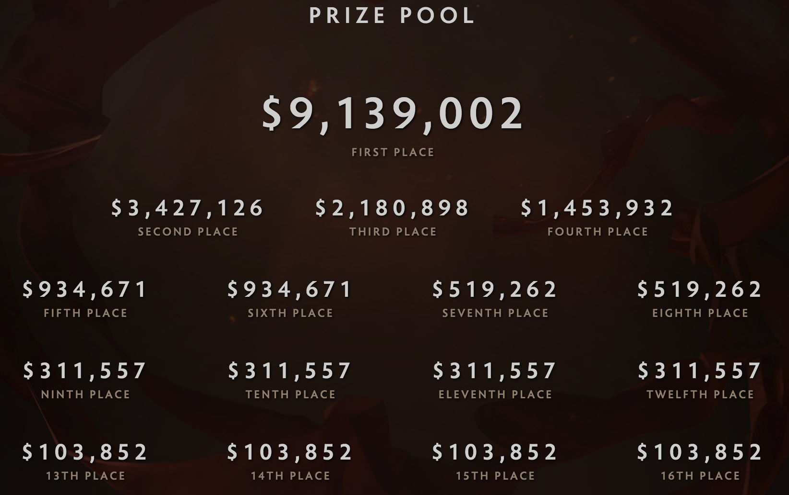
Motivation
Prize pool over 20 Million for The International 6.
A good lineup (aka hero combination) contributes to the victory significantly.

Slide 4
Research Question
If we can apply machine learning algorithms to predict win rate of DotA game?

Slide 5
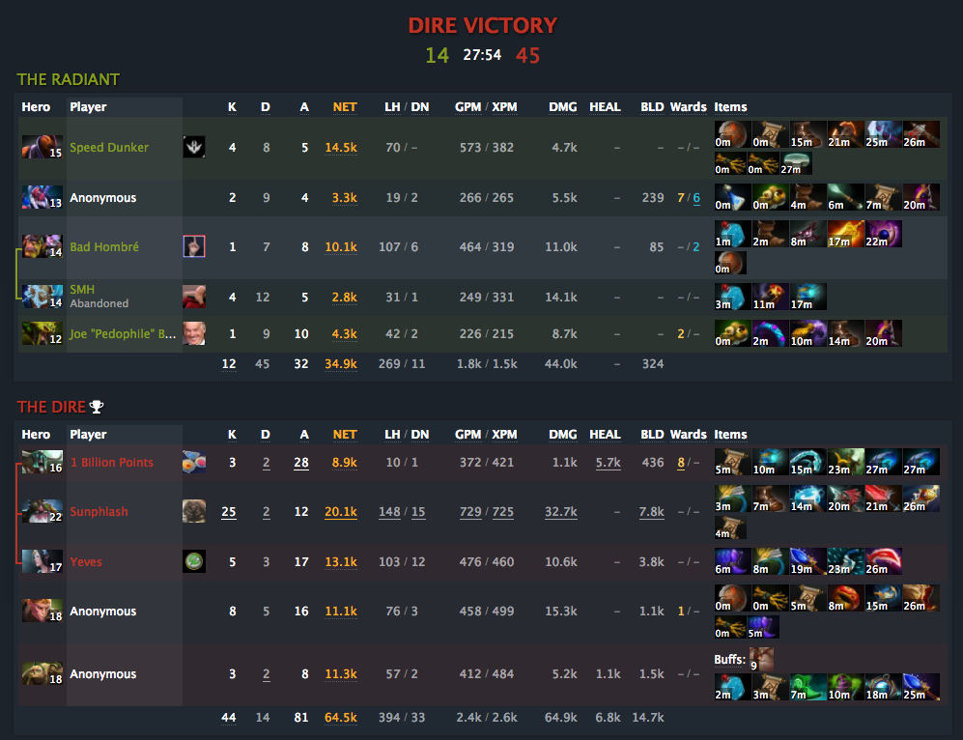
Data collection
Data comes from dotabuff.com
Dotabuff is the largest website to store Dota game statistics

Slide 6
Data collection
Data comes from dotabuff.com
Dotabuff is the largest website to store Dota game statistics
To remove the bias, only record the pro matches.
Use python to crawl dotabuff.com game data
Finally, we collect
Run for more than 4 days
Collect 15,197 games

Slide 7

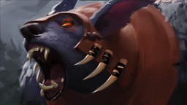


Feature Vector
synergic
111 hero lineup The value can be 1, -1, or 0.
30 synergic pairs The value can be 1, -1, or 0.
30 counter pairs The value can be 1, -1, or 0.
1 match time The unit of match time is minute.
1 match result The value can be 0 or 1.
In total, the # dimension of feature vector is 111+30+30+1=172
counter

Slide 8
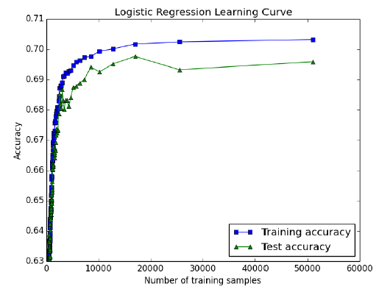


Design
Decision Tree
Accuracy rate is 58.05%
Not good
Logistic Regression
Hero selection is an important indicator of the outcome

Slide 9
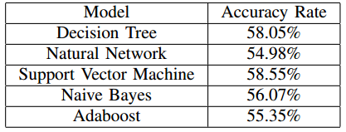
Results

Slide 10
Distance Weight
1. create a feature vector for the match as described before
2. clustering the heroes
3. label the relationship between heroes
4. use the new relationship to run knn

Slide 11


K-NN
Test accuracy rate is 75.10%.
Confusion matrix

Slide 12
Problems and future works
1) Concerning the data sets, we can only get the game records including the information of Team ID, Hero Lineup and result. More detailed information about teams and games are not available.
2) Regarding features, players skills, physical and emotional condition and the external environment all are vital to the result of a game, but they are difficult to be measured.

Slide 13
Thanks for listening!

