Slide 1
Homework5

Slide 2
Homework5
题目1
Assume we have following address binding table and value of registers :
Address | Value | Register | Value
0x100 | 0x10 | %eax | 0x10
0x110 | 0x11 | %ebx | 0x100
0x120 | 0x12
...... | ......
0x190 | 0x19
0x200 | 0x20

Slide 3
Homework5
题目1
Please fill in the table below
Operand | Value
%ebx
$0x150
0x170
(%ebx)
(%ebx,%eax)
0x30(%ebx)
80(%ebx,%eax,2)

Slide 4
Homework5
题目1
Suppose registers and bound values will be reset as above after each instruction. Please fill in the table below: (Write all if there are more than one destinations and None if there is no destination)
Instruction | Destination | Value
addl %eax,%ebx
subl %eax,(%ebx)
leal 0x50(%eax), %edx
movzbl %al, %ebx
movsbl %bh, %ecx

Slide 5
Homework5
题目1
Assume the initial value of the flags is 0. Fill the table below
Instruction | OF | SF | ZF | CF
leal(%eax),%ebx
subl %ebx, %eax
xorl %eax, %eax
test %eax, %ebx

Slide 6
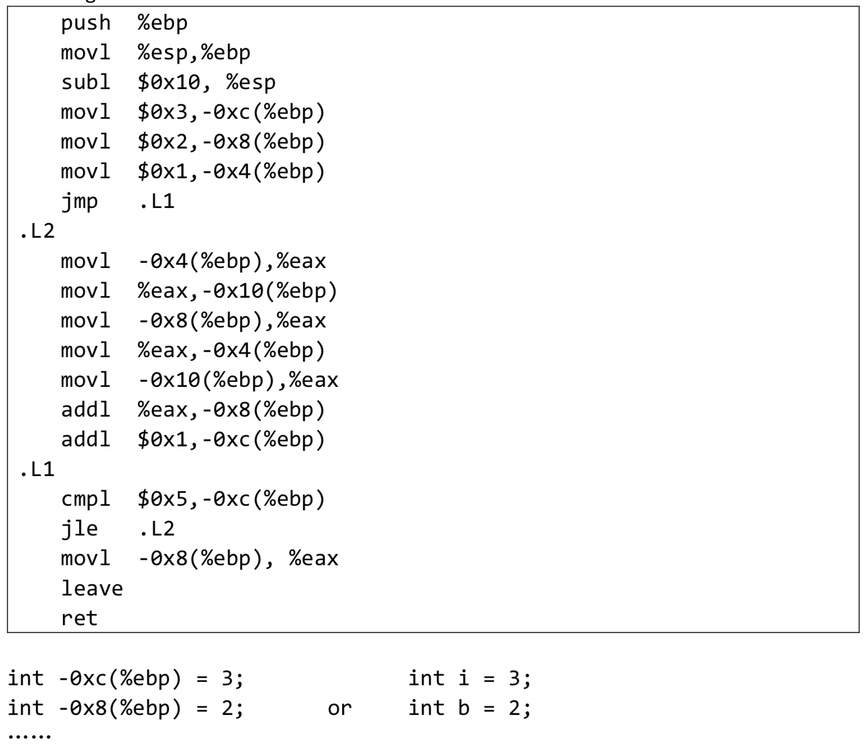
Homework5
题目2
Translate the following assembly into C codes.
You can name local variables represented by -12(%ebp), -8(%ebp)...or a,b,c... freely as you like.
The beginning of C codes is given.

Slide 7
题目3
Homework5
写一个Linux下的汇编程序，求解一个10个元素整型数组中的最小值，并且返回（可以用echo $?查看返回值）。源代码写入报告。
可以用循环等方式（需要自学一些后面的内容），也可以不用
然后用objdump工具对生成的可执行文件进行反汇编，并比较其与自己汇编源代码的差别，写入报告。
Notes:
1）!(x+1)
2) !x
3）!(~x&0xFF)
4) !(x>>24+1)

Slide 8
Homework5
题目4
Consider the following program: #define LEN 10 int a[LEN][LEN]; void f(void) {
int i, j; for (i = 0; i < LEN; i++)
for (j = 0; j < LEN; j++) {
a[i][j] = i * LEN + j;
}
}
Suppose the address of a is 0x10000000. After the function f() finished, fill the following table (if you don’t know the value, please write NONE):

Slide 9
Homework5
题目4
%eax | 0x10000000
%ecx | 22
$0x10000004
0x10000012
0xFFFFFF8
(%eax, %ecx, 8)

Slide 10
Homework5
The assembly code is as follows:
x@%ebp+8, y@%ebp+12, n@%ebp+16
movl 8(%ebp), %eax
movl 12(%ebp), %ecx
movl 16(%ebp), %edx
.L2:
addl %edx, %eax
imull %edx, %ecx
subl $1, %edx
testl %edx, %edx
jle .L5
cmpl %edx, %ecx
jl .L2
.L5:
题目5
Fill the blanks of the C program:
int dw_loop(int x, int y, int n) {
do{
}while ( );
returen x;
}

Slide 11
Homework5
题目6
After ICS class, Barathrum has written a function like below: int cmov_complex(int x, int y) {
return x < y? x * y; (x + y) * y; }
(1). Please write down the corresponding assembly code by using conditional move operations.
(2). When Barathrum compiles it with gcc, he finds that there’s no cmov at all in the assembly code! Please explain why gcc doesn’t use conditional move operations in this case.

Slide 12
Homework5
题目7
Translate the following switch statements into assembly using jump table.
int x = <some value>;
int result = 0;
switch (x) {
case 24:
result = x + x;
break;
case 27: case 28:
result = x + 10;
break;
case 26:
result = x * 2;
// Notice: there is no break here!
case 29: case 30:
result = result + 5;
break;
default:
result = 3;
break;
}

Slide 13
Homework5
题目8
一个C函数fun具有如下代码体：(参数从右向左入栈)
*p = d;
return x-c;
执行这个函数体的IA32代码如下：
Movsbl 12(%ebp), %edx ;较小的byte->dword, s表示符号填充，z表示0填充
Movl 16(%ebp), %eax
Movl %edx, (%eax)
Movswl 8(%ebp), %eax
Movl 20(%ebp), %edx
Subl %eax, %edx
Movl %edx, %eax
写出函数fun的原型，给出参数p, d, x, c的类型和顺序。写出求解过程。

Slide 14
Homework5
题目9
Suppose the initial value of %esp is 0x7FFFFFC4, initial value of %ebp is 0x7FFFFFF4.
The value stored in address 0x7FFFFFC0 is 0x120, value stored in address 0x7FFFFFC4 is 0x200, the value stored in address 0x7FFFFFF4 is 0x2710.
We have following x86 assembly code executed sequentially:
pushl %esp (instruction 1) movl %esp,%ebp (instruction 2) popl %ebp (instruction 3)
Question: After each instruction executed, what is the value of %esp and %ebp
(1) Instruction 1: (2) Instruction 2: (3) Instruction 3:

Slide 15
Homework5
1: .file "func.c"
2: .section .rodata.str1.1,"aMS",@progbits,1
3: .LC0:
4: .string "%d %d"
5:.LC1:
6: .string "%d %d %d\n"
7: .text
8: .globl main
9: .type main, @function
10:main:
11:.cfi_startproc
12: subq $24, %rsp
13: leaq 8(%rsp), %rdx
14: leaq 12(%rsp), %rsi
15: movl $.LC0, %edi
16: movl $0, %eax
17: call __isoc99_scanf
18: movl 12(%rsp), %ecx
19: movl 8(%rsp), %edx
20: movl %edx, %esi
21: xorl %ecx, %esi
22: movl $.LC1, %edi
23: movl $0, %eax
24: call printf
25: movl $0, %eax
26: addq $24, %rsp
27: ret
题目10
右边是C语言源代码文件func.c对应的汇编代码，请写出对应的C语言代码；
画出Line 24执行前栈的状态，以及此时寄存器%edi, %esi, %edx, %ecx, %rsp的值；假设进入main函数前%rsp的值为0x8000420（代码中出现的局部变量，要标记在栈图中；图中标记内存地址）

