Slide 1
Homework3

Slide 2
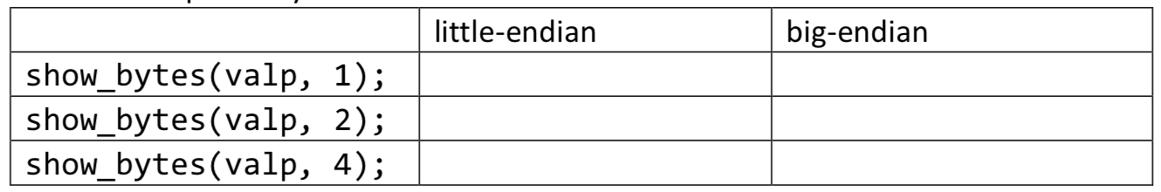
题目1
Consider the following function
typedef unsigned char * byte_pointer;
void show_bytes(byte_pointer start, int len) {
int i;
for (i=0; i<len; i++)
printf(“%.2x”, start[i]);
}
int val = 0x140A0233;
byte_pointer valp = (byte_pointer) & val;
What is the output of the following call to show_bytes on big-endian and little-endian machines respectively?

Slide 3
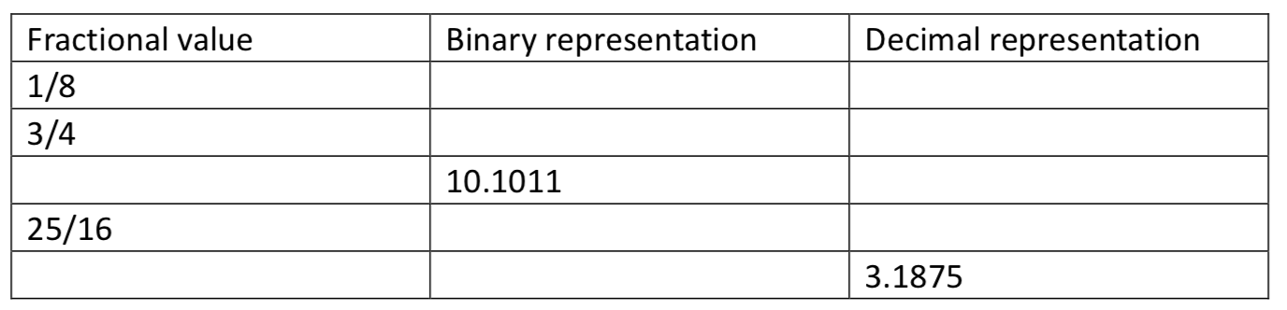
题目2
Fill in the missing information in the following table:

Slide 4
题目3
Given a floating-point format with a k-bit exponent and an n-bit fraction, write formulas for the exponent E, significand M, the fraction f, and the value V for the quantities that follow. In addition, describe the bit representation.
A. The number 5.0
B. The largest odd integer that can be represented exactly
C. The reciprocal of the smallest positive normalized value

Slide 5
题目4
Consider the following two 9-bit floating-point representations based on the IEEE floating-point format.
Format A
There is one sign bit.
There are k = 5 exponent bits. The exponent bias is 15.
There are n = 3 fraction bits.
Format B
There is one sign bit.
There are k = 4 exponent bits. The exponent bias is 7.
There are n = 4 fraction bits.
Below, you are given some bit patterns in Format A, and your task is to convert them to the closest value in Format B. If rounding is necessary, you should round toward positive infinity
In addition, give the values of numbers given by the Format A and Format B bit patterns. Given these as whole numbers(eg.,17) or as fractions(eg.,17/64 or 17/26).

Slide 6
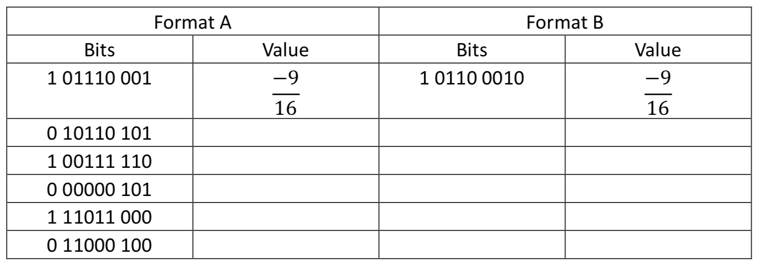
题目4

Slide 7
题目5
int为32位，float和double分别是32位和64位IEEE格式
Int x =random();
Int y = random();
Int z = random();
Double dx = (double)x;
Double dy = (double)y;
Double dz = (double)z;
对于下面的每个C表达式，判断是否恒为1。如果是请说明原理，如果不是请举出反例。
A. (float)x == (float)dx
B. dx-dy == (double)(x-y)
C. (dx+dy)+dz == dx+(dy+dz)
D. (dx*dy)*dz == dx*(dy*dz)
E. dx/dx == dz/dz
Notes:
Yes，转float可能损失精度，但左右近似的方法是一样的；
No，x=0, Y=Tmin
Yes, 都在double的表示范围，不需要近似
No,过大时有近似，不同顺序近似结果可能不同
No,x=0,z=1

Slide 8
题目6
编写如下函数，求浮点数f的绝对值|f|。如果f是NaN，那么应该直接返回f（注意NaN不要对f做任何修改）。
其中float_bits等价于unsigned，是float数字的二进制形式
typedef unsigned float_bits;
/* Compute |f|. If f is NaN, then return f. */
float_bits float_absval (float_bits f);

Slide 9
题目7
实现如下函数，对于浮点数f，计算2.0*f。如果f是NaN，你的函数应该简单返回f。
/* Compute 2*f. If f is NaN, return f. */
float_bits float_twice(float_bits f);

