Slide 1

Statistical Methods in Artificial Intelligence
CSE471 - Spring 2018
Project Title
Robust Loss Functions under Label Noise for Deep Neural Networks
Aritra Ghosh, Himanshu Kumar, P S Sastry
Team-37
Makarand Pawagi - 20173069
Rama Rao Bandreddi - 20173047
Abhishek Tyagi - 20173067
Raj Kiran Kokkula - 20173105

Slide 2
Introduction
During classifier learning, training data suffers from label noise, and this problem is more relevant in deep networks where huge training data is used.
In this paper, technique proposed for learning deep networks under label noise focus on choosing a loss functions that are inherently noise-tolerant.
  This paper, provides some sufficient conditions on a loss function so that risk minimization under that loss function would be inherently tolerant to label noise for multiclass classification problems.
  Study some of the widely used loss functions in deep networks and show that the loss function based on mean absolute value of error is inherently robust to label noise.
  Through experiments, illustrate the robustness of risk minimization with such loss functions for learning neural networks

Slide 3
Notations
Noise – η
True Label –
Noise Corrupted label –
label Noise - Class labels in the training data are noisy (i.e., may be incorrect).
MAE – Mean Absolute Error
MSE – Mean Square Error
CCE – Categorical Cross Entropy

Slide 4







Notations
Feature Space from where examples are drawn –
Class Labels –
Training Data –
Classifier –
Given any Loss Function “L” and classifier “f”, L-risk of f –
Noisy training data available to learner –
Where,
For all x, conditioned on we have .

Slide 5


Type of Noise
Symmetric or Uniform Noise:
  Percentage of Noise in labels (η) will be a constant and same across the data of all classes.
Simple non-uniform Noise:
  Percentage of Noise in labels (η) will be dependent on data (x).
Asymmetric or Class-conditional Noise:
  Percentage of Noise in labels (η) will be dependent on label and will be different for data of all classes.
 | Uniform Noise | Simple non-uniform Noise | Class-conditional Noise
Probability Of Getting correct label
Probability Of Getting incorrect label

Slide 6


Theorem – I (Definition)
In a multi-class classification problem, if symmetric loss function “L” satisfy following condition for some constant “C”:
Then L is noise tolerant under symmetric or uniform label noise if .

Slide 7

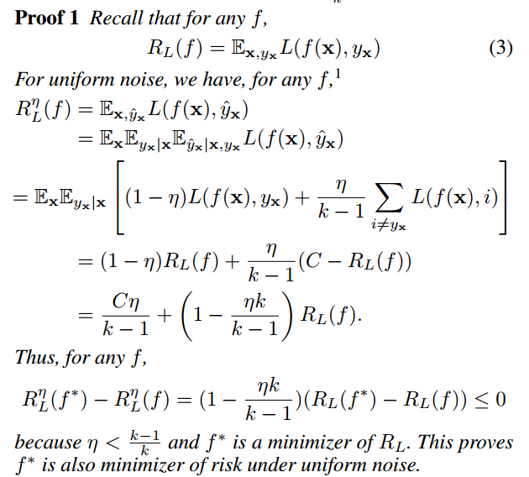
Theorem – I (Proof)

Slide 8
Theorem – II (Definition)
If “L” satisfy Eq 2, and if then L is also noise tolerant under simple non uniform noise when
If then, under simple non-uniform noise, is upper bounded by where is maximum noise rate over x ∈ X . (Recall that is minimizer of and is minimizer of ).

Slide 9

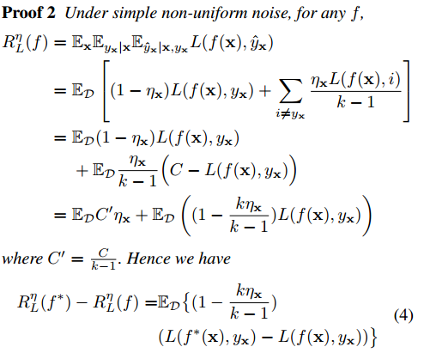
Theorem – II (Proof)
.

Slide 10
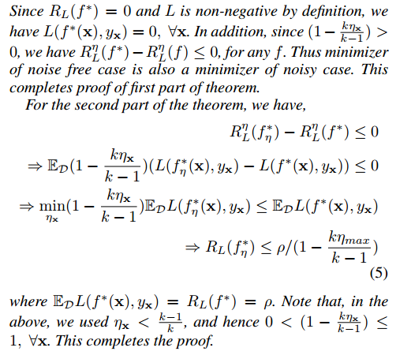
Theorem – II (Proof)
.

Slide 11
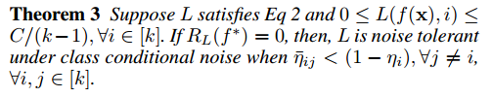

Theorem – III (Definition)
Kjh

Slide 12

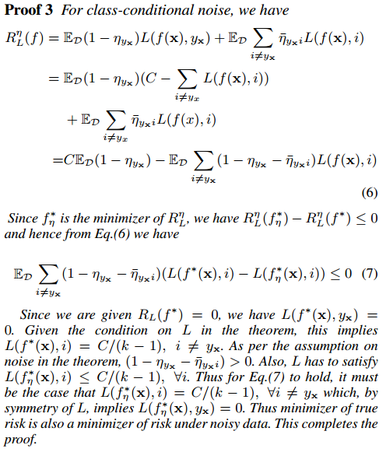
Theorem – III (Proof)
.

Slide 13

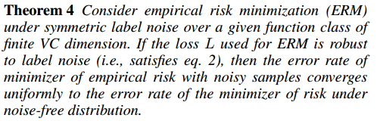
Theorem – IV (Definition)
Kjh

Slide 14
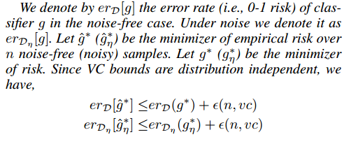
Theorem – IV (Proof)
.

Slide 15
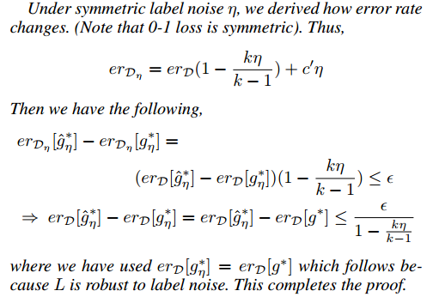
Theorem – IV (Proof)
.

Slide 16
Experimental Setting
.
Datasets: MNIST, CIFAR-10, IMDB
Loss functions: CCE, MAE, MSE
Noise Rates (eta): 0%, 30%, 60%
Class conditional noise
Optimizer: SGD
Github link: https://github.com/t25abhi/smai_proj

Slide 17
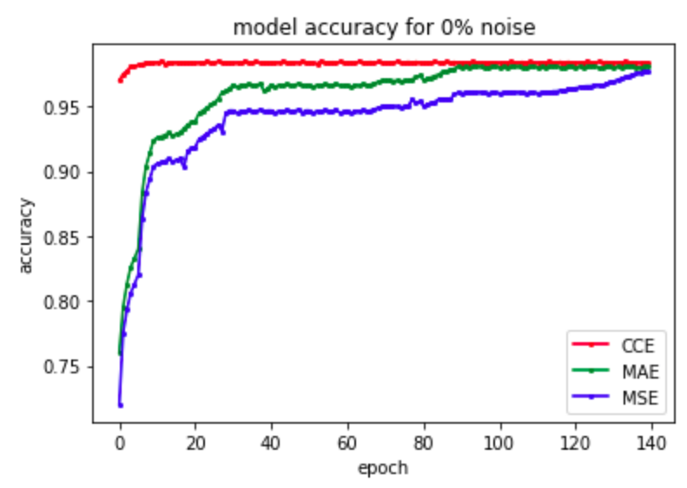
MNIST (Without Noise)
.

Slide 18
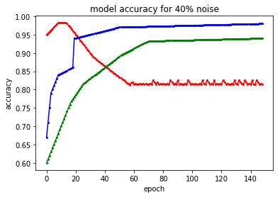
MNIST (eta = 40%)
.

Slide 19
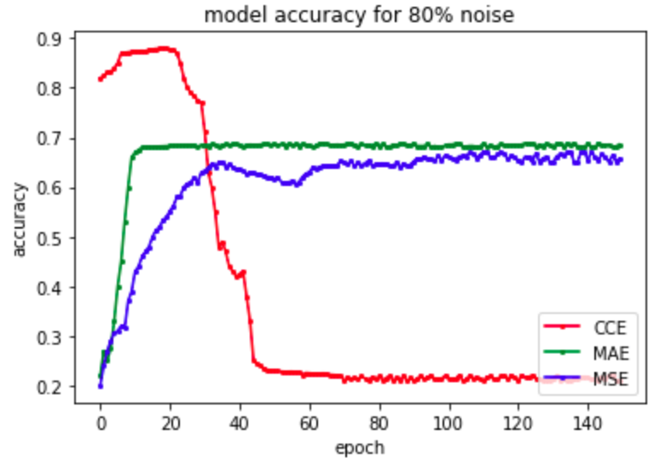
MNIST (eta = 80%)
.

Slide 20
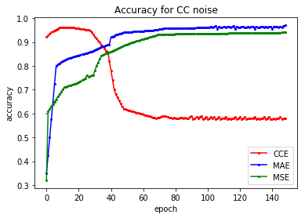
MNIST (Class conditional Noise)
.

Slide 21
Accuracies Table
.
Accuracies under different noise rates (η) for datasets (MNIST, CIFAR-10, and IMDB). The last column gives accuracies under class conditional noise.
Data | Loss Function | η = 0% | η = 40% | η = 80% | CC
MNIST | CCE MAE MSE | 0.9826 0.9811 0.9789 | 0.8154 0.9723 0.9386 | 0.2234 0.6912 0.6854 | 0.5983 0.9512 0.9397
CIFAR-10 | CCE MAE MSE | 0.7245 0.7612 0.7988 | 0.4675 0.6934 0.6966 | 0.2789 0.4987 0.4854 | 0.5674 0.6863 0.6912
IMDB | CCE MAE MSE | 0.8739 0.8711 0.8687 | 0.7123 0.8345 0.7011 | 0.6233 0.7252 0.6516 | 0.7599 0.8123 0.7500

