Slide 1
What to Expect When You’re Expected to Parse a CSV
Ruby Jam
Tony Drake
Indy.rb, July 2018

Slide 2
A brief history…
Ruby 1.8
CSV sucked
FasterCSV gem implemented “better” and faster CSV parsing
Ruby 1.9 and later
FasterCSV merged into Ruby core
CSV == FasterCSV

Slide 3
The basics
Reading a file line by line
CSV.foreach(filepath, options={})
CSV.read(filepath, options={})
CSV.open(filepath, mode=”rb”, options={})
CSV.new(data, options={})
DON’T USE THIS
Reading a whole file at once
Writing to a file
Generic constructor

Slide 4
Options are optional
Option | Default | Notes
:col_sep | “,” | Separator character
:row_sep | auto | How each row is terminated (\r\r / \n
:quote_char | ‘ “ ‘ | The quoting character
:converters / :header_converters | nil | Lambas / symbols to covert values from strings to Ruby objects
:headers | false | Assumes first row is header row and maps values accordingly
:return_headers | false | Include the header row as the first row of data
:skip_blanks | false | Skip over blank rows
:force_quotes | false | (For writing) Always wrap values in quotes
:skip_lines | nil | Skip row if regex matches the raw data

Slide 5
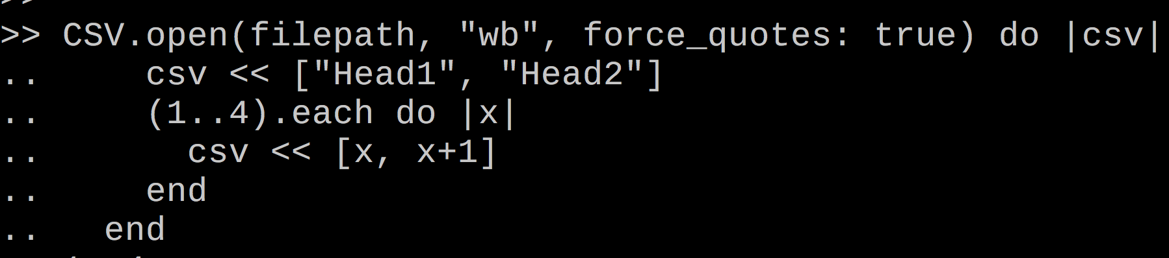
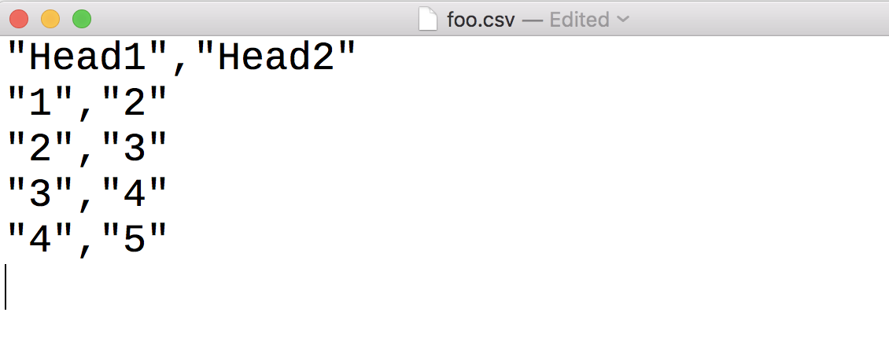
Writing a file

Slide 6
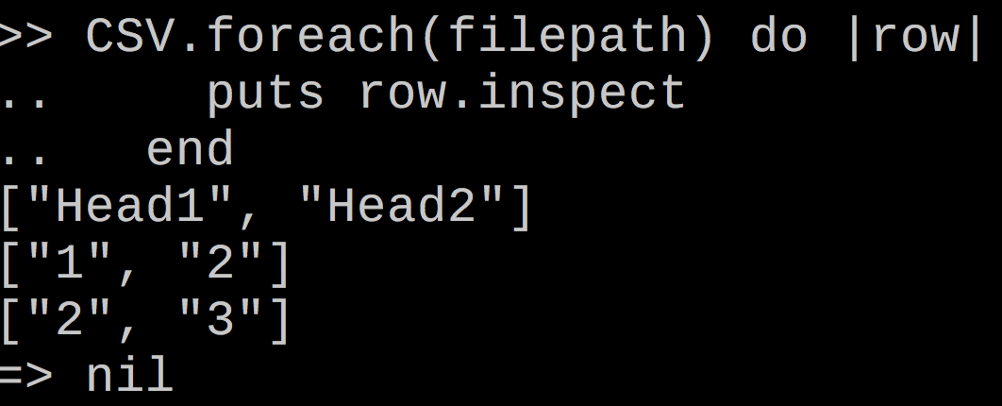
Reading a File
Head1,Head2
1,2
2,3

Slide 7
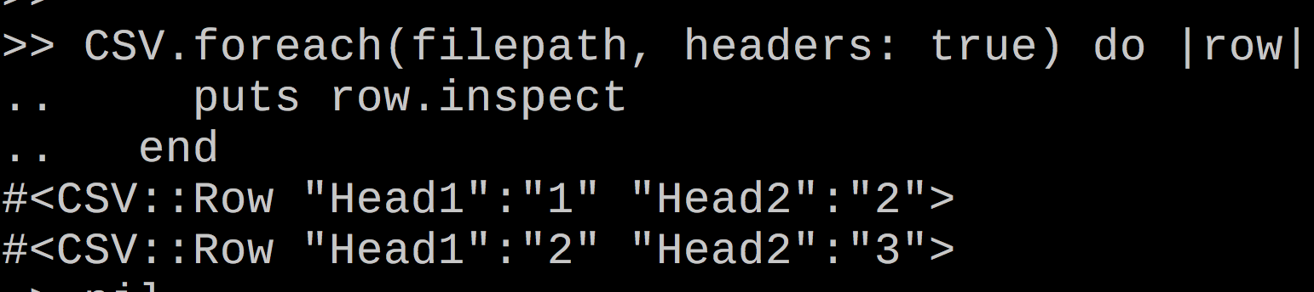
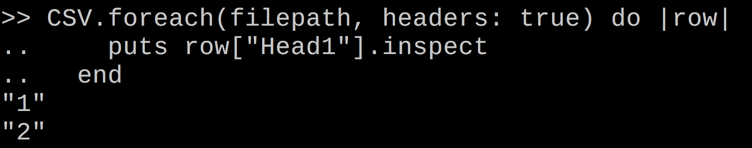
Reading a File (Parsing header row)

Slide 8
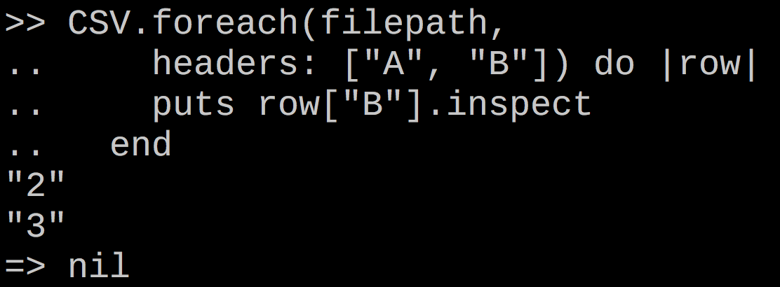
Reading a File (Providing your own headers)
1,2
2,3

Slide 9
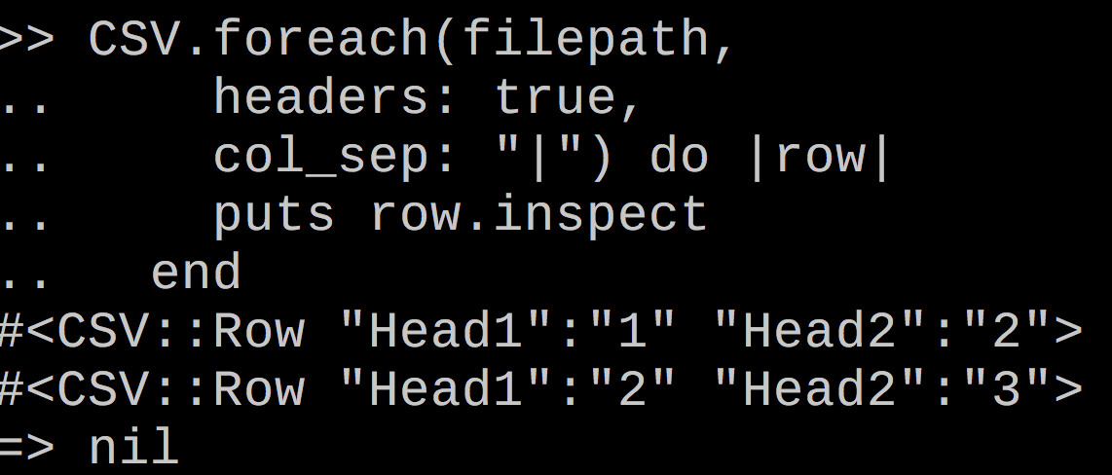
Reading a File (Pipe delimited)
Head1|Head2
1|2
2|3

Slide 10
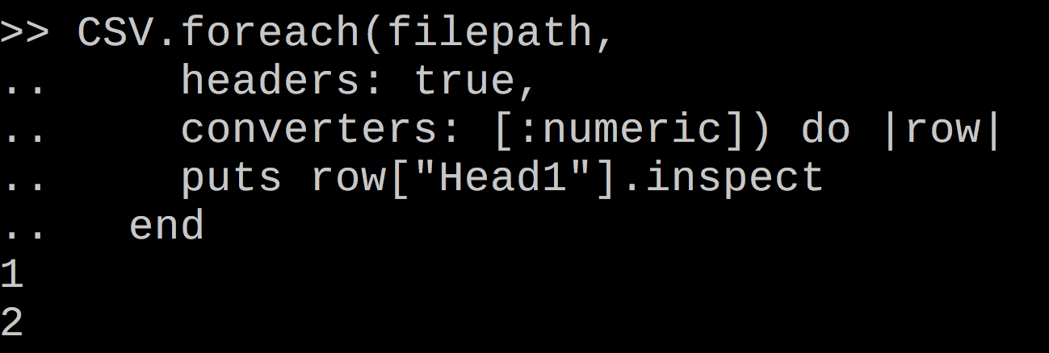
Reading a File

Slide 11
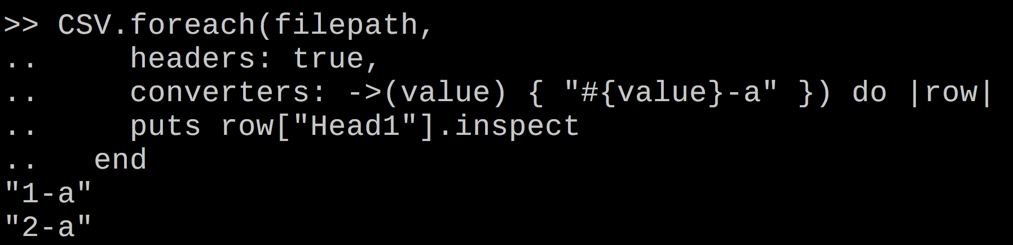
Reading a File

Slide 12
Reading a File?
Super Special Report
Client: Big Business, LLC
Generated: 9/9/1999
Account,Foo,Bar,Fizz,Buzz
123,456,789,000
123,456,789,000
Header row all the way down here?!?!?

Slide 13
CSV.new()
Basic constructor
Used internally by .foreach .read, and .open (for formatting)
Takes IO input
Raw string
StringIO object
File handle
CSV is just a glorified wrapper for File in Ruby!

Slide 14
Read the file!
file = File.open(filepath)
begin
end until(file.readline.strip.match(/^Account/))
header_row = file.lineno - 1
file.rewind
header_row.times{ file.readline }
CSV.new(file, headers: true).each do |row|
puts row.inspect
end
file.close
May raise EOFError, so rescue this
File#readline moves the cursor one line passed the header, so we must rewind and re-read to get to the spot we want
Give CSV.new the opened handle with the cursor right before the header row. Code the rest as normal
Always close your files!

Slide 15
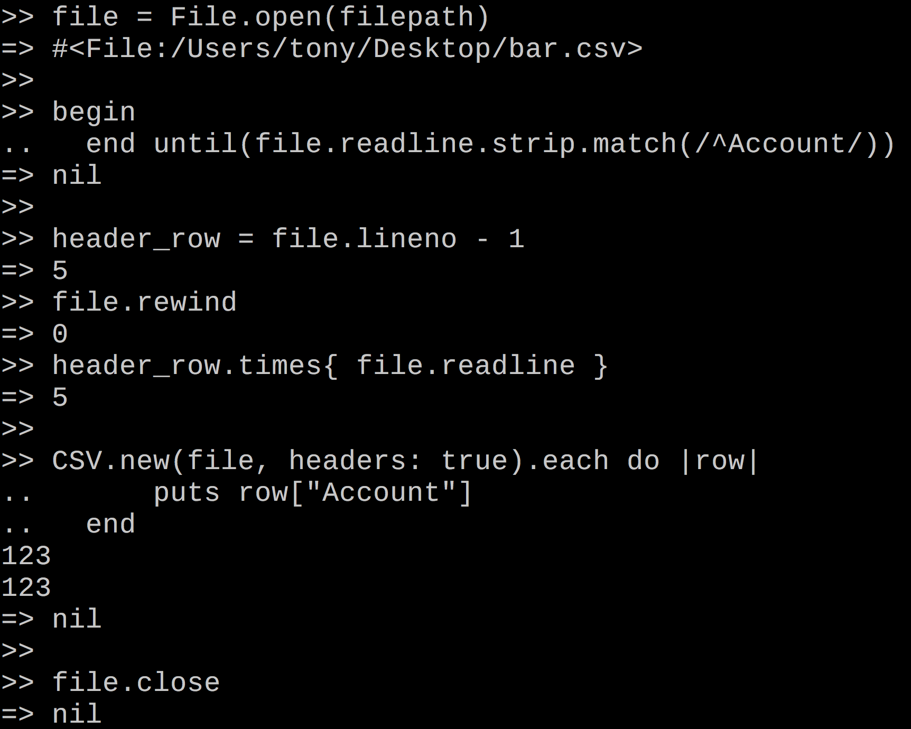

Slide 16
Final Notes
It’s all or nothing - Your files must be valid
Consistent line endings
Must have actual line endings
Properly escaped values
Read the documentation!
http://ruby-doc.org/stdlib-2.5.1/libdoc/csv/rdoc/CSV.html

Slide 17
The end
Twitter: @t27duck
Slides: github.com/t27duck/showandtell

