Slide 1
This slide intentionally left blank

Slide 2
Reporting on Rails ActiveRecord and ROLAP Working Together
WIP Edition
Tony Drake
IndyRB March 2017

Slide 3
Who am I?
Senior Developer at MOBI Wireless Management
Billing and Reporting Team
”Nearly one million devices under management.” ~ Our Marketing
Seven Years Working with Rails
Mario Kart Connoisseur

Slide 4
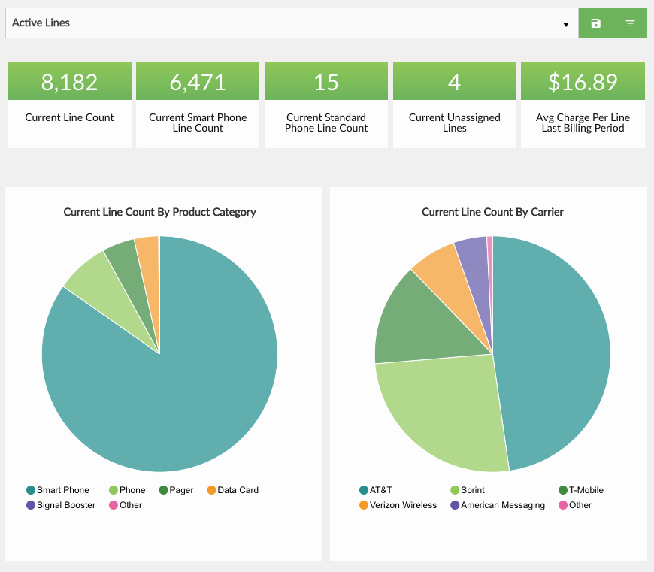
What I Do
“Magic”
Billing Data
Carrier Reports
PostgreSQL
Call Center Tickets
Orders

Slide 5
Today’s Talk
Define “reporting”
Industry standard terminology for “reporting”
Ways of organizing your data for “reporting”
How much can Rails do out of the box?

Slide 6
The Scenario
You are: Lead Developer
Median
Semi-successful blog site
~60,000 registered users
~1 million blog entries
~1.8 million comments
Median
Your Voice as we Travel the Highway of Life
(I spent way too much time on this fake logo)

Slide 7
The Scenario
Just a rough estimate / example.
Don’t bother memorizing this.
User
(Authors)
Blog
PostRating
Category
PostView
Comment
Post
One
Many

Slide 8
The Scenario
Feature Request: Build a series of dashboards to report on our data
Blog dashboard for authors
Overall dashboard for site admins
Allow for user-defined filtering
Where do you begin?

Slide 9
What is “reporting”?
Data is stored in our data stores (RDBMS)
Worthless to humans
Useful to computers
What’s useful? Information
Reports turn data into information for humans
Reports answer specific questions

Slide 10
What do you want to answer?
For owners
What is the total number of blogs by category?
How many users are signing up month over month?
Which posts are the most viewed?
For blog authors
How many users have viewed a post over the past 7 days?
How many comments are left on posts on average?
Which are my top 5 rated posts?
How many people have viewed posts for category ______?
How many posts have each of my blog’s authors written?

Slide 11
What is “OLAP”?
Online Analytical Processing
“…the technology behind many Business Intelligent (BI) applications. OLAP is a powerful technology for data discovery, including capabilities for limitless report viewing, complex analytical calculations, and predictive “what if” scenario planning.” From: http://olap.com/olap-definition/
Data is organized into “data cubes”
Comprised of dimensions and measures
Buyer
Amount
Date sold (Date, Month, Quarter, Year)
Every combination known and calculated ahead of time
Large amounts of preprocessed data stored in a warehouse for the express purpose of fast querying
Commonly deals with aggregate data (count, max, min)

Slide 12
What is “ROLAP”
Relational Online Analytical Processing
OLAP functionality implemented with a RDBMS
Dynamic queries generated for reports
Uses standard database tables and relations
May be implemented on both transactional data (OLTP) and warehouse data
Tables organized in a star and/or snowflake schema

Slide 13
Couple notes…
We don’t want “bloat” in our result set
No ActiveRecord instances (Less memory)
Generic, uniformed data (Arrays of rows)
Only get the information we care about

Slide 14
Terminology
Fact Table (Sometimes called “Fact Model”)
Dimension
Members (Labels)
Hierarchy
Dimension Filters (also known as just “Filters”)
Measure
Metric

Slide 15
Fact Table/Model
The primary table where information is derived from in a report
Fact columns – Commonly numeric columns
Dimension columns – values that may be grouped together or references other tables
SQL: FROM clause Rails: ActiveRecord model
What is the total number of blogs by category?
How many comments are left on posts on average?

Slide 16
Dimension
A point in the data where you can ”slice and dice” fact model info
Sales rep
Date of purchase
State of an order in a state machine
Lives on fact table or as a foreign key to another table
SQL: JOIN, GROUP BY Rails: ActiveRecord relation or attribute
What is the total number of blogs by category?
How many posts have each of my blog’s authors written?

Slide 17
Dimension Hierarchy
Related attributes on a dimension used to “drill up” and “drill down”
Found on dimensions which are relations to a fact model
Examples:
Dates: Date, Month, Quarter, Year
Mobile Phone: Model, Manufacture, OS, Wireless Technology

Slide 18
Dimension Members (Dimension Labels)
Information related to a dimension
When on fact table, the label is the column
When on a relation, a field representing the hierarchy level

Slide 19
Dimension Filters (or just “Filters”)
Not a “real” OLAP term
Takes advantage of querying capabilities of RDBMS
Allows for more fine-grained reporting
Can be part of the metric or user specified
SQL: WHERE Rails: where(), scopes, ransack

Slide 20
Measure
A column in a table (usually numeric) used in aggregations
Average, Sum, Maximum, etc
Examples:
Total amount in a sale
Number of units used in a transaction
SQL: A column in a fact table Rails: ActiveRecord attribute

Slide 21
Metric
A measured value; The subject of the report
The thing you actually want to answer
SQL: The query Rails: All the things
What is the total number of blogs by category?
How many posts have each of my blog’s authors written?

Slide 22
Terminology
ROLAP | SQL | Rails
Fact Table | FROM | ActiveRecord Model
Dimension | JOIN, GROUP BY | AR Relations, joins(), group()
Dimension Filter | WHERE | Scopes, where(), ransack
Measure | Numeric Column | Model Attribute
Metric | Query | All the above
(comment_count on posts)
How many comments were left on posts created today grouped by post category?

Slide 23
Star Schema
A design pattern for organizing data in a data warehouse
Allows for queries to be efficient and fast
Fact table holds core business information / processes
A sale
A bank transaction
Fact table holds foreign keys that branch out into dimension tables
Fact table may also hold non-foreign dimensions as columns
Other option: Snowflake Schema

Slide 24
Star Schema
Primary driving force of a report in the middle
Consists primarily of measures, foreign keys and dimensions that live on the fact table
belongs_to / has_one branch out to relations via foreign keys
More detailed info lives on dimensions
Prefer dimensions tables over dimensions living on the fact table
DOES NOT SUPPORT has_many relationships (well)
Dimension
Dimension
Dimension
Fact Table
Dimension
Dimension

Slide 25
Star Schema
Device
Plan
Carrier
Line
Status
Carrier Account
Overly simplified example

Slide 26
Star Schema
Blog
Status
Author
Post
Date Posted
Category
Median

Slide 27
Dates as Dimensions
date_dimensions
Want to report by Quarter? Year? Month?
Date functions on date columns can’t use a regular index
Simple join + group/filter is quicker
id | date | mday | month | year | quarter | wday
20170509 | 2017-05-09 | 9 | 5 | 2017 | 2 | 3
20170510 | 2017-05-10 | 10 | 5 | 2017 | 2 | 4
20170511 | 2017-05-11 | 11 | 5 | 2017 | 2 | 5
20170512 | 2017-05-12 | 12 | 5 | 2017 | 2 | 6
posts
id | posted_at_id | blog_id | author_id | title | content
16 | 20170509 | 123 | 15 | …. | ….
17 | 20170510 | 342 | 90 | …. | ….
18 | 20170511 | 123 | 15 | …. | ….
19 | 20170512 | 586 | 76 | …. | ….

Slide 28
Great! ActiveRecord can do all that… right?
ActiveRecord’s internals can provide all the information needed to construct ROLAP queries
Relationship information (joins and grouping)
Filtering capabilities (Scopes, where(), ransack)
Ability to select out specific columns

Slide 29
Great! ActiveRecord can do all that… right?
No programmatic way to easily group by all non-aggregate columns
You can group by relations and get objects back or by columns, not both
Can result in multiple queries resulting in ActiveRecord objects instanciated
Aggregation methods do not allow for full control over multiple columns returned
select() is ignored
group() can muck with the SELECT clause
No clear way to have “stock metrics” that can be reusable for different dashboards
No way to describe a fact table or metrics in ROLAP terms
No decent way to defining what a user can filter metrics on

Slide 30
Options?
Manually write hardcoded ActiveRelation queries?
Not very DRY
Complex logic for applying dimensions and filters
Write a queryer yourself?
ActiveRecord provides most of the information you want
Could result in dirtying up models
Switch your application to squeel?
Ship’s sailed for most apps
Requires management buy-in for a rewrite

Slide 31
active_reporting
https://github.com/t27duck/active_reporting
Implements a DSL for describing fact models, dimensions, filters
Build ready-made metrics to run reports on
Uses ActiveRecord to build a query and execute it on the database
Does not dirty up ActiveRecord (only one new method)
Not quite done yet (sad face)

Slide 32
active_reporting - FactModel
class PostFactModel < AR::FM
use_model ‘Post’
end
class Post < AR::Base
end

Slide 33
active_reporting – FactModel - Dimensions
class PostFactModel < AR::FM
…
dimension :blog
dimension :category
dimension :some_column
…
end
Define specific columns or relations for dimensions
Relation-based dimensions include identifier column and label in report results

Slide 34
active_reporting – Heirarchy + Labels
class DateDimFactModel < AR::FM
…
default_dimension_label :date
dimension_hierarchy [
:date, :month, :year, :quarter
]
…
end
Default label is “name”
Defining a hierarchy allows for specifying different columns to group by while dimensioning

Slide 35
active_reporting – Dimension Filters
class DateDimFactModel < AR::FM
…
dimension_filter :scope_on_model
dimension_filter :by_author_id, ->(x) { where(author_id: x) }
dimension_filter :title_cont, as: :ransack
…
end
Define available filters
Scopes defined on the ActiveRecord Model
Defined just for the fact model using scope syntax
Optional way to fallback to ransack on the AR model

Slide 36
active_reporting – Metric
m1 = ActiveReporting::Metric.new(
:post_count_by_author,
fact_model: PostFactModel,
dimensions: [:author]
)
m2 = ActiveReporting::Metric.new(
:comment_count,
fact_model: PostFactModel,
measure: :comment_count,
aggregate: :sum
)
Describes a question to answer
Declare
Fact Model
Dimensions
Measure
Aggregate (defaults to count)

Slide 37
active_reporting – Report
m2 = ActiveReporting::Metric.new(
:comment_count,
fact_model: PostFactModel,
measure: :comment_count,
aggregate: :sum
)
r = ActiveReporting::Report.new(
m1,
dimensions: [:blog], dimension_filter: {
blog_id_eq: [123, 456]
}
)
Builds and executes the report
Takes a pre-build metric and expands on it
Add additional dimensions and filters (ie, user input)
Returns simple array of hashes

Slide 38
active_reporting – Report
> r.run
=> [
{
comment_count: 742,
blog_identifier: 123,
blog: ‘Some Blog’
},
{
comment_count: 623,
blog_identifier: 456,
blog: ‘Some Other Blog’
},
]
SELECT
SUM(posts.comment_count)
AS comment_count,
blogs.id AS blog_identifier,
blogs.title AS blog
FROM posts
JOIN blogs ON blog.id = posts.blog_id
WHERE posts.blog_id IN(123, 456)
GROUP BY blogs.id, blogs.title

Slide 39
A Limitation of ActiveRecord
Extremely difficult to easily join against the same table twice and filter independently
SupportTicket. joins(:creator, :assignee). where(????)
class SupportTicket
belongs_to :creator, class_name: ‘User’ belongs_to :assignee, class_name: ‘User’
end

Slide 40
Other Database Considerations
Try not to have to make “multiple jumps” to tables
has_one :through can let us “cheat”, but query isn’t necessarily optimal
Keep dimensions “one deep” when focusing on Star Schema
Star/Snowflake Schema does not support one-to-many and many-to-many relationships (very well)
Index liberally where needed
Foreign keys
Columns commonly used for filtering
Use EXPLAIN [ANALYZE]
INSERTS will be ”slower” as you move to a more warehouse-like database
Read-only replicating slaves
Shard or schema separation

Slide 41
Outgrowing OLTP: Entering “Real” Data Warehousing
ROLAP functions well enough for OLTP (Transactional) data, but overtime more data leads to slower queries
Running aggregates on the fly will eventually become too slow
Rails counter caches
Pre-calculated aggregates (Rebuilt via background jobs)
Copy/move “historical” data into ”rollup tables” and report on them
Data is no longer “live”
Data is stamped out once
Pre-determined aggregates and summation of data
Note: Rolling aggregations can cause a loss in dimension data

Slide 42
The End
WIP Gem: https://github.com/t27duck/active_reporting
Slides: https://github.com/t27duck/showandtell
Twitter: @t27duck

