Slide 1
This slide intentionally left blank

Slide 2
Cheap Parlor Tricks in psql
Good PostgreSQL Advice
Top 10 Things You Should Do in PostgreSQL
Random and-totally-not-thrown-together PostgreSQL Talk #84
Tony Drake, Senior Web Developer, MOBI Wireless Management
Inby.rb, January 2017

Slide 3
Topics of Discussion
Four cool things you can do with psql
Do’s and Don’ts for PostgreSQL
Couple A “neat” query feature of PostgreSQL

Slide 4
Cool thing with psql: \e
Use \e to be dropped into a text editor
Prepopulated with the previously ran query/command
Save and exit to run the query
Uses the system’s $EDITOR environment variable
Great for writing/editing large queries!

Slide 5
Cool thing with psql: \timing
Run “\timing” to turn timing mode on
Shows the time each query takes to execute

Slide 6
Cool thing with psql: \watch
Append \watch to the end of your query
Query will be executed repeatedly ever few seconds
SELECT now() - query_start, state, query FROM pg_stat_activity \watch

Slide 7
Cool thing with psql: \copy (CSV export)
Use the \copy command to send a query to a file as a CSV
\copy (SELECT * FROM users) To '/tmp/test.csv' With CSV HEADER
Does not require super user access (unlike “COPY TO”)

Slide 8
Do’s and Don’t’s with PostgreSQL (A disclaimer)
Totally not scientific
Based on experience
YMMV
Restrictions apply
Do not take while pregnant
Valid only in the continental United States
Void where prohibited
See a doctor if this lasts longer than four hours

Slide 9
Do – Index Concurrently
Normal indexes lock the table while they are being applied
Concurrently takes longer to apply, but won’t lock the table
**WAITS FOR LONG RUNNING TRANSACTIONS TO FINISH FIRST**
class AddStatusIndexToPosts < ActiveRecord::Migration
disable_ddl_transaction!
def change
add_index :posts, :status_id, algorithm: :concurrently
end
end

Slide 10
Don’t – Over index tables
Just because you have an index on a table, doesn’t mean it’s being actively used
Indexes take up space just like tables. Unused index = bloat and waste
Note that tables have to be a certain size before PostgreSQL deems it necessary to use them. Sometimes a sequence scan of a small table is just as fast.
SELECT *
FROM pg_stat_all_indexes
WHERE schemaname = 'public'
ORDER BY indexrelname DESC, idx_scan ASC;

Slide 11
Do – Apply indexes to foreign keys (When they will be actually used)
Userbelongs to a Group
group_id lives on users
Apply an index to this column if
There will be a need to ask “I need all the users that belong to this group”
You will be actively joining users to groups in everyday queries

Slide 12
Don’t – Use like or ilike with btree indexes
Using “like” or “ilike” CANNOT USE BTREE INDEXES
Ok I lied… it can sorta use them if a wildcard is on the far right
SELECT … WHERE foo like ’bar%’
pg_trgm provides features for specialized GIN and GIST indexes that ilike and like can use!
https://www.postgresql.org/docs/current/static/pgtrgm.html

Slide 13
Do – Create indexes for sorting
Do you sort by and filter by a certain column a lot?
Example: publish_on for a blogs table
SELECT * FROM blogs WHERE publish_on <= now() ORDER BY publish_on DESC
PostgreSQL must sort the entire resultset after filtering the initial rows
You can even create an index for the sort order of the column
CREATE INDEX foo ON blogs (publish_on DESC)

Slide 14
Don’t – Use subqueries when you can join
SELECT * FROM widgets WHERE owner_id IN( SELECT id FROM users WHERE group_id = 2 )
SELECT * FROM widgets JOIN users ON widgets.owner_id = users.id WHERE users.group_id = 2

Slide 15
Do – Create specialized indexes
SELECT * FROM employees WHERE LOWER(cost_center) IN(?)
Does not use a standard index on cost_center
CREATE INDEX foo ON employees (LOWER(cost_center))

Slide 16
Don’t – Use hstore
Use JSON or JSONB instead
Queryable
Stores datatypes
No need for an extension
Gotchas:
Can take up more physical space on disk
Can’t SELECT DISTINCT * with JSON (JSONB is ok)

Slide 17
Do – Use explain analyze
“Why is this query slow”?
”Is my query using indexes”?
EXPLAIN – Gives the projected query plain
EXPLAIN ANALYZE – Executes query, gives exact plan, and timings
https://explain.depesz.com/

Slide 18
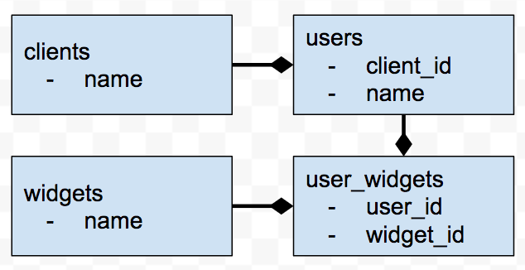
Don’t – Over normalize
What widgets are actually being used by a client?
class Client has_many :users
has_many :widgets, through: :users end
class User
belongs_to :client
has_many :widgets
end
class UserWidget
belongs_to :user
belongs_to :widget
end

Slide 19
Don’t – Over normalize
client.widgets.pluck(“DISTINCT widget_id”)
SELECT DISTINCT widget_id
FROM user_widgets JOIN users ON clients.user_id = users.id
WHERE user_widgets.user_id = users.id
So… what happens if a client has… 10,000 users?

Slide 20
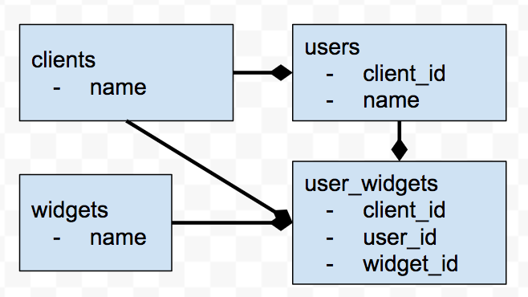
Don’t – Over normalize
What widgets are actually being used by a client?
class Client has_many :users
has_many :widgets end
class User
belongs_to :client
has_many :widgets
end
class UserWidget
belongs_to :user
belongs_to :widget
end

Slide 21
Don’t – Over normalize
client.widgets.pluck(“DISTINCT widget_id”)
SELECT DISTINCT widget_id
FROM user_widgets WHERE user_widgets.client_id = 123

Slide 22
Neat Feature – The WITH Clause
WITH unhappy_users AS ( SELECT count(*) user_count
FROM complaints
GROUP BY user_id
HAVING count(*) > 3
)
SELECT ROUND(
(unhappy_users.user_count / (SELECT count(*) FROM users) * 100) , 1
) FROM unhappy_users

Slide 23
Neat Feature – The WITH Clause
WITH user_client_relation AS (
SELECT u.client_id AS user_client_id, uw.user_id
FROM users u, user_widgets uw
WHERE uw.user_id = u.id
)
UPDATE user_widgets
SET client_id = user_client_relation.user_client_id
FROM user_client_relation
WHERE user_widgets.user_id = user_client_relation.user_id

Slide 24
Other tidbits
Use integers instead of strings to filter when possible
Always specify an ORDER BY for large, paginated datasets
Any ALTER TABLE requires a full table lock
Window functions
https://www.postgresql.org/docs/current/static/tutorial-window.html

Slide 25
The End
Gets these slides at https://github.com/t27duck/showandtell

