Slide 1
This slide intentionally left blank

Slide 2
Reporting on Rails ActiveRecord and ROLAP Working Together
Tony Drake
RailsConf 2017
github.com/t27duck @t27duck

Slide 3
Who am I?
Tony Drake
Senior Developer at MOBI
Billing and Reporting Team
Nearly one million devices under management + Billing data
Seven Years Working with Rails
Mario Kart Connoisseur
Notes:
Manage the corporate mobile phone accounts for fortune 500 companies.
Bill optimization, procurement and tier 1 tech support

Slide 4
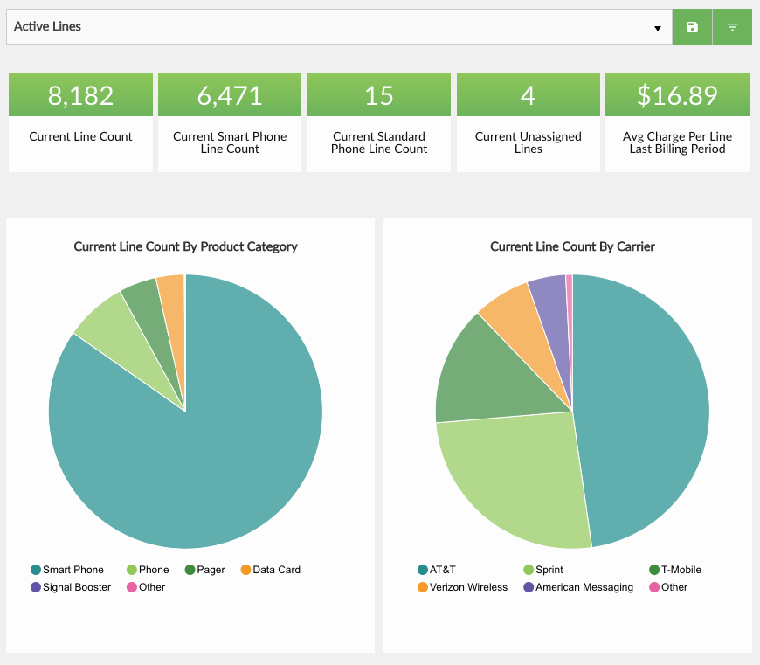
What I Do
“Magic”
Billing Data
Carrier Reports
PostgreSQL
Call Center Tickets
Orders

Slide 5
The Scenario
Feature Request: Build a series of dashboards to report on our data
Dashboard for client administrators
Dashboard for internal support staff
Dashboard for MOBI Management
Allow for user-defined filtering
Where do you begin?
Notes:
Back in the beginning of MOBI, ownership came with a “request”.

Slide 6
Couple notes…
Don’t want “bloat” in our result set
No ActiveRecord instances (Less memory)
Generic, uniformed data (Arrays of rows)
Only get the information we care about
Notes:
The goal was to have the frontend work with simple Ruby objects translated into JSON to feed into the flavor of the month JS charting system.

Slide 7
What is “reporting”?
Data is stored in our data stores (RDBMS)
Worthless to humans
Useful to computers
What’s useful? Information
Reports turn data into information for humans
Reports answer specific questions

Slide 8
What do you want to answer?
For internal support staff (Workflow ease)
How many support tickets by client were created in the last month?
For client administrators (Visibility into program)
What is the sum of mobile charges for for the last billing period by cost center?
For MOBI Management (Company health)
How many active lines of service by client?
Notes:
Get questions up front. If you don’t know what you’re asking, you’re throwing spaghetti at the wall and possibly not delivering useless information to the user.

Slide 9
What is “OLAP”?
Online Analytical Processing
“…the technology behind many Business Intelligent (BI) applications. OLAP is a powerful technology for data discovery, including capabilities for limitless report viewing, complex analytical calculations, and predictive “what if” scenario planning.” From: http://olap.com/olap-definition/
Data is organized into “data cubes”
Comprised of “dimensions” and “measures”
Every combination known and calculated ahead of time
Large amounts of preprocessed data stored in a warehouse
Commonly deals with aggregate data (count, max, min)
Notes:
Pre sliced and diced date for any combination of groupings.
Focuses on prebuild counts, averages, etc.
Oracle and MS provide OLAP modules for their database products. ($$$)

Slide 10
What is “ROLAP”
Relational Online Analytical Processing
OLAP functionality implemented with a RDBMS
Dynamic queries generated for reports
Uses standard database tables and relations
May be implemented on both transactional data (OLTP) and warehouse data

Slide 11
OLAP Terminology
Fact Table (Sometimes called “Fact Model”)
Dimension
Members (Labels)
Hierarchy
Dimension Filters (also known as just “Filters”)
Measure
Metric
Notes:
Standard OLAP terms. Will relate them to SQL and Rails terms.
Convert the Question to OLAP to SQL.

Slide 12
Fact Table/Model
The primary table where information is derived from in a report
Fact columns – Commonly numeric columns
Dimension columns – values that may be grouped together or references other tables
SQL: FROM clause Rails: ActiveRecord model
How many support tickets by clients were created in the last month?
How many active lines of service do we support broken down by client?
Notes:
The starting point of a report. The focal point that holds the data you want.

Slide 13
Dimension
A point in the data where you can ”slice and dice” fact model info
Carrier
Cost center
State of an order in a state machine
Lives on fact table or as a foreign key to another table
SQL: JOIN, GROUP BY Rails: ActiveRecord relation or attribute
How many open support tickets are in my queue by type?
What is my active lines of service count by carrier?

Slide 14
Dimension Hierarchy
Related attributes on a dimension used to “drill up” and “drill down”
Found on dimensions which are relations to a fact model
Examples:
Dates: Date, Month, Quarter, Year
Mobile Phone: Model, Manufacture, OS, Wireless Technology

Slide 15
Dimension Members (Dimension Labels)
Information related to a dimension
When on fact table, the label is the column
When on a relation, a field representing the hierarchy level
Notes:
Line of service has a carrier. Carrier table has a “name”.
Line of service has a device. Device has a name and OS.

Slide 16
Dimension Filters (or just “Filters”)
Not a “real” OLAP term
Takes advantage of querying capabilities of RDBMS
Allows for more fine-grained reporting
SQL: WHERE Rails: where(), scopes, ransack
Notes:
Benefit of using RLOAP. Allows to get information out dynamically.

Slide 17
Measure
A column in a table (usually numeric) used in aggregations
Average, Sum, Maximum, etc
Examples:
Total amount in a sale
Number of units used in a transaction
SQL: A column in a fact table Rails: ActiveRecord attribute
Notes:
The column in the table you wish to run an aggregate on. (Count is the exception)

Slide 18
Metric
A measured value; The subject of the report
The thing you actually want to answer
SQL: The query Rails: All the things
What is the sum of charges for the last billing period by cost center?
How many support tickets by client were created in the last month?

Slide 19
Terminology
ROLAP | SQL | Rails
Fact Table | FROM | ActiveRecord Model
Dimension | JOIN, GROUP BY | AR Relations, joins(), group()
Dimension Filter | WHERE | Scopes, where(), ransack
Measure | Numeric Column | Model Attribute
Metric | Query | All the above
What is the sum of mobile charges for the last billing period grouped by cost center?

Slide 20
Star Schema
Design pattern for organizing data in a data warehouse
Consists of measures and dimensions that live on the fact table
belongs_to / has_one branch out to relations via foreign keys
DOES NOT SUPPORT has_many relationships (well)
Other option: Snowflake Schema
Dimension
Dimension
Dimension
Fact Table
Dimension
Dimension

Slide 21
Star Schema
Overly simplified examples
Assignee
Plan
Category
Creator
Cost Center
Line Owner
Support Ticket
Bill Line
Created Date
Client
Bill Date
Client
Device
Carrier
Plan
Line
Client
Status
Carrier Account

Slide 22
Dates as Dimensions
date_dimensions
Want to report by Quarter? Year? Month?
Date functions on date columns can’t use a regular index
Simple join + group/filter is quicker
id | date | mday | month | year | quarter | wday
20170509 | 2017-05-09 | 9 | 5 | 2017 | 2 | 3
20170510 | 2017-05-10 | 10 | 5 | 2017 | 2 | 4
20170511 | 2017-05-11 | 11 | 5 | 2017 | 2 | 5
20170512 | 2017-05-12 | 12 | 5 | 2017 | 2 | 6
support_tickets
id | created_at_id | client_id | assigned_id_to | state | category
16 | 20170509 | 123 | 15 | …. | ….
17 | 20170510 | 342 | 90 | …. | ….
18 | 20170511 | 123 | 15 | …. | ….
19 | 20170512 | 586 | 76 | …. | ….

Slide 23
Great! ActiveRecord can do all that… right?
ActiveRecord’s internals can provide all the information needed to construct ROLAP queries
Relationship information (joins and grouping)
Filtering capabilities (Scopes, where(), ransack)
Ability to select out specific columns

Slide 24
Great! ActiveRecord can do all that… right?
No programmatic way to easily group by all non-aggregate columns
Aggregation methods (#count, #maximum, #minimum) do not allow for full control over multiple columns returned
No way to describe a fact table or metrics in ROLAP terms
No decent way to defining what a user can filter metrics on
Notes:
No programmatic way to easily group by all non-aggregate columns
You can group by relations and get objects back or by columns, not both
Can result in multiple queries resulting in ActiveRecord objects instantiated
Aggregation methods do not allow for full control over multiple columns returned
select() is ignored
group() can muck with the SELECT clause
No way to describe a fact table or metrics in ROLAP terms
No decent way to defining what a user can filter metrics on

Slide 25
Options?
Manually write hardcoded queries?
Write a queryer yourself?
Switch your application to sequel?
Notes:
Hardcoded queries? - Complex logic for applying dimensions and filters
Write a queryer yourself? - Could result in dirtying up models
Switch your application to sequel? - Ship’s sailed for most apps; Requires management buy-in for a rewrite

Slide 26
active_reporting
https://github.com/t27duck/active_reporting
Implements a DSL for describing fact models, dimensions, and filters
Uses ActiveRecord to build a query and execute it on the database
Does not dirty up ActiveRecord (only one new method)
Mostly production-ready
API pretty much at a good spot
Would love help with documentation :D

Slide 27
active_reporting – FactModel
class LineFactModel < ActiveReporting::FactModel
end
class Line < ActiveRecord::Base
end
Notes:
A fact model links to an ActiveRecord model.
Called fact model because we’re modeling out and describing how a table can be used in reporting.

Slide 28
active_reporting – Dimensions
class LineFactModel < AR::FM
…
dimension :number
dimension :carrier
dimension :some_column
…
end
Define specific columns or relations for dimensions
Relation-based dimensions include identifier column and label in report results

Slide 29
active_reporting – Heirarchy + Labels
class DateDimFactModel < AR::FM
…
default_dimension_label :date
dimension_hierarchy [
:date, :month, :year, :quarter
]
…
end
Default label is “name”
Defining a hierarchy allows for specifying different columns to group by while dimensioning
Notes:
Example of a fact model that wouldn’t be used as the base of a report, but we model out how it can be used when used as a dimension.

Slide 30
active_reporting – Dimension Filters
class TicketFactModel < AR::FM
…
dimension_filter :scope_on_model
dimension_filter :by_creator_id, ->(x) { where(creator_id: x) }
dimension_filter :subject_cont, as: :ransack
…
end
Define available filters
Scopes defined on the ActiveRecord Model
Defined just for the fact model using scope syntax
Optional way to fallback to ransack on the AR model
Notes:
Build a whitelist of available filters.
Gives us full control over the query.
Whitelisting because this is user input.

Slide 31
active_reporting – Metric
m1 = ActiveReporting::Metric.new(
:line_count_by_carrier,
fact_model: LineFactModel,
dimensions: [:carrier]
)
m2 = ActiveReporting::Metric.new(
:total_charges,
fact_model: BillLineFactModel,
measure: :total_charges,
aggregate: :sum
)
Describes a question to answer
Declare
Fact Model
Dimensions
Measure
Aggregate (defaults to count)
Notes:
Pulls information from fact models an dimensions together

Slide 32
active_reporting – Report
metric = ActiveReporting::Metric.new(
:total_charges,
fact_model: BillLineFactModel,
measure: :total_charges,
aggregate: :sum
)
r = ActiveReporting::Report.new(
metric,
dimensions: [:carrier], dimension_filter: {
carrier_id_eq: [123, 456]
}
)
Builds and executes the report
Takes a pre-build metric and expands on it
Add additional dimensions and filters (ie, user input)
Returns simple array of hashes
Notes:
Run the query. Allows to take a base metric and merge it with user input to expand it.

Slide 33
active_reporting – Report
metric = ActiveReporting::Metric.new(
:total_charges,
fact_model: BillLineFactModel,
measure: :total_charges,
aggregate: :sum
)
r = ActiveReporting::Report.new(
metric,
dimensions: [:carrier], dimension_filter: {
carrier_id_eq: [123, 456]
}
)
SELECT
SUM(bill_lines.total_charges)
AS total_charges,
carriers.id AS carrier_identifier,
carriers.name AS carrier
FROM bill_lines
JOIN carriers ON carriers.id = bill_lines.carrier_id
WHERE bill_lines.carrier_id IN(123, 456)
GROUP BY carriers.id, carriers.name

Slide 34
active_reporting – Report
SELECT
SUM(bill_lines.total_charges)
AS total_charges,
carriers.id AS carrier_identifier,
carriers.name AS carrier
FROM bill_line
JOIN carriers ON carriers.id = bill_lines.carrier_id
WHERE bill_lines.carrier_id IN(123, 456)
GROUP BY carriers.id, carriers.name
> r.run
=> [
{
total_charges: 742.34,
carrier_identifier: 123,
carrier: ‘AT&T’
},
{
total_charges: 432.34,
carrier_identifier: 456,
carrier: ‘Sprint’
},
]

Slide 35
Other Database Considerations
Try not to have to make “multiple jumps” to tables
has_one :through can let us “cheat”, but query isn’t necessarily optimal
Keep dimensions “one deep” when focusing on Star Schema
Rails counter caches
Pre-calculated aggregates (Rebuilt via background jobs)
Index liberally where needed
Foreign keys
Columns commonly used for filtering
Use EXPLAIN [ANALYZE]
Read-only replicating slaves
Shard or schema separation
Notes:
Also, AR isn’t good at joining against the same model twice.
(SupportTicket has creator and assignee)

Slide 36
The End
ActiveReporting Gem: https://github.com/t27duck/active_reporting
Slides: https://github.com/t27duck/showandtell
Twitter: @t27duck

