Slide 1
Containerizing Local Development... Is It Worth it?
Tony Drake
@t27duck, Indiana
RubyConf 2019
Copy of Slides: github.com/t27duck/showandtell

Slide 2
Currently… in Local Development-Land…
Configurations
Environment Variables
homebrew
rbenv/rvm/chruby/asdf
Ruby 2.5
Ruby 2.6
bash/zsh
GNU vs BSD binaries
Ruby 1.8
Postgresql 10
app
Side project
Postgresql 12?
Microservices
service
service
app
Legacy app
app
service
service
MySQL (because why not?)
service
…Could containers be used to better manage this?
Notes:
Local dev world – Still in the "dark ages" for many.
Homebrew/local packages (GNU vs BSD)
Ruby version managers
Legacy apps and Ruby
Multiple apps
Databases (conflicting versions)
Adding external dependencies painful
All manually managed
No where close to matching production

Slide 3
Ground Rules
Using Docker Community Edition
Composition with docker-compose (as in, not Kubernetes)
I am not an expert
There is no correct setup
"Ruby app" == "Ruby code (usually a web app) doing some work and may have external dependencies"
Your app may not be containerized in production already
This is not a tutorial on how containers work or how to use Docker!
Notes:
Helps if DevOps already containerized prod. Use (steal) that as a base.

Slide 4
Scenarios
1 – N Ruby apps
Independent
Separated dependencies
Multiple Ruby apps
Some / all talk to each other
Separated external stores
Some external stores could be shared
Basic Ruby hacking (gem building)
Dependencies possible
Notes:
First scenario is also common for side projects

Slide 5
Containerizing an App (In Brief): Let's Pretend…
Gemfile:
source "https://rubygems.org"
gem "pg"
gem "redis"
gem "sinatra"
"Complex" web application
Needs postgresql
Needs redis
Uses imagemagick
External settings handled by environment variables
app.rb:
require "sinatra"
set :bind, "0.0.0.0"
get "/" do
ENV.map do |k, v|
"<strong>#{k}:</strong> #{v}"
end.sort.join("<br />")
end
Notes:
Server shouldn't bind to localhost (default) but instead 0.0.0.0 to expose to outside Docker network

Slide 6
Dockerfile
FROM ruby:2.6.5-stretch EXPOSE 4567 ENV BUNDLE_PATH=/bundle \ BUNDLE_BIN=/bundle/bin \ GEM_HOME=/bundle ENV PATH="${BUNDLE_BIN}:${PATH}"
RUN \ echo "deb http://apt.postgresql.org/pub/repos/apt/ stretch-pgdg main" | tee /etc/apt/sources.list.d/pgdg.list && \ wget --quiet -O - https://www.postgresql.org/media/keys/ACCC4CF8.asc | apt-key add - && \ apt-get update && \ apt-get install -y --no-install-recommends \ postgresql-client-12 \ imagemagick \ && rm -rf /var/lib/apt/lists/* WORKDIR /app COPY Gemfile* ./ RUN bundle CMD "bash"

Slide 7
Dockerfile
FROM ruby:2.6.5-stretch
EXPOSE 4567 ENV BUNDLE_PATH=/bundle \ BUNDLE_BIN=/bundle/bin \ GEM_HOME=/bundle ENV PATH="${BUNDLE_BIN}:${PATH}"
Base image as a starting point https://hub.docker.com/
Port to expose to the docker network Environment variables for the container
(Custom path for installed gems)
Notes:
These ENVs are just to have quicker access to gem code.

Slide 8
Dockerfile
RUN \
echo "deb http://apt.postgresql.org/pub/repos/apt/ stretch-pgdg main" | tee /etc/apt/sources.list.d/pgdg.list && \
wget --quiet -O - https://www.postgresql.org/media/keys/ACCC4CF8.asc | apt-key add - && \
apt-get update && \
apt-get install -y --no-install-recommends \
postgresql-client-12 \
imagemagick \
&& rm -rf /var/lib/apt/lists/*
Add 3rd party repositories
Install needed packages from OS package manager
Delete unneeded files
Notes:
"\" means continue the same command

Slide 9
Dockerfile
WORKDIR /app
COPY Gemfile* ./
RUN bundle
CMD "bash"
(or ENTRYPOINT "script-file")
Directory where code will live
Add Gemfile + Gemfile.lock into container (in root of WORKDIR) Install gems into the container
A default command to run once built

Slide 10
Dockerfile
FROM ruby:2.6.5-stretch EXPOSE 4567 ENV BUNDLE_PATH=/bundle \ BUNDLE_BIN=/bundle/bin \ GEM_HOME=/bundle ENV PATH="${BUNDLE_BIN}:${PATH}"
RUN \ echo "deb http://apt.postgresql.org/pub/repos/apt/ stretch-pgdg main" | tee /etc/apt/sources.list.d/pgdg.list && \ wget --quiet -O - https://www.postgresql.org/media/keys/ACCC4CF8.asc | apt-key add - && \ apt-get update && \ apt-get install -y --no-install-recommends \ postgresql-client-12 \ imagemagick \ && rm -rf /var/lib/apt/lists/* WORKDIR /app COPY Gemfile* ./ RUN bundle CMD "bash"

Slide 11
docker-compose.yml
version: "3" services: web: build: .
volumes: - .:/app:delegated
command: ["ruby", "app.rb"]
ports: - "4567:4567"
Either the location of a Dockerfile to build and run or a premade container
Files (code) to mount from local drive into the container
Override for container's default CMD
Port in container to expose to port on your system

Slide 12
docker-compose.yml
version: "3" services: web: build: . volumes: - .:/app:delegated command: ["ruby", "app.rb"] ports: - "4567:4567"
db: image: postgres:12-alpine logging: driver: "none"
redis: image: redis logging: driver: "none"
External services (database and redis)
Uses prebuild images from the docker repository
Logging disabled for now unless needed

Slide 13
docker-compose.yml
version: "3" services: web: build: . volumes: - .:/app:delegated command: ["ruby", "app.rb"] ports: - "4567:4567" environment: - DATABASE_URL=postgres://postgres:postgres@db/app_db - REDIS_URL=redis://redis:6379 depends_on: - db - redis
db: image: postgres:12-alpine logging: driver: "none"
redis: image: redis logging: driver: "none"
Add environment variables to the web service (container)
Set db and redis services to start up when web starts up
Notes:
Can also provide an environment file

Slide 14
docker-compose.yml
version: "3" services: web: build: . volumes: - .:/app:delegated command: ["ruby", "app.rb"] ports: - "4567:4567" environment: - DATABASE_URL=postgres://postgres:postgres@db/app_db - REDIS_URL=redis://redis:6379 depends_on: - db - redis
db: image: postgres:12-alpine logging: driver: "none"
redis: image: redis logging: driver: "none"

Slide 15
docker-compose commands
$ docker-compose build $ docker-compose build [service]
Pulls and builds containers based on docker-compose.yml
Only rebuilds if changes in Dockerfile results in a different container
Use --no-cache to effectively force a rebuild

Slide 16
docker-compose commands
$ docker-compose up $ docker-compose up [service]
$ docker-compose up web
$ docker-compose down $ docker-compose down [service]
Brings up all services (or specified services) outlined in docker-compose.yml
Services in depends_on are automatically brought up
Services whose container isn't build are built at this time
Ctrl+C to stop all containers
Alternatively, "down" to stop

Slide 17
docker-compose commands
$ docker-compose exec [service] [cmd]
$ docker-compose exec web rake –T $ docker-compose exec web irb $ docker-compose exec web bash
Connects to a running service and runs a command/program
Notes:
"exec web bash" is like "ssh-ing" into the container

Slide 18
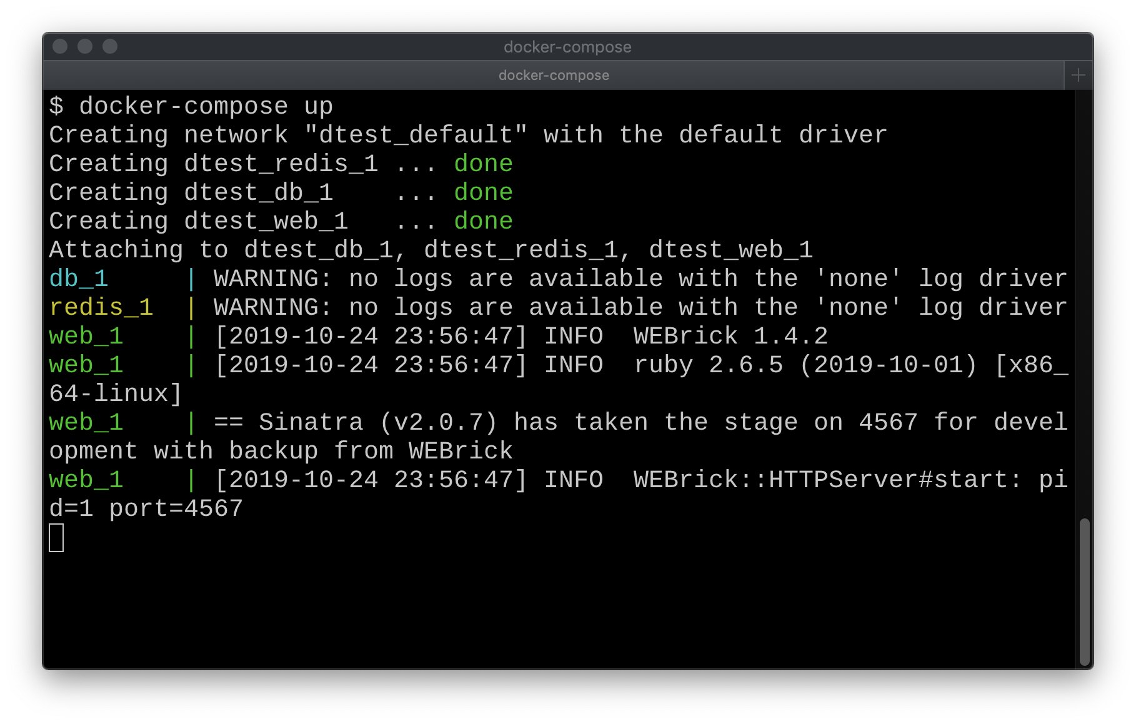
Running our "app"
$ cd myapp/
$ docker-compose build
$ docker-compose up

Slide 19
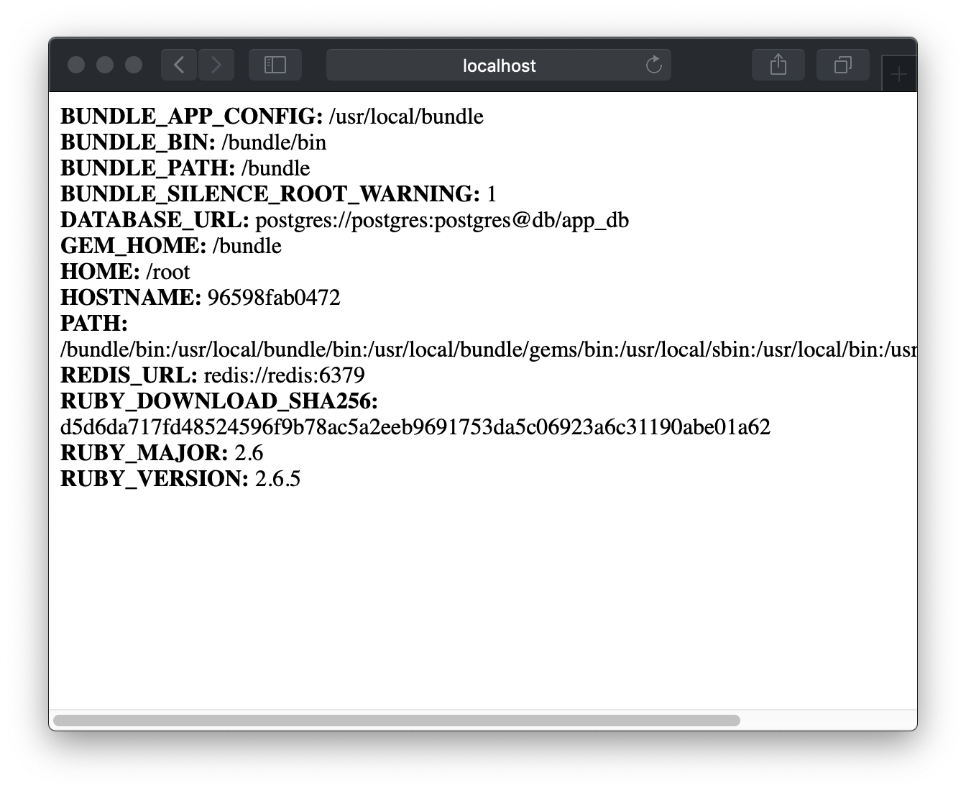
Running our "app"
$ cd myapp/
$ docker-compose build
$ docker-compose up
Visit http://localhost:4567

Slide 20
Scenario – One or more independent apps
All dependencies are siloed
More direct context switching
Easier to focus on one app
Closer representation of production
$ cd app1/
$ docker-compose up
Ruby App 1
Ruby Code
Dockerfile
docker-compose.yml
container
postgresql
redis
Ruby App 2
Ruby Code
Dockerfile
docker-compose.yml
container
mysql
redis
Ruby App 3
Ruby Code
Dockerfile
docker-compose.yml
container
postgresql
Notes:
Can be ran all at once, but watch out for port number collisions

Slide 21
Scenario – One or more independent apps (alternative setup)
Containers only used for external dependencies
Code runs directly on OS (performance boost)
Use exposed Docker network to connect to containers from code
$ cd app1/
$ docker-compose up db redis
$ ruby app.rb
Ruby App 1
Ruby Code
Executes on OS
docker-compose.yml
postgresql
redis
Ruby App 2
Ruby Code
Executes on OS
docker-compose.yml
mysql
redis
Ruby App 3
Ruby Code
Executes on OS
docker-compose.yml
postgresql

Slide 22
Scenario – One or more independent apps
Code in Docker - Worth it?
Code outside Docker - Worth it?
Setup used by…
Setup used by…
All of my side projects

Slide 23
Scenario – A System Like This…
app3
db1
app5
db2
(python)
redis
redis
app2 + sidekiq
db3
app1 + sidekiq
elastic search
app4
(python)
Client-Facing
Like, One Person
Primary Teams
Specialty Teams

Slide 24
Scenario – Multiple Apps, Multiple Teams
/work/app1/*git-repo-with-code
/work/app2/*git-repo-with-code
/work/app3/*git-repo-with-code
/work/app4/*git-repo-with-code
/work/app5/*git-repo-with-code
/work/bootstrap
/work/bootstrap
docker-compose.yml
Dockerfile-app1
Dockerfile-app2
Dockerfile-app3
Dockerfile-app4
Dockerfile-app5

Slide 25
Scenario – Multiple Apps, Multiple Teams (docker-compose.yml)
services:
db: image: postgres:12 redis: image:redis app1: build: context: ../app1 dockerfile: ../boostrap/Dockerfile-app1 environment: - DATABASE_URL=postgres://… - REDIS_URL=redis://… depends_on:
- redis - db - app2
If all DB versions are the same, share one instance
Apps may use a different redis database per cluster
Directs docker to use app1 directory as its root
App-specific environment variables
Other services to start up when it starts up

Slide 26
Scenario – Multiple Apps, Multiple Teams
services: db: redis: elasticsearch: app1: app2: app3: app4: app5:
$ cd boostrap
$ docker-compose up app1 app2
$ docker-compose exec app1 rake
Notes:
Requires code checked out for all apps locally

Slide 27
Scenario – Multiple Apps, Multiple Teams (compose files per-team)
docker-compose.yml
services:
db:
redis:
elasticsearch:
app1:
app2:
docker-compose.st.yml
services:
db:
redis:
app3:
app4:
Notes:
Default docker-compose.yml should be for apps used by majority of department.

Slide 28
Scenario – Multiple Apps, Multiple Teams (compose files per-team)
$ docker-compose up (app1 and app2)
$ docker-compose –f docker-compose.st.yml up (app3 and app4)
$ docker-compose –f docker-compose.st.yml –f docker-compose.yml up
(app1, app2, app3, and app4)
Notes:
Make aliases to save typing

Slide 29
Scenario – Multiple Apps, Multiple Teams
Allows teams to focus on the app(s) they care about
Closer represents production
Multiple apps and databases communicating
Independent systems
Bootstrapping for new team members a little more straight forward
Requires communication and a little more organization

Slide 30
Scenario – Multiple Apps, Multiple Teams
Worth it?
Setup used by…

Slide 31
Scenario – Simple Ruby Hacking / Gem Dev
Making gems with multiple Ruby versions possible
Scratch pad for random Ruby code execution
Gem 1
Ruby Code
Dependencies:
- postgres
Gem 2
Ruby Code
Dependencies:
- none
Misc Messing Around
Ruby Code
Dependencies:
- ?

Slide 32
Scenario – Simple Ruby Hacking / Gem Dev?
/code/Dockerfile
/code/docker-compose.yml
/code/stuff/
/code/stuff/gem1-code/
/code/stuff/gem2-code/

Slide 33
Scenario – Simple Ruby Hacking / Gem Dev?
Dockerfile
FROM buster
# Bootstrap rbenv + ruby-build
WORKDIR stuff
CMD "bash"
docker-compose.yml
services:
code:
build: . volumes: - .:/stuff:delegated environment: …
postgres: … redis: … mysql: …

Slide 34
Scenario – Simple Ruby Hacking / Gem Dev?
Any and all external dependencies within docker network
No need to install Ruby locally to execute code
As dependency needs increase, add more services
… anything else?

Slide 35
Scenario – Simple Ruby Hacking / Gem Dev?
Worth it?
(Unless you have a lot of external dependencies, maybe)

Slide 36
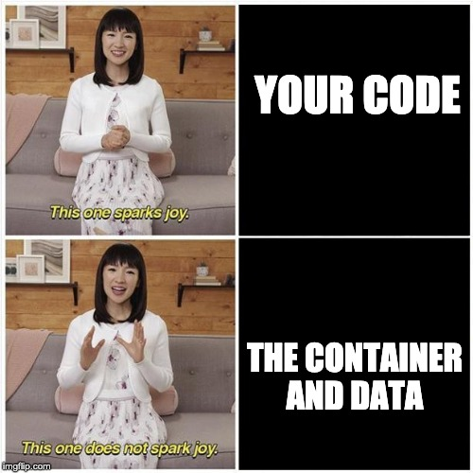
Shared Amongst All Scenarios (PROs)
Simplifies bootstrapping
Checkout repo(s), build/run containers
Closer representation of production
All dependencies contained
Multiple versions of the database
Ruby upgrades easy
Update Dockerfile, rebuild
Broken? Just rebuild!

Slide 37
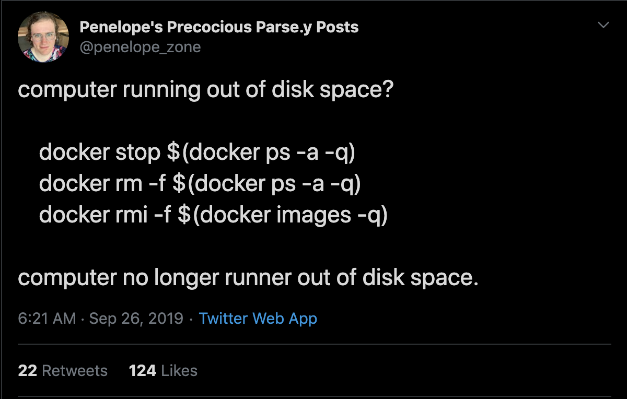
Shared Amongst All Scenarios (CONs)
Slower (You're running in a VM)
Linters have to still be installed locally for fast feedback
macOS's filesystem isn't great…
Adds a layer of local complexity
Docker likes to eat RAM… and CPU… and disk space…

Slide 38
So Local Containers…
Worth it?
???
Your call
(90% of the time, I think it's worth it)

Slide 39
The End!
My Twitter: @t27duck
GitHub: t27duck
Copy of Slides: github.com/t27duck/showandtell
Couple Neat Indiana Ruby Shops:
lessonly.com
springbuk.com

