Slide 1





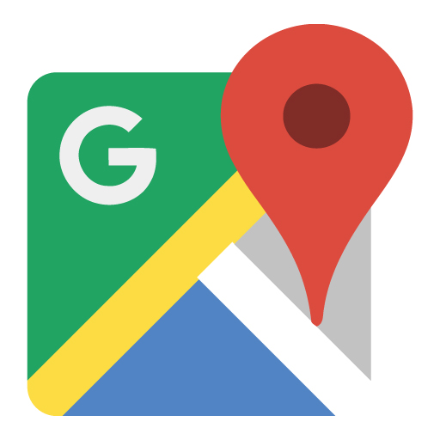


Team 6
“Create. Discover. Connect.”
Competition
Market and Customer Profile
82% of young adults (ages 18-24) using some form
of social media. Facebook has 1.13 Billion daily active
users alone.
Waze, Facebook, and Snapchat are Knome’s closest
competitors. Snapchat and Facebook both primarily
revolve around the idea of interacting with other users
online. However the facets of their apps and websites
that overlap with Knome’s vision still boast impressive
numbers. Snapchat’s events are less frequent but gain
high visibility on the front page for all users to see.
Facebook events have a massive user base with 41% of
Facebook users utilizing this feature but are non-spontaneous.
Waze events most closely resemble the location specific
events you will see on Knome however these events are
exclusively traffic related. The overwhelming majority of Waze’s
user base is over the age of 30.
Electronic maps have over 100 million active monthly
users. This number grows every year with less
consumers buying GPS systems and more relaying on
their mobile devices.
In the US there are 17.4 million college students,
attending 4,140 universities across the country. These
students make up the most active and event seeking
demographic.
Students report the average number of parties attend
per year is around 62. With over 49 million football tickets
sold and almost 60 million concert tickets sold each year
still, 27% of students say they are not aware of school
events.
Knome gains a competitive advantage by: Offering a more flexibility in terms of types of events, use of spontaneous events allowing the
app to be used as less of a planner and more a always available source of entertainment, and the visualization of events pinned on a
map that some of our competitors lack.
“Free up your schedule and let Knome decide your day”
Notes:
Knome
Spin: “Create. Discover. Connect.”
Users create events and pin them on the map.
Other users discover these events on the map.
Users go to these events and connect with people in their local communities.
Pitch:
This is an app that offers the best in flexibility and accuracy for location specific events.

