Slide 1
Overview of HATEOAS Approaches
W3C WoT IG / IRTF T2TRG Joint Meeting, Nice, France, 2016
Matthias Kovatsch (kovatsch@inf.ethz.ch)

Slide 2

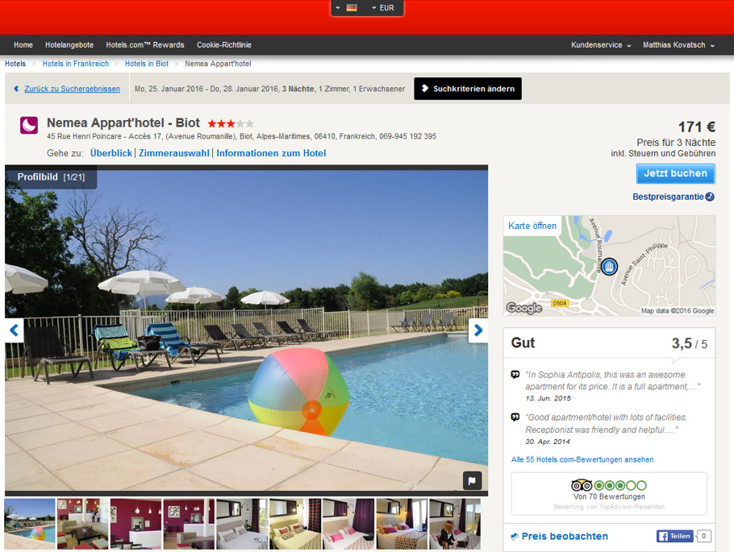




Web Mashups through Open APIs
Internal microservice APIs

Slide 3
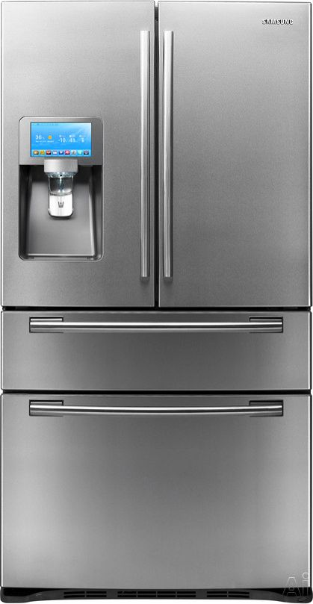
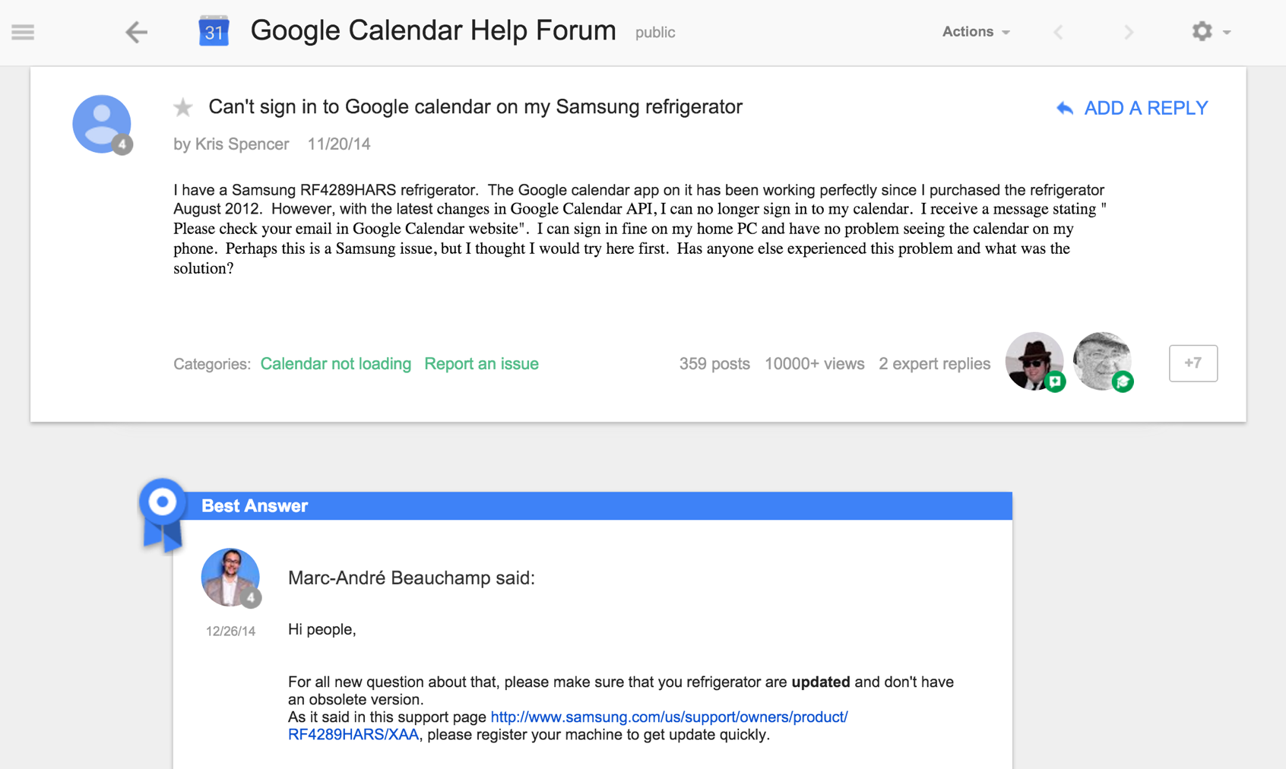
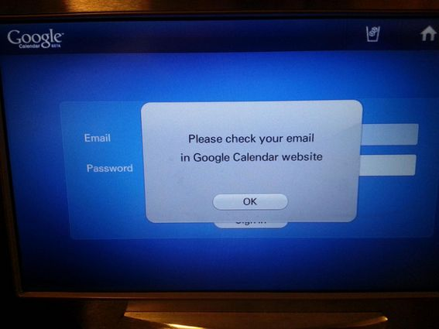
… Often Break
Notes:
>> In order to avoid broken API and to enable APIs to evolve over time.

Slide 4
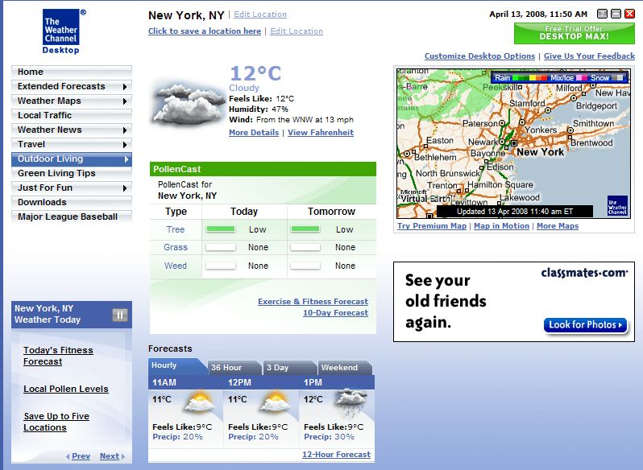
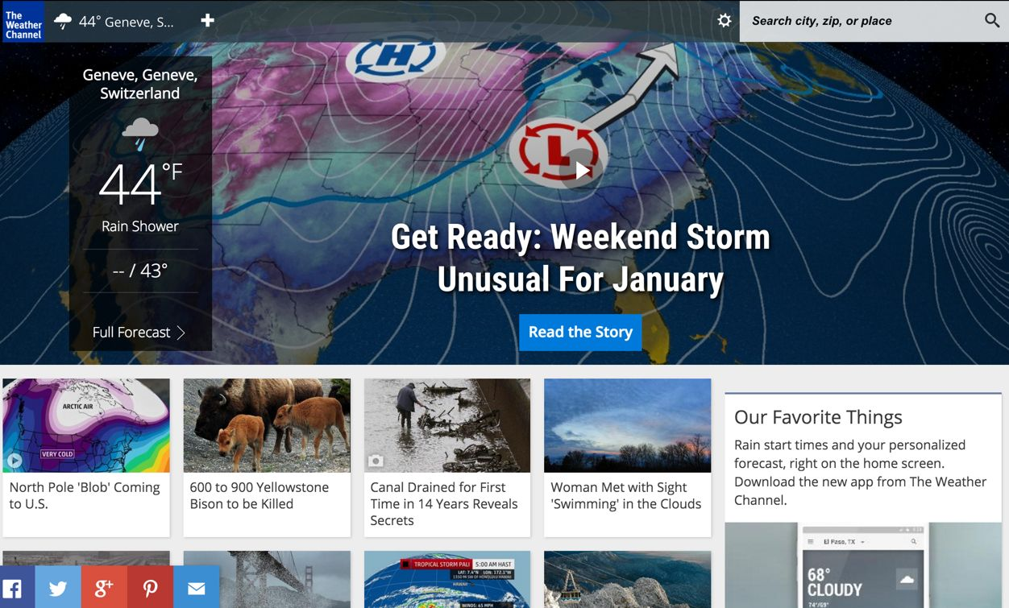
Human Web Interaction
Notes:
Solely based on the representations

Slide 5

Idea
Client
Entry URI
Action Result
Thing C
Submit forms
Resource Directory
Follow links
Thing A
Choice &
redundancy
Thing B
Thing D
Dynamically extend process flow
Auth-Server
HATEOAS

Slide 6
HATEOAS Summary
Function descriptions are in-band (optimizations always an option)
Clients can learn applications on the fly
Links and forms define control flow (functional descriptions)
Relation types provide semantic annotations
Servers are free to define their own resource structure
Structure in multiple components
Dynamically add new or proprietary features
Loose Coupling
Clients and servers can evolve independently
Clients can adapt to changing environments

Slide 7
Practical Approach: PlugREST
Starting point: Lighting use case
Well-known requirements
Many non-REST implementations (ZigBee etc.)
Plan
Define basic components (lights and controllers)
Evolve over time by adding features
Connect to smart energy domain for cross-domain evolution
Learn and test how to optimally handle change through REST
Learn more about representation format design
Learn more about machine-understandable hypermedia controls
Test independent client and server evolution

Slide 8
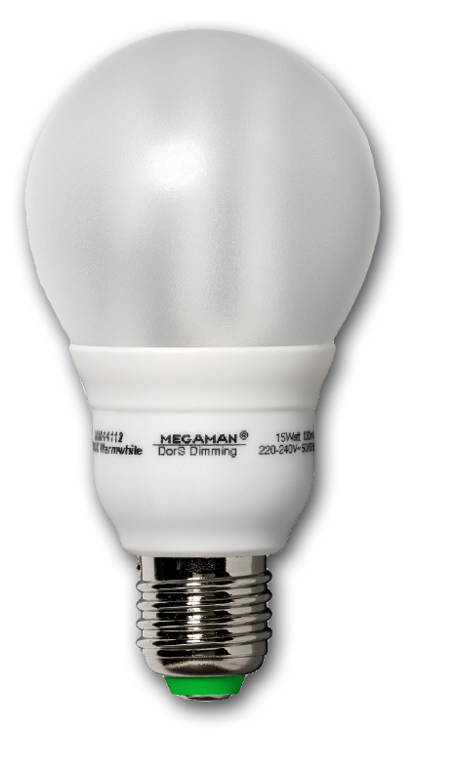
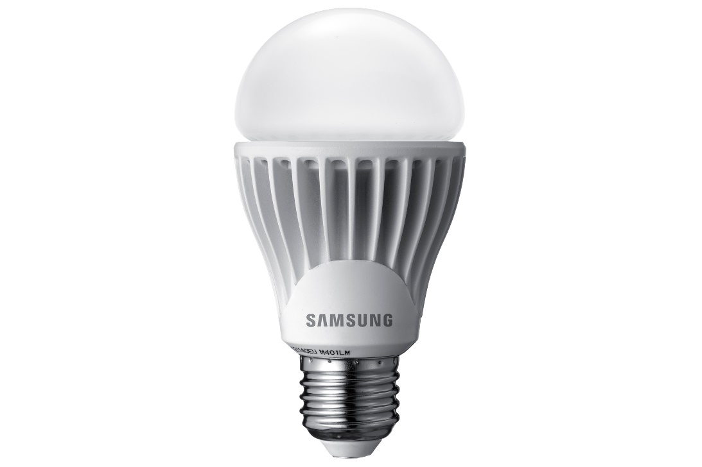

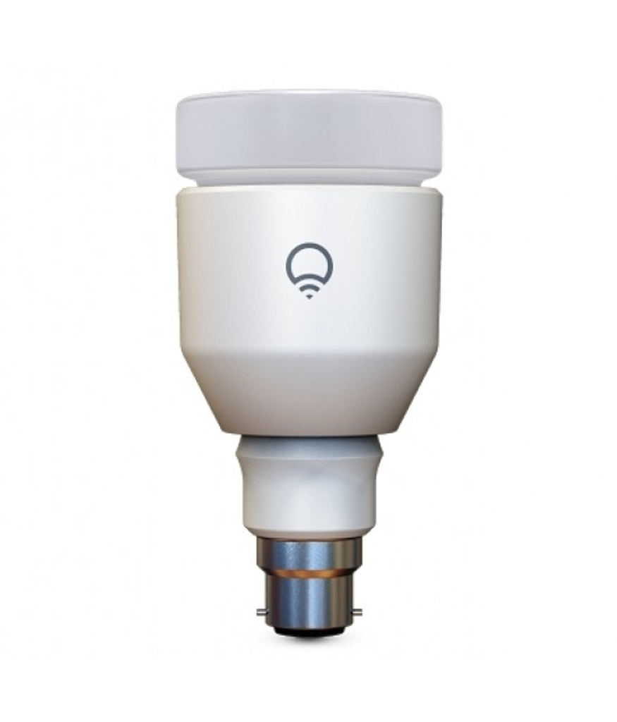
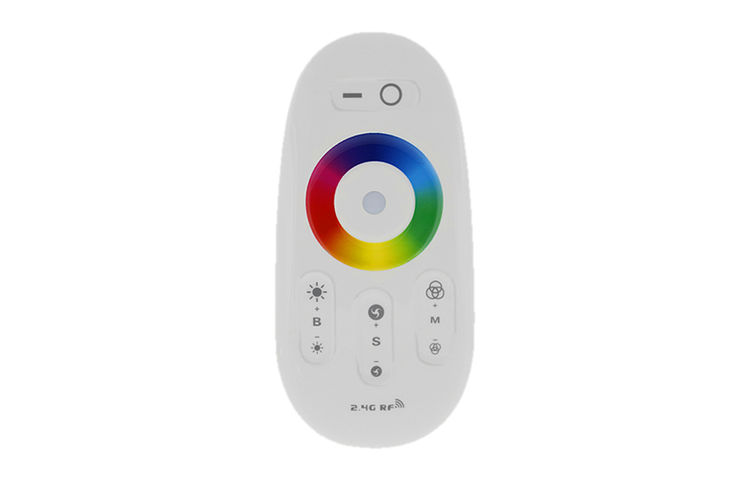
Change
Control alternative things
Also control future things
Still control old things
Add new things

Slide 9
CoRE Apps and CoRE Lighting
Individual drafts by Klaus Hartke hartke@tzi.org

Slide 10
Hypertext-driven Applications
CoRE Application Descriptions https://tools.ietf.org/html/draft-hartke-core-apps-02
Describe REST applications fully by
URI schemes that identify communication protocols,
Internet Media Types that identify representation formats,
link relation types that identify link semantics,
form relation types that identify form semantics, and
optionally, well-known locations as entry points

Slide 11
draft-hartke-core-lighting-00
Scenario and component description
Light bulbs
Light Remote Controls (LRCs)
Application-specific Internet Media Types
Give meaning to JSON properties
application/bulletin-board+json (discovery)
application/thing-description+json (thing metadata)
application/lighting-config+json (binding)
application/lighting+json (lighting state control)
Hypermedia controls based on HAL (Hypertext Application Language)
No templated links or CURIEs
Enriched with form support

Slide 12
Discovery through Links
Power Consumption
Clients use Bulletin Board as entry point
Complex things are realized by linking to sub-components
application/bulletin-board+json
application/lighting-config+json
Client
Bulletin Board
Lightbulb
Config
Controller
Lighting State
application/lighting+json
application/thing-description+json

Slide 13
Discovery through Links
Things register with the Bulletin Board
application/bulletin-board+json provides a «create item» form
Discovery as client and submit form
Bulletin Board
Lightbulb
Controller

Slide 14
Discovery through Links
Linking during discovery allows distribution and delegation (cf. DNS)
Large systems are usually organized hierarchically
Bulletin Board
Bulletin Board
Client
Bulletin Board
Bulletin Board
Bulletin Board
Bulletin Board

Slide 15
Links
https://tools.ietf.org/html/draft-hartke-core-apps-02
https://tools.ietf.org/html/draft-hartke-core-lighting-00

Slide 16
CoRE-HAL and Hypermedia Client
Extensions by Matthias Kovatsch and Yassin Hassan
kovatsch@inf.ethz.ch

Slide 17
Split Internet Media Type Definitions
CoRE-HAL base media type
For now JSON (without -LD)
Hypermedia controls (links and forms)
Thing Description properties
Location Description properties
Application-specific media types
Per atomic use case
Data model
Link and form relation types
Group semantic vocabulary

Slide 18
CoRE-HAL Lighting State Example
{
"value": {"r":255, "g":0, "b":0},
"mode": "rgb",
"_links": {
"same-as": {
"href": "/brightness",
"type": "application/x.lighting-state+json"
}
},
"_forms": {
"edit": {
"method": "PUT",
"href": "/light",
"accepts": "application/x.lighting-state+json"
}
},
"_self":"/light"
}
Application Data
Links
Forms

Slide 19
How?
Client
Entry URI
Action Result
Thing C
Submit forms
Resource Directory
Follow links
Thing A
Choice &
redundancy
Thing B
Thing C
Dynamically extend process flow
Auth-Server

Slide 20
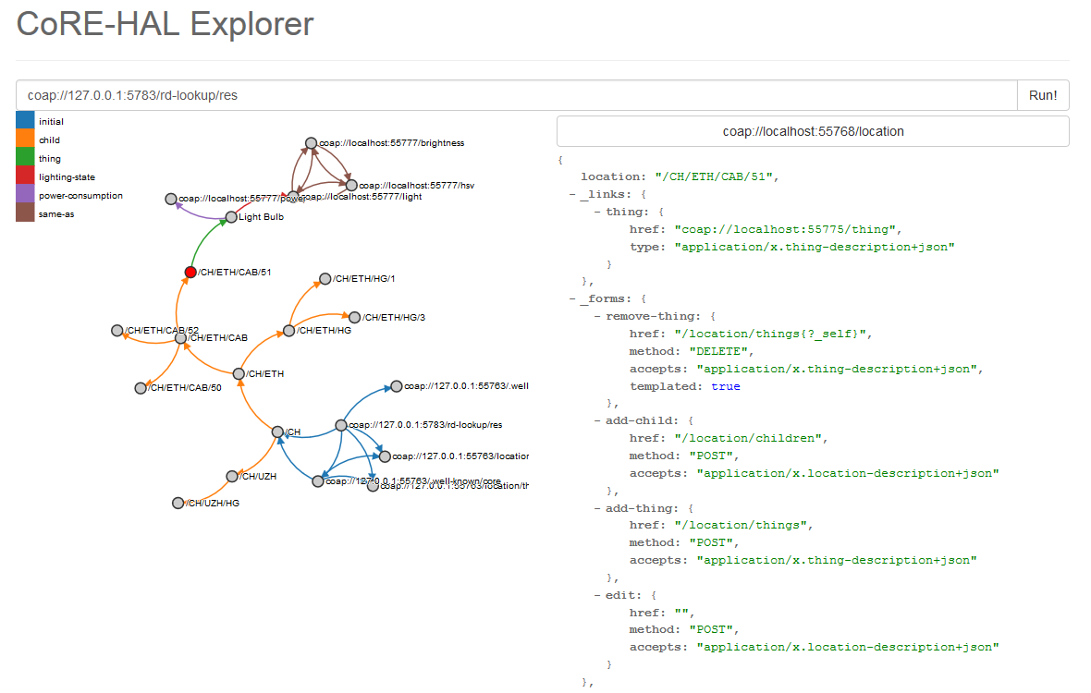

Slide 21
Hypermedia Client
High-level path description to resource based on link relation types
Actual (dynamic) URIs are retrieved from representations
ep = new HypermediaClient("coap://home.local"); // entry point
light = ep.followLink("light"); // link relation type
state = light.followLink("state"); // link relation type
Entry Point
light
Light Resource
state
State Resource

Slide 22
Hypermedia Client Futures
Lazy loading of resource representations
Only request representations (i.e., transmit data) when used
ep = new HypermediaClient("coap://home.local");
light = ep.followLink("light");
state = light.followLink("state");
data = state.get();
Entry Point
light
Light Resource
state
State Resource

Slide 23
Hypermedia Client Futures
Reloadable resource representation in the future
Transparently handles cache control
ep = new HypermediaClient("coap://home.local");
light = ep.followLink("light");
state = light.followLink("state");
data = state.get();
// Max-Age expires ...
data = state.get();
Entry Point
light
Light Resource
state
State Resource

Slide 24
Hypermedia Client Futures
Bookmark support
On error discovery is re-triggered to recover from unavailable/replaced devices
// thing is replaced, address and resource path changes
data = state.get();
Entry Point
light
Light Resource
state
State Resource

Slide 25
Media-type-specific Future Object
Programmatically provide application-specific operations
Allow developer to use the IDE auto-completion feature
public class LightingStateFuture extends CoREHalResourceFuture<LightingState> { public void setRGB(int r, int g, int b) { LightingState lightingState = new LightingState(); lightingState.setValue(new RGBValue(r,g,b)); submitForm("edit", lightingState); }
}

Slide 26
Links
http://ynh.github.io/core-hal-explorer/
https://github.com/ynh/coap-polyfill
Java Hypermedia Client and Actinium JavaScript module will be released publicly soon, announcement on T2TRG mailing list (https://www.irtf.org/mailman/listinfo/t2trg)

Slide 27
Hypermedia System Architecture
Approach by Michael Koster michael.koster@smartthings.com

Slide 28
Common CRUD Model for Protocol Bindings
Map abstraction to HTTP and CoAP request and responses
Encapsulate the abstraction in WS and MQTT payloads
CCML
CoAP
HTTP
MQTT
WS
REST
REST
REST
REST
REST
URI
URI
URI
Topic, Payload
Payload
Trx
Send/Rcv
Send/Rcv
Pub/Sub
Send/Rcv
(IP)
(IP)
(IP)
(IP)
(PHY)
(PHY)
(PHY)
(PHY)
Need CCML/REST shim layer

Slide 29
Internet Media Types
Existing Media Types
application/link-format+json (discovery)
application/senml+json (data items)
Extended
form values for SenML
application/collection+senml+json (item composition; embed, link)
JSON-LD context
http://thingschema.org
Collection
Link
(self)
Link
Item
Link
Item
Sub Resource Collection
Link
(sub)
Link
Link
Item
Link
Link
Collection
Link
Item
Link
Collection
Link
Item
Link
Link
Link

Slide 30
Hypermedia System Architecture
Application Logic
(Deferred Interface)
Public Resource
Thing Object Model
Discovery
Hypermedia Client
Client
Base Schema
Networks
Domain Schema
Server
Tools
Hypermedia Controls
Domain Model
Resource Model
Resources
Resource Logic
(Physical I/O)

Slide 31
HATEOAS-driven Discovery
Application Logic
(Deferred Interface)
Thing Object Model
Discovery
Hypermedia Client
Client
Base Schema
Domain Schema
Server
Hypermedia Controls
Domain Model
Resource Model
Resources
Resource Logic
(Physical I/O)

Slide 32
HATEOAS-driven Interaction
Application Logic
(Deferred Interface)
Thing Object Model
Discovery
Hypermedia Client
Client
Base Schema
Domain Schema
Server
Hypermedia Controls
Domain Model
Resource Model
Resources
Resource Logic
(Physical I/O)

Slide 33
Model-driven Resource Construction
Application Logic
(Deferred Interface)
Thing Object Model
Discovery
Hypermedia Client
Base Schema
Domain Schema
Hypermedia Controls
Domain Model
Resource Model
Resources
Resource Logic
(Physical I/O)

Slide 34
Modular “Runtime-ready” Architecture
Application Logic
“Scripting”
Thing Object Model
Resource Model
Common Client
Common CRUD Requests
Pluggable Protocols
HTTP
CoAP
MQTT
WS
Common CRUD Responses
Common Server
Resource Model
Resources
Resource Logic
“Scripting”

Slide 35
Links
https://github.com/connectIOT/MachineHypermediaToolkit
https://github.com/connectIOT/HypermediaDemo
thingschema.org

