Slide 1
IPSO Smart Objects and related IoT Standards
Matthew Gillmore Matthew.Gillmore@itron.com
July 2019

Slide 2



Good to know:
OMA SpecWorks maintains a repository that contains objects and re-usable resources.
IPSO-defined objects/resources are also found in this repository (and they are currently revising).
Access to the repository is also available through an API.
It is easy to create new objects using the editor tool.

Slide 3

The IP for Smart Objects (IPSO) device stack (recap)
Applications
Application
IPSO/LwM2M Objects (W3C, OCF, ZDO…)
Data Models
LwM2M Client
CoAP Server
Web Server
Other IP Stacks: MQTT, XMPP, etc.
API / Services
CoAP
HTTP
Application Protocol
6LowPAN
IPv4 / IPv6
Non-IP based Transport - BTLE
Routing
802.15.4
Wifi, Ethernet, Cellular, …
HW Network
MCU
MPU
Hardware

Slide 4
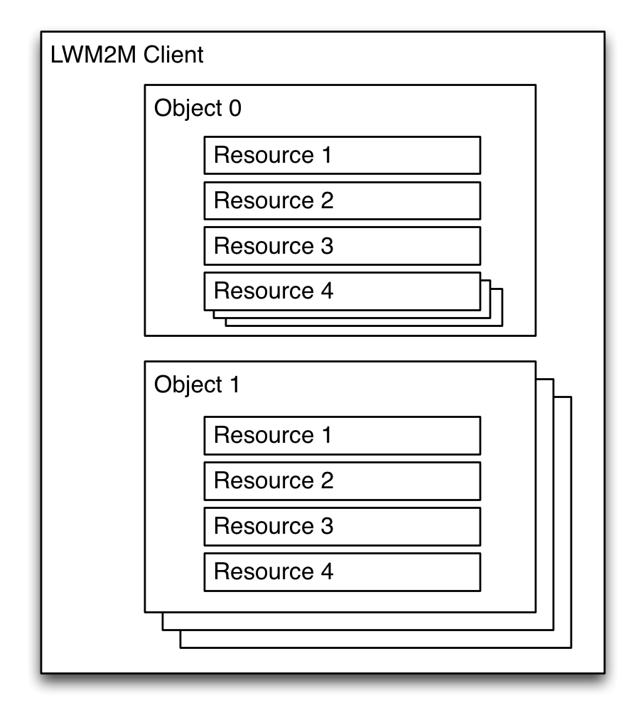
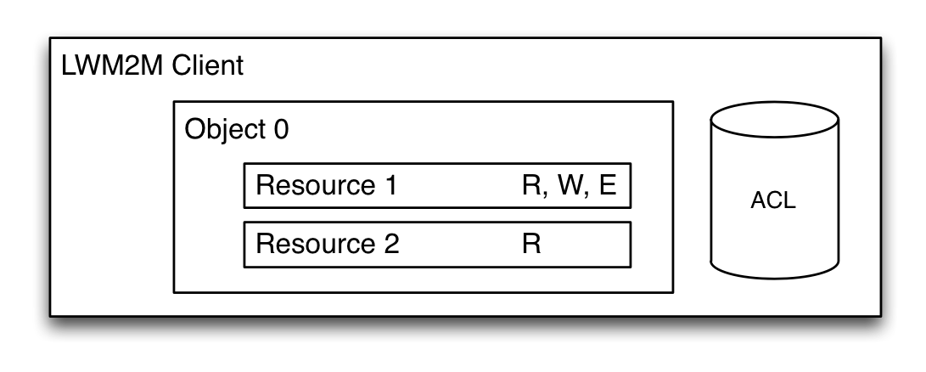
IPSO Object Structure
Same URIs as LwM2M : /{Object ID}/{Object Instance}/{Resource ID}
/3300/0/5700
- 3300 Temperature Sensor
- 0 Instance 0 of a Temperature Sensor
- 5700 Resource having the current value
Data Types (String, Integer, …) as LwM2M
Operations (Read, Write, Create…) as LwM2M
Object Linking and Core Link
Object Linking is used to refer to Objects within the device.
Allows composition without nasty large nested structures
Allows for complex objects (i.e. appliance made of several sensors)
Web Linking to refer to external items (over CoAP).
Query parameters: GET <URL>?rt=“urn:oma:lwm2m:temp”
Extensible data model
Only few “Mandatory” Resources to enable interoperability
Use of versioning for model updates

Slide 5
IPSO Example Temperature Object
Object definition
Name | Object ID | Instances | Mandatory | Object URN
Temperature | 3303 | Multiple | Mandatory | urn:oma:lwm2m:3303
Resource definitions
ID | Name | Operations | Instances | Mandatory | Type | Units | Description
5700 | Sensor Value | R | Single | Mandatory | Float | … | …
5601 | Min Measured Value | R | Single | Optional | Float | … | …
5602 | Max Measured Value | R | Single | Optional | Float | … | …
5603 | Min Range Value | R | Single | Optional | Float | … | …
5604 | Max Range Value | R | Single | Optional | Float | … | …
5701 | Sensor Units | R | Single | Optional | String | … | …
5605 | Reset Min and Max | E | Single | Optional | Opaque | … | …
Data
Metadata
Actions

Slide 6
IPSO Smart Objects
Object | Object ID
Digital Input | 3200
Digital Output | 3201
Analogue Input | 3202
Analogue Output | 3203
Generic Sensor | 3300
Illuminance Sensor | 3301
Presence sensor | 3302
Temperature Sensor | 3303
Humidity Sensor | 3304
Power Measurement | 3305
Actuation | 3306
Set Point | 3308
Load Control | 3310
Light Control | 3311
Power Control | 3312
Accelerometer | 3313
Magnetometer | 3314
Barometer | 3315
Voltage | 3316
Object | Object ID
Current | 3317
Frequency | 3318
Depth | 3319
Percentage | 3320
Altitude | 3321
Load | 3322
Pressure | 3323
Loudness | 3324
Concentration | 3325
Acidity | 3326
Conductivity | 3327
Power | 3328
Power Factor | 3329
Distance | 3330
Energy | 3331
Direction | 3332
Time | 3333
Object | Object ID
Gyrometer | 3334
Color | 3335
GPS Location | 3336
Positioner | 3337
Buzzer | 3338
Audio Clip | 3339
Timer | 3340
Addressable Text Display | 3341
On/Off Switch | 3342
Dimmer | 3343
Up/Down Control | 3344
Multiple Axis Joystick | 3345
Rate | 3346
Push Button | 3347
Multi-state Selector | 3348
Bitmap | 3349
Stopwatch | 3350

Slide 7
IPSO Reusable Resources
Resource | Resource ID
Digital Input State | 5500
Digital Input Counter | 5501
Digital Input Polarity | 5502
Digital Input Debounce | 5503
Digital Input Edge Selection | 5504
Digital Input Counter Reset | 5505
Current Time | 5506
Fractional Time | 5507
Min X Value | 5508
Max X Value | 5509
Min Y Value | 5510
Max Y Value | 5511
Min Z Value | 5512
Max Z Value | 5513
Latitude | 5514
Longitude | 5515
Uncertainty | 5516
Velocity | 5517
Timestamp | 5518
Min Limit | 5519
Max Limit | 5520
Delay Duration | 5521
Resource | Resource ID
X Coordinate | 5528
Y Coordinate | 5529
Clear Display | 5530
Contrast | 5531
Increase Input State | 5532
Decrease Input State | 5533
Counter | 5534
Current Position | 5536
Transition Time | 5537
Remaining Time | 5538
Up Counter | 5541
Down Counter | 5542
Digital State | 5543
Cumulative Time | 5544
Max X Coordinate | 5545
Max Y Coordinate | 5546
Multi-state Input | 5547
Level | 5548
Digital Output State | 5550
Digital Output Polarity | 5551
Analog Input State | 5600
Min Measured Value | 5601
Resource | Resource ID
Reset Min and Max Measured Values | 5605
Analog Output Current Value | 5650
Sensor Value | 5700
Sensor Units | 5701
X Value | 5702
Y Value | 5703
Z Value | 5704
Compass Direction | 5705
Colour | 5706
Application Type | 5750
Sensor Type | 5751
Instantaneous active power | 5800
Min Measured active power | 5801
Max Measured active power | 5802
Cumulative active power | 5805
Active Power Calibration | 5806
Instantaneous reactive power | 5810
Min Measured reactive power | 5811
Max Measured reactive power | 5812
Min Range reactive power | 5813
Resource | Resource ID
Reactive Power Calibration | 5816
Power Factor | 5820
Current Calibration | 5821
Reset Cumulative energy | 5822
Event Identifier | 5823
Start Time | 5824
Duration In Min | 5825
Criticality Level | 5826
Avg Load Adj Pct | 5827
Duty Cycle | 5828
On/Off | 5850
Dimmer | 5851
On Time | 5852
Muti-state Output | 5853
Off Time | 5854
Set Point Value | 5900
Busy to Clear delay | 5903
Clear to Busy delay | 5904
Bitmap Input | 5910
Bitmap Input Reset | 5911
Element Description | 5912
UUID | 5913

Slide 8
IPSO Object example
<?xml version="1.0" encoding="UTF-8"?>
<!-- MIT License
...
-->
<LWM2M xmlns:xsi="http://www.w3.org/2001/XMLSchema-instance" xsi:noNamespaceSchemaLocation="http://openmobilealliance.org/tech/profiles/LWM2M.xsd">
<Object ObjectType="MODefinition">
<Name>Generic Sensor</Name>
<Description1>This IPSO object ...</Description1>
<ObjectID>3300</ObjectID>
<ObjectURN>urn:oma:lwm2m:ext:3300</ObjectURN>
<LWM2MVersion>1.0</LWM2MVersion>
<ObjectVersion>1.0</ObjectVersion>
<MultipleInstances>Multiple</MultipleInstances>
<Mandatory>Optional</Mandatory>
<Resources>
<Item ID="5700">
<Name>Sensor Value</Name>
<Operations>R</Operations>
<MultipleInstances>Single</MultipleInstances>
<Mandatory>Mandatory</Mandatory>
<Type>Float</Type>
<RangeEnumeration></RangeEnumeration>
<Units></Units>
<Description>Last or Current Measured Value from the Sensor</Description>
</Item>
. . . . Other Resources . . . .
</Resources>
<Description2></Description2>
</Object>
</LWM2M>
XML Schema
Object Definition
Resource Definition

Slide 9
IPSO Serialization Formats
TLV (legacy)
SenML - JSON
C8 00 14 4F 70 65 6E 20 4D 6F 62 69 6C 65 20 41 6C 6C 69 61 6E 63 65
C8 01 16 4C 69 67 68 74 77 65 69 67 74 20 4D 32 4D 20 43 6C 69 65 6E 74
C8 02 09 33 34 35 30 30 30 31 32 33
C3 03 31 2E 30
86 06
41 00 01
41 01 05
88 07 08
42 00 0E D8
42 01 13 88
87 08
41 00 7D
42 01 03 84
C1 09 64
C1 0A 0F
83 0B
41 00 00
C4 0D 51 82 42 8F
C6 0E 2B 30 32 3A 30 30
C1 10 55
[{"bn":"/3/0/","n":"0","vs":"Open Mobile Alliance"}, {"n":"1","vs":"Lightweight M2M Client"}, {"n":"2","vs":"345000123"}, {"n":"3","vs":"1.0"}, {"n":"6/0","v":1}, {"n":"6/1","v":5}, {"n":"7/0","v":3800}, {"n":"7/1","v":5000}, {"n":"8/0","v":125}, {"n":"8/1","v":900}, {"n":"9","v":100}, {"n":"10","v":15}, {"n":"11/0","v":0}, {"n":"13","v":1367491215}, {"n":"14","vs":"+02:00"}, {"n":"16","vs":"U"}]
Notes:
sdsd

Slide 10
IPSO Serialization Formats
SenML-CBOR
SenML-CBOR diagnostic
90 a3 21 65 2f 33 2f 30 2f 00 61 30 03 74 4f 70 65 6e 20 4d 6f 62 69 6c 65 20 41 6c 6c 69 61 6e 63 65 a2 00 61 31 03 76 4c 69 67 68 74 77 65 69 67 68 74 20 4d 32 4d 20 43 6c 69 65 6e 74 a2 00 61 32 03 69 33 34 35 30 30 30 31 32 33 a2 00 61 33 03 63 31 2e 30 a2 00 63 36 2f 30 02 01 a2 00 63 36 2f 31 02 05 a2 00 63 37 2f 30 02 19 0e d8 a2 00 63 37 2f 31 02 19 13 88 a2 00 63 38 2f 30 02 18 7d a2 00 63 38 2f 31 02 19 03 84 a2 00 61 39 02 18 64 a2 00 62 31 30 02 0f a2 00 64 31 31 2f 30 02 00 a2 00 62 31 33 02 1a 51 82 42 8f a2 00 62 31 34 03 66 2b 30 32 3a 30 30 a2 00 62 31 36 03 61 55
[{-2: "/3/0/", 0: "0", 3: "Open Mobile Alliance"}, {0: "1", 3: "Lightweight M2M Client"},
{0: "2", 3: "345000123"},
{0: "3", 3: "1.0"},
{0: "6/0", 2: 1},
{0: "6/1", 2: 5},
{0: "7/0", 2: 3800},
{0: "7/1", 2: 5000},
{0: "8/0", 2: 125},
{0: "8/1", 2: 900},
{0: "9", 2: 100},
{0: "10", 2: 15},
{0: "11/0", 2: 0},
{0: "13", 2: 1367491215},
{0: "14", 3: "+02:00"},
{0: "16", 3: "U"}]
Notes:
sdsd

Slide 11
Implementations and OMNA Registry
Several Implementations support IPSO:
Example XML of the supported LwM2M and IPSO Objects in Leshan.
Sample C package for use of IPSO Objects in Contiki.
JS code templates of IPSO-defined devices code templates.
Sample Smart Objects Class can be used to create IPSO Smart Objects in your JavaScript applications.
BIPSO defines a set of BLE Characteristics that follows the IPSO Objects.
Contiki, Mbed, Zephyr and RIOT are example OS’s that support IPSO Objects.
Full object set available at the OMNA Registry:
http://www.openmobilealliance.org/wp/OMNA/LwM2M/LwM2MRegistry.html

