Slide 1
Semantics-enabled Connectivity: Configuring Time Sensitive Networking (TSN) from W3C WoT Thing Description (TD)
Luca Sciullo and Matthias Kovatsch
T2TRG / W3C WoT Meeting, Singapore, 15 Nov 2019

Slide 2
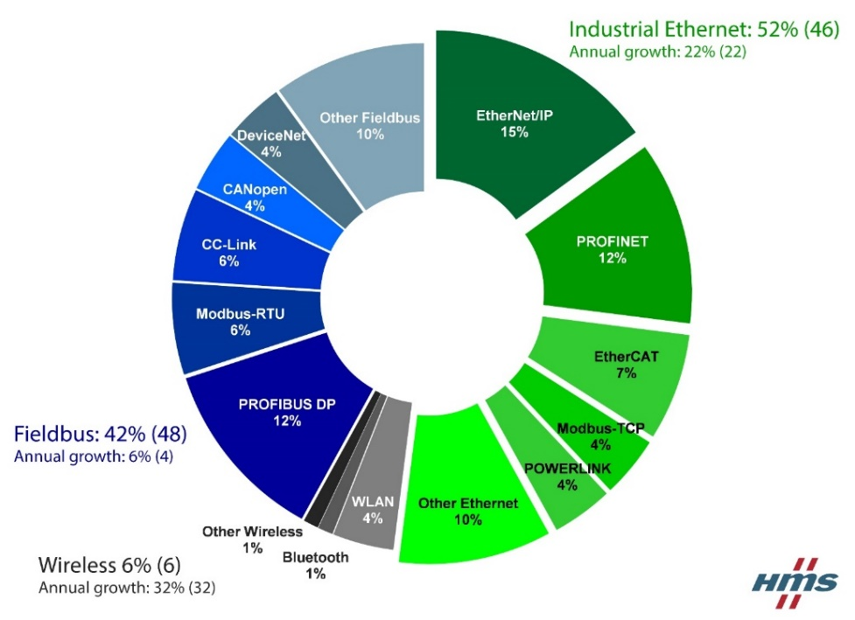
Background: TSN and OPC UA for IIoT
Industrial IoT often requires determenistic networking → Plethora of field buses and complex wireless standards (cf. 6TiSCH…)
Connectivity between applications requires network configuration!

Slide 3
OPC UA Field Level Communications
OPC UA: So far, mainly a management interface for configuration and diagnostics
Available
FLC activity: OPC UA to become also a field-level standard for cross-vendor interoperability
New
FLC Focus: Controller-to-Controller (and later -Device)

Slide 4
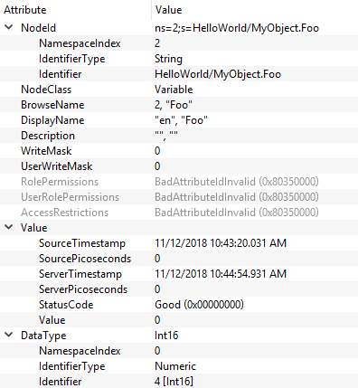
OPC UA Example (UAExpert Browse View)
Information Model roughly similar to the Web
Browsing
Nodes (~resources)
Namespace (URI mapped to integer)
Identifier
Integer
String
Binary
GUID
Class
Object
Variable
Method
Reference
Various type classes
Bidirectional references, bitmaps, word sizes, ...

Slide 5
OPC UA FLC as W3C WoT Binding
OPC UA FLC
W3C WoT
OPC UA Server plus PubSub
Functional Entity (FLC)
Variables
Methods
Published DataSets
Server addr, namespace, NodeID
Servient
Thing
Properties
Actions
Events
Form href

Slide 6
IEEE Time-Sensitive Networking (TSN)
.1AS (-rev)
1588 PTP
.1Qci
802.1Q
.1Qbv
.1Qcr
.1Qcc
.1Qbu
.1Qdd
.1Qca
.1Qdj
IEEE family of specification for deterministic networking
Extends 802.1Q VLAN standard (makes use of VLAN tagging)
Enables scheduled traffic, i.e., deterministic time slots, latency, and jitter for selected traffic
Allows for the convergence of many fieldbus technologies into a standard Ethernet network

Slide 7
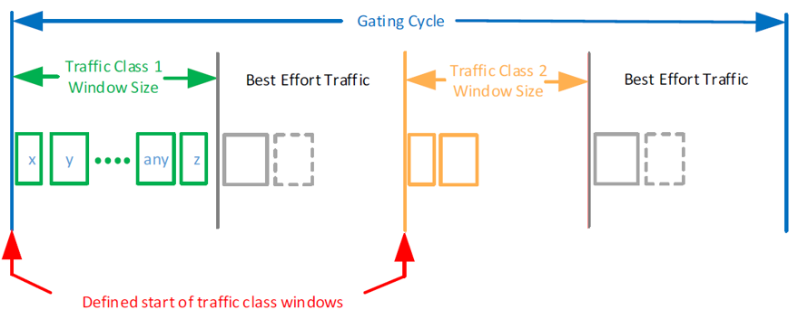
Time-Aware Scheduler and Gate Control Lists
Prio 7
Queue 7
Prio 6
Q. 6
Best Effort
Q. 5
Q. 0
non-TSN
non-TSN
...
T0: Occccccc
T1: ccOOOOOO
T2: cOcccccc
T3: ccOOOOOO
non-TSN
Gate
Gate
Gate
Gate
non-TSN
Transmission Selection
Bandwidth guarantee
TSN
Latency/deadline guarantee
TSN
Prio 7
Gate 7
Prio 6
Gate 6
Best Effort
Gate 5
Gate 0
non-TSN
...
Gate
Gate
Gate
Gate
Transmission Selection

Slide 8
Network Configuration (Centralized Model)
Network configuration usually done via YANG modules (cf. CoRECONF for LP-WAN work)
Multiple protocol choices for industry
NETCONF
RESTCONF
CoRECONF
Network equipment mainly has NETCONF interfaces

Slide 9
NETCONF as W3C WoT Binding
NETCONF
W3C WoT
Embedded stack on device
NETCONF datastores
Leaf nodes
RPCs (other than get/edit-config)
Notifications
X-Path
Servient
Thing
Properties
Actions
Events
Form href (part)

Slide 10
NETCONF Examples
Read Property
Write Property
<rpc ...attributes...>
<get>
<filter type="subtree">
<...path to leaf...>
</...path to leaf...>
</filter>
</get>
</rpc>
<rpc ...attributes...>
<edit-config>
<target>
<running/>
</target>
<config>
<...path to leaf...>
... Configuration data ...
</...path to leaf...>
</config>
</edit-config>
</rpc>

Slide 11
Discussion of Design Decisions: NETCONF
Multiple datastores (Startup, Running, Candidate)
Multiple Things (one per store)? No, need address info in form anyway
Multiple Properties per leaf?
URI-Template? (No, info not part of path)
Form term to select (nc:target)?
Also needs target as application metadata (at Property level)
Multiple forms per store? (No, all forms must be equivalent)
Batch changes and commit RPCs
writemultipleproperties Interaction? (No, would make commit implicit)
Application metadata and commit Action?
Custom RPCs
Form method field is open set (parameter passed to Binding)

Slide 12
Discussion of Design Decisions: OPC UA
OPC UA Binding requires detailed type information (e.g., word size)
Have info in Content-Type parameter? No, does not work for complex types
Extend DataSchema with new term (opc:datatype)
DataSchema needs to be passed to Binding (not only form metadata)
Custom data types in OPC UA are used often and blow up TD
Just inline and live with it?
Mechanism to declare once and reference? (cf. $ref feature of JSON Schema)
URI definition
HTTP style with query? → opc.tcp://host.local:4841/?ns=3&i=4711
OPC style from existing tools? → opc.tcp://host.local:4841/ns=3;i=41711
Historic access
Properties with URI-Template? No, getting too complex...
Action?

Slide 13
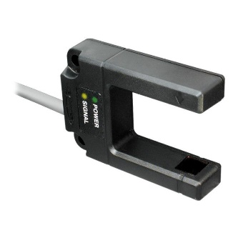

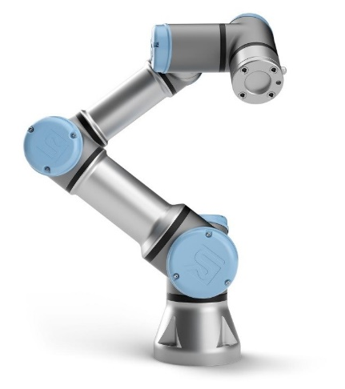
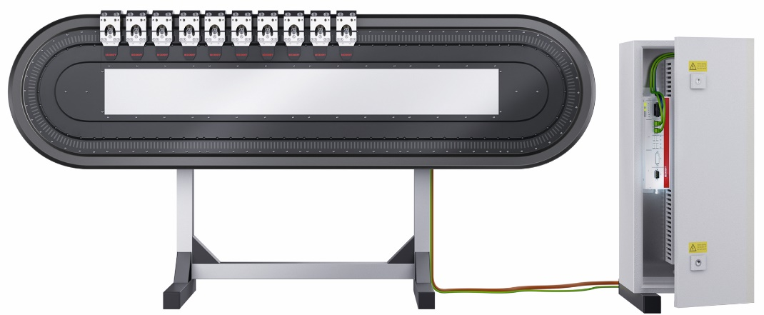
Semantics-enabled Connectivity through TDs
Request configuration
Servient
Sensor
(I/O Module)
① Fetch TDs with QoS capabilities
PLC Mashup App
Match with QoS requirements ②
③
TSN Controller App
⑤
①
Scripting API
Actuator
①
WoT Runtime
Confirm / Reject
Data Model
OPC UA
NETCONF
Transport System
Position
④ Try to push out schedule
* Currently no TSN-enabled end devices available

Slide 14
QoS Capabilities and Requirements
Capabilities of Things (sometimes req.)
Requirements of Apps
Minimum interval
Message sizes
Send offset (e.g., sensor reading ... sending)
Receive offset (e.g., Action invocation)
Clock synchronization
Maximum interval
Overall delay
Receive offset (jitter)
Currently being collected and mapped to new TD vocabulary

Slide 15
New TD Vocabulary for QoS, but there is more
Works for Things (illustration TD)
How to better describe apps?
{
"@context": [
"https://www.w3c.org/2019/wot/td/v1",
{ "qos": "https://example.org/qos-vocab-v1" }
],
"@type": ["Thing"],
"name": "MyRobot",
"securityDefinitions": {
"default": {
"scheme": "bearer"
}
},
"qos:clockSyncrhonization": "as-rev",
"qos:minInterval": 31.25, // microseconds enough? nano? How many .zeros
"actions": {
"goto": {
"qos:receiveOffset": 2.3,
"input": {
"type": "object",
...
}, "form": [
"qos:maxFrameSize": 127,
...
]
}
}
}
Only Scripting API potential standard
Currently no container format
Apps may also have requirements
Related work
OSGi Requirements and Capabilities
Network Function Virtualization

Slide 16
Related Work
QoS information in TDs just one way to do it
Builds on cross-application capabilties of W3C WoT
TSN configuration not only for OPC UA FLC
TSN is for a converged network
Other applications are also expected to provide QoS requests
CUC became part of mashup app
CNC implemented as app + Binding
IEEE 802.1Qcc has abstract concept of CUC and CNC
Application protocol to communicate QoS request to CUC
CUC informs CNC through standard interface (t.b.d. in .1Qdj)
CNC rolls out TSN configuration using NETCONF / YANG
OPC UA TSN Sub-group proposes PubSub TSN Centralized Configuration (PTCC)

Slide 17
Conclusions
TSN converges IIoT connectivity (wired, which are 94% of fieldbuses)
Application QoS requests have to be converted into TSN configuration
TSN for WLAN and TSN abstractions for 5G under development
TDs can semantically model QoS requirements and capabilities
Initial proposal and proof of concept in upcoming paper
Need also a description mechanism for apps
Many design choices for W3C WoT Bindings
Many trade-offs for complex/traditional ecosystem standards
Upcoming paper will give guidance based on OPC UA and NETCONF

Slide 18
Other Points
Why mainly RESTCONF support on devices?
Myth of RESTCONF only being a subset missing features for device?
CoRECONF timeline?
TSN + CoRECONF + CoRE applications a candidate for IIoT?
Feature set very close to modern industrial fieldbuses
Could there be an actual industrial revolution?
Real-time NodeJS? Anyone working on this?

Slide 19
Contact
Luca Sciullo
PhD Student / Visiting Researcher
University of Bologna / Huawei
Dr. Matthias Kovatsch
Principal Researcher
Huawei, Munich Research Center
matthias.kovatsch@huawei.com
(Note that this is a research view)

