Slide 1
IoT Extensions for schema.org
T2TRG IETF 104
March 26, 2019

Slide 2
Brief Status
Community Group formed but still not active
Need to elect chairs and create the mail list
One Data Model proposal
Integration of IoT extensions into schema.org

Slide 3
One Data Model Proposal
High level semantic model that is aligned with the pattern we have been using for the prototype definitions
"has" property types
DataItem class without any directionality
Protocol Binding based on @type annotations in OCF/Swagger definition files – same format as the WoT TD annotation
https://github.com/mjkoster/ODM-Examples

Slide 4
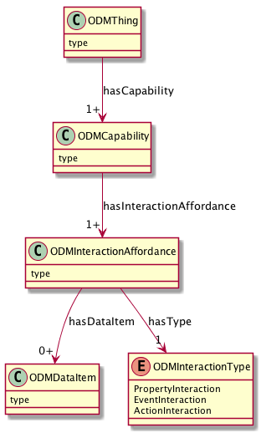
UML Model
Device Type and Constraints e.g. Thermostat, Light
Composable Capabilities e.g. onoff, level, temperature
Events, Actions, Properties
Data Types, Enums

Slide 5
Capabilities
{
"@id": "st:SwitchCapability",
"rdfs:subClassOf": "odm:Capability",
"rdfs:comment": "Basic On/Off Switch Capability",
"rdfs:label": "SmartThings Switch Capability",
"odm:hasInteractionAffordance": [
"st:Switch.valueProperty",
"st:Switch.onAction",
"st:Switch.offAction"
]
},
{
"@id": "st:SwitchLevelCapability",
"rdfs:subClassOf": "odm:Capability",
"rdfs:comment": "Capability to control the level",
"rdfs:label": "SmartThings SwitchLevel Capability",
"odm:hasInteractionAffordance": [
"st:SwitchLevel.levelProperty",
"st:SwitchLevel.setLevelAction"
]
}

Slide 6
Properties, Actions, Events
{
"@id": "st:SwitchLevel.levelProperty",
"rdfs:comment": "The current level setting",
"rdfs:label": "SwitchLevel levelProperty",
"@type": "odm.PropertyInteraction",
"rdfs:subClassOf": "odm:InteractionAffordance",
"odm:hasDataItem": "st:SwitchLevel.levelData"
},
{
"@id": "st:SwitchLevel.setLevelAction",
"rdfs:comment": "Action to set the level",
"rdfs:label": "SwitchLevel setLevelAction",
"@type": "odm:ActionInteraction",
"rdfs:subClassOf":"odm:InteractionAffordance",
"odm:hasDataItem": [
"st:SwitchLevel.levelData"
"st:SwitchLevel.rateData"
]
}

Slide 7
Data Items
{
"@id": "st:Switch.valueData",
"rdfs:comment": "value data for Switch (on/off string encoding)",
"rdfs:label": "SmartThings SwitchLevel.levelData",
"rdfs:subClassOf": "odm:DataItem",
"odm:DataItemType": "js:string",
"js:enum": ["on", "off"]
},
{
"@id": "st:SwitchLevel.levelData",
"rdfs:comment": "Level data for SwitchLevel",
"rdfs:label": "SmartThings SwitchLevel.levelData",
"rdfs:subClassOf": "odm:DataItem",
"odm:DataItemType": "js:integer",
"js:minimum": 0,
"js:maximum": 100
},
{
"@id": "st:SwitchLevel.rateData",
"rdfs:comment": "Rate time data for setLevelAction",
"rdfs:label": "SmartThings SwitchLevel.rateData",
"rdfs:subClassOf": "odm:DataItem",
"odm:DataItemType": "js:integer",
"js:minimum": 0,
"js:maximum": 65535
}

Slide 8
OCF Definition with annotated paths and operations
"paths": {
"/BinarySwitchResURI" : {
"@type": [
"ocf:BinarySwitch.valueProperty",
"ocf:BinarySwitch.OnAction",
"ocf:BinarySwitch.OffAction"
],
"get": {
"@type": "ocf:BinarySwitch.valueProperty",
}
"post": {
"@type": [
"ocf:BinarySwitch.valueProperty",
"ocf:BinarySwitch.OnAction",
"ocf:BinarySwitch.OffAction"
],
}

Slide 9
OCF Definition with data annotations
(...)
"minItems": 1,
"readOnly": true,
"type": "array"
},
"value" :
{
"@type": [
"ocf:BinarySwitch.valueData",
"ocf:BinarySwitch.OnValueData",
"ocf:BinarySwitch.OffValueData"
],
"description": "Status of the switch",
"type": "boolean"
},

Slide 10
Schema.org integration
Contribution to schema.org based on our prototype definition ontology (the terms need work)
Capability, InteractionAffordance, Event, Action, Property, DataItem classes
ProvidesInteractionPattern, AcceptsInputData, ProvidesOutputData property types
DataItem constraints using PropertyValueConstraint or other suitable vocabilaries (e.g. JSON Schema)
FoI property types
The definitions can be in external namespaces, only the core model needs to be accepted to start

Slide 11
schema.org IoT Extension Core Model
schema:thing
providesOutputData
providesInteractionPattern
acceptsInputData
Capability
InteractionPattern
DataItem
schema:PropertyValue
Action
Event
Property
schema:PropertyValueSpec.
rdfs:subclassOf
schema:Property
iotschema Class
Reused Class

Slide 12
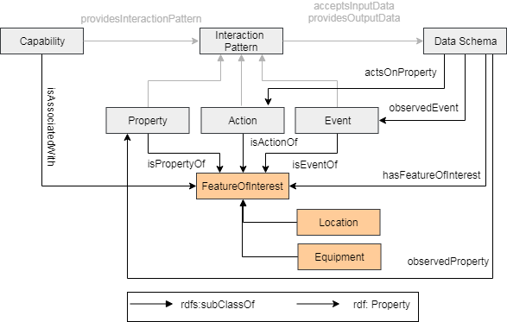
Feature of Interest Properties

Slide 13
Schema.org integration
Drive it through issues and discussion on our iotschema-collab github organization and in the new CG
At some key point, create issues on the schema.org github organization

Slide 14
Technical Plan – Schema.org Integration
Develop the existing ontology to be suitable for integration into schema.org
Terminology needs broad agreement
Develop the references and browser navigation hooks to definitions in external namespaces

Slide 15
Technical Plan – Definitions
Create example definition sets from existing ecosystems – Annotation and Feature Extraction
ZCL/dotdot, OCF, LWM2M, SmartThings
Create a Developer Guideline for new definitions and for using existing definitions
Collect useful tools and scripts
New classes
Data classes
Capability sets for common Thing types?
Definitions for common Enumerations?

Slide 16
Technical Plan – Web Interface
Add Shapes Constraints to the definitions
Develop the browser navigation hooks
Determine namespace references from schema.org

Slide 17
Technical Plan – Feature of Interest
Develop integrations for external FoI ontologies
Automotive (VSS Schema)
Buildings (Brick Schema)
Sensor data and geospatial (W3C, OGC)
Industrial (IIC collaboration?)
Examples of annotations including domain-specific FoI definitions

