Slide 1

Constrained RESTful Application Language
T2TRG | IETF 104

Slide 2
Hypermedia
JSON Hypertext Application Language draft-kelly-json-hal-08
JSON Hyper-Schema draft-handrews-json-schema-hyperschema-01
Profiled Hypertext Application Language draft-montoya-phtal-00
Constrained RESTful Application Language draft-hartke-t2trg-coral-08
Web Linking RFC 8288
CoRE Link Format RFC 6690
Home Documents for HTTP APIs draft-nottingham-json-home-06

Slide 3
CoRAL
The Constrained RESTful Application Language (CoRAL) defines a data model and interaction model as well as two specialized serialization formats for the description of typed connections between resources on the Web (“links”), possible operations on such resources (“forms”), as well as simple resource metadata.
Hypermedia Data & Interaction Model
Compact, binary serialization format suitable for constrained environments
Lightweight, textual serialization format easy to read and write for humans
draft-hartke-t2trg-coral-08
“What is the resource?”
“What can you do with the resource?”
“How does the resource relate to other resources?”

Slide 4
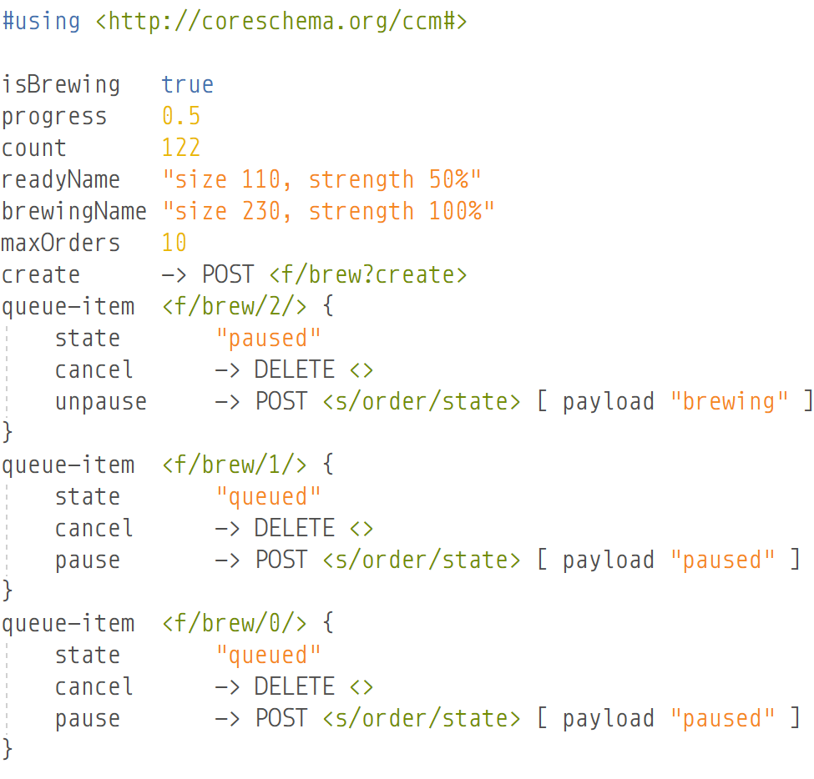
Carsten’s Coffee Machine SPLOT Example

Slide 5
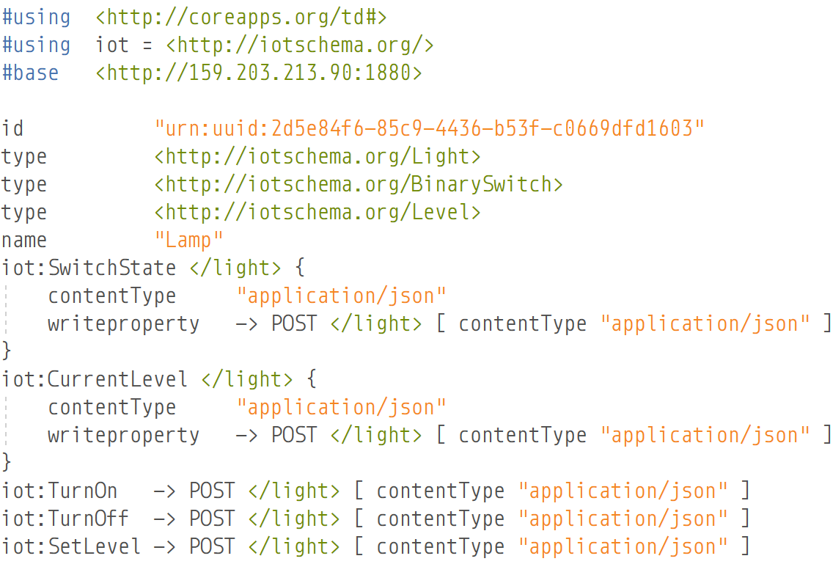
Michael’s Light Switch W3C Thing Description
{
"@context": [
"http://www.w3.org/ns/td",
{"iot": "http://iotschema.org/",
"http": "http://www.w3.org/2011/http#"}
],
"base": "http://159.203.213.90:1880",
"security": [{ "scheme": "nosec" }],
"id": "urn:uuid:2d5e84f6-85c9-4436-b53f-c0669dfd1603",
"@type": [ "Thing", "iot:Light", "iot:BinarySwitch", "iot:Level" ],
"name": "Lamp",
"properties": {
"SwitchState": {
"@type": ["Property", "iot:SwitchState"],
"observable": false,
"writable": true,
"type": "object",
"properties": {
"on": {
"@type": ["iot:StateData"],
"type": "boolean"
}
},
"forms": [
{
"href": "/light",
"mediaType": "application/json",
"op": "readproperty",
"http:methodName": "GET"
},
{
"href": "/light",
"mediaType": "application/json",
"op": "writeproperty",
"http:methodName": "POST"
}
]
},
"CurrentBrightness": {
"@type": ["Property", "iot:CurrentLevel"],
"observable": false,
"writable": true,
"type": "object",
"properties": {
"name": "bri",
"@type": ["iot:LevelData" ],
"type": "integer",
"min": 0,
"max": 254
},
"forms": [
{
"href": "/light",
"mediaType": "application/json",
"op": "readproperty",
"http:methodName": "GET"
},
{
"href": "/light",
"mediaType": "application/json",
"rel": "writeproperty",
"http:methodName": "POST"
}
]
}
},
"actions": {
"SwitchOn": {
"@type": ["Action", "iot:TurnOn"],
"input": {
"type": "object",
"properties": {
"on": {
"type": "boolean",
"const": true
}
}
},
"forms": [
{
"href": "/light",
"mediaType": "application/json",
"op": "invokeaction",
"http:methodName": "POST"
}
]
},
"SwitchOff": {
"@type": ["Action", "iot:TurnOff"],
"input": {
"type": "object",
"properties": {
"on": {
"type": "boolean",
"const": false
}
}
},
"forms": [
{
"href": "/light",
"mediaType": "application/json",
"op": "invokeaction",
"http:methodName": "POST"
}
]
},
"SetBrightnessLevel": {
"@type": ["Action", "iot:SetLevel"],
"input": {
"type": "object",
"properties": {
"bri": {
"@type": ["iot:LevelData"],
"type": "integer",
"min": 0,
"max": 254
},
"duration": {
"@type": ["iot:TransitionTimeData"],
"type": "integer",
"min": 0,
"max": 65535
},
"on": {
"@type": ["iot:StateData"],
"type": "boolean"
}
}
},
"forms": [
{
"href": "/light",
"mediaType": "application/json",
"op": "invokeaction",
"http:methodName": "POST"
}
]
}
}
}

Slide 6
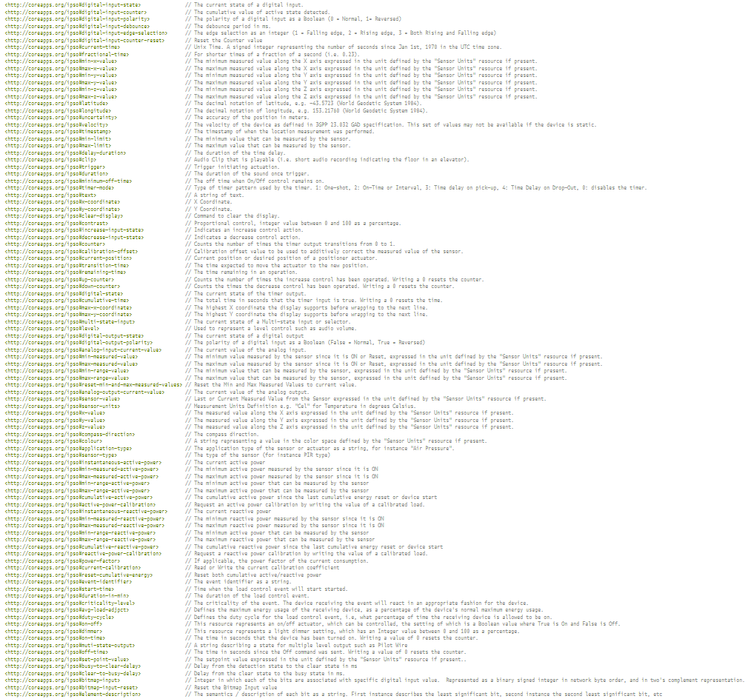
IPSO Reuseable Resources

Slide 7
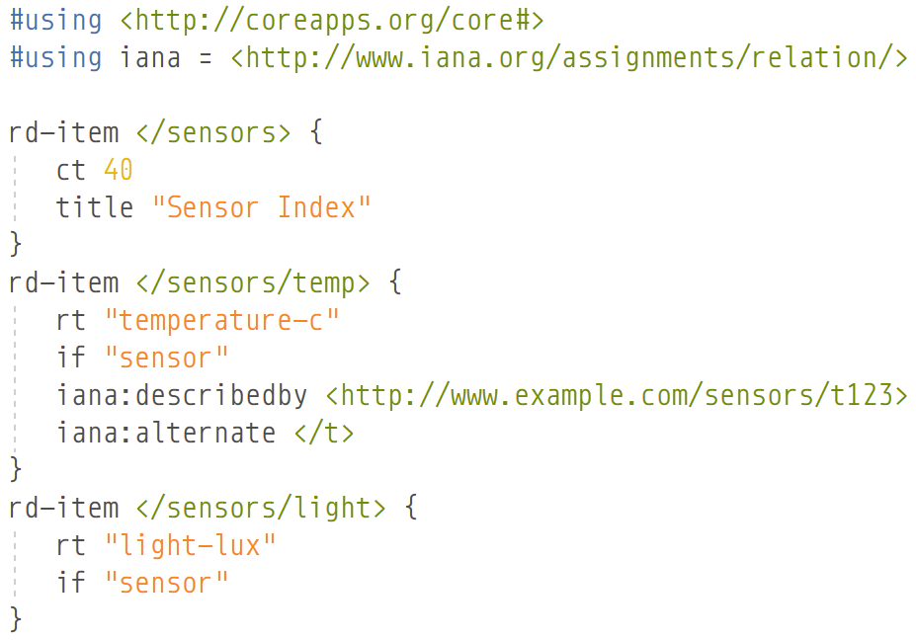
.well-known/ core Link Format

Slide 8
https://datatracker.ietf.org/doc/draft-hartke-t2trg-coral/
https://datatracker.ietf.org/doc/draft-hartke-t2trg-ciri/
https://datatracker.ietf.org/doc/draft-hartke-t2trg-coral-reef/
https://datatracker.ietf.org/doc/draft-hartke-t2trg-data-hub/
https://github.com/ektrah/coral
Photo credits:
“Morning in the anemone forest” by FotoFloridian
https://flic.kr/p/W2HdTS (CC BY-NC 2.0)

