Slide 1
STRUCTURE OF DNA
Reference Book :Lippincott's Biochemistry
Chapter 29(Page 395-398)

Slide 2
Nucleic acids
Nucleic acids are molecules that store information for cellular growth and reproduction.
There are two types of nucleic acid
Deoxyribonucleic acid (DNA)
Ribonucleic acid (RNA)
The primary structures of both is similar,
linear polymers composed of monomers called nucleotides.
Building blocks of nucleic acid are NUCLEOTIDES.
Cellular RNAs range in length from less than one hundred to many thousands of nucleotides.
Cellular DNA molecules can be as long as several hundred million nucleotides.
These large DNA units in association with proteins can be stained with dyes and visualized in the light microscope as chromosomes.

Slide 3
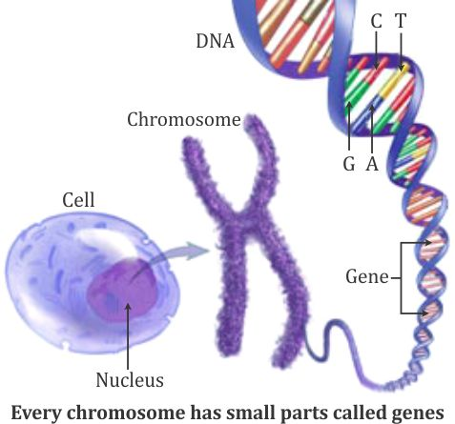
Deoxyribonucleic acid (DNA) Introduction
It contain all the information required to build the cells and tissues of an organism.
The exact replication of this information in any species assures its genetic continuity from generation to generation and is critical to the normal development of an individual.
The information stored in DNA is arranged in hereditary units, now known as genes, that control identifiable traits of an organism.

Slide 4

In the process of transcription, the information stored in DNA is copied into ribonucleic acid (RNA) which is then translated to make proteins.
Central dogma of genetics???

Slide 5
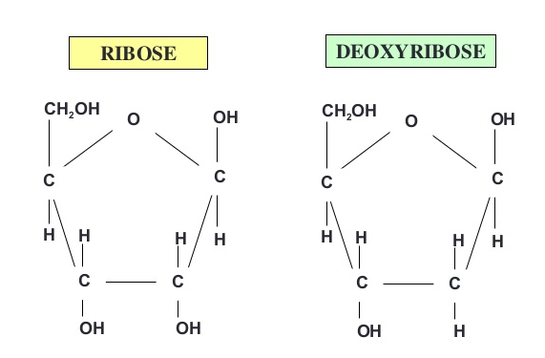
Chemistry of DNA
Nucleic Acids are polynucleotides
Building blocks are nucleotides
DNA is polymer composed of monomers called Nucleotides.
A nucleotide is made of Nitrogenous base, deoxy ribose sugar and phosphate molecule.
Nitrogenous bases
Purines
Pyrimidines
Sugar (Pentose sugar)
Deoxyribose
Phosphate molecule
Nucleotide = Nucleoside + Phosphate
}
Nucleosides

Slide 6
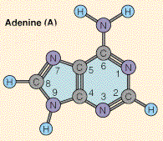
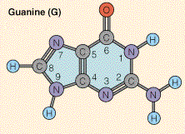
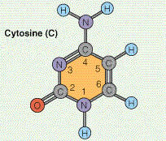
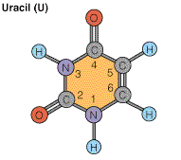
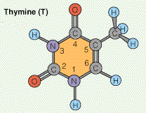
Nitrogenous Bases of DNA (and RNA)
Pentose sugar
In RNA
In DNA
Purines:
Pyrimidines:
RNA only
DNA only

Slide 7
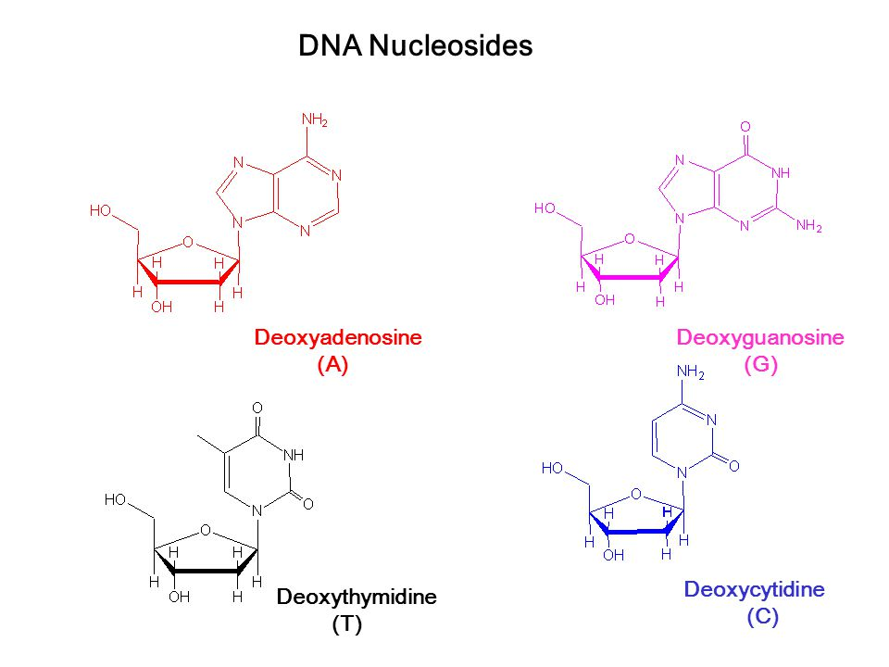
DNA Nucleosides

Slide 8
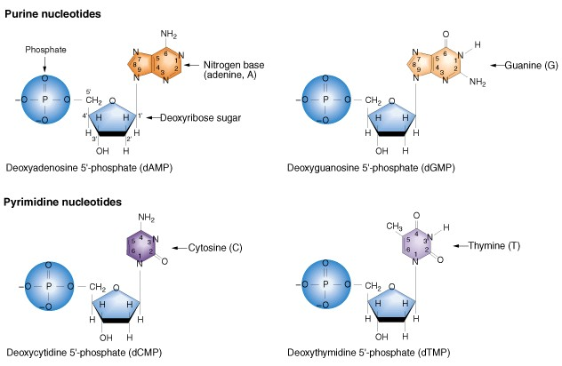
DNA Nucleotides

Slide 9
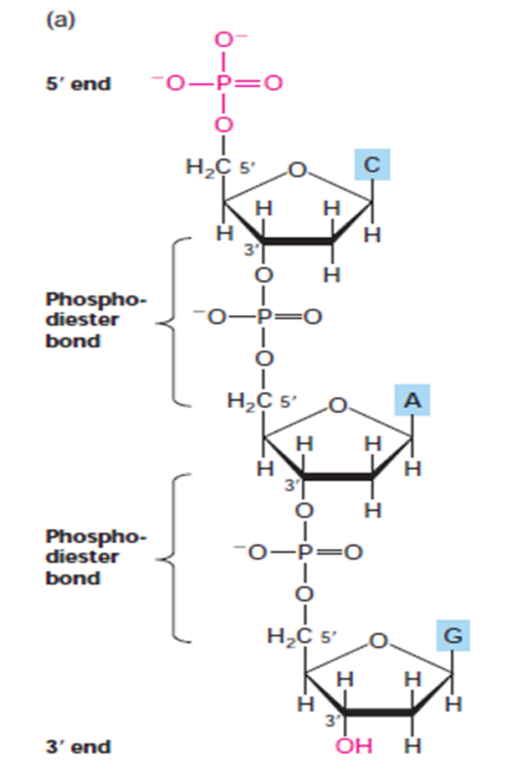
Structure of DNA
A single nucleic acid strand has a backbone composed of repeating pentose-phosphate units from which the purine and pyrimidine bases extend as side groups.
Like a polypeptide, a nucleic acid strand has an end-to-end chemical orientation: the 5 end has a hydroxyl or phosphate group on carbon 5΄.
3΄ end usually has a hydroxyl group on the 3 carbon of its terminal sugar.
Polynucleotide sequences are always written and read in the 5΄ to 3΄ direction (from left to right); for example, the sequence CAG is assumed to be (5)CAG(3).

Slide 10
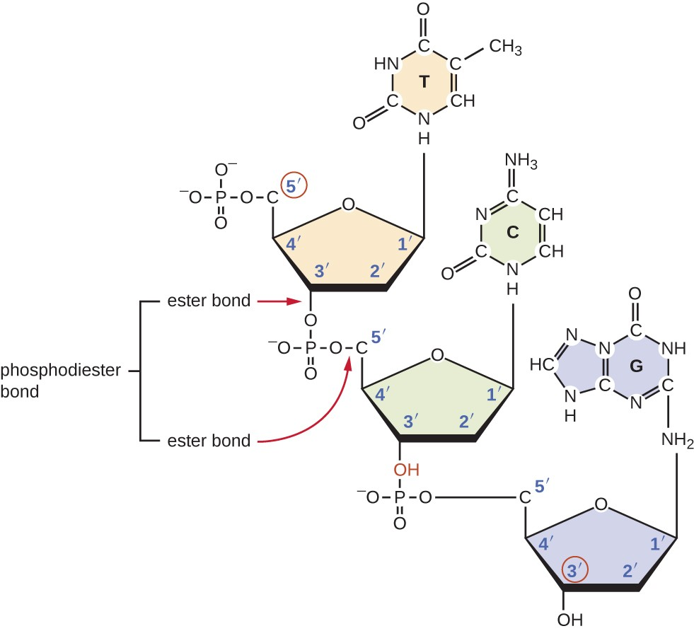

Slide 11
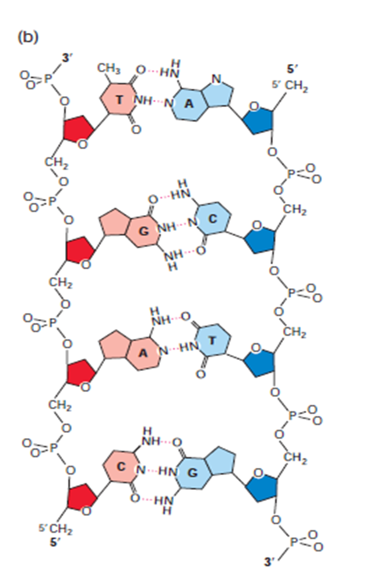
DNA structure is double helix, both strands are anti-parallel in orientation.
The chemical linkage between adjacent nucleotides is called a phosphodiester bond.
The strands are held in precise register by formation of base pairs between the two strands: A is paired with T through two hydrogen bonds; G is paired with C through three hydrogen bonds.
This base-pair complementarity is a consequence of the size, shape, and chemical composition of the bases.

Slide 12
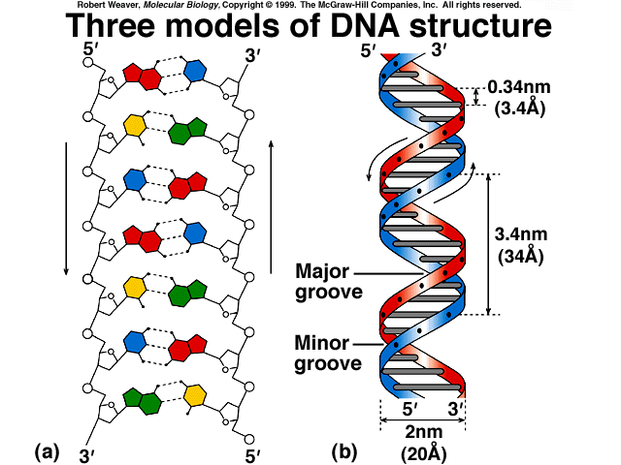
Stacked bases are regularly spaced 0.34-0.36 nm apart along the helix axis.
The helix makes a complete turn every 3.4/3.6 nm; thus there are about 10.5 pairs per turn.
Hydrogen bonds between the bases stabilize the double helical structure of DNA
Loss of hydrogen bond leads to separation of two strands of DNA (Melting of DNA).

